Slide 1


Field Isolation & Moisture Control
م. فرح صلاح الدين عباس
ماجستير معالجة الاسنان

Slide 2
Isolation:
Moisture control
Retraction
Harm prevention
Excluding Sulcular fluid ,saliva & gingival bleeding from operative field.
Prevent aspiration of debris, handpiece spray & any other objects.
Moisture control

Slide 3
Techniques for moisture management:
Oral evacuation system : saliva ejector
Non invasive dental procedures
Remove excess saliva
Not debris /clotted blood
Oral evacuation system :high volume evacuator
Surgical site
Remove saliva /blood /debris/ water
Retract cheek /tongue
Air water syringe
Rinse
dry
Water & air

Slide 4
Dental dam
Moisture control
Infection control
Prevent swallowing objects
Retract lip /tongue /gingiva
Cotton rolls and cellulose pads
Local anesthetics
Anti salivary drugs

Slide 5
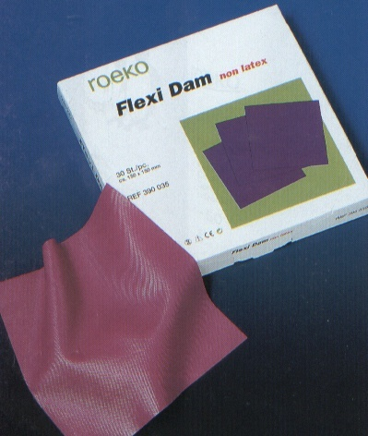
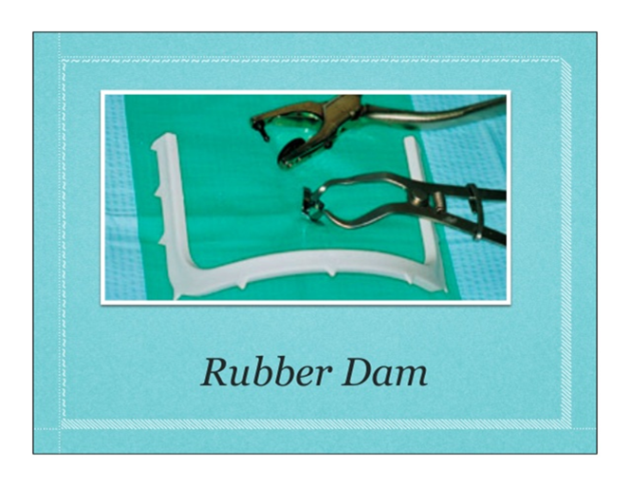
Rubber dam

Slide 6
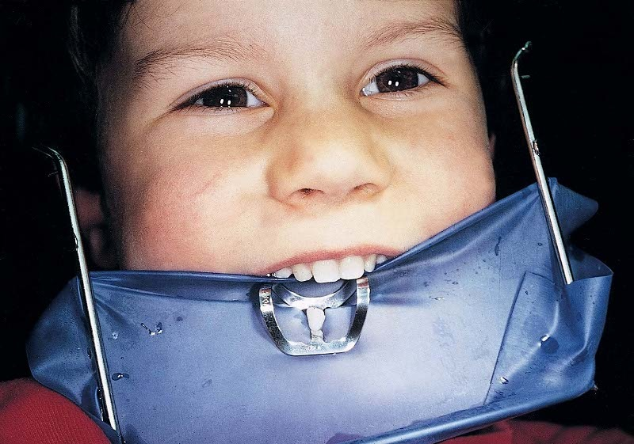
Rubber dam it gives the most complete control over moisture in the mouth.

Slide 7
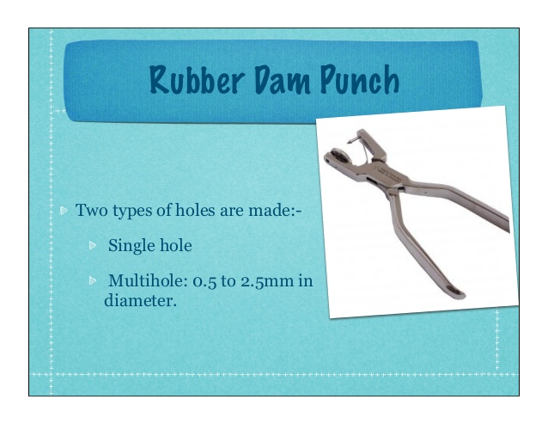
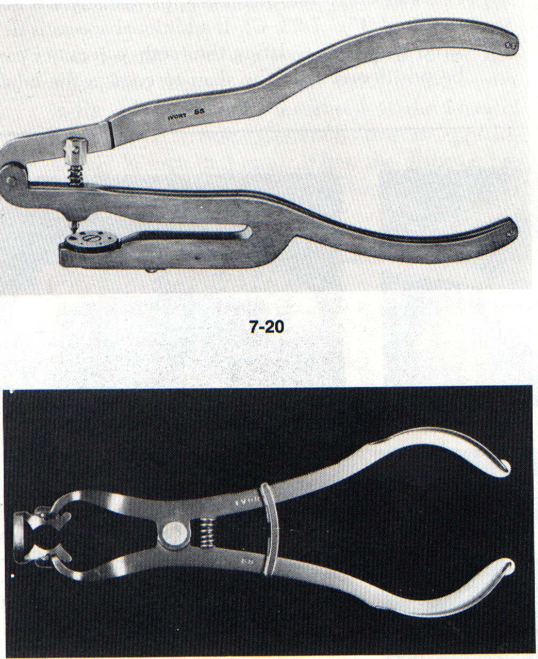
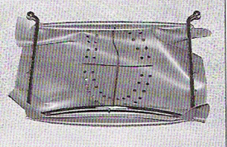
Rubber dam punch : used to give a sharp clean hole without any tearing .

Slide 8
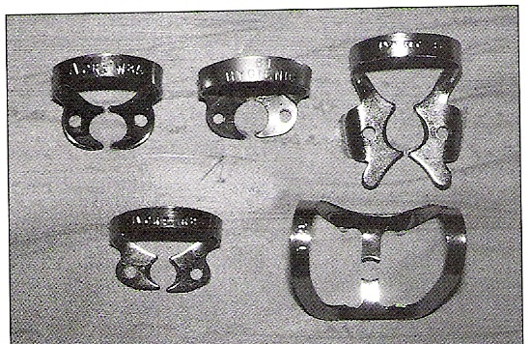
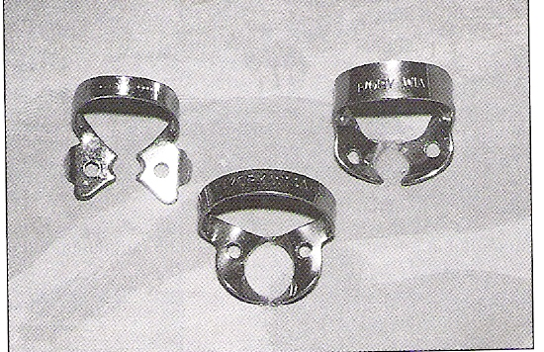
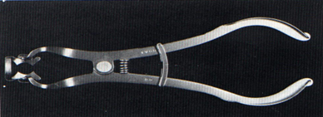
Clamp , clamp forceps : for positioning & removing the clamps

Slide 9
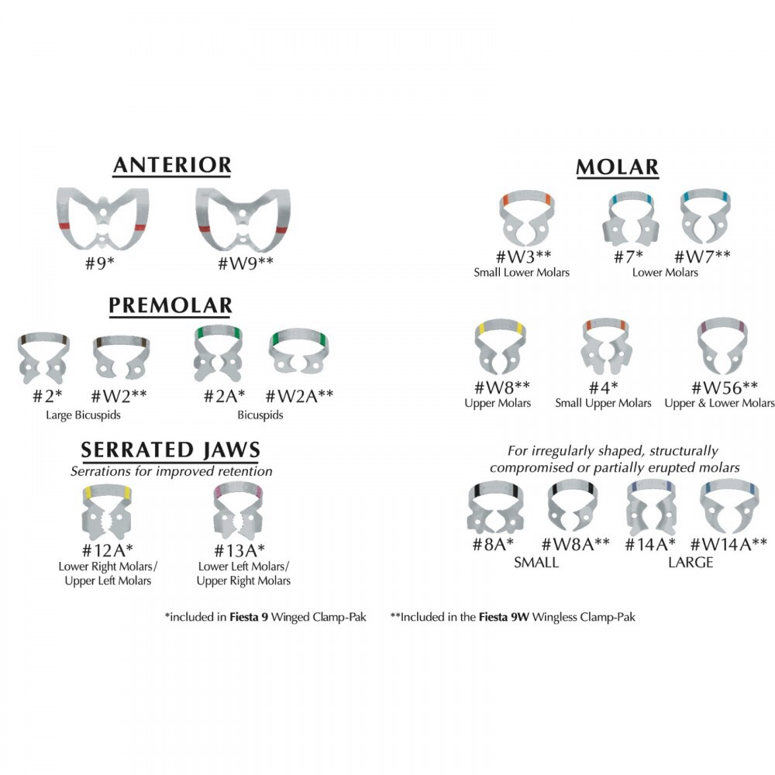
Clamps

Slide 10
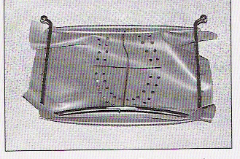
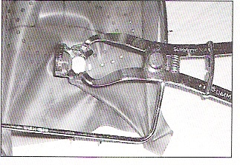
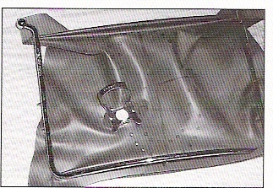
Rubber dam application method 1

Slide 11
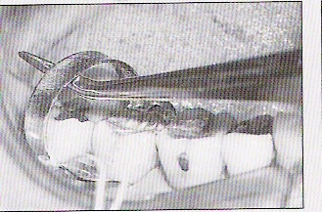
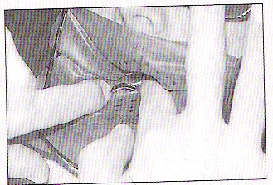
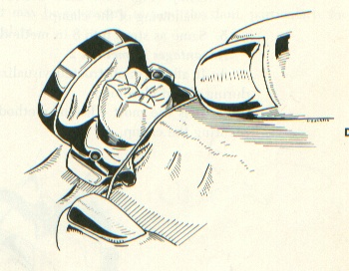
Rubber dam application method 2

Slide 12
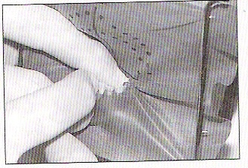
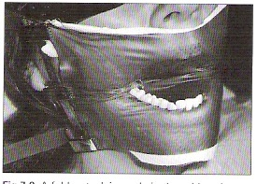
Multiple isolation

Slide 13
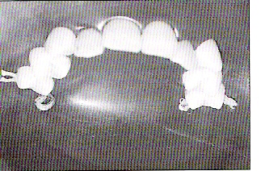
Anterior isolation

Slide 14
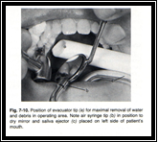
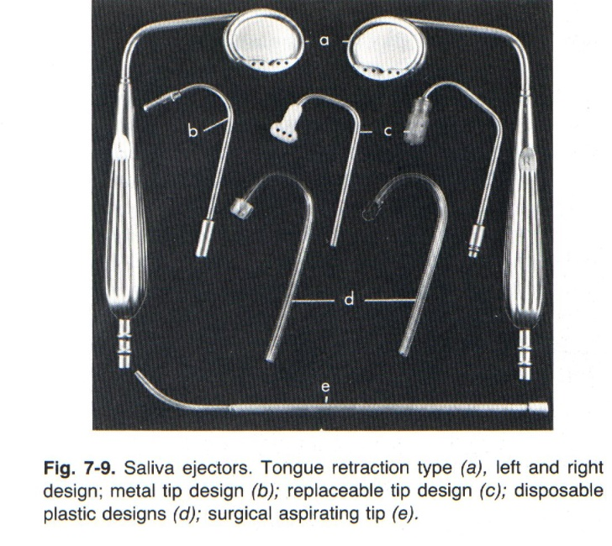
Oral evacuation system

Slide 15
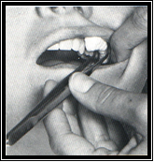
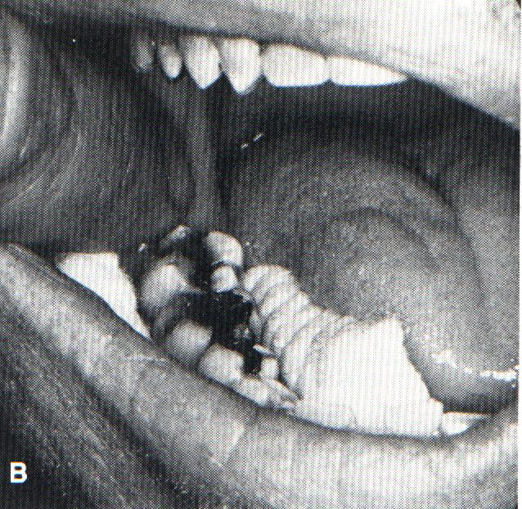
Cotton rolls

Slide 16
Local anesthetics
reduces salivation because the patient is more comfortable, less anxious and less sensitive to oral stimuli.
Local anesthetics incorporating a vasoconstrictor also reduce blood flow, thus helping to control hemorrhage at the operating site.

Slide 17
Anti salivary drugs
Rarely indicated in operative dentistry

Slide 18


