Slide 1
Development and Growth of Teeth:

Slide 2
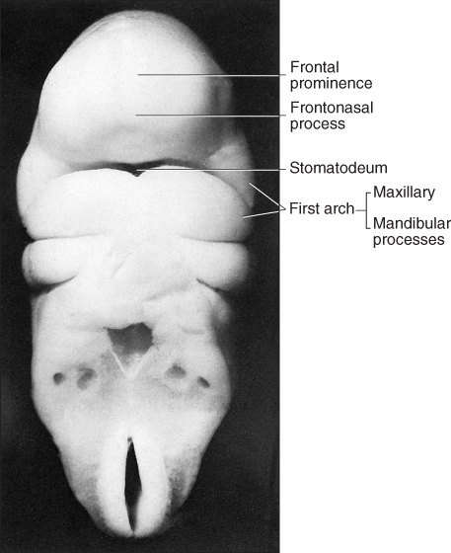
The primitive oral cavity, or stomodeum, is lined by stratified squamous epithelium called the oral ectoderm or primitive oral epithelium.

Slide 3
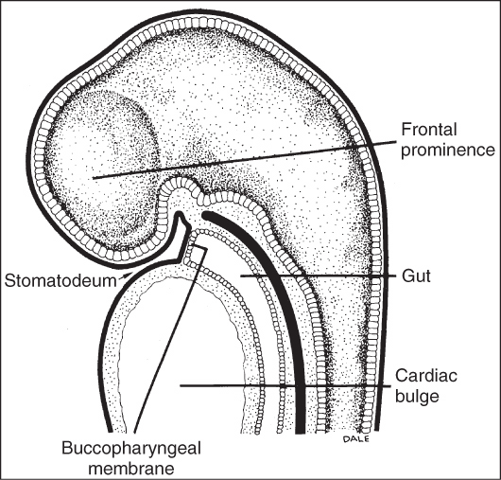
The oral ectoderm contacts the endoderm of the foregut to form the buccopharyngeal membrane.
At about the twenty-seventh day of gestation this membrane ruptures and the primitive oral cavity establishes a connection with the foregut.

Slide 4
Most of the connective tissue cells underlying the oral ectoderm are of neural crest or ectomesenchyme in origin.
These cells are thought to instruct or induce the overlying ectoderm to start tooth development, which begins in the anterior portion of what will be the future maxilla and mandible and proceeds posteriorly.

Slide 5
HISTOPHYSIOLOGY
A number of physiologic growth processes participate in the progressive development of the teeth .
Except for their initiation, which is a momentary event, these processes overlap considerably, and many are continuous throughout the various morphologic stages of odontogenesis.
Nevertheless, each physiologic process tends to predominate in one stage more than in another.

Slide 6
For example, the process of histodifferentiation characterizes the bell stage, in which the cells of the inner enamel epithelium differentiate into functional ameloblasts.
However, proliferation still progresses at the deeper portion of the enamel organ.

Slide 7
1-Initiation:
The dental laminae and associated tooth buds represent those parts of the oral epithelium that have the potential for tooth formation.
Specific cells within the horseshoe-shaped dental laminae have the potential to form the enamel organ of certain teeth by responding to those factors that initiate or induce tooth development.

Slide 8
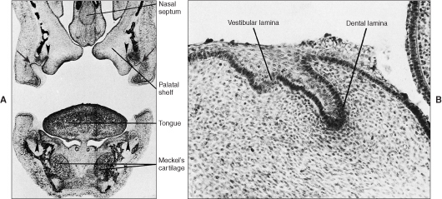

Slide 9
Different teeth are initiated at definite times. Initiation induction requires ectomesenchymal–epithelial interaction.
The mechanism of such interaction is not clearly understood.
However, it has been demonstrated that dental papilla mesenchyme can induce or instruct tooth epithelium and even non tooth epithelium to form enamel.

Slide 10
2-Proliferation
Enhanced proliferative activity begins at the points of initiation and results successively in the bud, cap, and bell stages of the odontogenic organ.
Proliferative growth causes regular changes in the size and proportions of the growing tooth germ.
Even during the stage of proliferation, the tooth germ already has the potential to become more highly developed

Slide 11
3-Histodifferentiation:
Histodifferentiation succeeds the proliferative stage.
The formative cells of the tooth germs developing during the proliferative stage undergo definite morphologic as well as functional changes and acquire their functional assignment (the appositional growth potential).
The cells become restricted in their functions.
They differentiate and give up their capacity to multiply as they assume their new function; this law governs all

Slide 12
differentiating cells.
This phase reaches its highest development in the bell stage of the enamel organ, just preceding the beginning of formation and apposition of dentin and enamel.

Slide 13
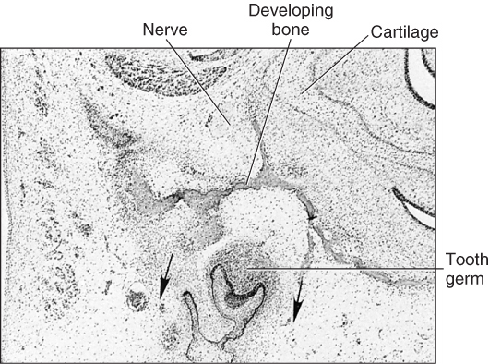

Slide 14
The organizing influence of the inner enamel epithelium on the mesenchyme is evident in the bell stage and causes the differentiation of the adjacent cells of the dental papilla into odontoblasts.
With the formation of dentin, the cells of the inner enamel epithelium differentiate into ameloblasts and enamel matrix is formed opposite the dentin.
Enamel does not form in the absence of dentin, as demonstrated by the failure of transplanted ameloblasts to form enamel when dentin is not present.

Slide 15
Dentin formation therefore precedes and is essential to enamel formation.
The differentiation of the epithelial cells precedes and is essential to the differentiation of the odontoblasts and the initiation of dentin formation.
The importance of the basement membrane of this interface has been recognized.

Slide 16
Morphodifferentiation:
The morphologic pattern, or basic form and relative size of the future tooth, is established by morphodifferentiation, that is, by differential growth.
Morphodifferentiation therefore is impossible without proliferation.
The advanced bell stage marks not only active histodifferentiation but also an important stage of morphodifferentiation in the crown, outlining the future dentinoenamel junction.

Slide 17
The dentinoenamel and dentinocemental junctions, which are different and characteristic for each type of tooth, act as a blueprint pattern.
In conformity with this pattern the ameloblasts, odontoblasts, and cementoblasts deposit enamel, dentin, and cementum, respectively, and thus give the completed tooth its characteristic form and size.
For example, the size and form of the cuspal portion of the crown of the first permanent molar are established at birth long before the formation of hard tissues begin.

Slide 18
Apposition:
Apposition is the deposition of the matrix of the hard dental structures. Appositional growth of enamel and dentin is a layer like deposition of an extracellular matrix.
This type of growth is therefore additive. It is the fulfillment of the plans outlined at the stages of histodifferentiation and morphodifferentiation.
Appositional growth is characterized by regular and rhythmic deposition of the extracellular matrix, which is of itself incapable of further growth. Periods of activity and rest alternate at definite intervals during tooth formation.

Slide 19
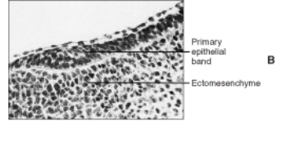
DENTAL LAMINA:
Two or 3 weeks after the rupture of the buccopharyngeal membrane, when the embryo is about 6 weeks old, certain areas of basal cells of the oral ectoderm proliferate more rapidly than do the cells of the adjacent areas.
This leads to the formation of the Primary epithelial band which is a band of epithelium that has invaded the underlying ectomesenchyme along each of the horseshoe-shaped future dental arches.

Slide 20
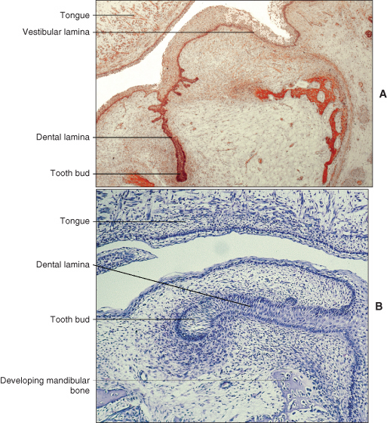
At about 7th week the primary epithelial band divides into an inner (lingual) process called Dental lamina and an outer (buccal) process called Vestibular lamina.
The dental laminae serve as the primordium for the ectodermal portion of the deciduous teeth.

Slide 21
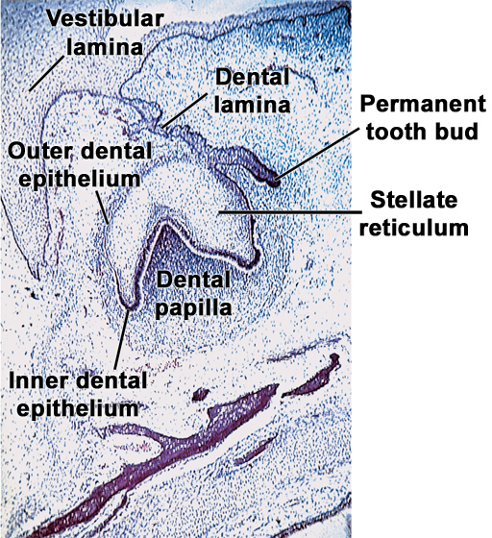
Later, during the development of the jaws, the permanent molars arise directly from a distal extension of the dental lamina.
The development of the first permanent molar is initiated at the fourth month in utero.
The second molar is initiated at about the first year after birth, the third molar at the fourth or fifth years.

Slide 22
The distal proliferation of the dental lamina is responsible for the location of the germs of the permanent molars in the ramus of the mandible and the tuberosity of the maxilla.
The successors of the deciduous teeth develop from a lingual extension of the free end of the dental lamina opposite to the enamel organ of each deciduous tooth.

Slide 23
The lingual extension of the dental lamina is named the successional lamina and develops from the fifth month in utero (permanent central incisor) to the tenth month of age (second premolar).

Slide 24
Fate of dental lamina:
1-It is evident that the total activity of the dental lamina extends over a period of at least 5 years.
2-However, the dental lamina may still be active in the third molar region after it has disappeared elsewhere, except for occasional epithelial remnants. As the teeth continue to develop, they lose their connection with the dental lamina.

Slide 25
3-They later break up by mesenchymal invasion, which is at first incomplete and does not perforate the total thickness of the lamina.
4- Remnants of the dental lamina persist as epithelial pearls or islands within the jaw as well as in the gingiva.
These are referred to as cell rest of Serres.

Slide 26
Vestibular lamina
Labial and buccal to the dental lamina in each dental arch, another epithelial thickening develops independently and somewhat later. It is the vestibular lamina, also termed the lip furrow band. It subsequently hollows and forms the oral vestibule between the alveolar portion of the jaws and the lips and cheeks.

Slide 28
TOOTH DEVELOPMENT:
At certain points along the dental lamina, each representing the location of one of the 10 mandibular and 10 maxillary deciduous teeth, the ectodermal cells multiply still more rapidly and form little knobs that grow into the underlying mesenchyme .

Slide 29
Each of these little downgrowths from the dental lamina represents the beginning of the enamel organ of the tooth bud of a deciduous tooth.
Not all of these enamel organs start to develop at the same time, and the first to appear are those of the anterior mandibular region.

Slide 30
As cell proliferation continues, each enamel organ increases in size, sinks deeper into the ectomesenchyme and due to differential growth changes its shape.
As it develops, it takes on a shape that resembles a cap, with an outer convex surface facing the oral cavity and an inner concavity.

Slide 31
On the inside of the cap (i.e., inside the depression of the enamel organ), the ectomesenchymal cells increase in number.
The tissue appears more dense than the surrounding mesenchyme and represents the beginning of the dental papilla.

Slide 32
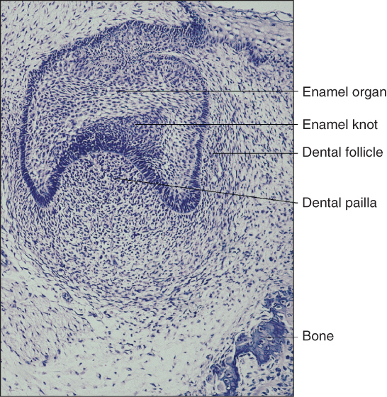
Surrounding the combined enamel organ and dental papilla, the third part of the tooth bud forms. It is the dental sac or dental follicle, and it consists of ectomesenchymal cells and fibers that surround the dental papilla and the enamel organ.
Thus the tooth germ consists of the ectodermal component—the enamel organ and the ectomesenchymal components—the dental papilla and the dental follicle.

Slide 33
The tooth and its supporting structures are formed from the tooth germ.
The enamel is formed from the enamel organ, the dentin and pulp from the dental papilla and the supporting tissues namely the cementum, periodontal ligament and the alveolar bone from the dental follicle.

Slide 34
During and after these developments the shape of the enamel organ continues to change.
The depression occupied by the dental papilla deepens until the enamel organ assumes a shape resembling a bell.

Slide 35
As this development takes place, the dental lamina, which had thus far connected the enamel organ to the oral epithelium, becomes longer and thinner and finally breaks up and the tooth bud loses its connection with the epithelium of the primitive oral cavity.

Slide 36
Development of tooth results from interaction of the epithelium derived from the first arch and ectomesenchymal cells derived from the neural crest cells.
Like any other organ development in our body numerous and complex gene expression occurs to control the development process through molecular signals.

Slide 37
