Slide 1
DEVELOPMENT OF FACIAL PROMINENCES

Slide 2
On the completion of the initial crest cell migration and the vascularization of the derived mesenchyme, a series of out-growths or swellings termed “facial prominences” initiates the next stages of facial development.
Begins week 4 centered around stomodeum, external depression at oral membrane.
The growth and fusion of upper facial prominences produce the primary and secondary palates. 6 initial primordia from neural crest mesenchyme

Slide 3
1-Otic placodes:
The first structures to become evident in the face.
These are thickenings of the ectoderm on the outer surface of developing embryo from which the ear develops that appear to be derived at least partly from the anterior rim of the neural plate. The ear including both the vestibular system and the auditory system , develops from the otic placode beginning the third week of development.

Slide 5
2-Single frontonasal prominence (FNP)
(Week 7, 44 - 48 days)
Forms forehead, nose dorsum and apex. After the neural crest cells arrive in the future location of the upper face and midface, this area often is referred to as the frontonasal region.

Slide 6
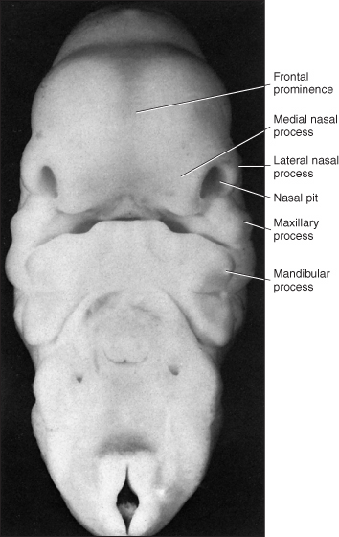

Slide 7
The frontonasal prominences (FNP) forms the majority of the superior part of the early face primordia.
It later fuses with the maxillary component of the first pharyngeal arch to form the upper jaw.
Failure of this fusion event during the embryonic period leads to cleft lip.
Under the surface ectoderm the process mesenchyme consists of two cell populations; neural crest cells, forming the connective tissues; and the mesoderm forming the endothelium of the vascular network.

Slide 8
3-Theolfectory placodes:
a-The paired lateral nasal prominences :
The lateral edges of the placodes actively curl forward, which enhance the initial development of the nose.This morphogenetic movement combined with persisting high rates of cell proliferation rapidly brings the lateral nasal prominence forward so that it catches up with the medial nasal prominance.
b- The paired Medial nasal prominences :
which was situated in a more forward position at the beginning of its development.

Slide 9
5-The paired maxillary prominence has already grown forward from its origin at the proximal end of the first visceral arch to merge with the lateral nasal prominence and make early contact with the medial nasal prominence. maxillary prominences - form upper cheek and upper lip.
6- The paired mandibular prominences - lower cheek, chin and lower lip.

Slide 11
Development of the palate:
The hard palate composed of 2 parts; single primary palate and 2 secondary palate.With development of the lateral nasal prominence ; medial nasal prominence and maxillary process contact, all three prominences contribute to the initial separation of the developing oral cavity and nasal pit.
This separation is usually called the primary palate. The combined right and left maxillary prominences are sometimes called the intermaxillary segment or globular process.

Slide 13
The contacting epithelia form the epithelial seam. Before contact many of the surface epithelial (peridermal) cells are lost, and the underlying basal epithelial cells appear to actively participate in the contact phenomenon by forming processes

Slide 14
that span the space between the contacting epithelia. During the fifth week of human embryonic development, a portion of the epithelial seam breaks down and the mesenchyme of the three prominences becomes confluent.

Slide 15
Fluid accumulates between the cells of the persisting epithelium behind the point of epithelial breakdown. Eventually, these fluid-filled spaces coalesce to form the initial nasal passageway connecting the olfactory pit with the roof of the primitive oral cavity. The tissue resulting from development and fusion of these prominences is termed the primary palate.

Slide 16
It forms the roof of the anterior portion of the primitive oral cavity, as well as forming the initial separation between the oral and nasal cavities. In later development, derivatives of the primary palate form portions of the upper lip, anterior maxilla, and upper incisor teeth. Although the nose is disproportionately large, the basic form is easily recognizable.

Slide 18
Subsequent alterations in form lead to progressively more mature structure.
The palate has two key stages of development during embryonic and an early fetal involving the fusion of structures (epithelia to mesenchymal).

Slide 19
Embryonic:
Primary palate, fusion in the human embryo, from an epithelial seam to the mesenchymal bridge.
Fetal:
Secondary palate, fusion in the human embryo in week 9. This requires the early palatal shelves growth, elevation and fusion during the early embryonic period. The fusion event is to both each other and the primary palate.

Slide 20
New outgrowths from the medial edges of the maxillary prominences form the shelves of the secondary palate. These palatal shelves grow downward beside the tongue, at which time the tongue partially fills the nasal cavities. At about the

Slide 21
At about the ninth gestational week; the shelves elevate, make contact, and fuse with each other above the tongue.
In the anterior region, the shelves are brought to the horizontal position by a rotational (hinge like) movement.
In the more posterior regions, the shelves appear to alter their position by changing shape (remodeling) as well as by rotation.

Slide 22
The shelves are incapable of elevation until the tongue is first withdrawn from between them. Fusion of palatal shelves requires alterations in the epithelium of the medial edges that begin prior to elevation.
These alterations consist of cessation of cell division, which appears to be mediated through distinct underlying biochemical pathways, including a rise in cyclic AMP levels.

Slide 23
There is also loss of some surface epithelial (peridermal) cells and production of extracellular surface substances, particularly glycoproteins, that appear to enhance adhesion between the shelf edges as well as between the shelves and inferior margin of the nasal septum.

Slide 24
The final fate of these remaining epithelial cells is controversial.
Some of them appear to undergo cell death and eventually are phagocytized, but many undergo direct transformation in mesenchymal cells.
Some of the epithelial cells remain indefinitely in clusters (cell rests) along the fusion line.
Eventually, most of the hard palate and all of the soft palate form from the secondary palate.

Slide 26
Tongue Development:
Ectoderm of the first arch surrounding the stomodeum forms the epithelium lining the buccal cavity. Also the salivary glands, enamel of the teeth, epithelium of the body of the tongue.
As the tongue develops "inside" the floor of the oral cavity, it is not readily visible in the external views of the embryonic stages of development.

Slide 27
It is known that the anterior two thirds of the tongue are covered by ectoderm whereas endoderm covers the posterior one third.
Contributions from all arches, which changes with time
Begins as swelling rostral to foramen cecum, median tongue bud.

Slide 29
Arch 1 - oral part of tongue (ant 3/2)
Arch 2 - initial contribution to surface is lost
Arch 3 - pharyngeal part of tongue (post 1/3)
Arch 4 - epiglottis and adjacent regions

Slide 31
Tongue muscle:
Tongue muscles originate from the somites.
The tongue forms in the ventral floor of the pharynx after arrival of the hypoglossal muscle cells.
The lateral lingual tubercles or swellings with tuberculum impar form the tongue.
Tongue muscles develop before masticatory muscles and is completed by birth.
While the Masticatory muscles originate from the somitomeres; develop late and are not complete even at birth.

Slide 33
Salivary Glands:
epithelial buds in oral cavity (week 6 to 7) extend into mesenchyme. They include major glands parotid, submandibular, sublingual. The epithelial components of a number of glands are derived from the endodermal lining of the pharynx. salivary glands are derived from oral ectoderm.

Slide 34
Development of the nose and nasal cavity:
I-The nasal pits deepen during week 6 due to the growth of the surrounding nasal swellings, also their penetration into the underlying mesenchyme. Thus, the primitive nasal cavities or nasal sacs (pits) each grow dorsocaudally in a position which is ventral to the developing brain.

Slide 36
Each sac (Pit), at first, is separated from the primitive oral cavity by the so-called oronasal membrane which soon breaks down and allows the nasal and oral cavities to communicate with each other via the primitive choanae, which lie posterior to the primary palate.

Slide 38
1-After the secondary palate develops, the choanae are at the junction of the nasal cavities and the pharynx
2-Lateral palatine processes: when the lateral palatine processes fuse with each other and the nasal septum, the oral and nasal cavities are again separated. This results in a separation of the nasal cavities from each other
3-The superior, middle, and inferior conchae or turbinates develop as elevations on the lateral nasal wall of each nasal cavity

Slide 40
The ectodermal epithelium: in the roof of the nasal cavities becomes specialized for olfaction
The paranasal sinuses develop during late fetal life and in infancy as diverticula of the lateral nasal walls
The sinuses : extend into the maxilla, the ethmoid, and the frontal and the sphenoid bones during childhood and reach their mature size in the early twenties, whereupon they enlarge very slowly until death.

Slide 42
Developmental malformations of nasal cavities and nose
ABSENCE OF NOSE: no nasal placodes form
A SINGLE NOSTRIL: only one nasal placode forms
BIFID NOSE: the medial nasal prominences do not merge completely. The nostrils are widely separated and the nasal bridge is bifid.

Slide 43
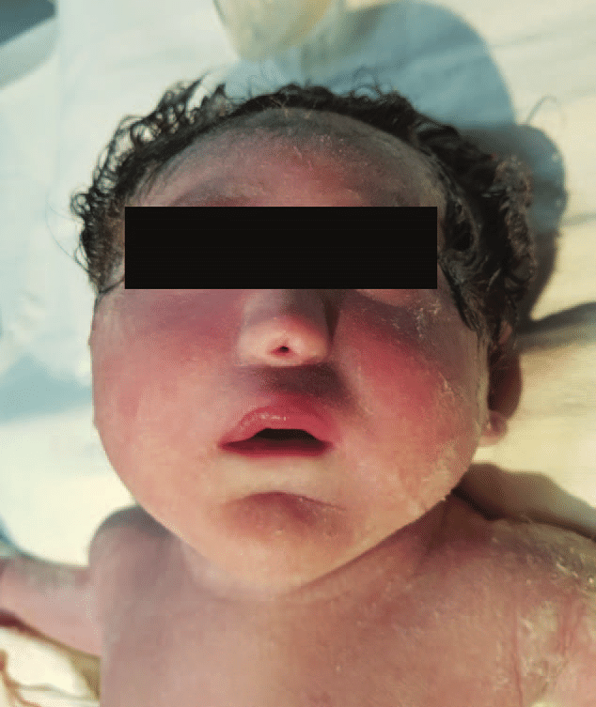
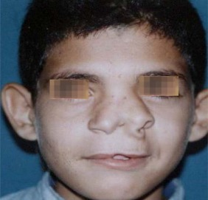

Slide 44
CLINICAL CONSIDERATIONS
Aberrations in embryonic facial development lead to a wide variety of defects.
Facial clefts:
clefts of the upper lip with or without associated cleft primary palate
Etiology : heredity, environmental (epileptic mothers undergoing phenytoin (Dilantin) therapy and to mothers who smoke cigarettes; in the latter case the embryonic effects are thought to result from hypoxia)

Slide 45
Causes:
1-In the larger group of cleft lip, deficient medial nasal prominences appear to be the major developmental alteration.
Whereas in the smaller group of cleft the major developmental alteration appears to be underdevelopment of the maxillary prominence.
Combination of developmental alterations (e.g., placodal breakdown associated with medial nasal prominence deficiency) may relate to the multifactorial etiology thought to be responsible for many human cleft cases.

Slide 46
2-Primary palate also have clefts of the secondary palate
causes: About two thirds of patients. Excessive separation of jaw segments as a result of the primary palate cleft prevents the palatal shelves from contacting after elevation.
The degree of clefting is highly variable. Clefts may be either bilateral or unilateral and complete or incomplete. Degrees of mesenchyme in the facial prominences. Some of the variations may represent different initiating events.

Slide 47
3-Clefts involving only the secondary palate (cleft palate, constitute, after clefts involving the primary palate) the second most frequent facial malformation in humans.
causes:
1- Usually some chemical agents retard or prevent shelf elevation.
2-shelf growth that is retarded so that, although elevation occurs, the shelves are too small to make contact.
3-There is also the failure of the epithelial seam or failure of it to be replaced by mesenchyme occurs after the application of some environmental agents.

Slide 49
4-Oblique facial clefts: Less frequently types of facial clefting. The failure of merging and fusion between the maxillary prominence and the lateral nasal prominence
5-Lateral facial clefts (macrostomia) : due to failure of merging of the maxillary prominence and mandibular arch.

Slide 50
Many of the variations in the position or degree of these rare facial clefts may depend on the timing or position of arrest of growth of the maxillary prominence that normally merges and fuses with adjacent structures. Other rare facial malformations (including oblique facial clefts) may also result from abnormal pressures or fusions with folds in the fetal (e.g., amniotic) membranes.

Slide 52
The apparent role of epithelial– mesenchymal interactions via the mesenchymal cell process meshwork (CPM) may help to explain the frequent association between facial abnormalities, especially clefts, and limb defects. Genetic and/or environmental influences on this interaction might well affect both areas in the same individual.

Slide 53
6-Hemifacial microsomia:
The term “hemifacial microsomia” is used to describe malformations involving underdevelopment and other abnormalities of the temporomandibular joint, the external and middle ear, and other structures in this region, such as the parotid gland and muscles of mastication.
The associated malformations of the vertebrae and clefts of the lip and/ or palate. The combination with vertebral anomalies is often considered to denote a distinct etiologic syndrome (oculoau- riculovertebral syndrome, etc.).

Slide 54
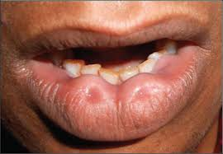

Slide 55
7-Labial pits:
Small pits may persist on either side of the midline of the lower lip. They are caused by the failure of the embryonic labial pits to disappear.
Lingual (tongue) anomalies:
1-Median rhomboid glossitis, an harmless, red, rhomboidal smooth zone of the tongue in the midline in front of the foramen cecum, is considered the result of persistence of the tuberculum impar.
bifid tongue : due to lack of fusion between the two lateral lingual prominences may produce a.
Thyroid tissue may be present in the base of the tongue.

Slide 56
