Slide 1
Fetal head development (week 12):
ا.م.د.ورقاء محمود علي

Slide 2
The head and neck is not really a "system", but structurally quite different in origin from the body.
The head and neck are one of the most complicated structures that the embryo forms, with special intermediate structures (the pharyngeal arch) and contributions from all 3 embryonic layers (ectoderm, mesoderm, endoderm), and significantly, a major contribution from the neural crest.

Slide 4
Neural crest contributes jaw skeletal elements, connective tissues and tendons.
The associated muscles derive mainly from cranial mesoderm.
These components though will form different structures dependent upon which arch they are within.
The cavity within the pharyngeal arches forms the pharynx.

Slide 5
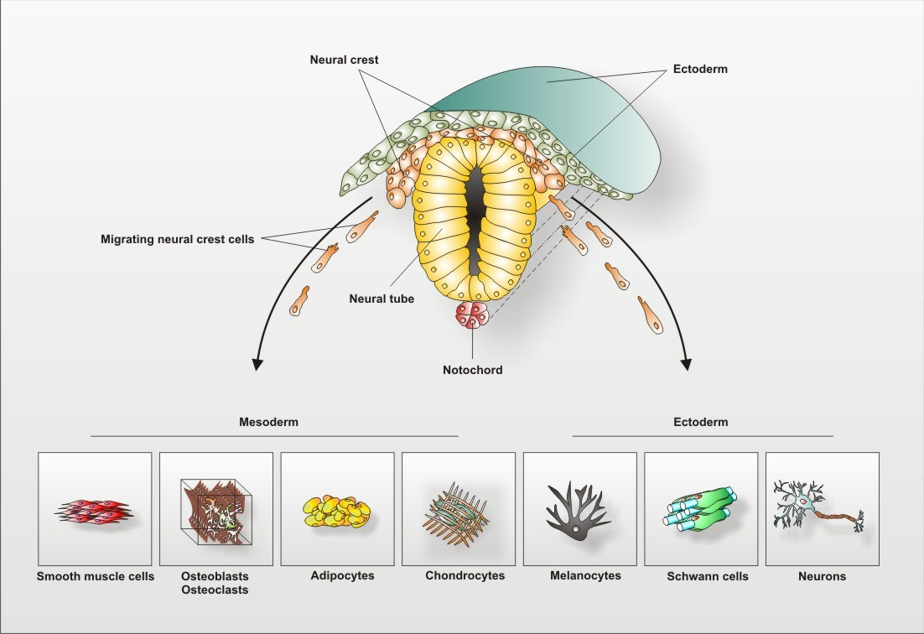

Slide 6
The Pharynx: -
begins at the buccopharyngeal membrane (oral membrane), apposition of ectoderm with endoderm (no mesoderm between)
The pharynx contributes to 2 endocrine organs, in the roof the pituitary (hypophysis) and the floor the thyroid.
The thyroid gland, being one of the first endocrine organs to be formed, has an important role in embryonic development. The pharynx floor of all arches also contribute to the formation of the tongue.

Slide 7
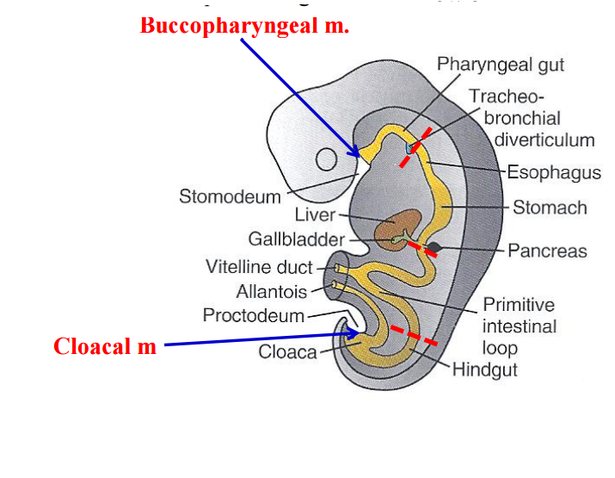

Slide 8
Pharyngeal (branchial) ( visceral) Arch Components:
Human embryo pharyngeal arches Contribute to the formation of head and neck and in the human appear at the 4th week.
Major features to identify for each arch:
1-Pouch: internally separates each arch ,pockets from the pharynx
2- Groove(cleft): externally separates each arch also called a cleft only first pair persist as external auditory meatus

Slide 9
    3-Membrane:
    ectoderm and endoderm contact regions
    only first pair persist as tympanic membrane
The first arch contributes the majority of upper and lower jaw structures

Slide 10
Pharyngeal Arch Development
branchial arch (Gk. branchia= gill)
arch consists of all 3 trilaminar embryo layers
ectoderm- outside
mesoderm- core of mesenchyme: the mesodermal core of each visceral arch is concerned primarily with the formation of vascular endothelial cells.
As noted below, these cells appear to be later replaced by cells that eventually form visceral arch myoblasts.
endoderm- inside

Slide 11
Arch Features
Each arch contains: artery, cartilage, nerve, muscular component
Arches and Phanynx Form the face, tongue, lips, jaws, palate, pharynx and neck cranial nerves, sense organ components, glands
Humans have 5 arches - 1, 2, 3, 4, 6 (Arch 5 does not form or regresses rapidly)
from in rostro-caudal sequence, Arch 1 to 6 from week 4 onwards
arch 1 and 2 appear at time of closure of cranial neuropore
As the heart recedes caudally,1 and 2 arches send out bilateral processes that merge with their opposite members in the ventral midline.
Face - mainly arch 1 and 2

Slide 12
Neck components - arch 3 and 4 (arch 4 and 6 fuse)
Myoblast cells in the visceral arches actually originate from mesoderm more closely associated with the neural tube (cells that form the hypoglossal and extrinsic eye musculature).
They would then migrate into the visceral arches and replace the mesodermal cells that initiated blood vessel formation earlier.

Slide 13
It therefore appears that myoblasts forming voluntary striated muscle fibers of the facial region would then originate from mesoderm adjacent to the neural tube.
Groups of visceral arch myoblasts that are destined to form individual muscles each take a branch of the appropriate visceral arch nerve.

Slide 14
Pharyngeal Arch 1 (Mandibular Arch) has 2 prominences:
  smaller upper- maxillary forms maxilla, zygomatic bone and squamous part of temporal
  larger lower- mandibular, forms mandible

Slide 15
Pharyngeal Arch 2 (Hyoid Arch)
  forms most of hyoid bone
Arch 3 and 4
  neck structures

Slide 16
Arch Arteries
Arch 1 - mainly lost, form part of maxillary artery
Arch 2 - stapedial arteries
Arch 3 - common carotid arteries, internal carotid arteries
Arch 4 - left forms part of aortic arch, right forms part right subclavian artery
Arch 6 - left forms part of left pulmonary artery , right forms part of right pulmonary artery
placental vein -> liver -> heart -> truncus arteriosus -> aortic sac -> arch arteries -> dorsal aorta -> placental artery

Slide 17
Arch Cartilage :Meckel's cartilage, first pharyngeal arch
Pharyngeal arch cartilages
Arch 1 - Meckel's cartilage, horseshoe shaped
  dorsal ends form malleus and incus
  midpart forms ligaments (ant. malleus, sphenomandibular)
  ventral part forms mandible template

Slide 18
Arch 2 - Reichert's cartilage
  dorsal ends form stapes and Temporal bone styloid process
  ventral part ossifies to form hyoid bone components
  lesser cornu and superior part of hyoid body
Arch 3- forms greater cornu and inferior part of hyoid body
Arch 4&6- form laryngeal cartilages, except epiglottis (from hypobranchial eminence)

Slide 19
Arch Muscle
Arch 1 - muscles of mastication, mylohyoid, tensor tympanic, and ant. belly digastric
Arch 2 - muscles of facial expression, stapedius, stylohyoid, and post. belly digastric
Arch 3 - stylopharyngeus
Arch 4&6 - crycothyroid, pharynx constrictors, larynx muscles, oesophagus muscles

Slide 20
Arch Nerve:
Arch 1 - CN V trigeminal, caudal 2/3 maxillary and mandibular, cranial 1/3 sensory nerve of head and neck, mastication motor
Arch 2 - CN VII facial
Arch 3 - CN IX glossopharyngeal
Arch 4&6 - CN X vagus, arch 4- superior laryngeal, arch 6- recurrent laryngeal

Slide 21
Arch Pouches
Arch 1 - elongates to form tubotympanic recess, tympanic cavity, mastoid antrum, eustachian tube
Arch 2 - forms tonsillar sinus, mostly oblierated by palatine tonsil
Arch 3 - forms inferior parathyroid and thymus
Arch 4 - forms superior parathyroid, parafollicular cells of Thyroid

Slide 22
Thyroid Gland
not a pouch structure
first endocrine organ to develop at day 24from floor of pharynx
The thyroid gland forms by invagination of the most anterior endoderm (thyroglossal duct). descends thyroglossal duct upper end at foramen cecum.
A residual pit (the foramen cecum) left in the epithelium at the site of invagination marks the junction between the anterior two thirds and posterior one third of the tongue, which are, respectively, covered by epithelia of ectodermal and endodermal origin.

Slide 23
Anterior Pituitary:
The pituitary gland develops as a result of inductive interactions between the ventral forebrain and oral ectoderm and is derived in part from both tissues. Following initial neural crest cell migration, these cells invade the area of the developing pituitary gland and are continuous with cells that will later form the maxillary prominence.
Eventually, neural crest cells form the connective tissue components of the gland.

Slide 24
Sensory placodes (week 5)
During week 4 a series of thickened surface ectodermal patches form in pairs rostro-caudally in the head region.
These sensory placodes will later contribute key components of each of our special senses (vision, hearing and smell).
Note that their initial position on the developing head is significantly different to their final position in the future sensory system

Slide 25
1-Otic placodes:
In the stage 13/14 embryo ; the otic placode has sunk from the surface ectoderm to form a hollow epithelial ball, the otocyst, which now lies beneath the surface surrounded by mesenchyme (mesoderm).
The epithelia of this ball varies in thickness and has begun to distort, it will eventually form the inner ear membranous labyrinth.

Slide 26
2-Lens placode
lies on the surface, adjacent to the outpocketing of the nervous system (which will for the retina) and will form the lens.
3-Nasal placode
Has 2 components (medial and lateral) and will form the nose olfactory epithelium.

Slide 27
Head Growth
Continues postnatally - fontanelle allow head distortion on birth and early growth
Bone plates remain unfused to allow growth, puberty growth of face

Slide 28
Skull :
1-Chondrocranium - chondrocranium forms base of skull; derived from paraxial mesoderm in lower vertebrates encases brain
2-cranial end of vertebral column
modified vertebral elements
occipital and cervical sclerotome
bone preformed in cartilage (endochondrial ossification)

Slide 29
3-Cranial Vault and Facial Skeleton - formed from neural crest
muscle is paraxial mesoderm
somitomeres and occipital somites
4-Calveria - bone has no cartilage (direct ossification of mesenchyme)
Bones do not fuse, fibrous sutures
1. allow distortion to pass through birth canal
2. allow growth of the brain
6 fontanelles, posterior closes at 3 months, anterior closes at 18 months

Slide 30
Ear development:
Ear Auricles: form from 6 hillocks (week 5), 3 on each of arch 1 and 2. Lateral extension from the inner groove between the first and second arch gives rise to the eustachian tube, which connects the pharynx with the ear. The external ear, or pinna, is formed at least partially from tissues of the first and second arches .

