Slide 1
Histochemistry lab
Assistant lecturer noor natik

Slide 2
H& E

Slide 3
H& E

Slide 6
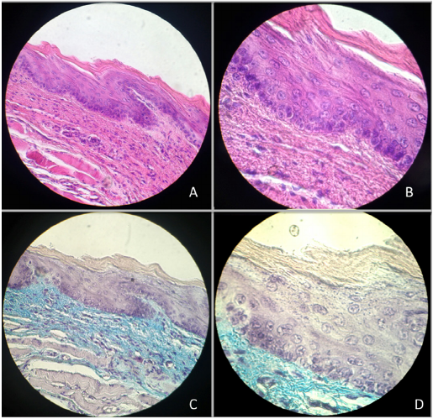
Histological sections in control rat, oral mucosa coating the floor of the mouth and ventral side of the tongue. (A) 40x HE. (B) 100x HE. (C) 40x Masson. (D) 100x Masson.

Slide 7
Masson trichrome

Slide 8
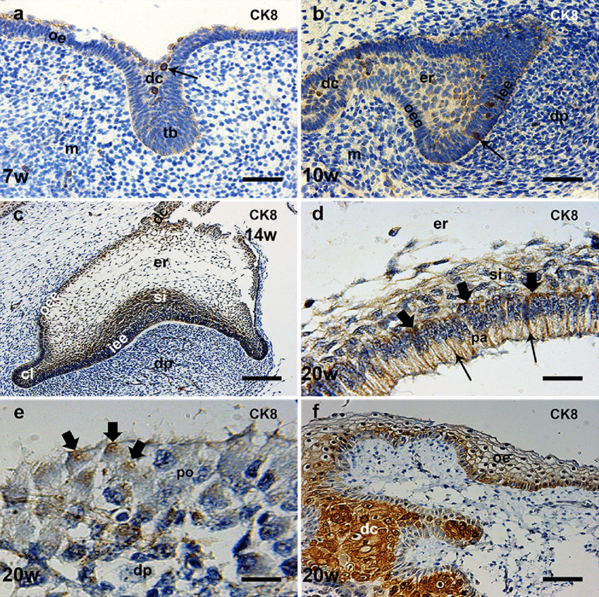
Immunohistochemical

Slide 9
Immunohistochemical

