Slide 1
Hemodynamics Dysfunction 2
م.م نور ناطق

Slide 2
Hemodynamic Dysfunction part 2
An embolus: is a detached intravascular solid, liquid, or gaseous mass that is carried by the blood to a site distant from its point of origin.
Embolism: - This is the passage and eventual trapping within the vasculature of any of a wide variety of mass objects.

Slide 4
Forms of emboli A. Thromboembolism. Embolism of fragments of thrombi is the most frequent form of embolism.
1. Pulmonary emboli
a. These emboli are an important cause of sudden death, usually occurring in immobilized postoperative patients and in those with CHF.
b. Immobilization leads to venous thrombosis in the lower extremities.
c. Pulmonary emboli vary in size from saddle emboli which can produce sudden death, to less clinically significant small emboli.
d. Obstruction of the pulmonary artery leads to pulmonary infarction.

Slide 5
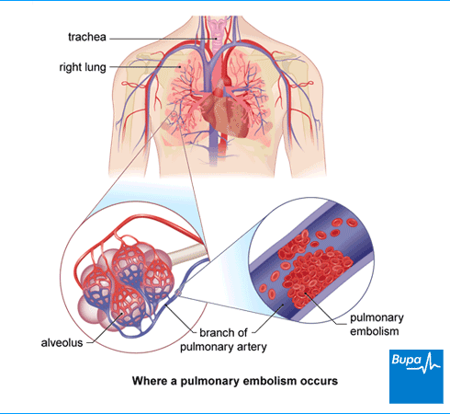

Slide 6
2. Arterial emboli
a. Sites of origin. Arterial emboli usually arise from a mural thrombus, a thrombus that adheres to one wall of a heart chamber or major artery.
(1) Mural thrombi in the left atrium are associated especially with mitral stenosis with atrial fibrillation.
(2) Mural thrombi in the left ventricle are caused by myocardial infarction.
(3) Thrombi at the junction of the internal and external carotid arteries are a cause of thrombotic brain infarcts and can also be a site of origin of emboli.

Slide 7
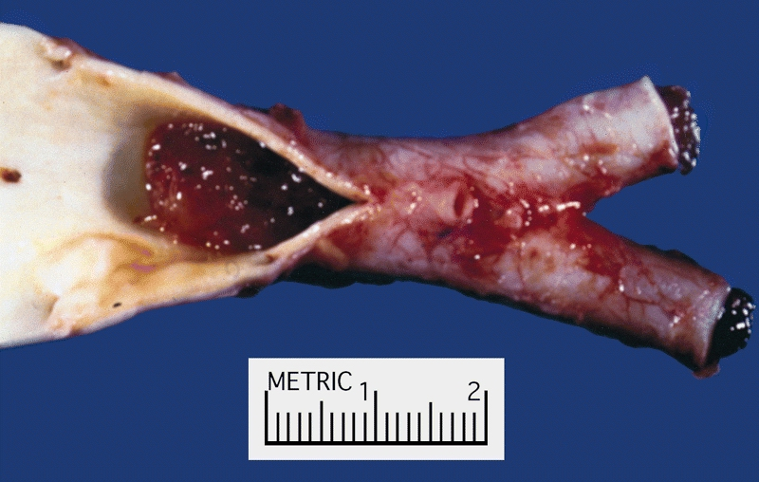

Slide 8
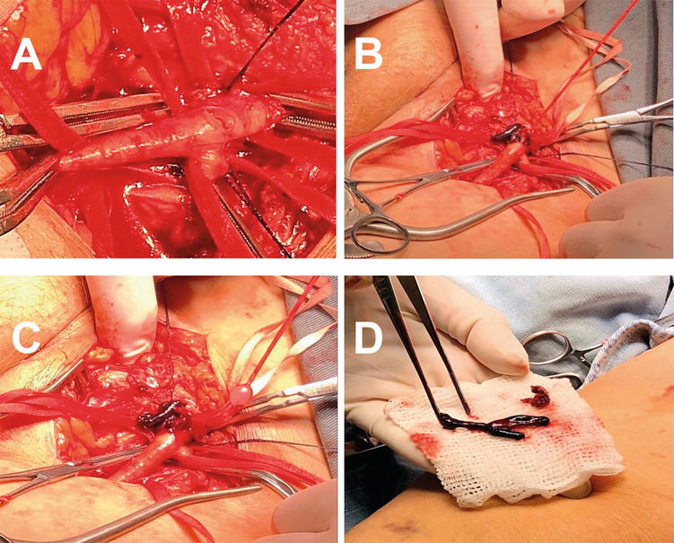
Acute arterial embolism of lower limb

Slide 9
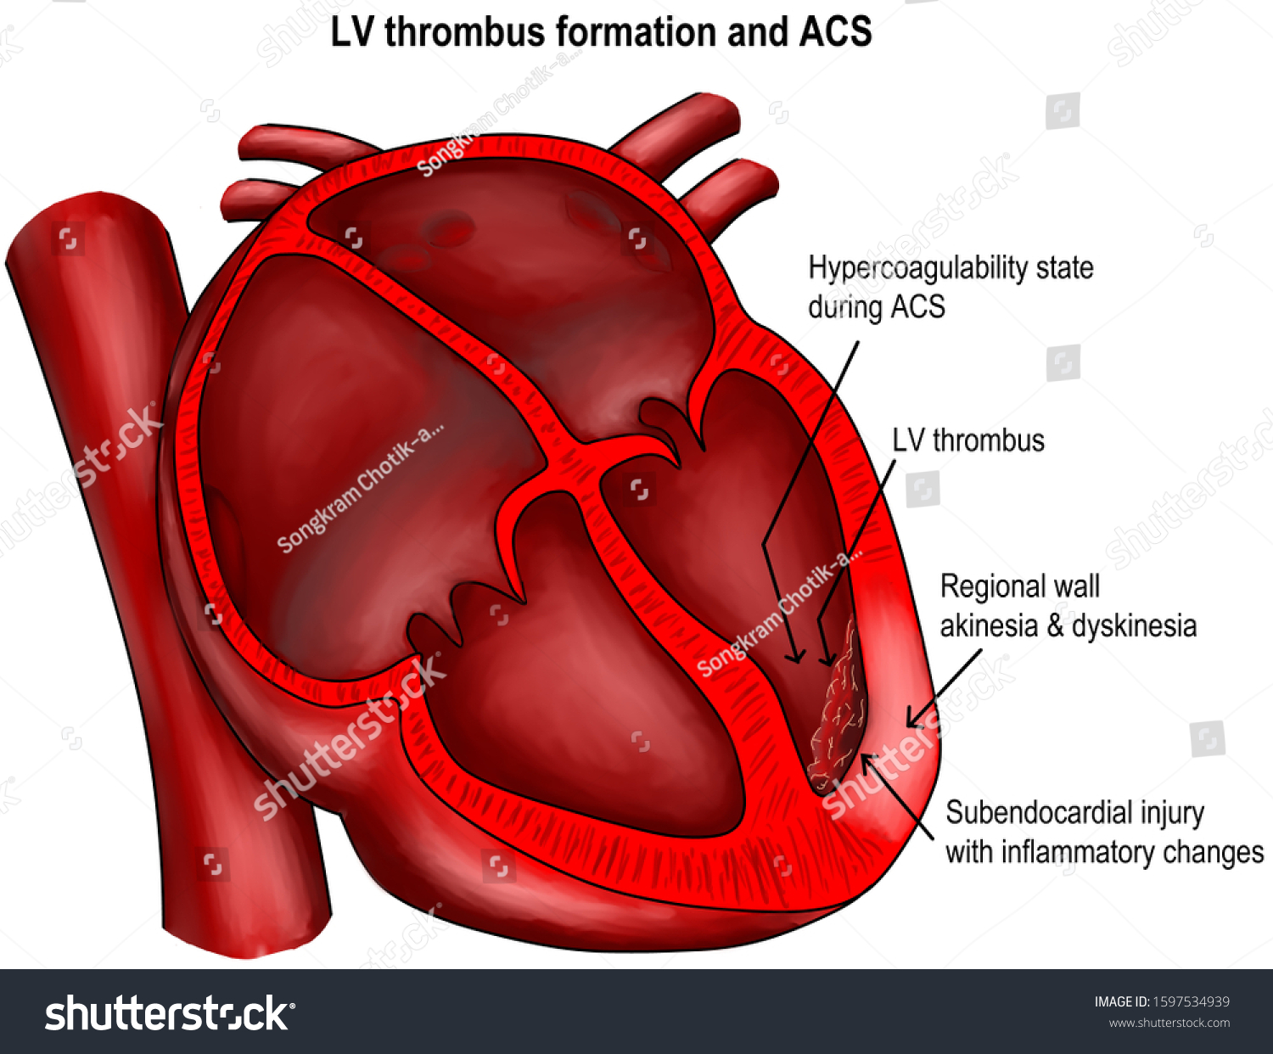
Mural thrombi

Slide 10
b. Sites of arrest
(1) Branches of the carotid artery, most frequently the middle cerebral artery, leading to cerebral infarction
(2) Branches of the mesenteric artery, leading to hemorrhagic infarction of the intestine
(3) Branches of the renal artery, producing characteristic wedge-shaped pale infarcts of the renal cortex.
3. Paradoxical emboli are left-sided emboli that originate in the venous circulation but gain access to the arterial circulation through a right-to-left shunt, most often a patent foramen ovale or an atrial septal defect.

Slide 11
B. Fat emboli
a. These emboli are particles of bone marrow and other fatty intraosseous tissue that enter the circulation as a result of severe (often multiple) fractures.
b. They lodge in the lungs, brain, kidneys, and other organs.
c. They may be asymptomatic or may be manifest clinically by the potentially fatal fat embolism syndrome, characterized by pulmonary distress, cutaneous petechiae, and various neurologic manifestations.

Slide 13
C. Air emboli
a. result from the introduction of air into the circulation, most often by a penetrating chest injury or as a consequence of a clumsily performed criminal abortion.
b. They can occur as decompression sickness, observed in deep-sea divers who return to the surface too rapidly.

Slide 14
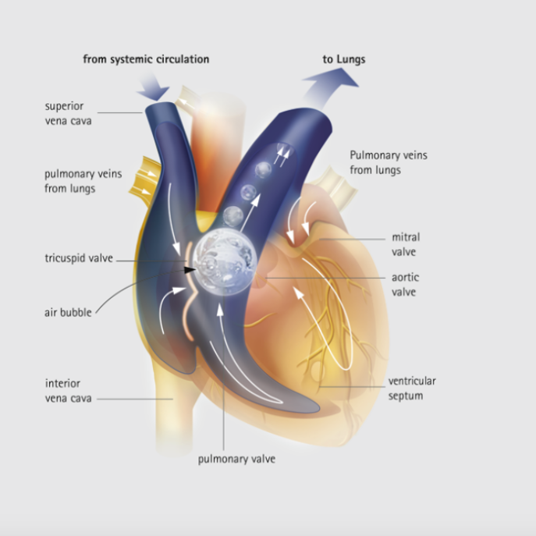

Slide 15
D. Amniotic fluid emboli
a. caused by escape of amniotic fluid into the maternal circulation.
b. They can activate the coagulation process, leading to DIC.
c. They can cause maternal death.
E. Miscellaneous sources of emboli include fragments of atherosclerotic plaques, clumps of inflamed, infected tissue, and tumor fragments.

Slide 16
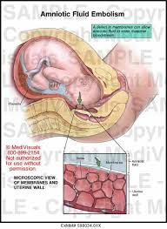

Slide 17
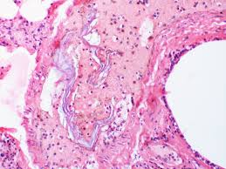

Slide 18
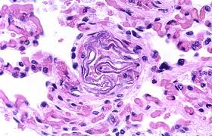
Amniotic fluid embolism

Slide 19
Shock: - This condition represents circulatory collapse with resultant hypoperfusion and decreased oxygenation of tissues.
A. Causes of shock
1. Decreased cardiac output, as occurs in hemorrhage or severe left ventricular failure
2. Widespread peripheral vasodilation, as occurs in sepsis or severe trauma, with hypotension often being a prominent feature
B. Types of shock
1. Hypovolemic shock is circulatory collapse resulting from the acute reduction in circulating blood volume caused by:
a. Severe hemorrhage or massive loss of fluid from the skin, from extensive burns, or from severe trauma
b. Loss of fluid from the gastrointestinal tract, through severe vomiting or diarrhea

Slide 20
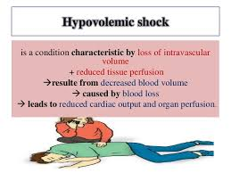

Slide 21
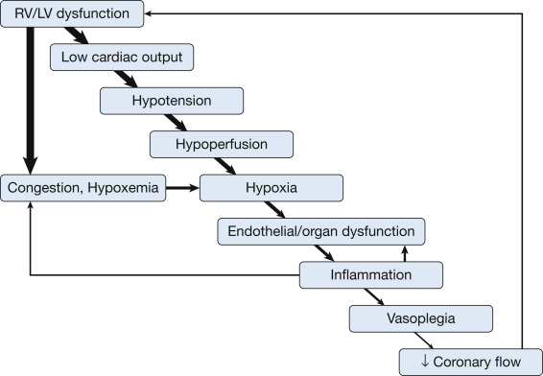
2. Cardiogenic shock is circulatory collapse resulting from pump failure of the left ventricle, most often caused by massive myocardial infarction.

Slide 22
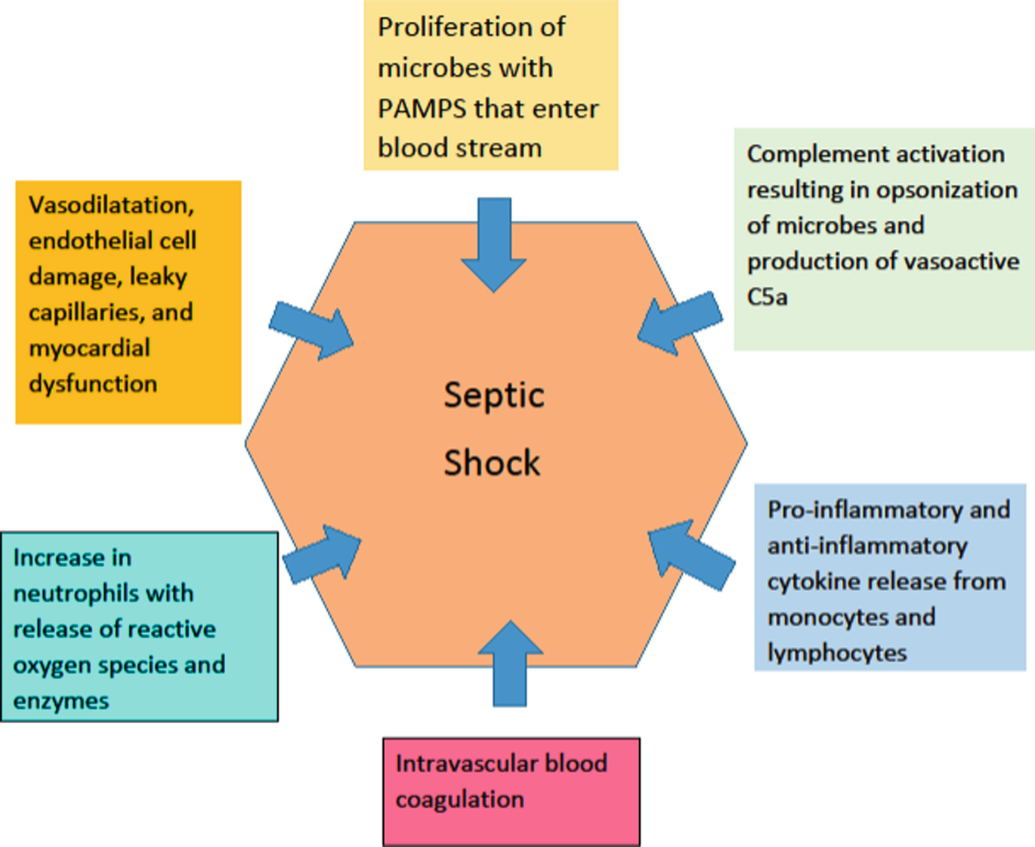
3. Septic shock is most characteristically associated with gram-negative infections, which cause gram-negative endotoxemia: also occurs with gram-positive and other infections.

Slide 23
a. Initially, vasodilation may result in an overall increase in blood flow
b. Lipopolysaccharide and other bacterial products appear to induce a cascade of cytokines activate complement components and the kinin system, and cause direct toxic injury to vessels.
c. Endothelial injury can lead to activation of the coagulation pathways and to DIC.
d. A group of toxic molecules, the so-called superantigens, produces septic shock-like manifestations. The release of these molecules occurs in the “toxic shock syndrome,” which is most often associated with Staphylococcus aureus infection.
e. The systemic inflammatory response syndrome (SIRS) is a generalized immune and inflammatory reaction
f. The multiple organ dysfunction syndrome (MODS)

Slide 24
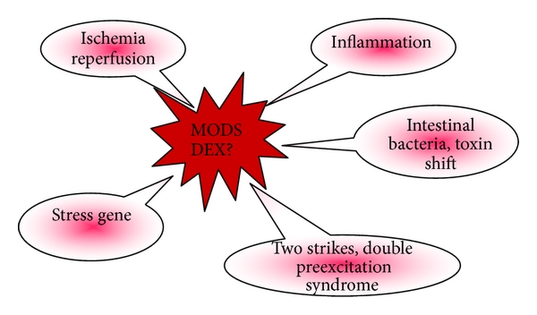

Slide 25
4. Neurogenic shock is most often associated with severe trauma and reactive peripheral vasodilation.
C. Stages of shock
Nonprogressive (early) stage. Compensatory mechanisms, including increased heart rate and increased peripheral resistance, maintain perfusion of vital organs.
2. Progressive stage. characterized by tissue hypoperfusion and the onset of circulatory and metabolic imbalance, including metabolic acidosis from lactic acidemia.
3. Irreversible stage. Organ damage and metabolic disturbances are so severe that survival is not possible.

Slide 27
D. Morphologic manifestations
1. A wide variety of anatomic findings are observed in shock. The most important of these is acute tubular necrosis of the kidney, which is potentially reversible with appropriate medical management.
2. Other anatomic findings in shock include:
a. Areas of necrosis in the brain
b. Centrilobular necrosis of the liver
c. Fatty change in the heart or liver
d. Patchy mucosal hemorrhages in the colon
e. Depletion of lipid in the adrenal cortex
f. Pulmonary edema

Slide 29
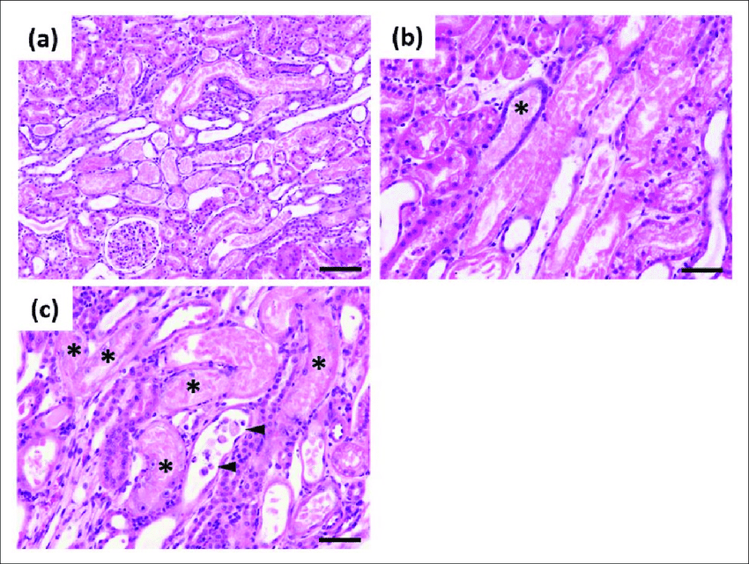
(a) Acute tubular necrosis was observed in the cortex. (b) Acute tubular necrosis and regeneration
c) Regeneration was observed in renal tubules with acute tubular necrosis.

Slide 30
