Slide 1
Temperature Measurement and Thermometer
Ass. Lec. Firas Harith

Slide 2
Thermometry and Temperature Scales
Temperature is difficult to measure directly, so we usually measure it indirectly by measuring one of many physical properties that change with temperature. We then relate the physical property to temperature by a suitable calibration.
In the United States, the most common temperature scale is the Fahrenheit (ºF) scale. Water freezes at 32ºF and boils at 212ºF, and the normal body temperature (rectal) is about 98.6ºF. Fahrenheit devised this scale in 1724 so that 100ºF would represent the normal body temperature and 0ºF would represent the coldest temperature man could then produce (by mixing ice and salt).

Slide 3
Most scientists in the United States use the Celsius (ºC) scale (formerly called centigrade scale), which is in common use throughout most of the world. Water freezes at 0ºC and boils at 100ºC, and the normal body temperature (rectal) is about 37ºC.
Another important temperature scale used for scientific work is the Kelvin (ºK), or absolute scale, which has the same degree intervals as the Celsius scale; 0ºK (absolute zero) is -273.15ºC. On the absolute scale, water freezes at 273.15ºK and boils at 373.15ºK, and the normal body temperature (rectal) is about 310ºK. This temperature scale is not used in medicine.

Slide 4
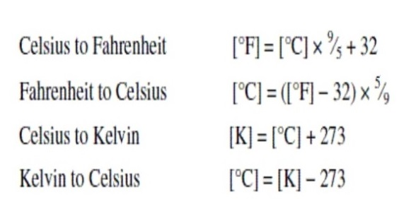
Scales
Temperature normally measured in degrees [º] using one of the following scales:
Fahrenheit [ºF].
Celsius or centigrade[ºC].
Kelvin [ºK].
The relationships between the different temperature scales are: -

Slide 5
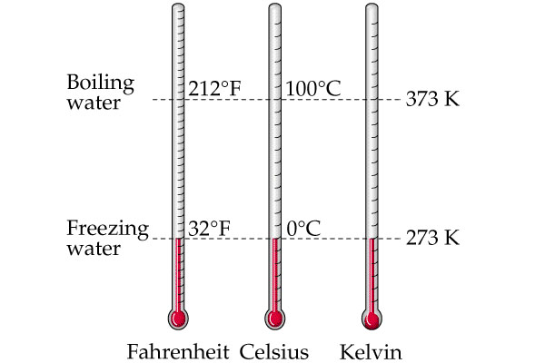

Slide 6
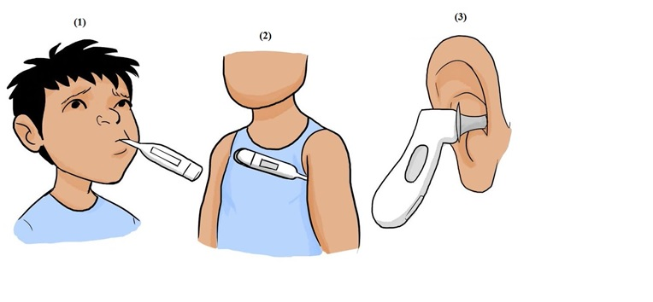
The Ways of Measuring the Temperature
1. Orally (Conduction).
2. Axillary (Conduction).
3. Ear Drum (Radiation).

Slide 7
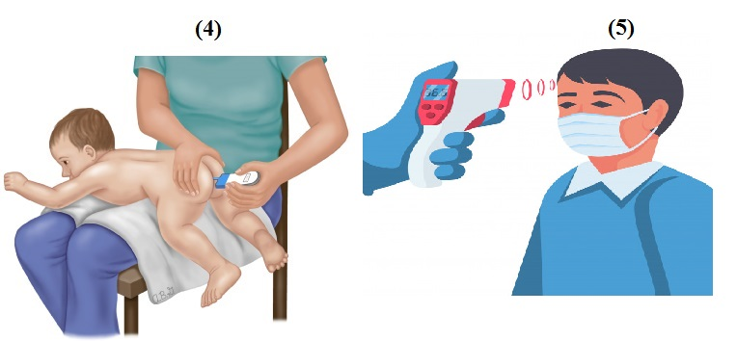
4- Rectally (Conduction).
5- IR thermometer (Radiation).

Slide 8
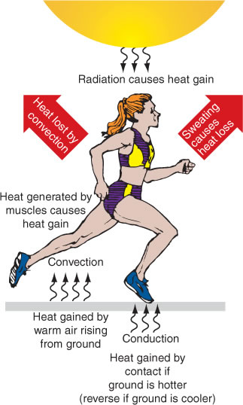
How Does Heat Travel?
Heat can be transferred from one place to another by four methods: -
1. Conduction.
2. Convection.
3. Evaporation.
4. Radiation.

Slide 9
The method used to transfer heat is usually the one that is the most efficient. If there is a temperature difference in a system, heat will always move from higher to lower temperatures.
Heat Verses Temperature
We have all noticed that when you heat something up, its temperature rises. Often we think that heat and temperature is the same thing. However, this is not the case. Heat and temperature are related to each other, but are different concepts.

Slide 10
Heat
Is the total energy of molecular motion in a substance.
Temperature
Is a measure of the average energy of molecular motion in a substance.
Heat energy depends on the speed of the particles, the number of particles (the size or mass), and the type of particles in an object.

Slide 11
Heat vs. Temperature
Temperature | Heat
The degree of hotness and coldness of a body. | A form of energy which flows from a hotter region to a cooler region | Definition
Kelvin (ºK) Celsius(ºC) | Joule (J) | Unit of Measurement
Increases when Heated. Decreases when Cooled. | Flows from hot area to a cold area. | Property

Slide 12
Temperature does not depend on the size or type of object. For example, the temperature of a small cup of water might be the same as the temperature of a large tub of water, but the tub of water has more heat because it has more water and thus more total thermal energy.
If we add heat, the temperature will become higher. If we remove heat, the temperature will become lower. Higher temperatures mean that the molecules are moving, vibrating and rotating with more energy.

Slide 13
Detecting Heat
There are many ways to detect heat. The method chosen often depends on what heat source we are trying to measure. For example, the way we detect the heat in the air is different from how we detect heat from a fire or heat from objects in deep space.
We have all felt various levels of heat. Our skin is a good detector of heat and we interpret the average molecular motion within an object as a feeling that the object is hot or cold. However, our skin does not always give us consistent measurements of heat energy.
For this, we need special instruments, which can accurately measure temperature, like a thermometer.

Slide 14
The Mercury Thermometer
The most common way to measure temperature is with a glass fever thermometer containing mercury or alcohol. The principle behind this thermometer is that an increase in the temperature of different materials usually causes them to expand different amounts. In a fever thermometer, a temperature increase causes the alcohol or mercury to expand more than the glass and thus produces an increase in the level of the liquid. If the liquid expanded the same amount as the glass, the level of the liquid in the stem would remain constant with temperature.

Slide 15
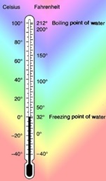
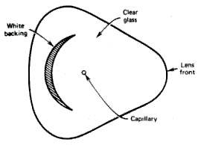
In order to show this expansion, thermometers are designed so that the mercury is forced to rise from the bulb in a capillary tube with a very small diameter. The smaller the diameter of the capillary, the greater is the sensitivity of the thermometer.

Slide 16
Two things increase the visibility of the capillary: -
1. The glass case acts as a magnifying glass.
2. An opaque white backing is used.
The capillary of a fever thermometer has a restriction just above the bulb so that after the liquid is forced into the stem by expansion it does not return when the temperature falls. In order to return the mercury to the bulb it is necessary to take advantage of some elementary physics involving centrifugal forces.

Slide 17
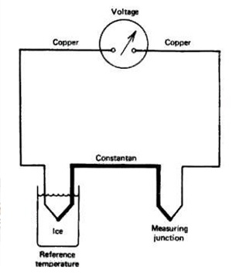
The Thermocouple

Slide 18
A thermocouple consists of two junctions of two different metals. If the two junctions are at different temperatures, a voltage is produced that depends on the temperature difference. Usually one of the junctions is kept at a reference temperature such as in an ice-water bath. The copper-constantan thermocouple can be used to measure temperatures from (-190 to 300 ºC). For a 100ºC temperature difference, the voltage produced is only about 0.004V (4mV). Thermocouples can be made small enough to measure the temperature of individual cells.

Slide 19
Core Temperature and Skin Temperature
The temperature of the deep tissues of the body-the “core”-remains almost exactly constant, within ±1ºF (±0.6ºC), day in and day out except when a person develops a febrile illness. Indeed, a nude person can be exposed to temperatures as low as 55ºF or as high as 130ºF in dry air and still maintain an almost constant internal body temperature

Slide 20
See You Next Lab

