Slide 1

The velocity of sound by means of a resonance tube closed at one end

Slide 2
Sound
The word "sound" may be defined in two ways (objectively and subjectively).
Objectively, the sound is a type of wave-motion taking place in a material medium (whether gaseous, liquid or solid) due to an original vibration or mechanical disturbance set up by a sounding body.
Subjectively, it is a sensory experience in the brain conveyed to it by the auditory nerves of the ear.

Slide 3
Sound is a type of wave, so are light and earthquake tremors. Wave that are periodic and go through several cycles before dying out. For example, the sound from a tuning fork is a continuous wave; the sound from an explosion is not. The cause of continuous waves is a periodic motion.

Slide 4
Sound passes through matter by transferring energy through particles, the particles hit the other particles next to them and the wave is formed. Sound has no absolute speed; the speed of sound depends on the material it is passing through. For example, sound travels much faster in water than it does in air, this is because in the air, there aren't as many particles for the other particles to knock in to. This causes the sound to loose energy faster and disperses more quickly.

Slide 5
Sound: it is audible waves between (20Hz-20kHz).
Infrasound: refers to the sound frequency below the normal hearing range, or less than (20Hz).
Ultrasound: refers to the sound frequency above the normal hearing range, or more than (20kHz).

Slide 6
Reflection, Refraction, and Diffraction
Like any wave, a sound wave doesn't just stop when it reaches the end of the medium or when it encounters an obstacle in its path. Rather, a sound wave will undergo certain behaviors when it encounters the end of the medium or an obstacle. Possible behaviors include reflection off the obstacle, diffraction around the obstacle, and transmission (accompanied by refraction) into the obstacle or new medium.

Slide 7
Types of Motion within Waves
1. A Transverse Wave
Is one in which motion within the wave is perpendicular to the travel of the wave.
2. A Longitudinal Wave
Is one in which motion within the wave is parallel to the travel of the wave.
Sound is a longitudinal wave.

Slide 8
Wavelength and Other Wave Characteristic
The wavelength λ of the sound waves is the distance between consecutive compressions or rarefactions.
Another common characteristic is that waves travel with some speed of propagation, labeled v.

Slide 9
An important relationship, valid for all waves, can be obtained by further examination. The time required for one complete vibration is T, the period of the wave. One full wavelength passes to the right in this time. This means that the wave has moved a distance λ in a time T, so that the speed of propagation v is given by:-
v=λ/T
Given the relationship f =1/T, this can also be written:-
v=λ f

Slide 10
The Hearing Mechanism
The ear properly divided into three parts: -
1. The Outer Ear
Is just the ear canal, which terminates at the eardrum (tympanic membrane).
2. The Middle Ear
Contains three small bones called the hammer, anvil, and stirrup (malleus, incus, and stapes) and an opening to the mouth (Eustachian tube).
3. The Inner Ear
Contains the cochlea, the organ that converts sound waves into nerve signal to the brain.

Slide 11
The Doppler Effect
The Doppler Effect occurs when there is relative motion between a source of sound and a listener.
The Doppler Effect, (a) The listener hears a higher frequency from a sound source moving toward him and a lower frequency when it is moving away from him. (b) A listener hears a higher frequency when he is moving toward a sound source than when he is moving away from it. Here c is the velocity of sound in air, v is the velocity of the source in (a) and the listener in (b), and f_{o} is the frequency in the absence of motion.

Slide 12
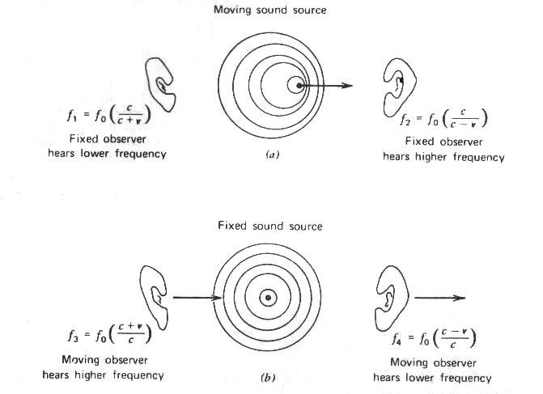
The Doppler Effect can be observed to occur with all types of waves-most notably water waves, sound waves, and light waves.
The Doppler Effect can be used to calculate the velocity of moving source.

Slide 13
The Medical Applications of Sound
The intensity of ultrasound used for medical diagnostic is kept low to avoid tissue damage. Intensities of about 10⁻²W/m² are used and seem to cause no ill effects.
Ultrasound of considerably higher intensity is used for therapeutic purposes. Ultrasound diathermy is deep heating using ultrasound of intensities 1-10W/m².
Ultrasonic sound waves sent into the body are Doppler shifted by any motion in the objects that reflect them. It is possible, for example, to measure blood velocity by observing the Doppler shift of ultrasound reflected from the blood cells. More commonly, the Doppler shift of ultrasound is used to monitor the fatal heart motion.

Slide 14
The ultrasound used for sterilization because it kills the virus and bacteria.
It is also used as massage tool for muscles: cure the cancer, destruction the kidney stone.
Many devices use ultra-sonic sound, like toothbrushes.
Sonic denture cleaner or sonic cleaning device eliminates limescale deposits.
Ultra-Max Cube: multiple of uses such as cleaning brushes, dentures, burs, diamonds, etc.

Slide 15


