Slide 1

To investigate the properties of a parallel resonance circuit
Assist Lecture: Firas Harith

Slide 2
Resonant Circuit
An electrical circuit that combines capacitance and inductance in such a way that a periodic electric oscillation will reach maximum amplitude.
Or: -
An electrical circuit with inductance and capacitance chosen to allow the greatest flow of current at a certain frequency.
In a tuned circuit such as a example is radio receiver, the frequency selected is a function of the inductance (L) and the capacitance (C) in series.

Slide 3
Resonator
A resonator is device or part that vibrates with and amplifies waves. It naturally oscillates at some frequencies with greater amplitude than at others.
The noun resonator has three meanings: -
1. A hollow chamber whose dimensions allow the resonant oscillation of electromagnetic or acoustic waves.
2. An electrical circuit that combines capacitance and inductance in such a way that a periodic electric oscillation will reach maximum amplitude.
3. Any system that resonates.

Slide 4
Each of our major organs has its on resonant frequency depending on its mass and the elastic forces that act on it. Pain or discomfort occurs in a particular organ if it is vibrated at its resonant frequency.
We find that excessive vibration often occurs in motor trucks. It results in fatigue and discomfort and may cause visual disturbances. The vibratory frequency of motorized vehicles is usually 8Hz or less. As might be expected, aircraft and space vehicles have higher vibratory frequencies.

Slide 5
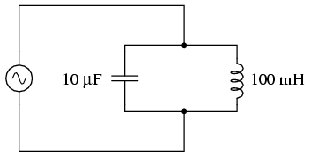
Simple Parallel (Tank Circuit) Resonance
A condition of resonance will be experienced in a tank circuit when the Electric impedances of the capacitor and of inductance(coil) are equal to each other. Because impedance of inductance (coil) increases with increasing frequency and impedance of capacetance decreases with increasing frequency, there will only be one frequency where these two Electric impedances will be equal.

Slide 6
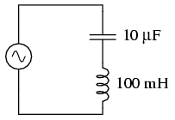
Simple Series Resonance
A similar effect happens in series inductive/capacitive circuits. When a state of resonance is reached (capacitive and inductive Electric impedances equal), the two impedances cancel each other out and the total impedance drops to zero.

Slide 7
Since we know the equations for determining the reactance of each at a given frequency, and we're looking for that point where the two reactances are equal to each other, we can set the two reactance formulae equal to each other and solve for frequency algebraically.
1

Slide 8
Setting the two equal to each other represented a condition of equal reactance (resonance(
Multiplying both sides by f eliminates the f term in the denominator of the fraction.
Dividing both sides by 2πL leaves f by itself on the left-hand side of the equation.
2
3
4

Slide 9
Taking the square root of both sides of the equation leaves f by itself on the left side.
Simplifying: -
5
6

Slide 10
The Medical Applications of Resonance
Nuclear Magnetic Resonance
Nuclear magnetic resonance (NMR) is a non-invasive means of obtaining clinical images and of studying tissue metabolism in vivo. Bloch and Purcell independently discovered NMR in 1946. Six years later, they were awarded the Nobel Prize for their achievements. Since then, the development of NMR spectrometers and NMR scanners has led to the opening up of whole new branches of physics, chemistry, biology and medicine.

Slide 11
A new diagnostic technique utilizing magnetic fields shows great promise. It uses an effect called "Nuclear Magnetic Resonance (NMR) " and is called "NMR imaging". The nuclei of some atoms have small magnetic fields because of their spins, just as electrons do. Usually these spins motion of atoms are randomly oriented, but when placed in a strong magnetic field they align themselves with that field. The directions of these tiny magnets point can be altered by sending in a radio signal.

Slide 12
By measuring the amount of radio waves absorbed and reemitted, it is possible to measure the location and abundance of certain elements. It is a type of resonance since only certain frequencies of radio waves will work, depending on the type of nucleus and the strength of the magnetic field-hence the name NMR. One element that can easily be detected using NMR is hydrogen, which is found in great abundance throughout the body. To make an NMR image, one places the patient in a strong magnetic field.

Slide 13
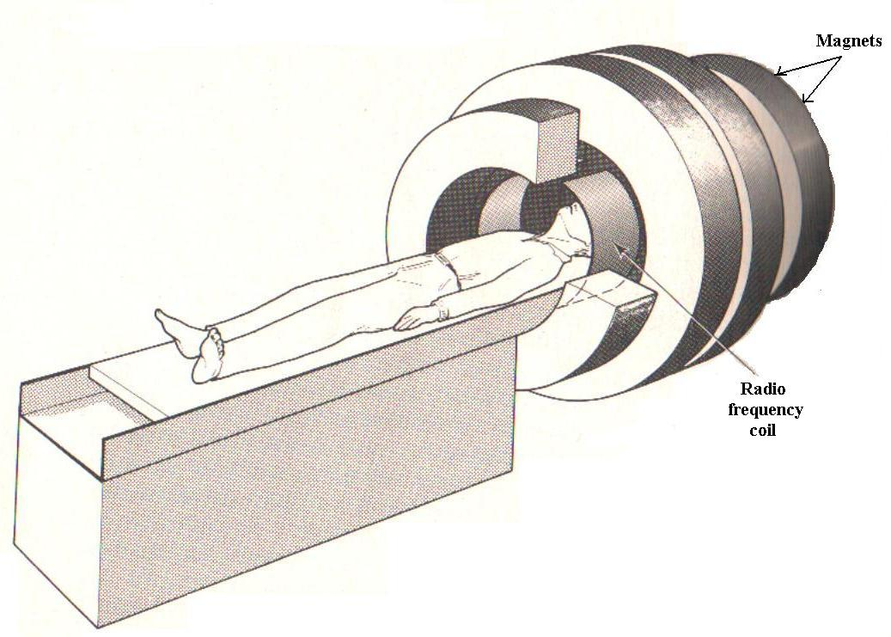
Radio signals are sent into the patient, and their absorption and reemission are measured and then analyzed by a computer. An image is constructed by the computer.

Slide 14
The resolution of the image is not as good as that of some X-rays, but NMR is still in an early stage of development.
It has two advantages over X-rays: -
  1- It has none hazards when compared with X-rays.
  2- NMR gives information related to the functioning of organs, whereas X-rays are sensitive to their densities, which is not always a good indication of organ function.

Slide 15
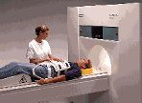
NMR imaging promises to be very useful in detecting cancer and other degenerative diseases and seems certain to become an increasingly important diagnostic tool.

