Slide 1
Medical Physics in Dentistry
Machines
Instrument
Material

Slide 2
The application of physics
The application of physics in dentistry is of great important for the dentist and may be essential factors for reaching an optimum treatment and treatment plan this may include the machines used in dentistry the instruments and the materials of dentistry itself.

Slide 3
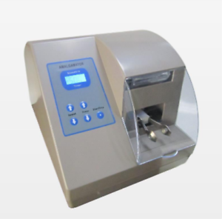
1- machines:
The operation of machines in dentistry depends on the application of physics principles .
A-amalgamator: Which is used for mixing amalgam, the role of the action of amalgamator depend greatly on the vibration in shape 8 during movement of the rotating holder of the device.

Slide 4
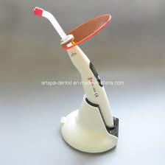
B-light cure device:
The light cure device function is harden light cure material filling
It is principle depend on the focusing light intensity to create photo reaction in light cure material to be harden

Slide 5
C- sterilizer:
which is for sterilizing instruments, the role of action of this devise is depend the high temperature generation which is used to kill mint microorganisms, another method of sterilizing is by autoclave which is depend on heat and pressure generation.
D- ultra wave scalar:
Which is used for removing calculus from the tooth and the role of action of this device is by the ultrasound wave.
E- chair of dentist:
The role of its action is depending on pressure, electric and force balance.
F- Sucker:
Which is used during the surgical operation, and the basic of its action depend on the negative pressure generated by special compressor.

Slide 6
2- INSTRUMENTS
Many instruments used in dentistry may depend on the physical roles.
vernea: which it is used for measuring very thin objects.
metal gauge: used in measuring the thickness of crown metal.
elevator: which used in tooth extraction, in which the role of these instruments depends on the lever action.

Slide 7
3- Materials
The materials that used in dentistry have many characters which is affected by the physical and the chemical factors:
Heat: where heat may increase the setting reaction of many materials e.g.: alginate impression material, amalgam filling, and cement isolating material.
The ability of dissolving in water (hydrophilic) e.g. :local anesthesia.
Photo reaction: light cure materials.

