Slide 1
Molecular diagnosis of human papillomavirus (HPV)oral infections
Dr. Osama Mohammed AL-Mosawy

Slide 2
Human papillomavirus (HPV)
DNA virus that has been implicated, in a subset of oropharyngeal cancers but at different rates. HPV genomic DNA was detected by sensitive polymerase chain reaction (PCR) –based methods . However, in the majority of studies, 50% or more of oropharyngeal tumors contained the HPV genome . At present, 118 HPV genotypes have been classified according to their biological niche, oncogenic potential and phylogenetic position

Slide 3
HPV Genome
The HPV virion has a double-stranded, circular DNA genome of approximately 7900 bp, with eight overlapping open reading frames, comprising early (E), and late (L)genes and an untranslated long control region. The L1 and L2 genes encode the major and minor capsid proteins. The capsid contains 72 pentamers of L1, and approximately 12 molecules of L2. The early genes regulate viral replication and some have transformation potential

Slide 4
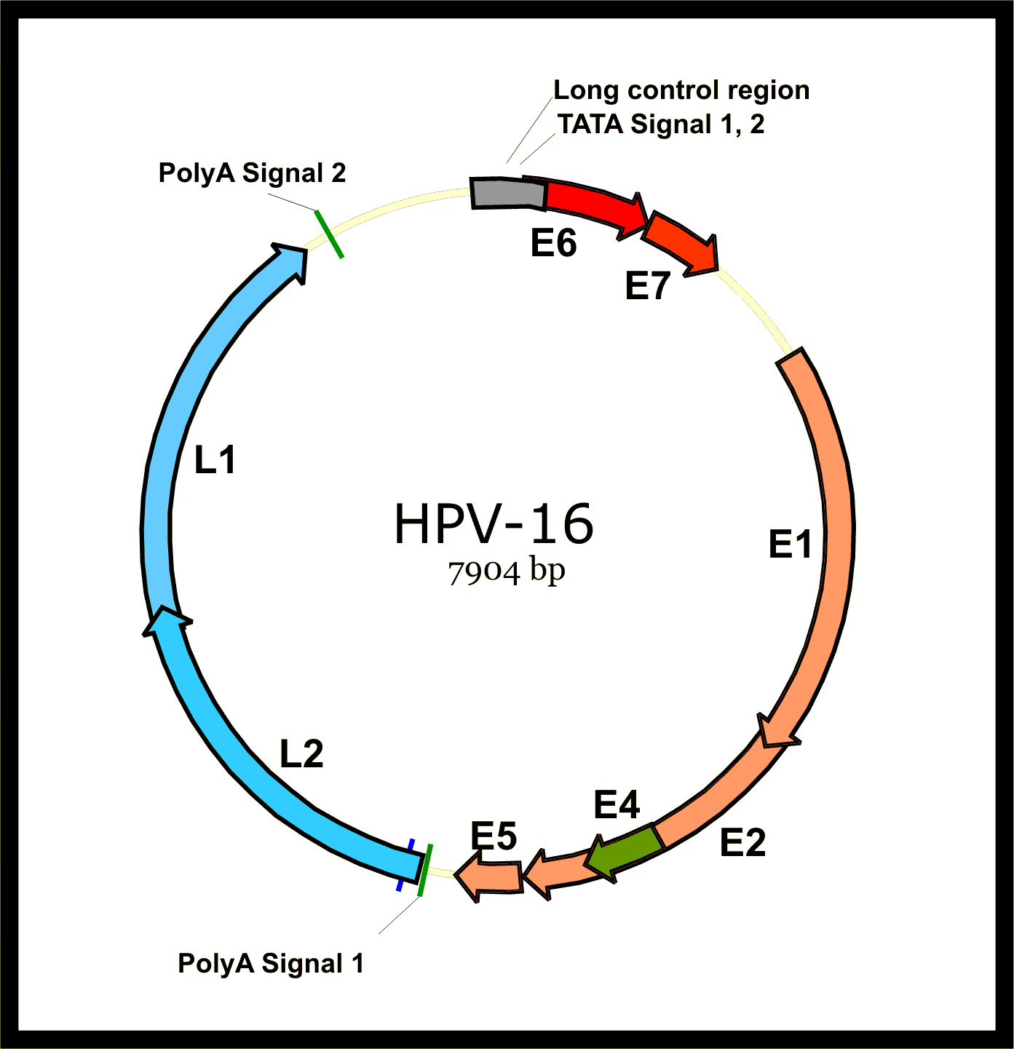

Slide 5
PCR (Polymerase Chain Reaction)
is a molecular biological technique that is used to amplify specific fragment of DNA in vitro without using living organism such as bacteria, sometimes it is called "molecular photocopying”
. The sensitivity of this technique depends on avoiding the contamination of the sample with any other DNA in the laboratory environment.
The purpose of a PCR is to make a huge number of copies of a gene.

Slide 6
Principle of PCR
The reaction depends on three incubation steps at different temperature denaturation, annealing and extension. At the end of the first cycle two copies of original DNA are produced, then the cycle is repeated and four
copies are produced from the second cycle and so on. Usually the cycles are repeated for 30 to 40 cycles .

Slide 7
Components of PCR reaction :
1- Primers : Primer is a short single strand DNA (less than 50 nucleotide usually between 18-25nt) which is complementary to the ends of the DNA fragment to be amplified. Primer are needed to start the replication by DNA polymerase at specific site on DNA template. Two primers are used : forward and reverse primers .
Forward primer is needed to determine start point of replication .
Reverse primer is needed to determine the end point of replication .

Slide 8
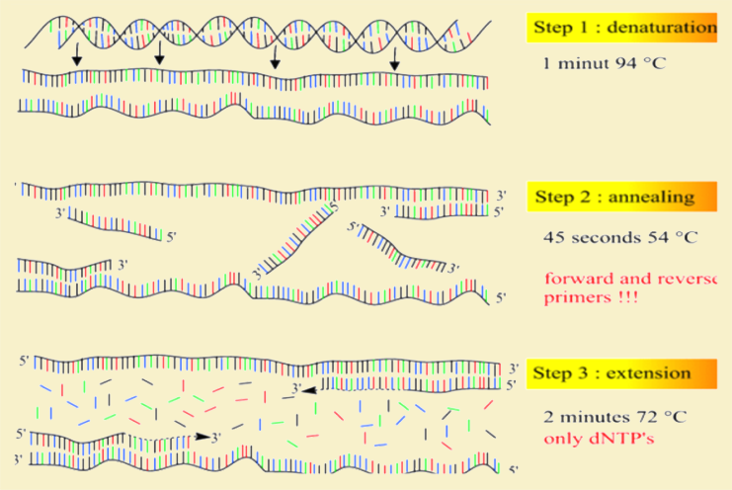

Slide 9
2- DNA template : is the DNA fragment to be amplifed .
3- dNTPs : is a mixture of four nucleotides triphosphate (dGTP, dATP, dCTP and dTTP ) that are used to elongates DNA strand .
4- Taq DNA polymerase : is a thermostable enzyme which is used to elongates DNA template. It is extracted from thermophilis bacteria called Thermus Aquaticus that life in hot spring, so it doesn't effected or denaturated by high temperature that is used in PCR .

Slide 10
5- MgCl₂ : is a cofactor for DNA polymerase .
6- Buffer : provide suitable chemical environment for the enzyme by controlling the reaction pH.
7- Water : to complete the reaction volume to the required volume ( 25ml or 50ml ) .

Slide 11
How Real-Time PCR Works
Real-time PCR analysis detects specific nucleic acid amplification products as they accumulate in real-time.
Real-time PCR uses a fluorescently labeled oligonucleotide probe, which eliminates the need for post-PCR processing.
It is capable of screening genetic activity within hours using a minimal amount of sample material, and can detect a single molecule of DNA or RNA.

Slide 12
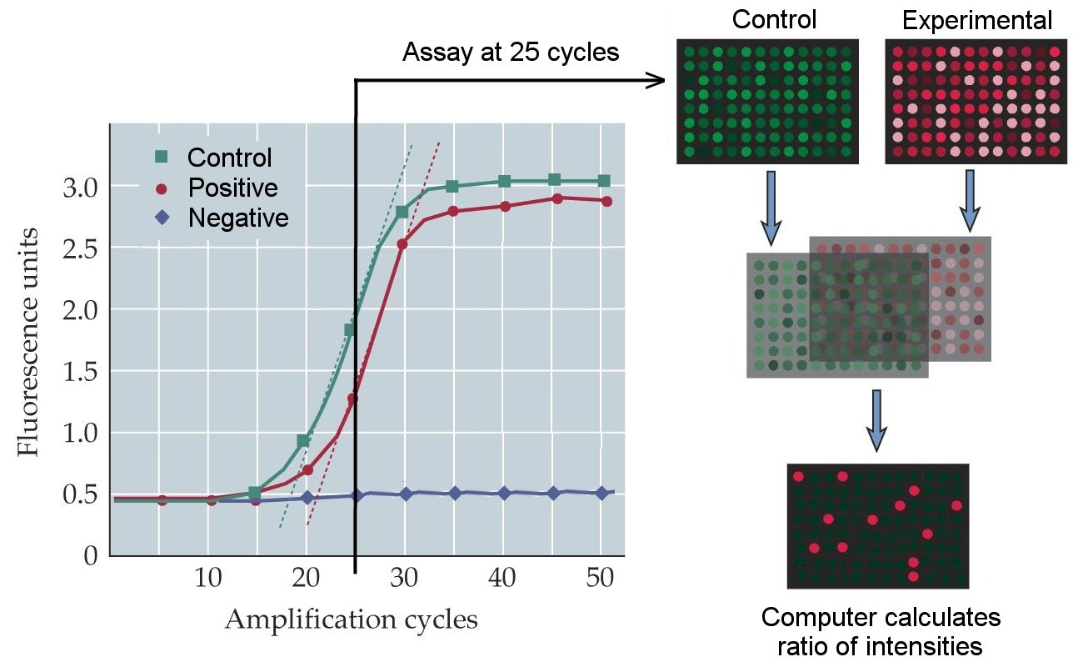

Slide 13
How TaqMan® works:
Once the TaqMan® probe has bound to its specific piece of the template DNA after denaturation (high temperature) and the reaction cools, the primers anneal to the DNA. Taq polymerase then adds nucleotides and removes the Taqman® probe from the template DNA. This separates the quencher from the reporter, and allows the reporter to give off its emit its energy. This is then quantified using a computer. The more times the denaturing and annealing takes place, the more opportunities there are for the Taqman® probe to bind and, in turn, the more emitted light is detected.

Slide 14
The reporter dye is released from the extending double-stranded DNA created by the Taq polymerase. Away from the quenching dye, the light emitted from the reporter dye in an excited state can now be observed. The light emitted from the dye in the excited state is received by a computer and shown on a graph display, showing PCR cycles on the X-axis and a logarithmic indication of intensity of the Y-axis.

Slide 15
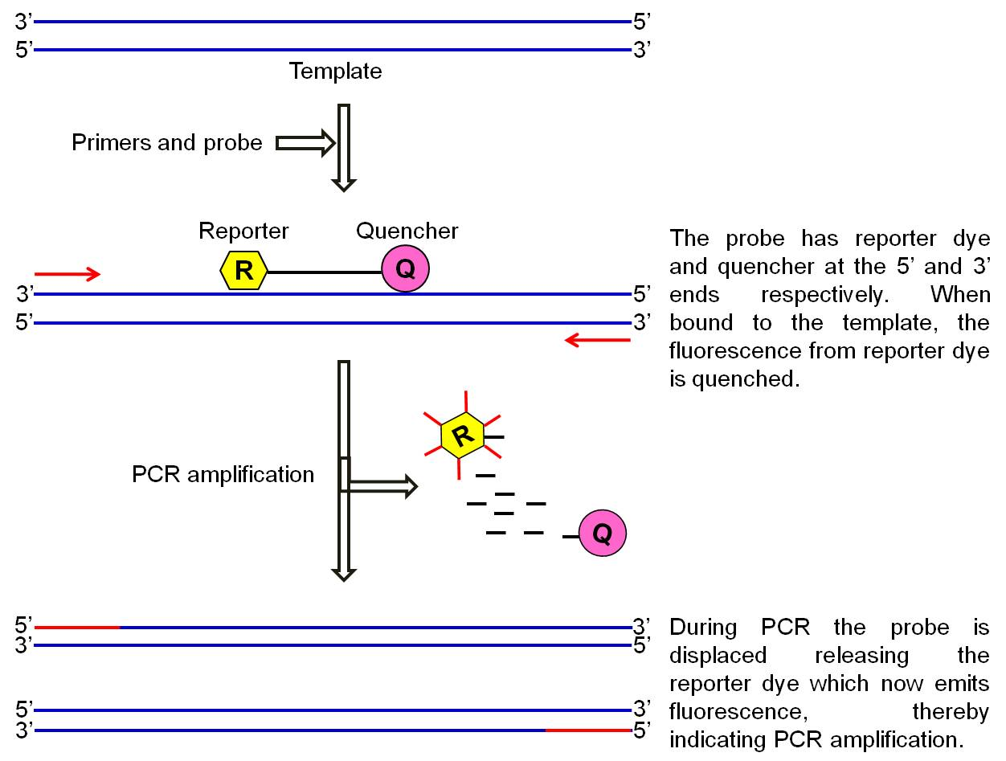

Slide 16
Type specific PCR versus broad-spectrum PCR
Type specific primers designed to amplify exclusively a single HPV genotype can be used, but to detect the presence of HPV-DNA in a single sample, multiple type-specific PCR reactions must be performed separately. This method is labor-intensive, expensive and the type-specificity of each PCR primer set should be validated. Alternatively, consensus or general PCR primers can be used to amplify a broadspectrum of HPV genotypes.

Slide 17
Such primers target a conserved region in different HPV genotypes. Since the L1 region is the most conserved part of the genome, several consensus PCR primer sets are aimed at this region. and several other broad-spectrum PCR primers were reported, but have not been extensively used in clinical situations. Three different designs of general PCR primers can achieve broad-spectrum detection of HPVDNA.

Slide 18
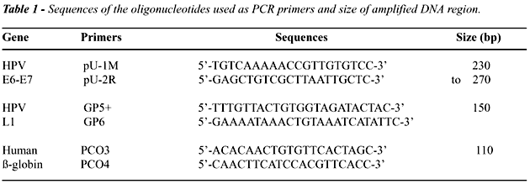

Slide 20
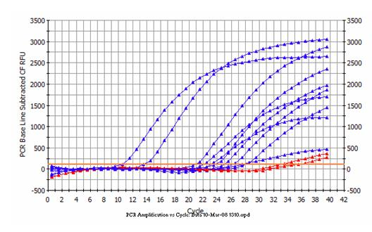

Slide 21
Conclusion
Accurate HPV genotyping is essential for adequate classification of patients into low-risk or high-risk groups. Furthermore, preliminary evidence suggests that the presence of multiple HPV genotypes may reflect repeated exposure and may relate to increased risk for disease progression .HPV viral load may also be a valuable predictor of disease although currently accurate quantitative viral load measurements are technically difficult in clinical samples.

Slide 22
Thank You..

