Slide 1
Treatment options for traumatized primary teeth

Slide 2
Treatment options for traumatized primary teeth
Introduction
Etiology
Predisposing factors
Types of injuries
History and examination
Advise and treatment
Sequeles

Slide 3
Introduction
Dental injury is a common injury
1/3 preschool children sufford
Trauma results in pain, loss of function, esthetic & psychological
Peak incidence of dental trauma between 1-3 years
Most affected teeth maxillary incisors

Slide 4
Etiology
Accidents & sprots
Oro tracheal intubation /premature infants
Non accidental injury or physical abuse

Slide 5
Predisposing factors
Increase over jet
Anterior open bite
Protrusion upper incisors
Hyperactivity
Epilipsy

Slide 6
Types of injuries depends on:
Direction, intensity of force
Luxation more common than fracture / primary dentition

Slide 7
Types of injuries
crown fracture
Root fracture
Crown root fracture
Concussion
subluxation
Luxation
Avulsion
Alveolar process

Slide 8
History and Examination
Time, cause
Patient Medical history
Head injuries
Lost teeth, tooth fragments
Extra oral examination: Facial lacerations, haematomas, bleeding, facial bone injury or fracture
Intra oral examination: soft tissue injury, teeth, alveolar bone
Radiographic examination: reproducible long cone technique periapicals, occlusal view, extra oral lateral view

Slide 9
In a radiograph:
Deciduous tooth intruted labially away from permanent follicle image shortened
Deciduous tooth moved palatally into follicle of permanent tooth germ appear elongated

Slide 10
Advise and treatment
Washing
Compressing 5-10 min.
Keep calm
Extraction / very mobile
Analgesic/ pain
Antibiotics/
Refer to hospital/ alveolar process fracture
Brushing not possible
Soft diet (10-14 days)
Pacifiers & nursing bottle restricted
Possible complications / increase mobility, swelling

Slide 11
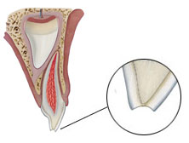
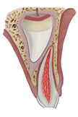
Treatment options:
Uncomplicated crown fracture enamel & dentin
Smooth off sharp
GIC or Composite
Complicated crown fracture enamel, dentin & pulp
Pulp capping CaOH or MTA
extraction

Slide 12
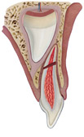
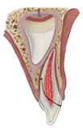
Root fracture
Left untreated (resorption)
Extraction coronal fragment/ displaced, loose
Crown /root fracture enamel, dentin, root with or without pulp exposure/
Extraction

Slide 13
Concussion / tender to touch
Reassurance & maintenanse
Good oral hygiene
Sub luxation / mobile, bleeding
Reassurance & maintenanse
Good oral hygiene

Slide 14
Luxation 1-lateral
Treatment options:
Crown palatally, root labially& firm gentle repositioning if occlusal derangement.
Spontaneous repositioing no occlusal derangement.
Crown labially, root palatally, severe displacement & mobile extraction

Slide 15
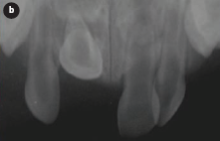
Luxation 2-Intrusive
Treatment options:
Not displaced into developing tooth germ Spontaneous re eruption expected.
Not re erupt, ankylosis likely extraction to prevent ectopic eruption.
Apex displaced into developing tooth germ, signs of infection extraction & antibiotic

Slide 16
Luxation 3- Extrusive:
mobile, elongated
Treatment options:
Minor : careful re positioning/ spontaneous alignment.
Severe, delayed presentation: extraction.

Slide 17
Avulsion
Tooth completely out off socket
Radiograph: make sure definitely avulsed not intruded& found not inhaled.
Re plantation avoided.

Slide 18
Sequeles of trauma to the primary teeth:
1-Pulp necrosis:
gray discoloration, loss of vitality
Radiograph: arrested root development, peri apical radiolucency.
Treatment : endo. or extraction.
2-Pulp obliteration:
common, yellowish
Radiograph: obliteration pulp chamber, root canal.
No treatment/ normal exfolation.

Slide 19
Sequeles of trauma to the primary teeth:
1-Pulp necrosis
2-Pulp obliteration

Slide 20
Sequeles of trauma to the primary teeth:
3-Internal root resorption:
Uncommon, signs of infection
Radiograph: oval shape pulp chamber
Treatment: endo. or extraction
4-External root resorption:
inflammatory, Signs of infection
Radiograph: loss tooth substance with R.L. Adjacent alveolar bone.
Treatment: extraction

Slide 21
Sequeles of trauma to the primary teeth:
3-Internal root resorption
4-External root resorption

Slide 22
Sequeles of trauma to the permanent teeth
1-Malocclusion
Delay resorption / palatal position of permanent
Premature loss / labial position of permanent

Slide 23
2-White or yellow- brown discoloration of enamel , White or yellow- brown discoloration of enamel with circular enamel hypoplasia
Interference with enamel deposition
Demarcated, stained enamel opacities / labial
2-7 years / following trauma to deciduous
Treatment:
Acid -pumice micro abration
External bleaching, ,composite restoration

Slide 24
3-crown dilaceration
Rare
Trauma Under 2 years
½ of teeth permanent impacted
Treatment:
If un erupted : surgical exposure+ ortho.
Dilacerated portion (permanent crown) when sufficiently extruded removal+ provisional crown

Slide 25
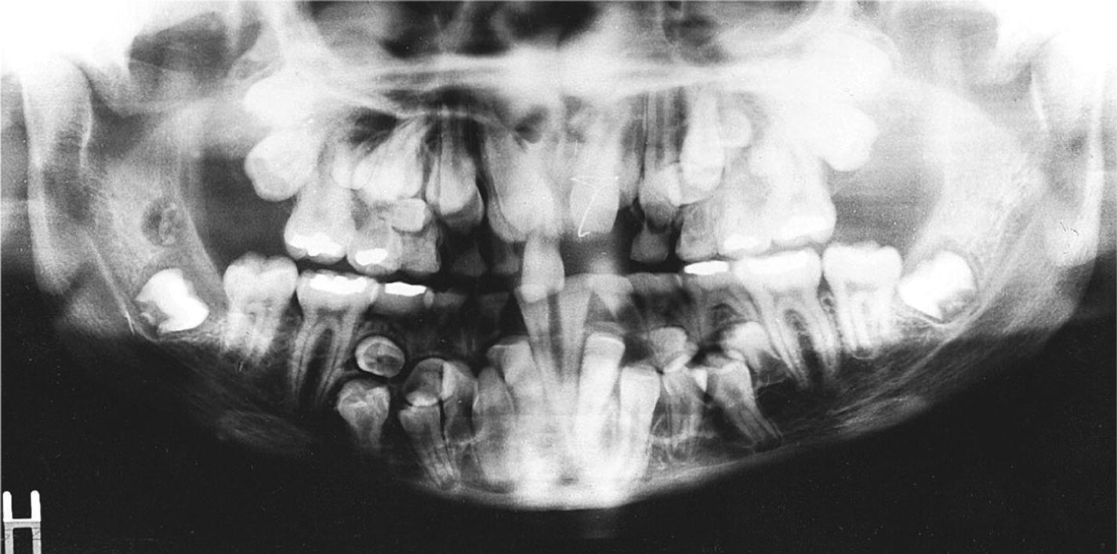
4-Odontoma- like malformation
Radioopaque mass
Rare
Trauma less than 1-3 years
Treatment: removal
5-Disturbance in eruption
Delay eruption permanent due to premature loss primary
Space loss permanent incisors due to early loss deciduous

Slide 26
Other (Rare)
Dentigerous cyst formation
Root duplication
Sequestration permanent tooth germ
Partial or complete arrest of root formation

