Slide 1
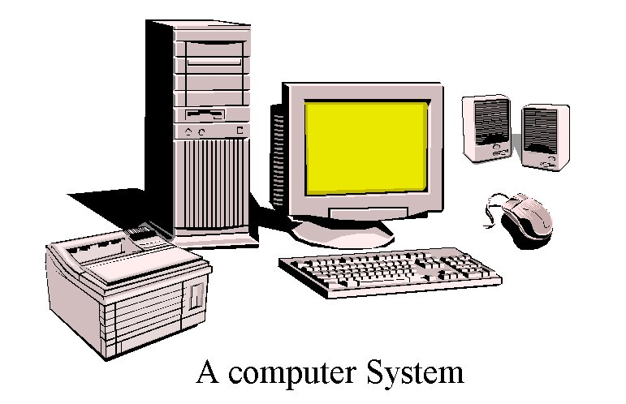
Computer Units
System Unit
Output device
Output device
Output device
Input device
Input device

Slide 2
Motherboard
A motherboard is the central printed circuit board (PCB) in many modern computers and holds many of the crucial components of the system, while providing connectors for other peripherals. The motherboard can be easily compared to the human body’s nervous system. The wires (nerves) on it transfer data between all of the other components.

Slide 3
Main Components of a Computer System
Processor (CPU)
Runs program instructions
Main Memory
Storage for running programs and current data
Secondary Storage
Long-term program & data storage (hard disk, CD, etc)
Input Devices
Communication from the user to the computer(e.g. keyboard, mouse)
Output Devices
Communication from the computer to the user (e.g. monitor, printer, speakers)

Slide 4
The Processor
The processor is the "brain" of the computer system.
Main processor is called the Central Processing Unit (CPU).
A particular computer will have a particular type of processor, such as a Pentium or a SPARC chip.
Co-processors assist the CPU with some of the processing functions. Examples:
Math co-processors handle heavy duty math processing
Graphics coprocessors speed up the display of graphics onto the monitor

Slide 5
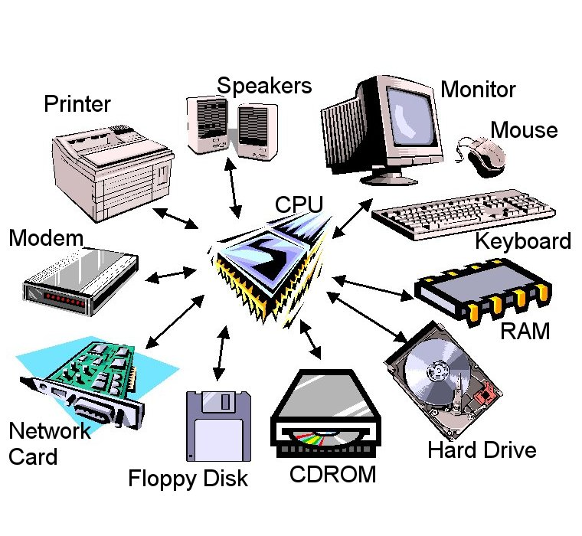
Component Interaction
The CPU controls all of the other resources within the system,
in order to accomplish a task.

Slide 6
Central Processing Unit (CPU)
Arithmetic / Logic Unit
Performs calculations and decisions
Coordinates processing steps
Control Unit
Small, fast storage areas for instructions and data
Registers

