Slide 1
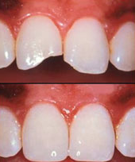
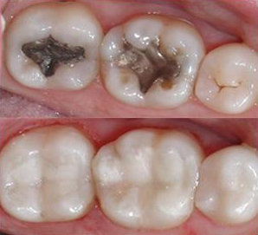
Direct Tooth colored restorative materials
“Direct materials are those that can be placed directly in the tooth cavity during a single appointment. Indirect materials are used to fabricate restorations in the dental laboratory that then are placed in or on the teeth; placement of indirect materials generally requires two or more visits to complete the restoration”
Before treatment
After treatment
Increased aesthetic demand.
Rapid improvement in application techniques and materials.

Slide 2
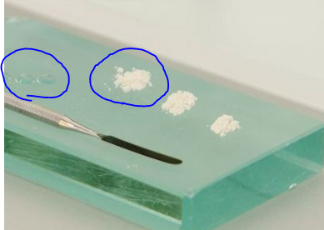
Historical development
Silicate cement:
introduced in 871.
Aluminosilicate powder and a phosphoric acid liquid.
The silicate has several advantages over the amalgam restoration:
Matching tooth color
Ease of manipulation and;
Anti-caries activity due to high fluoride content.
Disadvantages:
It irritates the dental pulp due to its phosphoric acid content, and
Has an early clinical failure, which mostly related to its dissolution in oral fluids,
Loss of translucency,
Surface crazing, and
Lack of adequate mechanical properties

Slide 3
Unfilled acrylic polymers (acrylic resins)
introduced about 1945 and were improved so that they were in moderate usage in the 1960.
based on polymethyl methacrylate (PMMA)
Advantages:
less soluble in oral fluids,
less susceptible to fracture, and
More color stable than silicate materials.
Disadvantages:
They had low abrasion resistance,
high coefficient of thermal expansion and contraction.
Not bond to the tooth structure.

Slide 4
Composite
Started in late 1950_{s} and early 1960_{s}, when Bowen began
Epoxy resins reinforced with filler particles.
Advantages:
better mechanical properties and
higher abrasion and wear resistance,
lower polymerization shrinkage and
lower coefficient of thermal expansion than that of unfilled resins.

Slide 5
Composite
Resin matrix
Coupling agent
Non-organic fillers
Monomers;
Polymerization initiator/activator
Polymerization inhibitor
Ultraviolet radiation absorber
gamma-methacryloxy-propyl-trimethoxy-silane
Pure silica particles with
different sizes
Bis-GMA, UEDMA, TEGDMA
Benzoyl peroxide, tertiary amine activator, Camphorquinone
Size
load
Roughness
Viscosity
Hydroquinone
2-hydroxy-4-methoxy benzophenone

Slide 6
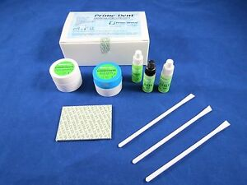
Polymerization reaction
Methods of activations
Chemical activation (self-curing composite resin)
Long setting time
Voids in the final restoration
A higher probability of long term discoloration
after 3-5 years of intraoral service.
Difficult handling on placement especially at class IV cavities.
More finishing time.
Few shade options

Slide 7
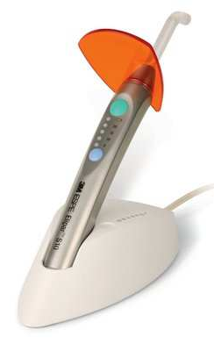
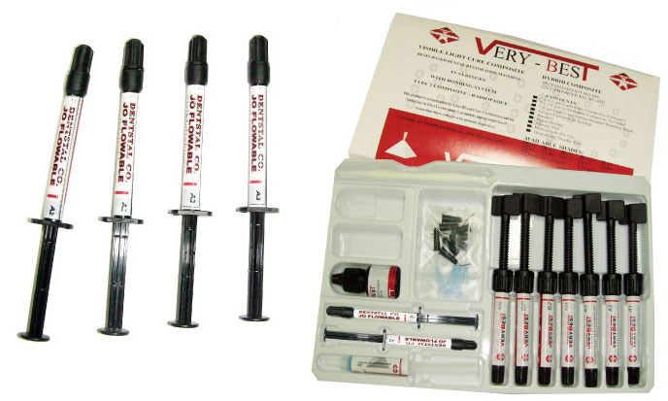
Visible Light activated composite resin (1970)
single-component pastes,
require no mixing,
reduced porosity,
better resistance to wear and abrasion.
The working time is virtually that chosen by the clinician,
Wide range of shade options

Slide 8
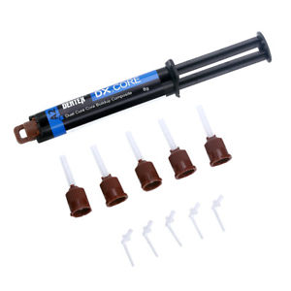
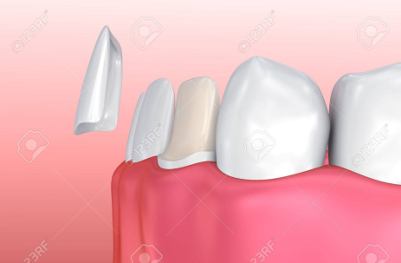
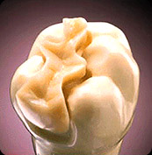
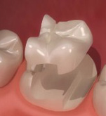
Dual cure composite.
A combination of chemical cure and light cure composites
Slow chemical curing process starts on mixing (BP) then accelerated by light (CQ)
For CEMENTATION veneers and
ceramic inlays or onlays

Slide 9
Classification of dental composites
Based on filler size
Macrofilled (conventional)
Size 8-12 µm
Microfilled
Hybrid
Size 0.04 µm
Size 0.6-1 µm
Load 50 %
Load 75-80 %
Load 70-80 %
Hardness
Hardness
Hardness
Surface roughness
Surface roughness
Surface roughness

Slide 10
Classification of dental composites
Based on filler load
Flowable composite
load 30 %
good wettability,
Good handling properties, and
Can be used only up to a thickness of 6 mm at one time.
Packable composite
Fiber reinforced composite

Slide 11
Thank you

