Slide 1
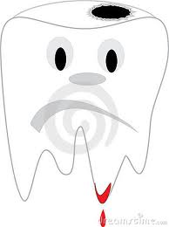
Inflammatory conditions of the pulp

Slide 2
Several factors make the pulp unique
The pulp is almost totally surrounded by a hard tissue (dentin)
The pulp has almost a total lack of collateral circulation
The pulp possesses unique set of cells, the odontoblasts as well as undif. Mesenchymal cells.

Slide 3
Pulpitis
caries, microleakage
irritants (bac.toxin& caious dentin)
Direct destroy to odontoblast
osmotic effect
Chemical mediators e.g. Histamine, bradykinin
(mediators of vascular changes)
Initiate inflammation

Slide 4
Increased vascular permeability & extravasation (edema) causing elevation in local pressure later distraction to odontoblasts.
Chemical modification evidences by increasing eosinophil,
Dilation of vessels lead to slowing of erythrocytes , migration of leukocytes around the dilated vessels.

Slide 5
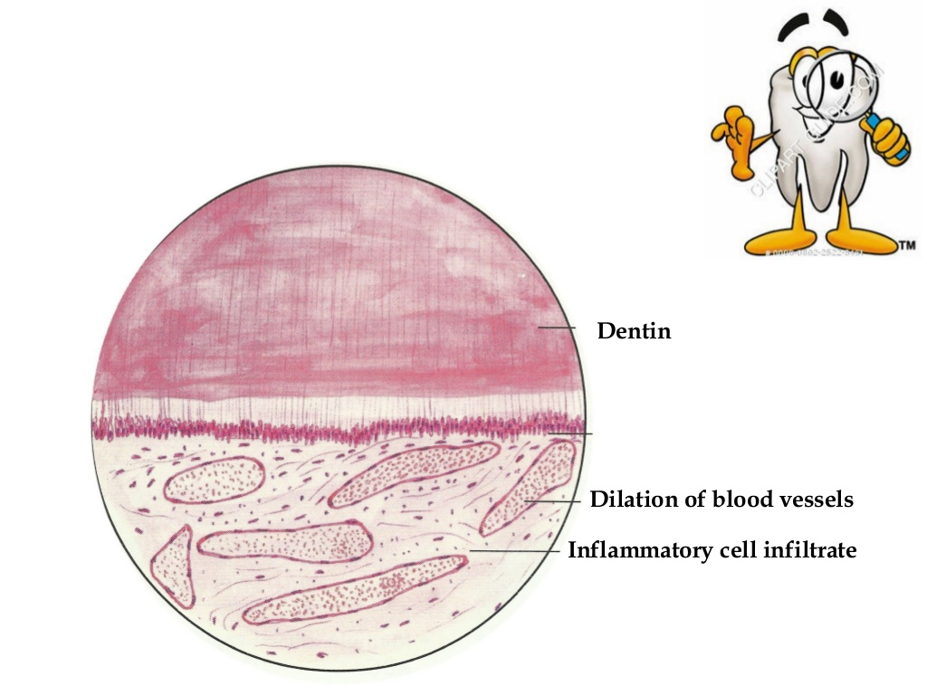

Slide 6
Acute cells is variable. Leukocytes of all forms are present
Chronic cells (lymphocytes, macrophages, and plasma cells)
quickly dominate
Mast cell is rarely seen in healthy pulps but appears in large
numbers with inflammation
Immune and inflammatory reactions may destroy adjacent
normal cellular and extracellular components
In general, the density of inflammatory cells and the size of the pulp lesion increase as the caries progresses in depth and width.
The ability of the pulp to withstand injury is related to
severity of inflammation &blood supply.

Slide 7
Pain is often caused by different factors. Release of mediators of inflammation causes pain directly by lowering the sensory nerve threshold.
These substances also cause pain indirectly by increasing both vasodilatation and permeability of vessels, resulting in edema and elevation of tissue pressure. This pressure acts directly on sensory nerve receptors.

Slide 8
The pathway of the pulp and periapical pathosis set out from caries

Slide 9
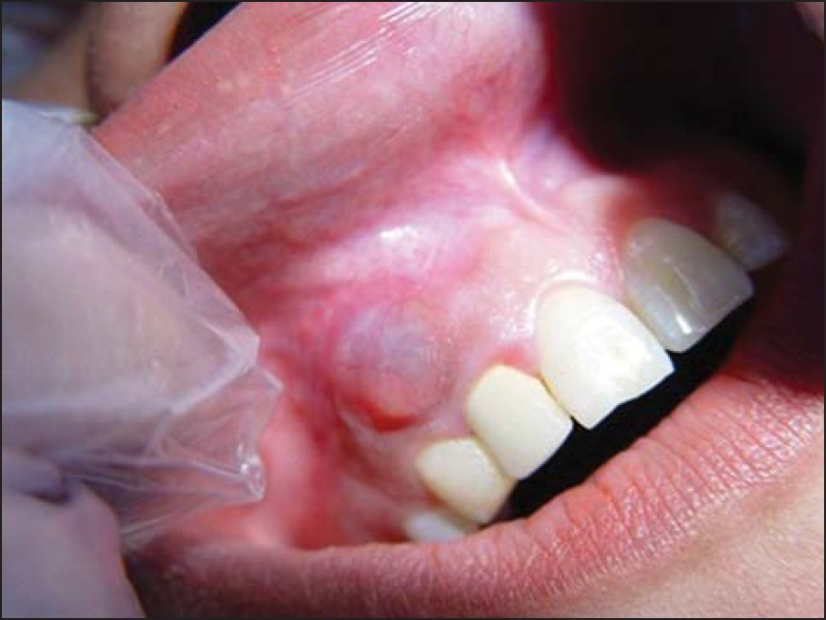
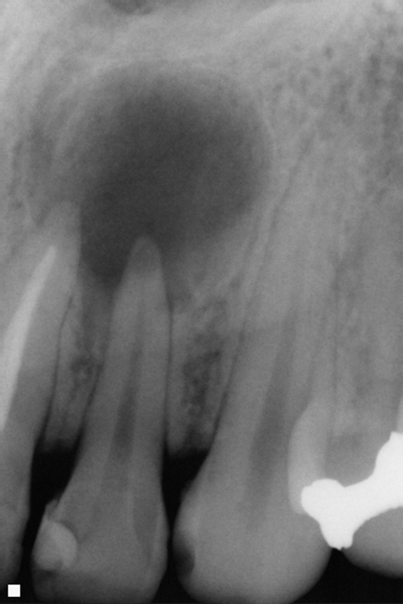
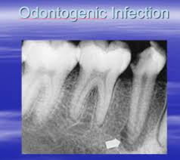

Slide 10
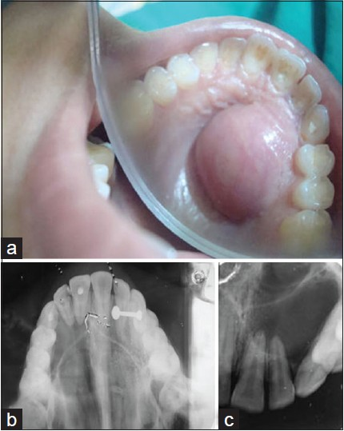

Slide 11
Classification of pulpal disease:
1.Soft tissue change:
Reversible pulpitis
Irreversible pulpitis
Hyperplastic pulpitis
Pulp necrosis
2.Hard tissue change
Pulp calcification
Internal resorption

Slide 12
Normal Pulp
Symptoms: None
Radiograph No periapical change
Pulp tests mild to moderate transient
response to thermal & electrical stimuli
Periapical tests Not tender to percussion or
palpation

Slide 13
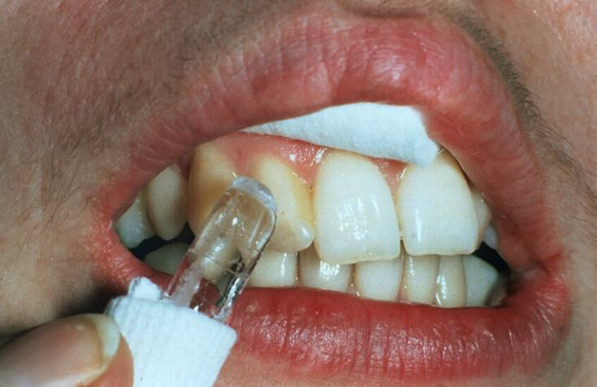
Vitality test
cold test: ethyl chloride
Ice stick

Slide 14
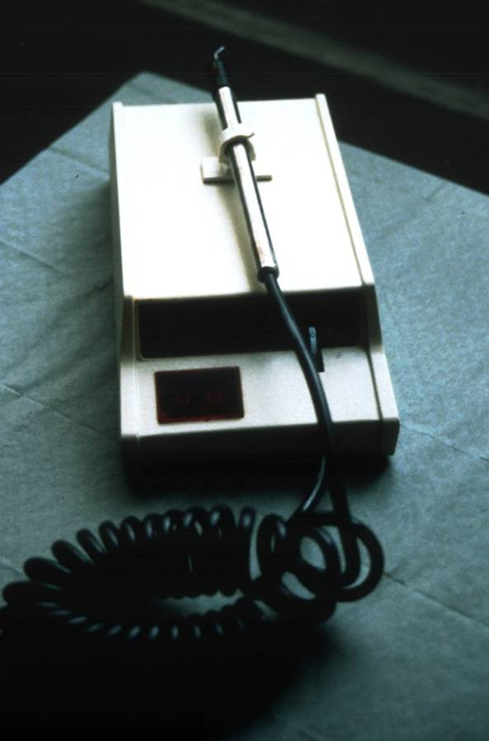
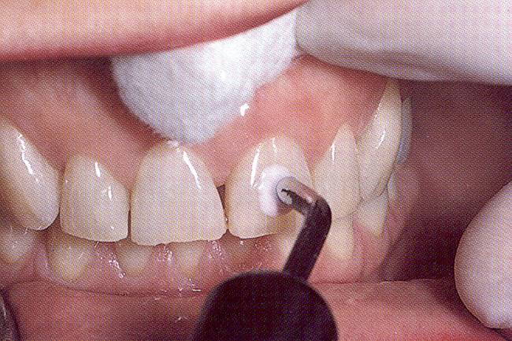
Electric Pulp Test

Slide 15
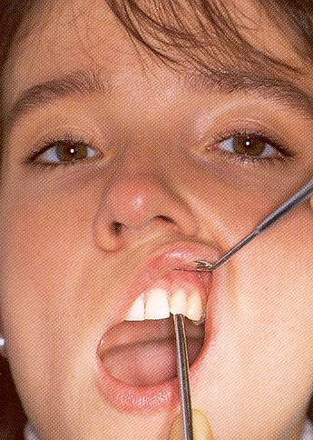
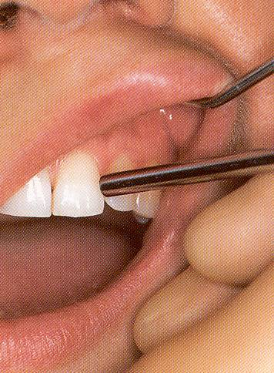
Percussion Test
Vertical percussion
Horizontal percussion

Slide 16
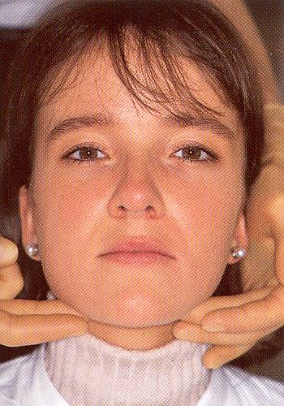
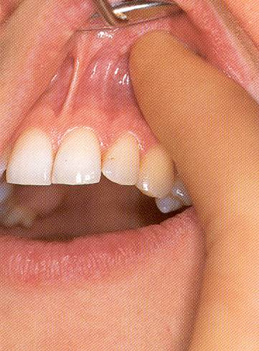
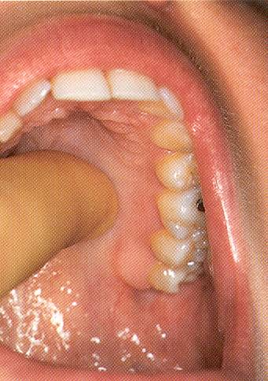
Palpation

Slide 17
Reversible Pulpitis
Is a reactive inflammatory process resolves or diminishes with removal of irritant.
Irritants
Caries , microleakage, unbased restorations
Periodontal scaling, root planning
Cervical erosion, occlusal attrition
Most operative procedure and enamel fractures resulting in exposure of dentinal tubules.

Slide 18
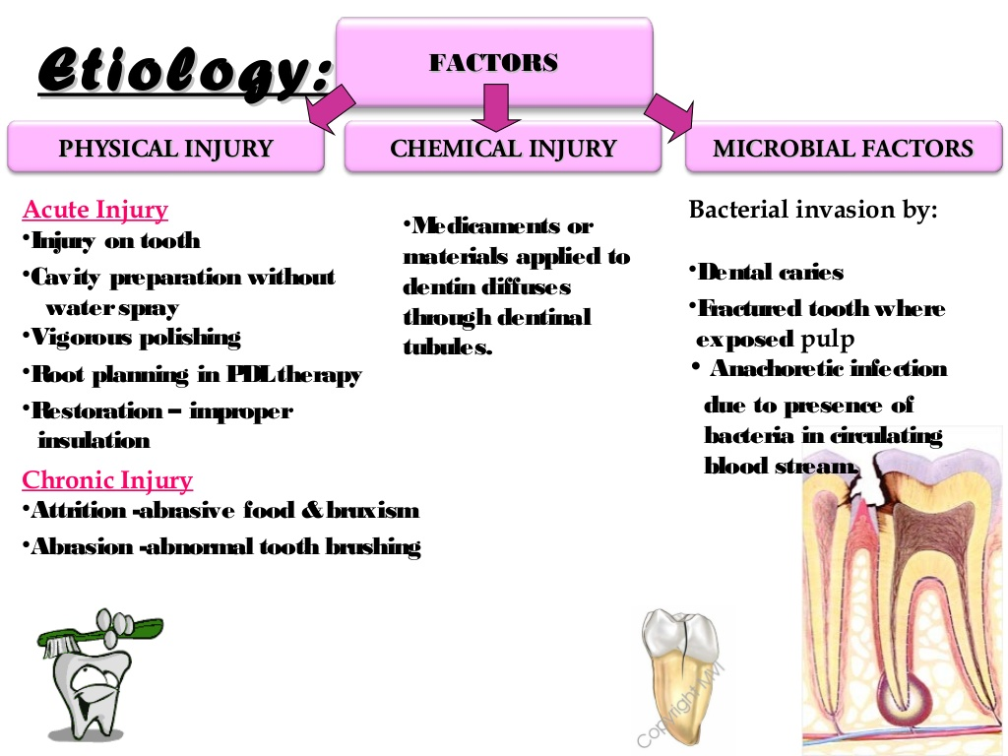

Slide 19
Reversible Pulpitis ( Pulp Hyperemia)
Mild, transient, localized inflammatory response.
CLINICAL FEATURES: Tooth is sensitive to thermal changes, especially cold (sharp transient pain) for a short duration, disappears on withdrawal of thermal irritant.
Responds to stimulation of electric pulp tester at lower level of current indicating low pain threshold.
Teeth usually show deep caries, metallic restoration with defective margins.

Slide 20
Reversible Pulpitis
In this stage there is a condensed inflammatory reaction of chronic type with no sign of necrosis
That mean once we remove the cause it will return back to healing process.
Reactionary dentin may continue to form after the onset of pulpitis, providing the pulp has not been irreversibly damaged.

Slide 21
Reversible Pulpitis
Prognosis
Irritant remains
Symptoms persist
+
more widespread
Irreversible pulpitis
Irritant removed
+
appropriately treated
Asymptomatic
uninflammed pulp

Slide 22
Reversible pulpitis
Distinguished from irreversible pulpitis
Thermal test
Reversible pulpitis
momentary, painful response subsides as soon as the stimulus removed
Irreversible pulpitis
painful, lasts longer, linger after the stimulus removed, pain may come even without a stimulus.

Slide 23
Irreversible pulpitis
The pulp is damaged beyond repair and even with the removal of the irritant it will not heal.
Irreversible pulpitis is often a sequel to and progression from reversible pulpitis.
Irreversible pulpitis may be acute, subacute, or chronic, partial or total and the pulp may be infected or sterile. symptomatic or asymptomatic.

Slide 24
TREATMENT & PROGNOSIS:
Drainage of exudates from pulp chamber. Pulpotomy.
Root canal treatment.
Extraction of tooth.

Slide 25
Symptomatic pulpitis
Characterized by intermittent or continuous episodes of spontaneous pain (with no external stimuli) pain tends to be moderate to sever depending on the severity of inflammation, and it may be sharp or dull. Localized or referred.
Pain may last only minutes or for hours.
Application of thermal stimuli to teeth may produce an immediate response, and the response does not disappear and is prolonged after removal of stimuli.
Occasionally, application of cold in-patients with acute painful irreversible pulpitis causes vasoconstriction, drop in pulpal pressure, and subsequent pain relief.

Slide 26
Asymptomatic pupitis
May be developed from a symptomatic pulpitis or from a low-grade pulp irritant.
It may develop from any type of injury, but is usually caused by a large carious exposure or by previous traumatic injury that resulted in painless pulp exposure of long duration.

Slide 27
Asymptomatic pulpitis
The infection leads to the development of micro abscess begins as tiny zones of necrosis with dense inflammatory cell
Commonly an abscess contains of necrotic and degenerating cells, cellular elements and microorganisms.
The important inflammatory cell in the abscess is the neutrophil.
Immediately surrounding the abscess may be a dense infiltration of lymphocytes, plasma cells and macrophages

Slide 28
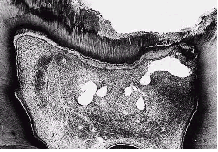
Asymptomatic pulpitis
It may end up with complete necrosis of the pulp.
It is proceeded further to involve radicular pulp part (chronic total pulpitis with partial necrosis), we can see more than one pulp abscess in the coronal and radicular pulp and it is more sever. And it may end up with complete necrosis of the pulp.

Slide 29
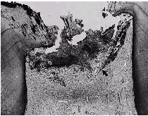
Some pulps respond to carious exposure by surface ulceration that exposes the pulp to the oral cavity (chronic ulcerative pulpitis). And this is considering as safety valve that delays the spread of injury

Slide 30
Clinical tips:
Pain
Elicited by thermal stimuli or referred
On mastication/tooth contact and well localized
Pulpal
Peri-radicular
Throbbing constant reacts to heat
Dull short reacts to cold&sweets
Irreversible pulpitis
Reversible pulpitis

Slide 31
Percussion
Lateral
Apical
Periodontal
Pulpal

Slide 32
Test :if inflammation is confined and has not extended periapically, teeth respond within normal limits to palpation and percussion.
Extension of inflammation to the periodontal ligament causes percussion sensitivity and better localization of pain.
Treatment: Root canal treatment or extraction is indicated for teeth with signs and symptoms of irreversible pulpitis.

Slide 33
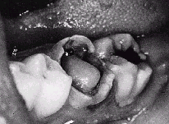
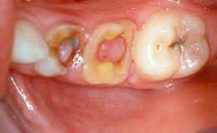
Hyperplastic pulpitis (pulp polyp)
A form of irreversible pulpitis, is the result of growth of chronically inflamed young pulp into occlusal surfaces
Usually asymptomatic. reddish cauliflower-like growth of connective tissue.
Attributed to a low- grade chronic irritation

Slide 34
Hyperplastic pulpitis (pulp polyp)
It is occasionally associated with signs of irreversible pulpitis such as spontaneous pain.
The teeth respond within normal limits when palpated or percussion.
The threshold to electrical stimulation is similar to that found with normal pulp.

Slide 35
Hyperplastic pulpitis (pulp polyp)
Microscopically:
A complex of new capillaries
proliferating fibroblasts & inflammatory cells.
Sensory nerve elements are almost totally absent near the surface, in contrast to the rich innervations of an exposed non-hyperplastic pulp.
Treatment: requires pulpectomy, R.C.T or extraction.

Slide 36
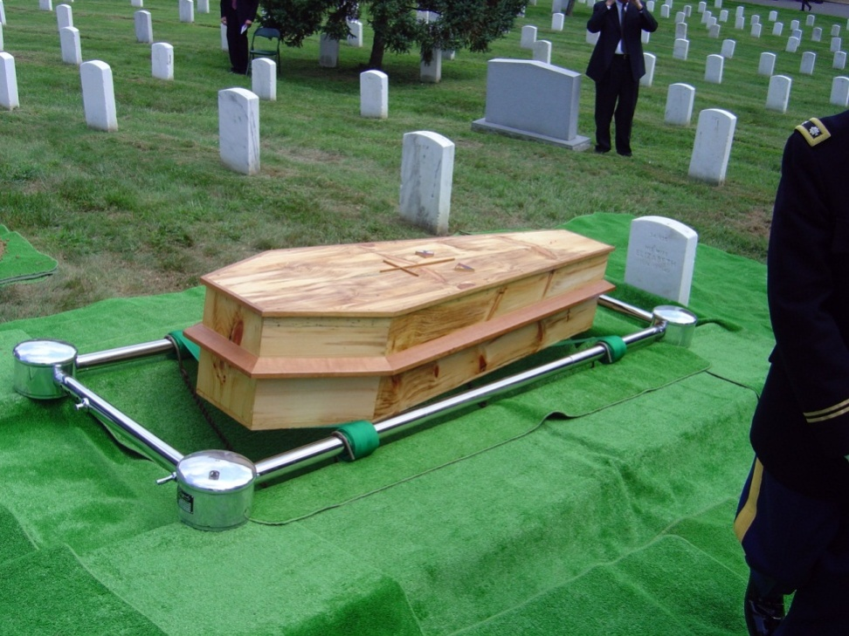
Pulp necrosis

Slide 37
Pulp necrosis
Death of the pulp may result from an untreated irreversible pulpitis or from traumatic injury that disrupts the blood supply to the pulp.
It can be partial N. which gives similar symptoms to irreversable pulpitis
or total N. which is asymptomatic.
If not treated it will spread beyond the apical foramen causing inflammation of the periodontal ligament; result in thickening of periodontal ligament, which may be quit sensitive to percussion

Slide 38
Pulp necrosis of 2 types:
Liquefaction N: A complete liquefaction of cellular elements surrounded by disintegrated polymorphonuclear leukocytes and chronic inflammatory cells and usually leads to an apical abscess (liquefaction necrosis and pus).
Coagulation N: as a result of protein denaturation that followed hypoxic tissue death. Under microscope we see cellular boundaries of the cells, but no intracellular content.
Pulp can remain necrotic in that manner for many years.

Slide 39
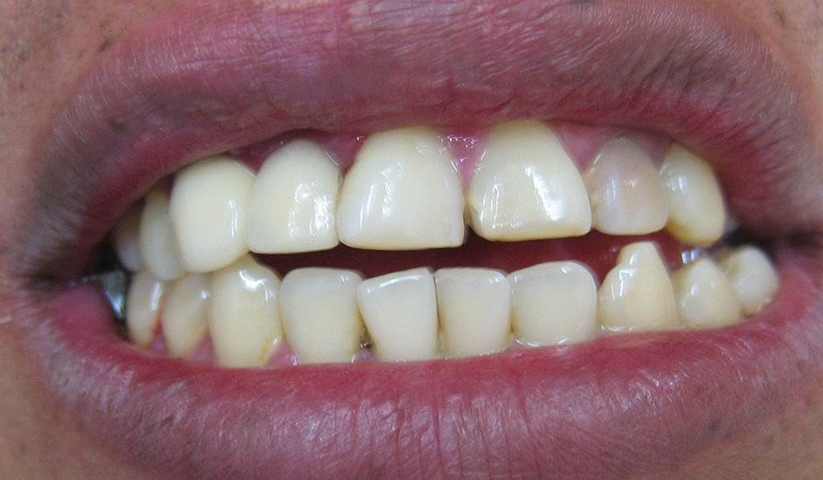
Hard tissue changes due to pulpal inflammation:
Internal resorption
Is another type of asymptomatic irreversible pulpitis.
The term internal resorption is applied to the destruction of predentin and dentin.
visible on radiographs
can be seen as a pink area through the intact enamel. The pink color is due to the granulation tissue in the coronal dentin undermining the enamel.

Slide 40
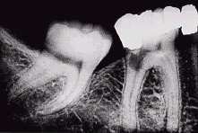
Internal resorption
It may begin in the pulp chamber, or the root canal.
If allowed to continue untreated, it can perforate either above bone or into the periodontal ligament within bone. Such communication of the pulp and periodontium creates sever, irreversible pathosis.

Slide 41
Clinically
Pain may be a presenting symptom if perforation occurs and the metaplastic tissue is exposed to the oral fluid.
Teeth with intracanal resorpative lesions usually respond within normal limits to pulpal and periapical test.

Slide 42
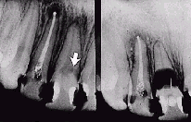
Radiographs reveal radiolucency with irregular enlargement of root canal compartment.
Histologically: granulation tissue with multinucleated giant cell, an area of necrotic pulp is found coronal to granulation area.
Treatment: Immediate removal of inflamed tissue and institution of root canal treatment is recommended

Slide 43
Canal calcification
Deposition of abnormally large amount of reparative dentin through out the canal system.
Related to various forms of injury (Restorative procedures, attrition, abrasion, and trauma), where as others regard it as a natural phenomenon.
As irritation increases, the amount of calcification may also increases leading to partial or complete radiographic obliteration of the pulp chamber and root canal. A yellowish discoloration of the crown is often a manifestation of calcific metamorphosis.

Slide 44
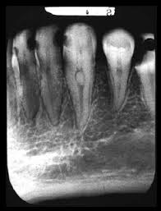
Clinically: pain threshold to thermal and electrical stimuli usually increases, or often the teeth are unresponsive.
Palpation and percussion are usually within normal limits.
Radiographically: calcification of pulp tissue is associated with various degrees of pulp space radiographic obliteration. A reduction of coronal pulp space followed by a gradual narrowing of the root canal is the first signs.
Tt: Calcification of itself is not pathosis and dose not require treatment

Slide 45
Subjective History
Pain History
Location
Intensity
Duration
Stimulus
Relief
Spontaneity

Slide 46
Objective Testing
Visual Examination
Percussion
Palpation
Mobility, Occlusion
Periodontal probing
Selective anesthesia
Test cavity
Transillumination
Thermal tests, Electric Pulp Test
Radiographs

Slide 47
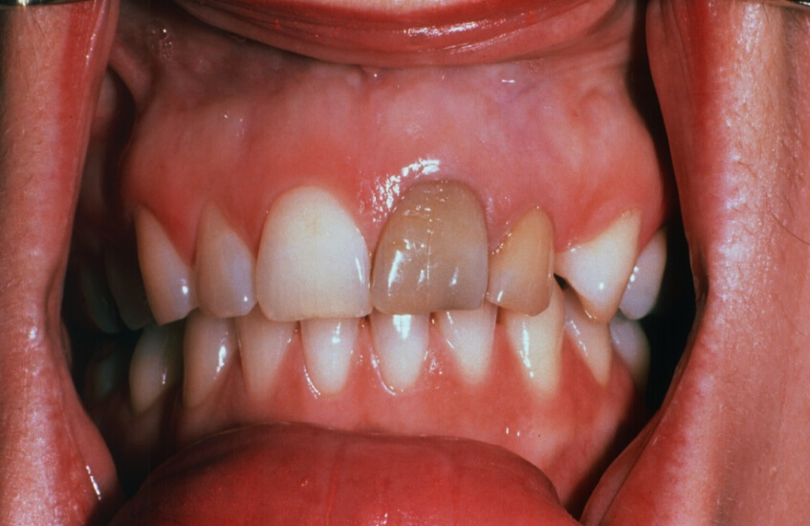
Discoloration

Slide 48
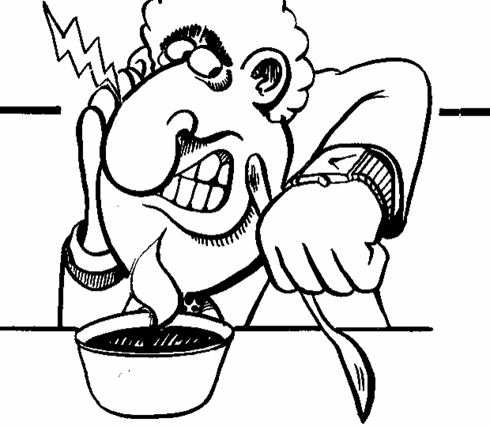
Thank you

