Slide 2
Dental Pulp

Slide 3
Functions of the Dental Pulp
Nutrition: blood supply for pulp and dentin.
Sensory: changes in temp., vibration and chemical that affect the dentin and pulp.
Formative: the pulp involve in the support, maintenance and continued formation of dentin.
Defensive: triggering of inflammatory and immune response.
Protective: Development and formation of secondary and tertiary dentin which increase the coverage of the pulp.

Slide 4
Anatomy of Pulp
Pulp horns or cornua
Pulp Chamber or coronal coronal pulp, located in the crown of the tooth.
Root canal or radicular pulp, is the portion of the pulp located in the root area.
The apical foramen is the opening from the pulp at the apex of the tooth.
Accessory canals or lateral canal, extra canal located on lateral portions of root on the lateral portions of the root.

Slide 5
Lateral canas developed due to
1.It may be an areas of premature loss of cells of root sheath (which initiated formation of odontoblast that form dentin.
2. if the developing root comes in contact with a blood vessel as the dentin encircles the blood vessel and a lateral or accessory canal is formed.

Slide 6
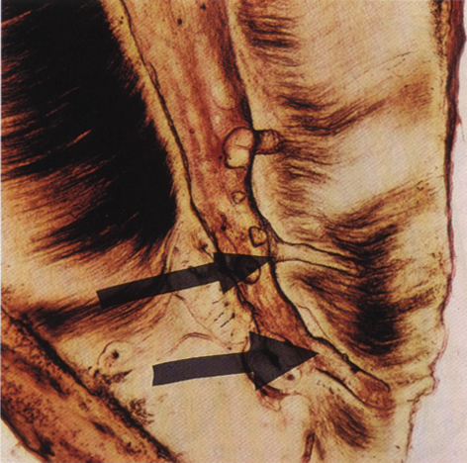
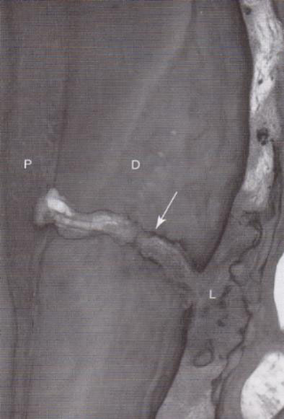
Lateral or accessory canal

Slide 7
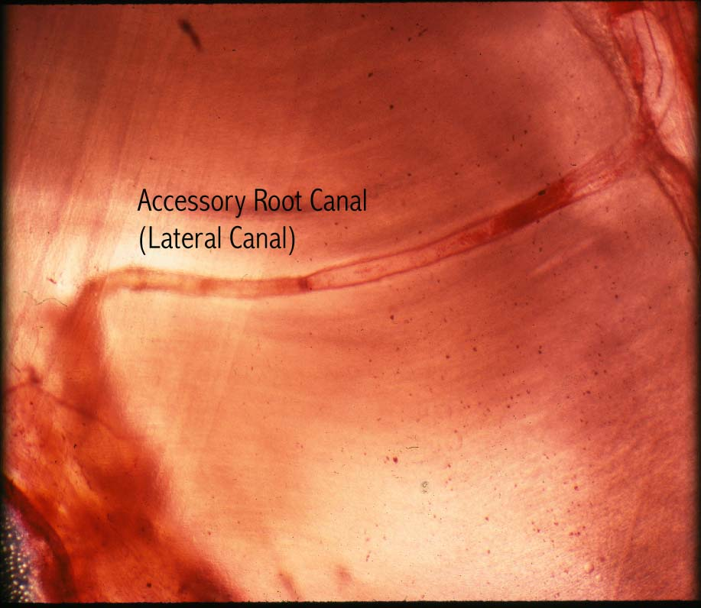
Lateral Canal

Slide 8
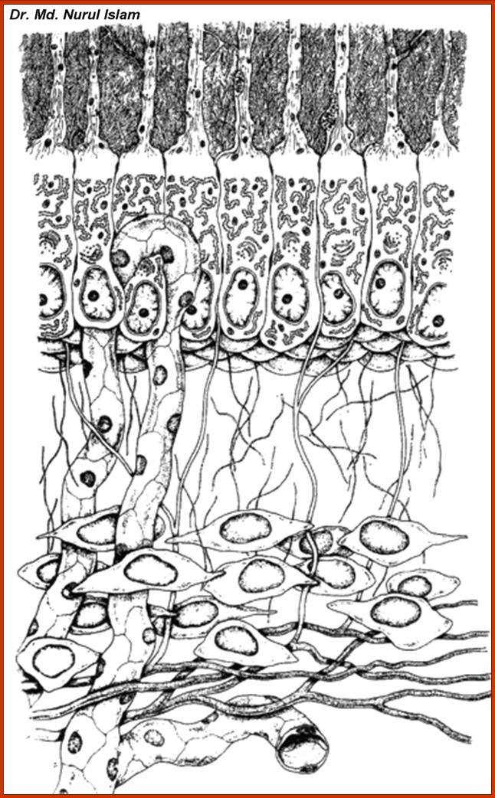
Odontoblastic
process
Predentin
Cell bodies
Odontoblasts
Cell-free zone
Cell-rich zone

Slide 9
Microscopic Zones in Pulp
Zones-from outer to inner zone | Description
Odontoblastic layer | Lines the outer pulpal wall and consists of the cell bodies of odontoblast. Secondary dentin may form in this area from the apposition of odontoblast.
Cell-free zone | Fewer cells than odontoblastic layer. Nerve and capillary plexus located here
Cell-rich zone | Increased density of cells as compared to cell-free zone and also a more extensive vascular system
Pulpal-core | Located in the center of the pulp chamber, which has many cells and an extensice vascular supply, similar to cell-rich zone

Slide 10
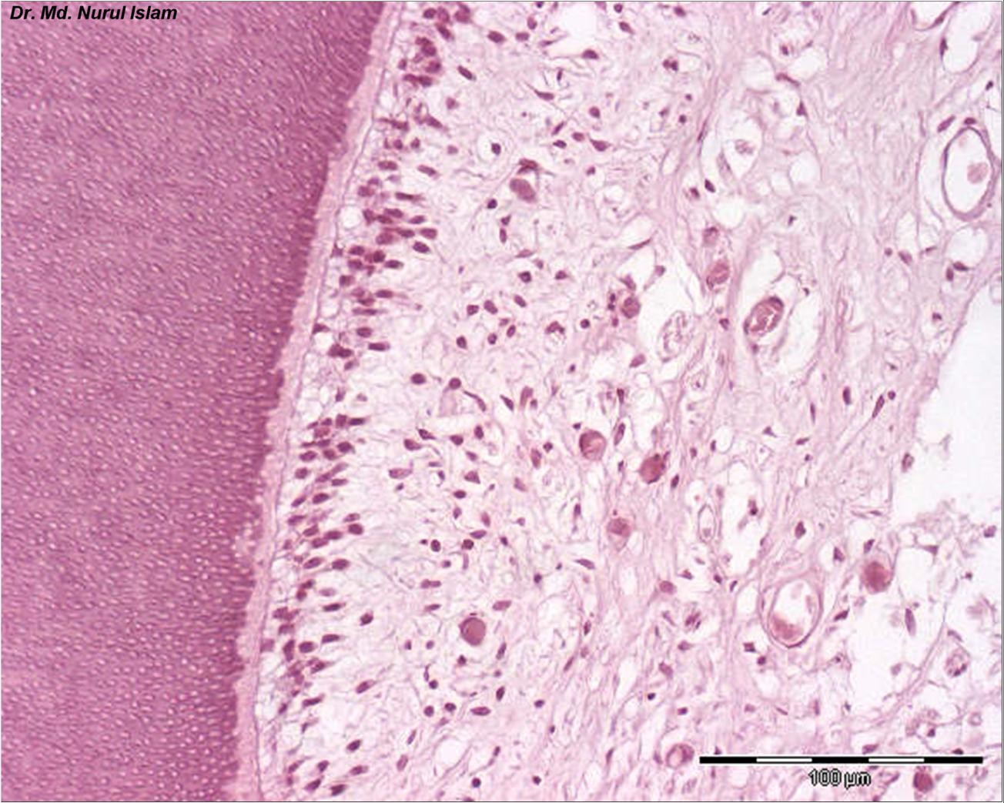
Dentin
Odontoblasts layer
Predentin
Cell rich zone
Pulp core
Cell free zone

Slide 11
Contents of the Pulp
Cells: Odontoblast, Fibroblast, white-blood cells, Undifferentiated mesenchymal cells, Macrophages and Lymphocytes. No fat cell.
Fibrous Matrix: Mostly reticular fibres and collagen fibres (Type I and Type III).
Ground substance: Act as a medium to transport nutrients to cells and metabolites of the cell to the blood vessels.

Slide 12
Vascularity and Nerves of the Pulp
The pulp organ is extensively vascular with vessels arising from the external carotids to the superior or inferior alveolar arteries. It drain by the same vein.
Blood flow is more rapid in the pulp than in most area of the body, and the blood pressure is quite high.
The walls of the pulpal vessels become very thin as their enter the pulp.
Nerves : Several large nerves enter the apical canal of each Molar and Premolar and single ones enter the anterior teeth. This trunks transverse the radicular pulp, proceed to the coronal area and branch peripherally.

Slide 13
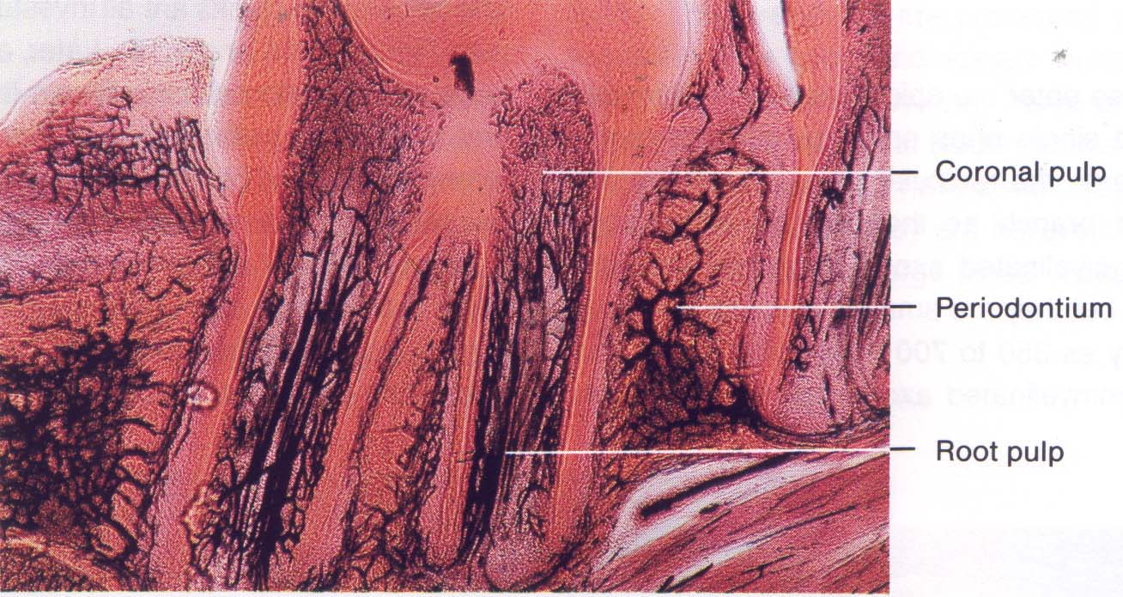
Nerves and vessels in pulp
Blood and vessels enter and exit the dental pulp by way of the apical and accessory foramina. Pulp is richly innervated; nerves enter the pulp through the apical foramen, along with afferent blood vessels and together form the neuro-vascular bundle.

Slide 14
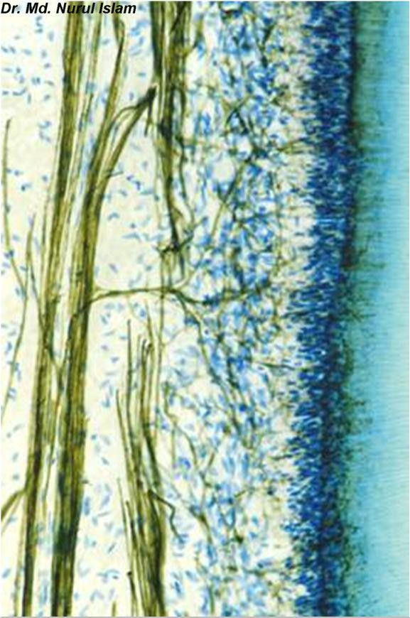
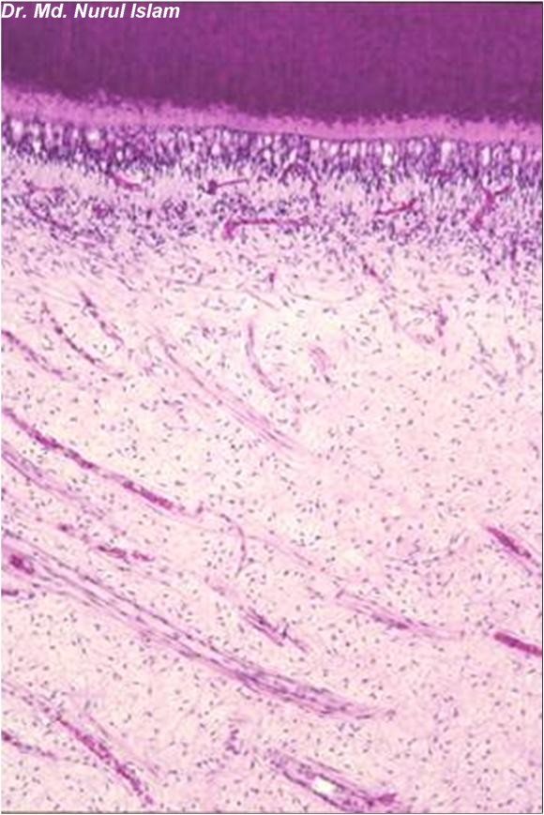
Odontoblast, Fibroblast, white-blood cells, Undifferentiated mesenchymal cells, Macrophages and Lymphocytes. No fat cell.
Odontoblast, Fibroblast, white-blood cells, Undifferentiated mesenchymal cells, Macrophages and Lymphocytes. No fat cell.
Nerves in pulp

Slide 15
Clinically Importance features of the Dental Pulp
With age the pulp becomes less cellular. The number of cells in the dental pulp decreases as cell death occurs with age.
The volume of the pulp chamber with continued deposition of dentine. In older teeth, the pulp chamber decreases in size; in some cases the pulp chamber can be obliterated. An increase in calcification in the pulp occurs with age.
An increase in calcification in the pulp occurs with age.

Slide 16
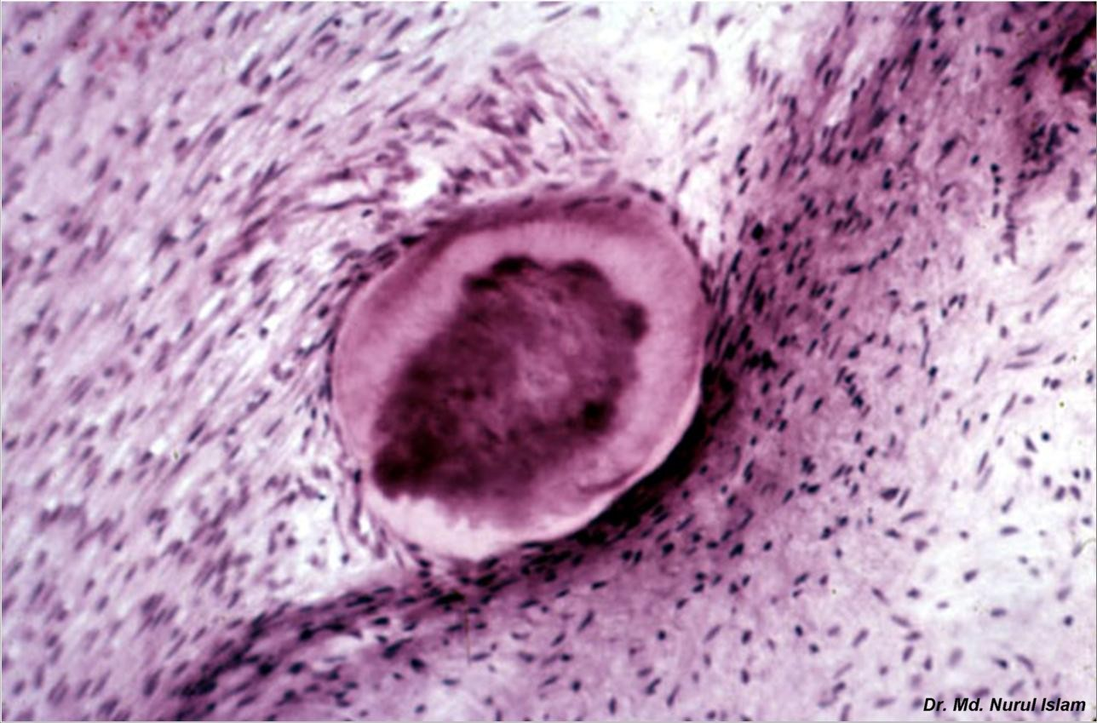
Free True Denticle(pulp ston)
Free True
Denticle

Slide 17
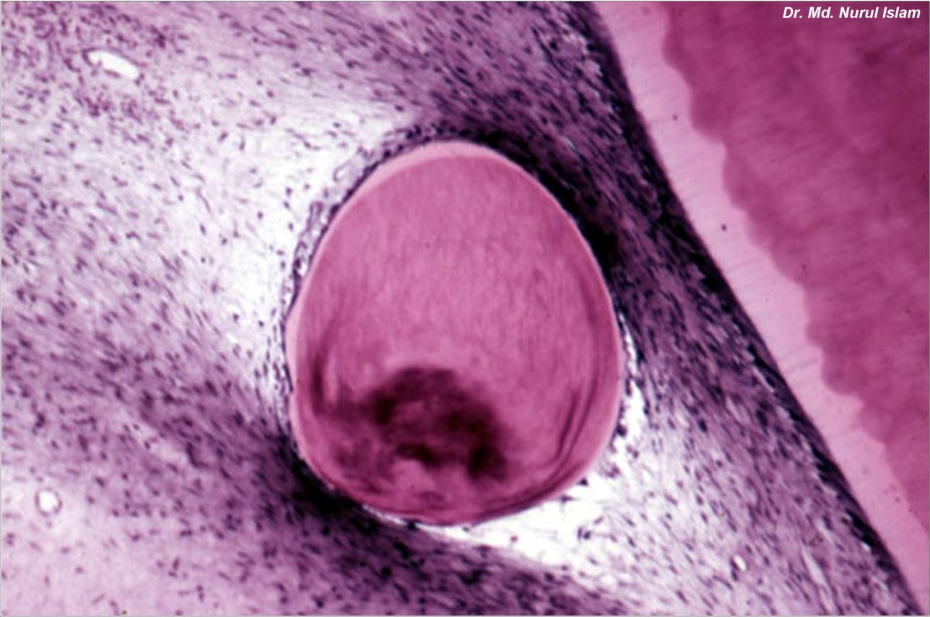
Free True Denticle

Slide 18
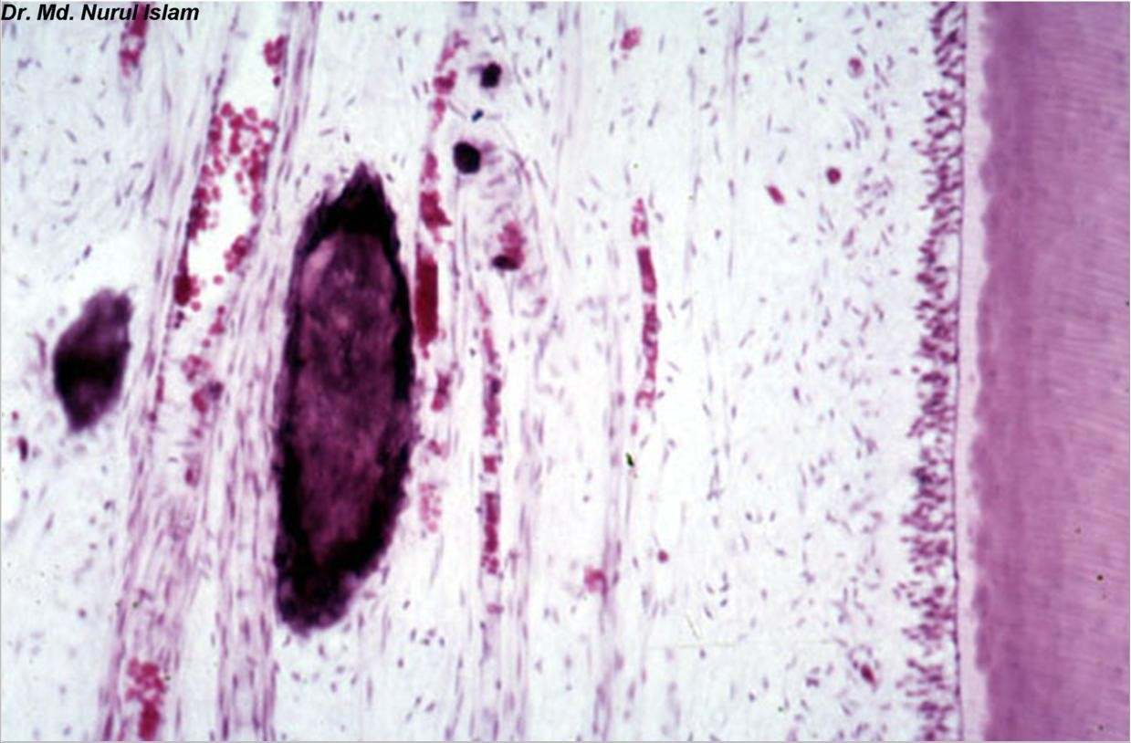
Free False Denticle

Slide 19
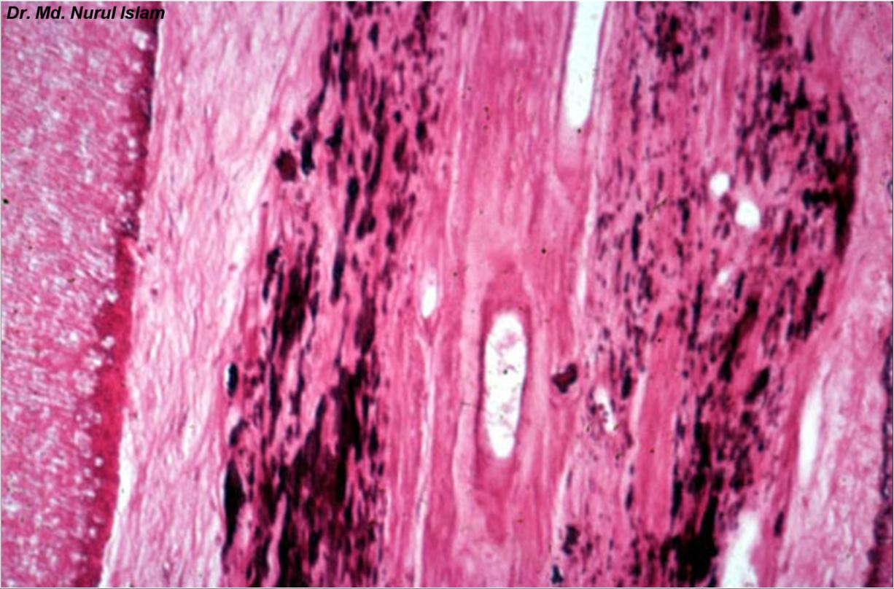
Diffuse Pulp Calcification

Slide 20
THANK YOU

