Slide 1
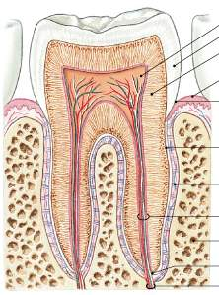
PERIODONTIUM
Pulp cavity
Enamel
Cementum
PDL
Alveolar bone
Sharpey's fibers
Attachment
organ
Dentin
Gingiva
Cementum
Periodontal
ligament
Root canal
Alveolar bone
Apical foramen
Alveolar vessels
& nerves

Slide 2
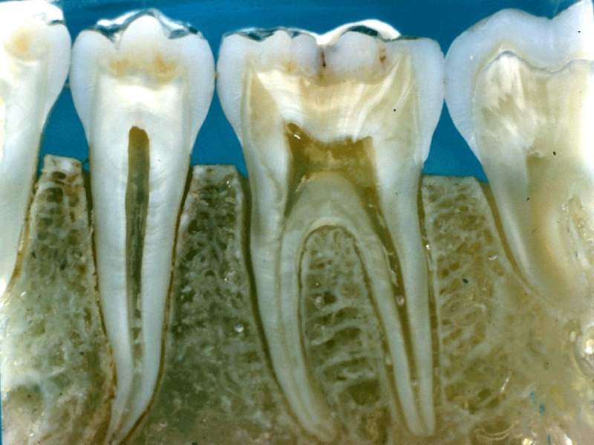
TEETH IN-SITU

Slide 3
Periodontium
Gingiva(fibrous CT)
Periodontal Ligament(fibrous CT)
Alveolar bone(minerlaized CT)
Cement(minerlaized CT)

Slide 4
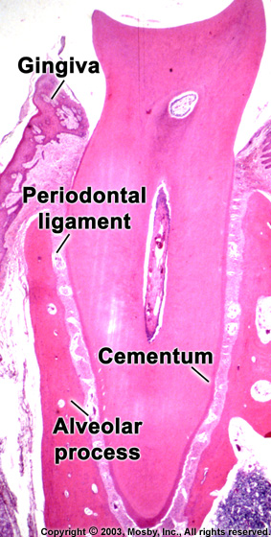
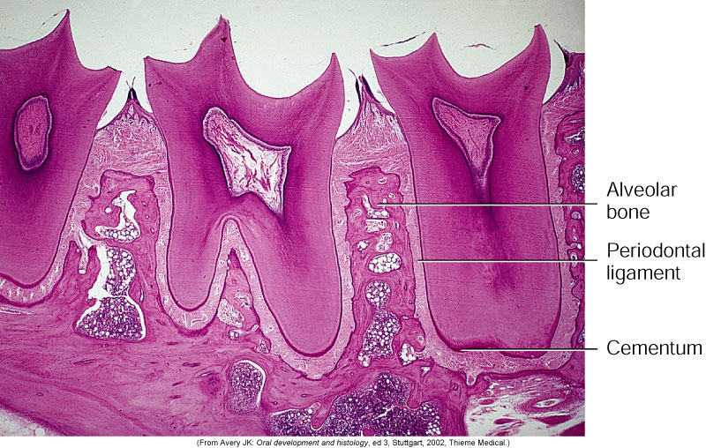

Slide 5
Cementum
It is a hard avascular connective tissue that covers the roots of teeth

Slide 6
Role of Cementum
It covers and protects the root dentin (covers the opening of dentinal tubules)
2) It provides attachment to the periodontal fibers
3) It compensates for tooth resorption

Slide 7
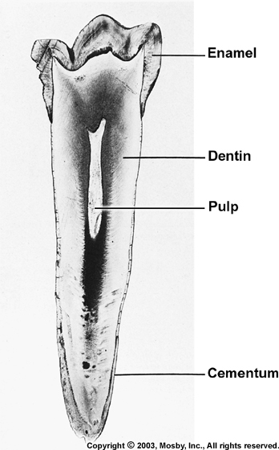
Varies in thickness: thickest in the apex and
in the inter-radicular areas of multirooted
teeth, and thinnest in the cervical area
10 to 15 μm in the cervical areas to
50 to 200 μm (can exceed > 600 μm) apically

Slide 8
Cementum simulates bone
Organic fibrous framework, ground substance, crystal type, development
Lacunae
Canaliculi
Cellular component
Incremental lines (also known as “resting” lines; they are produced by continuous but phasic, deposition of cementum)

Slide 9
Differences between cementum and bone
Not vascularized – a reason for it being resistant to resorption
Minor ability to remodel
More resistant to resorption compared to bone
Lacks neural component – so no pain
70% of bone is made by inorganic salts (cementum only 45-50%)

Slide 10
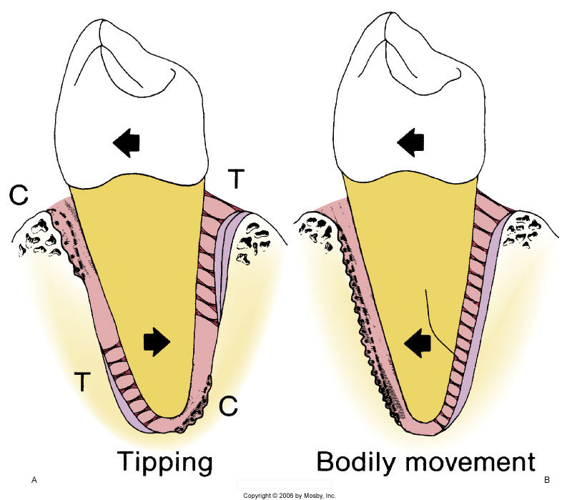
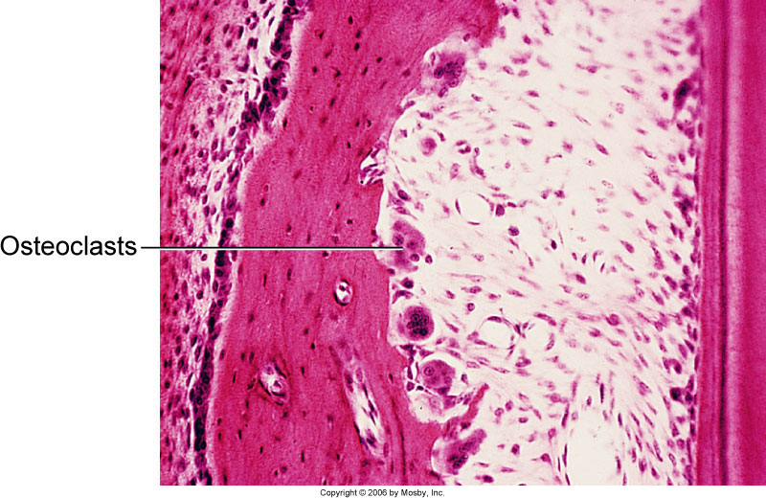
Clinical Correlation
Cementum is more resistant to resorption: Important in permitting
orthodontic tooth movement

Slide 11
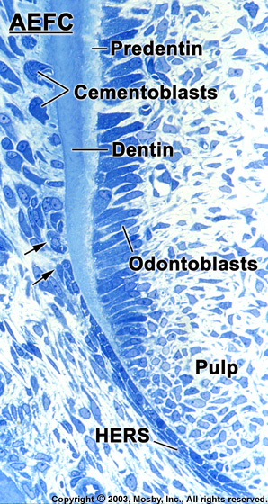
Development of Cementum
Cementum formation occurs along the
entire tooth
Hertwig’s epithelial root sheath (HERS) –
Extension of the inner and outer enamel
epithelium
HERS sends inductive signal to ectomesen-
chymal pulp cells to secrete predentin by
differentiating into odontoblasts
HERS becomes interrupted
Ectomesenchymal cells from the inner portion
of the dental follicle come in with predentin by
differentiating into cementoblasts
Cementoblasts lay down cementum

Slide 12
Cementoblasts
Derive from dental follicle

Slide 13
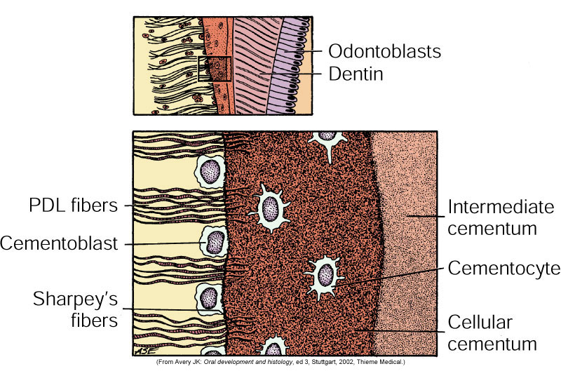

Slide 14
Properties of Cementum
Physical: Cementum is pale yellow with a dull surface
Cementum is more permeable than other dental tissues
Relative softness and the thinness at the cervical portion means
that cementum is readily removed by the abrasion when gingival
recession exposes the root surface to the oral environment

Slide 15
Chemical Composition of Cementum
45% to 50% hydroxyapatite (inorganic)
50% to 55% collagenous and noncollagenous matrix proteins
(organic)

Slide 16
Collagenous component
TYPE I
TYPE III
TYPE XII
TYPE V
TYPE XIV

Slide 17
Classification of Cementum
Presence or absence of cells
Origin of collagenous fibers of the matrix
Prefunctional and functional

Slide 18
Cellular and Acellular Cementum
Acellular cementum: covers the root
adjacent to dentin whereas cellular
cementum is found in the apical area
Cellular: apical area and overlying
acellular cementum. Also common in
interradicular areas
Cellular: Has cells
Acellular: No cells and has no structure
Acellular cementum (primary cementum)
Cellular Cementum (secondary cementum

Slide 19
A: Acellular cementum
B: Hyaline layer of Hopwell-Smith
C: Granular layer of Tomes
D: Root dentin
Cellular cementum usually overlies acellular cementum

Slide 20
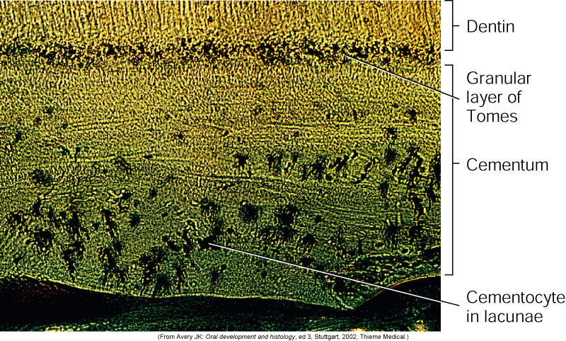
Acellular
Cellular
Variations also noted where acellular and cellular reverse in position
and also alternate

Slide 21
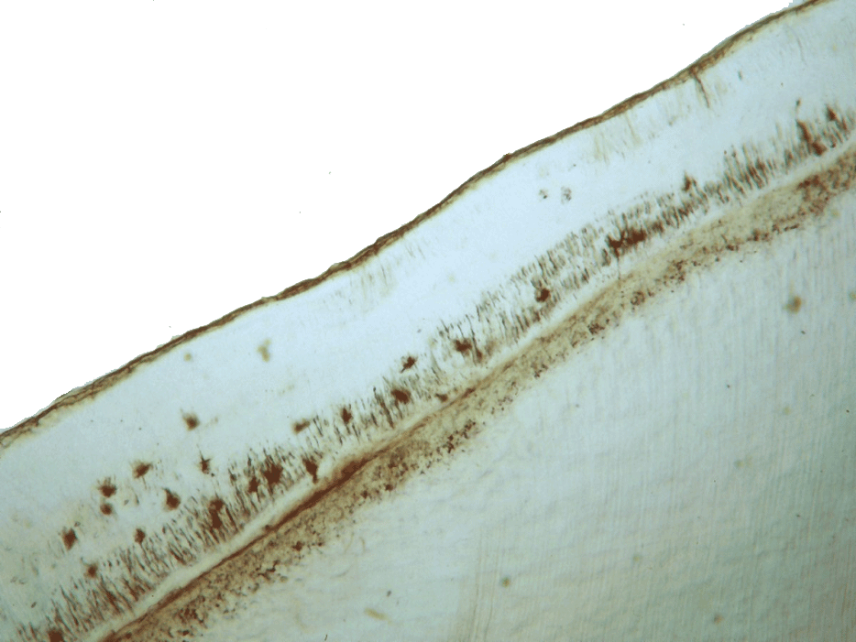
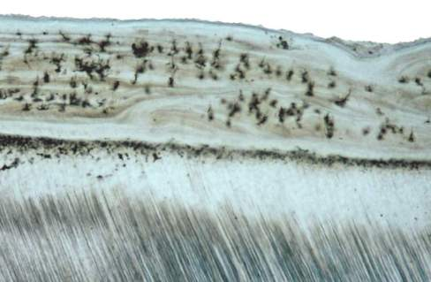
CEMENTUM
Canaliculus
GT
Lacuna of cementocyte
Dentin
Acellular cementum
Cellular cementum
Hyaline layer
(of Hopewell Smith)
Granular layer of tomes
Dentin with tubules

Slide 22
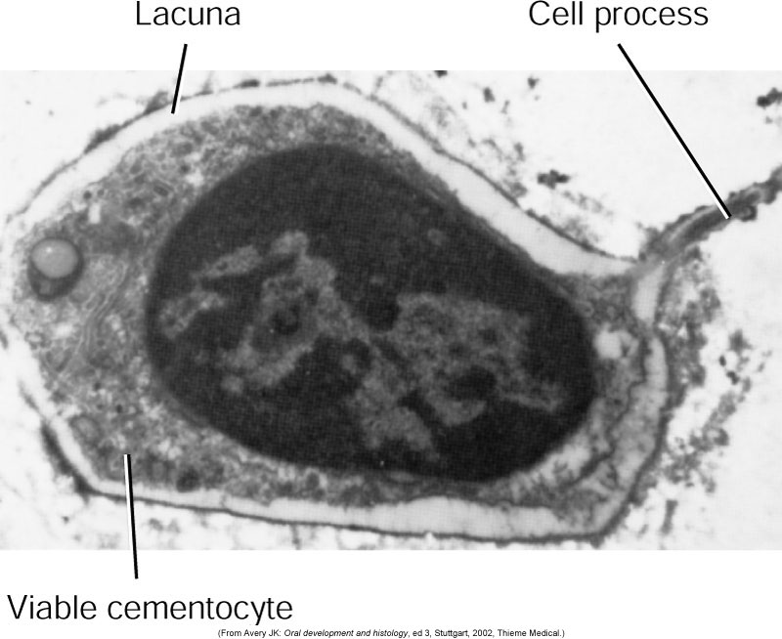
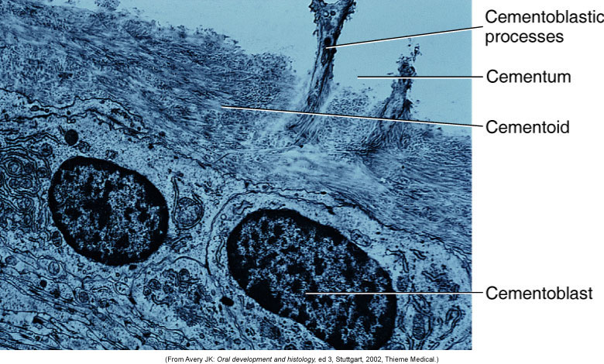
Cementoblast and cementocyte
Cementocytes in lacunae and the channels that their processes extend are
called the canaliculi
Cementoid: Young matrix that becomes secondarily mineralized
Cementum is deposited in increments similar to bone and dentin

Slide 23
Classification Based on the Nature and Origin of Collagen Fibers
Organic matrix derived form 2 sources:
Periodontal ligament (Sharpey’s fibers)
Cementoblasts
Extrinsic fibers if derived from PDL. These are in the same
direction of the PDL principal fibers i.e. perpendicular or
oblique to the root surface
Intrinsic fibers if derived from cementoblasts. Run parallel to
the root surface and at right angles to the extrinsic fibers
The area where both extrinsic and intrinsic fibers is called
mixed fiber cementum

Slide 24
Combined classification
Acellular Extrinsic Fiber Cementum (AEFC-Primary Cementum)
Located in cervical half of the root and constitutes the bulk of cementum
The collagen fibers derived from Sharpey’s fibers and ground substance from cementoblasts
Covers 2/3rds of root corresponding with the distribution of primary acellular cementum
Principal tissue of attachment
Function in anchoring of tooth
Fibers are well mineralized

Slide 25
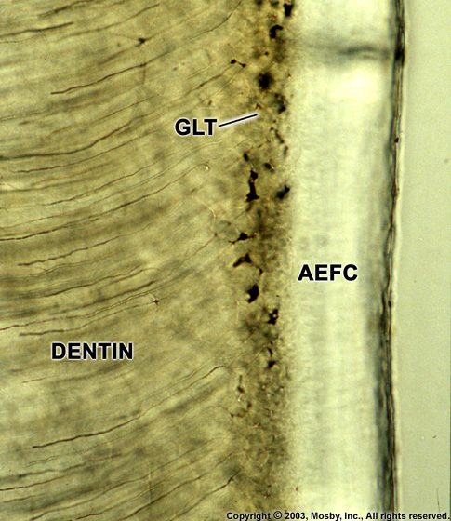
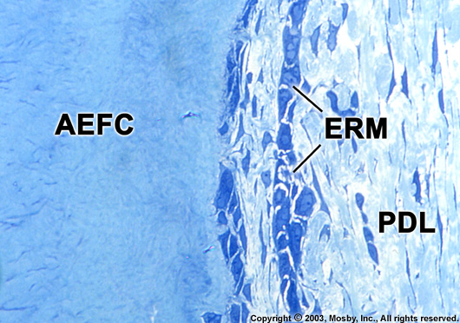

Slide 26
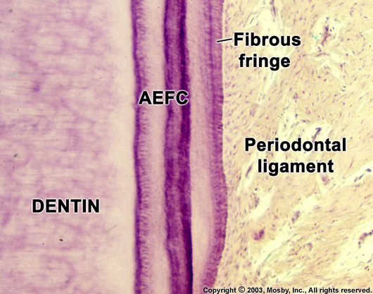
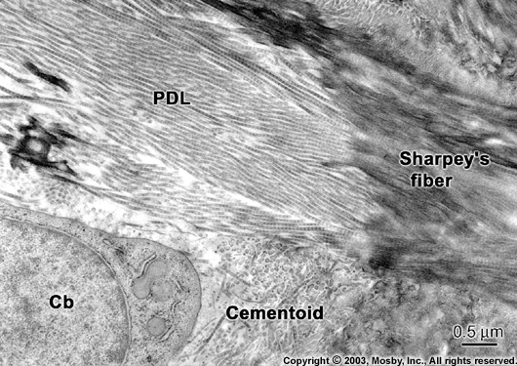

Slide 27
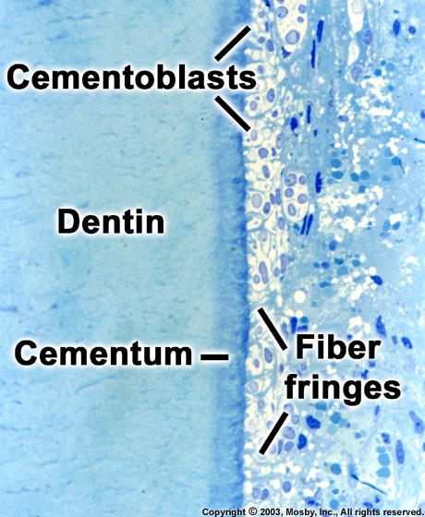

Slide 28
Distribution of Cementum on the Root
Acellular afibrillar: cervical enamel
Acellular extrinsic: Cervix to practically the whole root (incisors, canines) increasing in thickness towards the apical portion 50→200μm
Cellular: Apical third, furcations

Slide 29
Cemento-enamel junction(CEJ)
Cementum overlaps enamel 60%
Cementum just meets enamel 30%
Small gap between cementum and enamel 10%

Slide 30
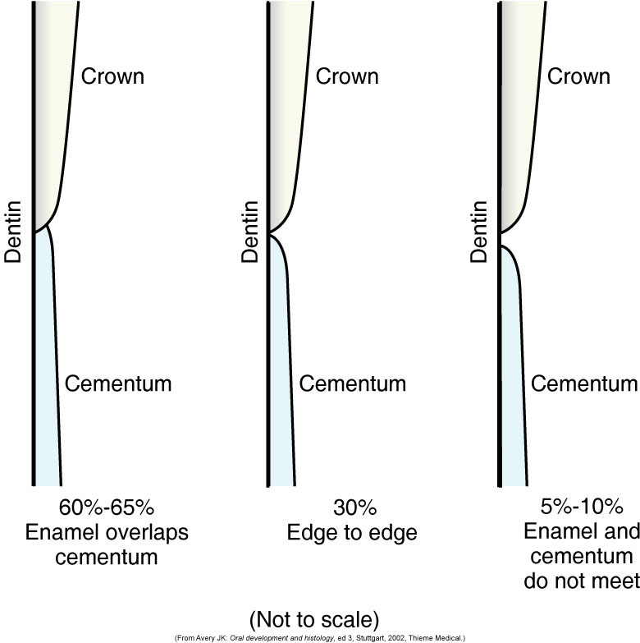

Slide 31
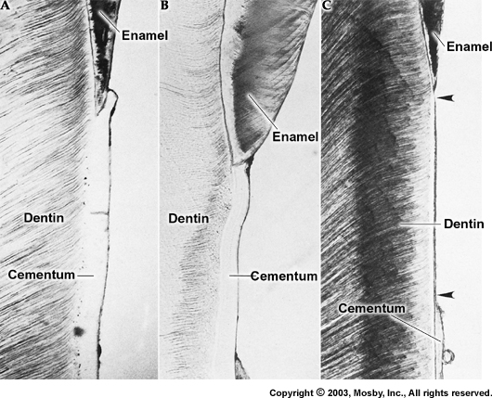

Slide 32
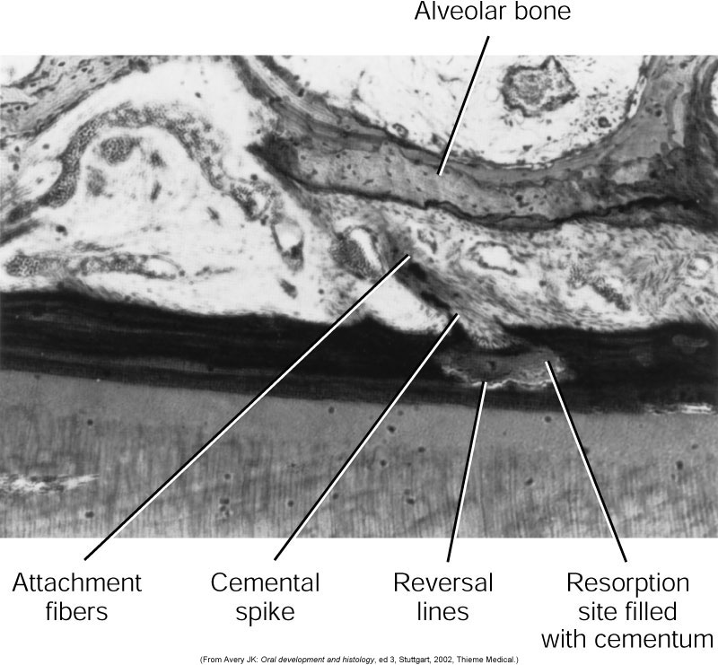
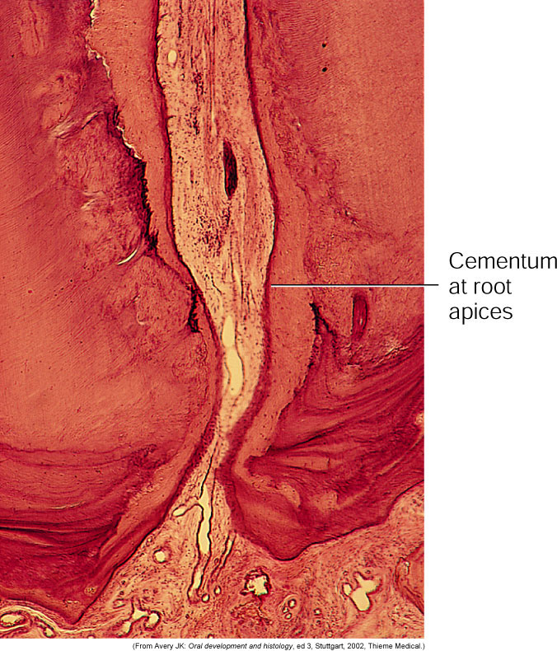
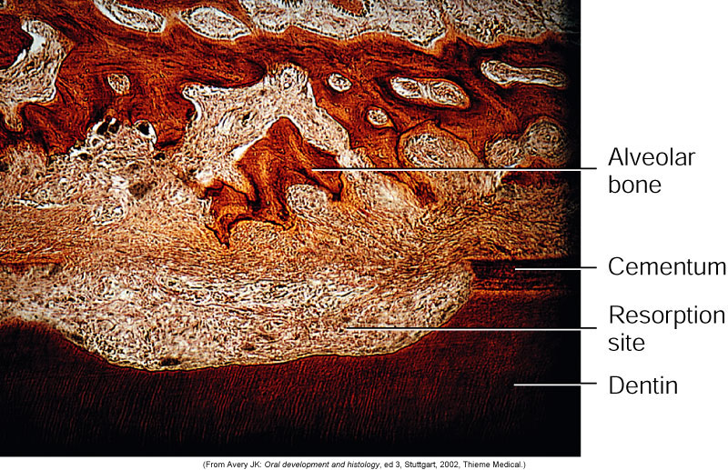
Aging of Cementum
Smooth surface becomes irregular due
to calcification of ligament fiber bundles
where they are attached to cementum
Continues deposition of cementum occurs
with age in the apical area.
[Good: maintains tooth length; bad:
obstructs the foramen]
Cementum resorption. Active for a period
of time and then stops for cementum
deposition creating reversal lines
Resorption of root dentin occurs with aging
which is covered by cemental repair

Slide 33
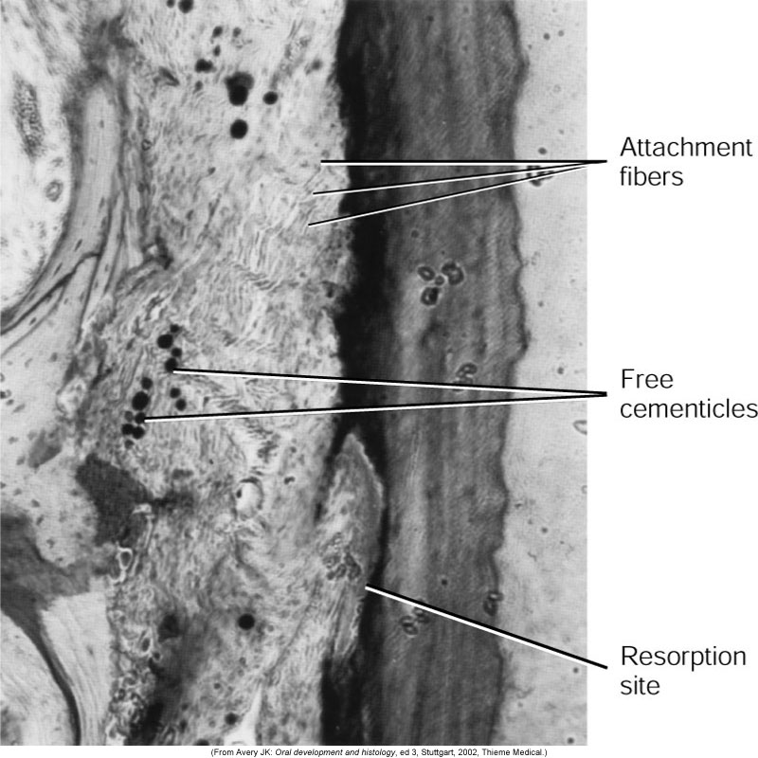
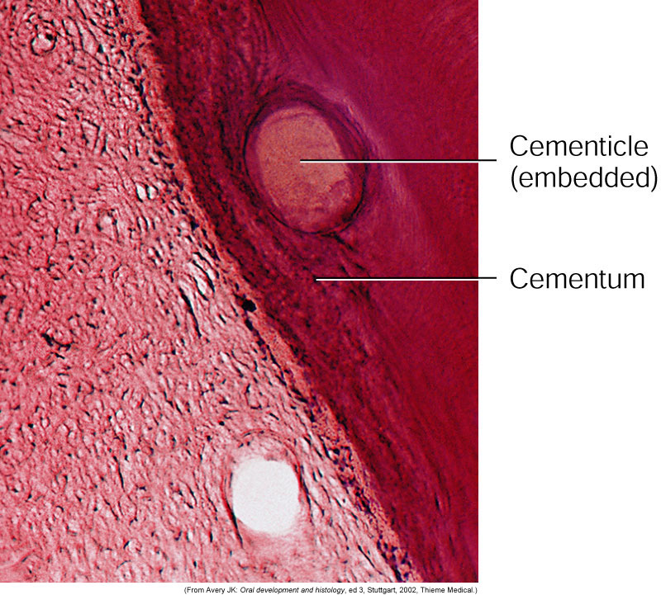
5.Cementicles
Calcified ovoid or round nodule found
in the PDL
Single or multiple near the cemental surface
Free in ligament; attached or embedded
in cementum
Aging and at sites of trauma

