Slide 1
ENAMEL

Slide 2
PHYSICAL CHARACTERSTICS
On the cusps of human molars and premolars the enamel attains a maximum thickness of about 2 to 2.5mm, thinning down to almost a knife edge at the neck of the tooth.
It is the hardest calcified tissue in the human body.
It is brittle in nature.
The specific gravity of enamel is 2.8.
The color of the enamel covered crown ranges from yellowish white to grayish white.

Slide 3
Incisal areas may have a bluish tinge where the thin edge consists only of a double layer of enamel.
Acts like a semipermeable membrane, permitting complete or partial passage of certain molecules: C14- labeled urea, I, etc.
The function of enamel is to form a resistant covering of the teeth, rendering them suitable for mastication.

Slide 4
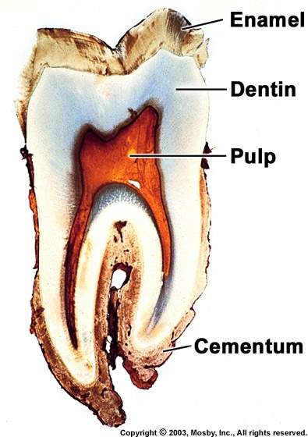

Slide 5
CHEMICAL PROPERTIES
Consists mainly of inorganic material (96%) and only a small amount of organic substance and water.
The relative space occupied by the4% organic material and water and the entire enamel is almost equal.

Slide 6
STRUCTURE
The enamel is composed of enamel rods or prisms, rod sheaths, and in some regions a cementing interprismatic substance.
The number of enamel rods ranges from 5 million in the lower lateral incisors to 12 million in the upper first molars.
From the dentinoenamel junction the rods run somewhat tortuous courses outward to the surface of the tooth.
The length of most rods is greater than the thickness of enamel because of the oblique direction & the wavy course of the rods.

Slide 8
SUBMICROSCOPIC STRUCTURE
The most common pattern is a key-hole or paddle-shaped prism in human enamel.
The rods measure about 5 um in breadth & 9 um in length.
The bodies of the rods are nearer occlusal & incisal surfaces, whereas the tails point cervically.
The apatite crystals are oriented parallel to the long axes of the rods in their bodies or heads & deviate about 65 degrees from their axes as they fan out into the tails of the prisms.
The rods are segmented because the enamel matrix is formed in a rhythmic manner.

Slide 9
KEY HOLE SHAPED ENAMEL ROD

Slide 10
HUNTER- SCHREGER BANDS
The more or less regular change in the direction of rods may be regarded as a functional adaptation, minimizing the risk of cleavage in the axial direction under the influence of occlusal masticatory forces.
The change in the direction of rods is responsible for the appearance of the Hunter- Schreger bands.
These are alternating dark and light strips of varying widths seen in longitudinal ground section.

Slide 12
INCREMENTAL LINES OF RETZIUS
Appear as brownish bands in ground sections of the enamel.
Illustrate the successive apposition of layers of enamel during the formation of crown.
In longitudinal sections they surround the tip of the dentin.
In cervical parts of the crown they run obliquely.
From the dentinoenamel junction to the surface they deviate occlusally.
In transverse sections of a tooth, they appear as concentric circles.

Slide 17
The enamel of the deciduous tooth develops partly before & partly after birth.
The boundary between the two portions of enamel in the deciduous teeth is marked by an accentuated incremental line of retzius, the neonatal line or neonatal ring.

Slide 18
Hypocalcified structures in E. 1. ENAMEL LAMELLAE
Thin leaf like structures that extend from the enamel surface toward the dentinoenamel junction.
May sometimes extend to dentin.
Consist of organic material, with but little mineral content.
Develop in planes of tension.

Slide 19
Three types of lamella
May be a site of weakness in a tooth & may form a road of entry for bacteria that initiate caries.

Slide 21
2.ENAMEL TUFTS
Arise at the dentinoenamel junction & reach into the enamel.
Resemble tufts of grass when viewed in ground sections.
Is a narrow, ribbon like structure.
Consists of hypocalcified enamel rods & interprismatic substance.
Act to prevent enamel fractures, stress-shielding to increase compliance with dentin.

Slide 23
3. Enamel spindle
Represent extension of odontoblast process through enamel before it’s fully mature

Slide 25
DENTINOENAMEL JUNCTION
The surface of the dentin at the dentinoenamel junction is pitted.
Into the shallow depressions of the dentin fit rounded projections of the enamel.
This relation assures the firm hold of enamel cap on dentin.
Is scalloped.
The convexities of the scallops are directed toward the dentin.

Slide 27
Clinical considerations
Ameloblasts are lost after the enamel has been laid down ,therefore enamel could not be repaired by itself ,it only repaired by filling material.

Slide 28
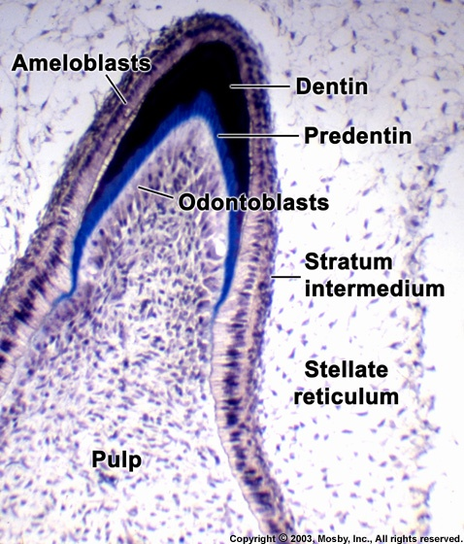
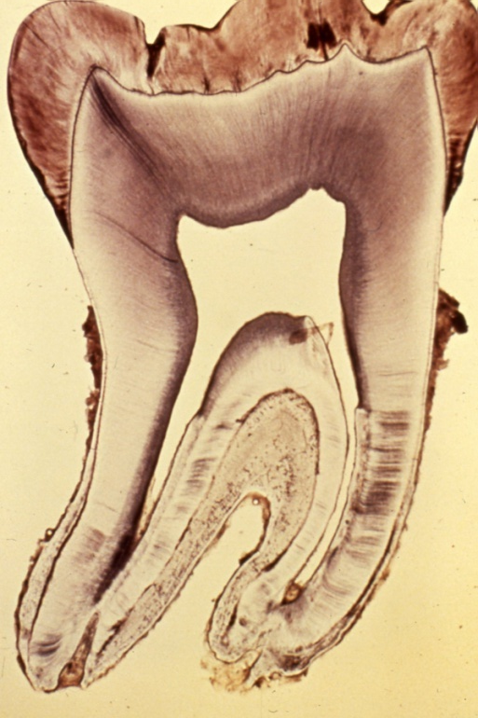
Amelogenesis
Begins first at cusp tips
Then sweeps down crown slopes
Stops at CEJ

Slide 29
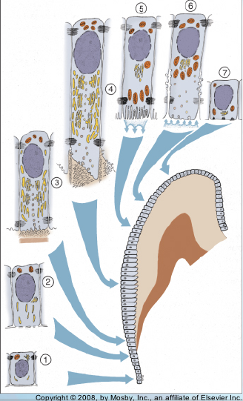
Amelogenesis - Life Cycle of Ameloblasts
Functional stages in life cycle of ameloblasts:
Morphodifferentiation
Histodifferentiation
3. Secretory (initial)
4. Secretory (Tomes’ process)
Maturation (ruffle-ended)
Maturation (smooth-ended)
Protective

Slide 30
Ameloblast
Ameloblasts are derived from oral epithelium tissue of ectodermal origin. Their differentiation from preameloblasts (whose origin is from inner enamel epithelium) is a result of signaling from the ectomesenchymal cells of the dental papilla.
The ameloblasts will only become fully functional after the first layer of dentin (predentin) has been formed by odontoblasts. Then the cells be part of the reduced enamel epithelium after enamel maturation and then are subsequently lost during tooth eruption

Slide 31
Ameloblast in formative stage
Each ameloblast is a columnar cell approximately 4 micrometers in diameter, 40 micrometers in length and is hexagonal in cross section. The secretory end of the ameloblast ends in a six-sided pyramid-like projection known as the Tomes' process. The angulation of the Tomes' process is significant in the orientation of enamel rods, the basic unit of tooth enamel.

Slide 32
Amelogenesis - Maturation Stage
Maturation Process:
Removal of water & organic material
Introduction of additional inorganic material
Process = “Modulation”
cyclic creation, loss, and recreation of highly invaginated ruffle-ended apical surface on ameloblasts

Slide 33
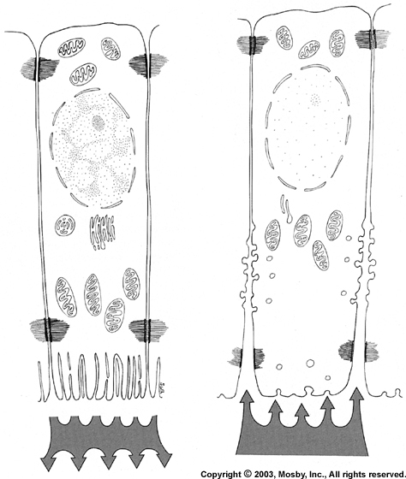
Amelogenesis - Maturation Stage
Ameloblasts
incorporation of inorganic material
Ameloblasts
exit of protein fragments & water
Ruffle-ended
Smooth-ended

Slide 34
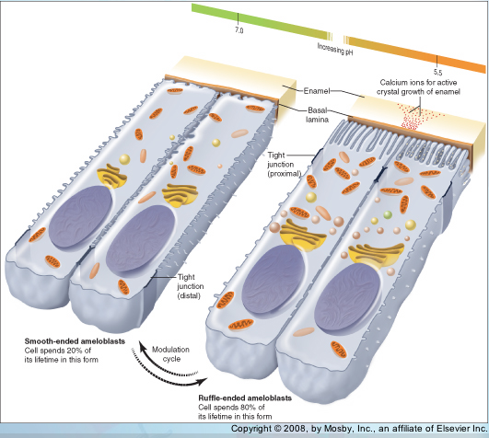
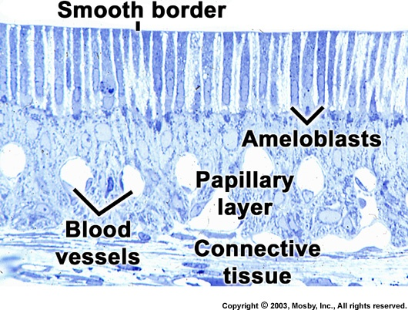
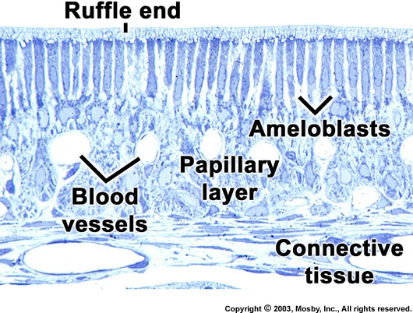
Amelogenesis - Maturation Stage

Slide 35
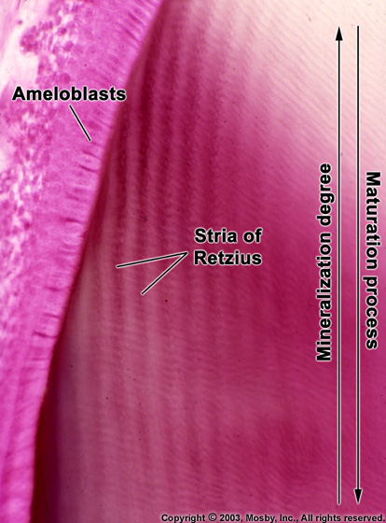
Amelogenesis - Maturation Stage
Enamel hardens before tooth erupts
Results from growth in width, thickness of crystals
Amelogenesis slow process
almost mature enamel, most mineral removed

Slide 36
Amelogenesis - Enamel Proteins
Enamel Proteins:
1. Contributing to appositional growth, thickness enamel * Amelogenin (main protein in forming enamel) * Ameloblastin * Enamelin

Slide 37
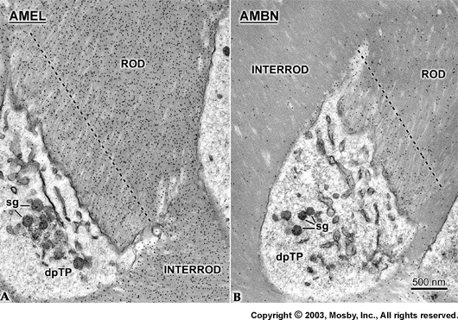
Amelogenesis - Enamel Proteins
Amelogenin vs Ameloblastin

Slide 38
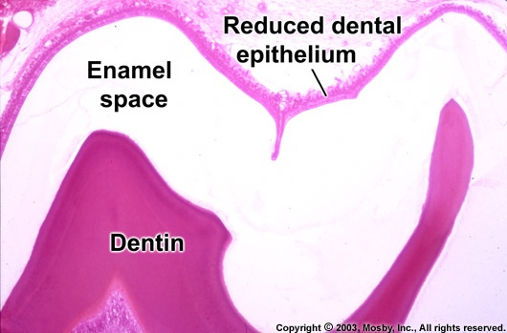
Protective Stage
Full thickness of enamel complete, enamel mature
Ameloblast layer & papillary layer form “reduced enamel epithelium”
What is the enamel space?

Slide 39
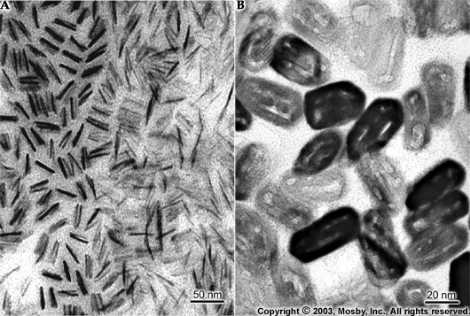
Enamel - Structure
Crystals
hexagonal contour to older mature crystals
recently formed thin crystals

Slide 40
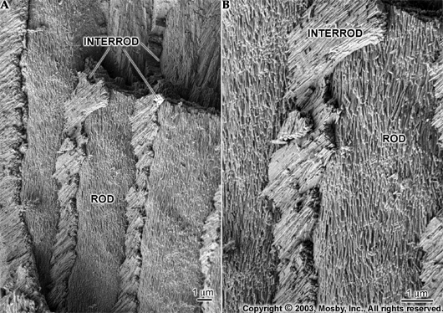
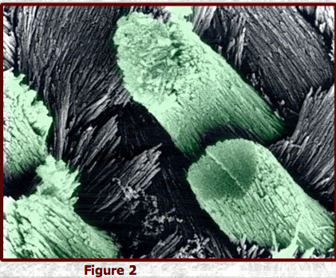
Enamel - Structure
Aapd.org/publications/peddent/
Note: rod, interrod crystals same, but divergent orientation

Slide 41
Enamel - Structure
Crystals
hexagonal contour to older mature crystals
recently formed thin crystals

Slide 42
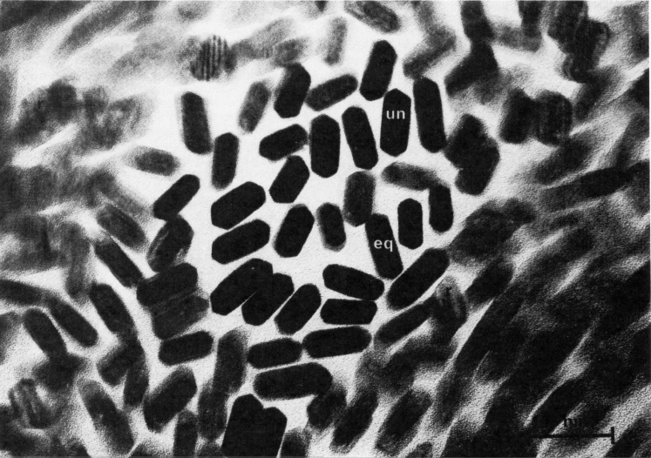
Enamel - Structure
Crystal Profiles
hexagons with unequal-sided peaks (un) & equal-sided peaks (eq) x 300,000 (rat incisor)

Slide 43
THANK YOU

