Slide 1
DENTIN
Provides the bulk and general form of tooth.
Determines the shape of the crown.
Physically & chemically the dentin closely resembles the bone.
The main morphologic difference between bone & dentin is that some of the osteoblasts that form bone marrow enclosed within its matrix substance as osteocytes, whereas the dentin contains only the processes of the cells that form it.
Both are considered vital tissue because they contain because they contain living protoplasm.

Slide 2
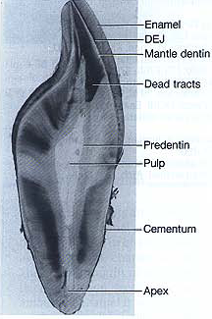
RELATIONSHIP BETWEEN ENAMEL, DENTIN AND PULP

Slide 3
PHYSICAL PROPERTIES
It is light yellowish in color, becoming darker with age.
It is elastic and subject to slight deformation.
Harder than bone but softer than enamel.
Lower content of mineral salts in dentin renders it more radiolucent than enamel.

Slide 4
CHEMICAL PROPERTIES
Consists of 35% organic matter and water & 65% inorganic material.
The organic substance consists of collagenous fibrils and a ground substance of mucopolysaccharides (proteoglycans and glycos aminoglycans).
The inorganic component consists of hydroxyapetite as in bone, cementum & enamel.
Organic constituents can be removed from the mineral by incineration or organic chelation.

Slide 5
STRUCTURE
The bodies of the odontoblasts are arranged in a layer on the pulpal surface of the dentin, and only their cytoplasmic processes are included in the tubules in the mineralized matrix.
Each cell gives rise to one process, which traverses the predentin & calcified dentin within one tubule.
Terminates in a branching network at the junction with enamel or cementum.
Tubules are found throughout normal dentin & are therefore characteristic of it.

Slide 6
DENTINAL TUBULES
The course follows a gentle curve in the crown, less so in the root, where it resembles S in shape.
Starting at right angles from the pulpal surface, the first convexity of this doubly curved course is directed toward the apex of the tooth.
These tubules end perpendicular to the dentinoenamel and dentinocementum junctions.
Near the root tip & along the incisal edges and cusps the tubules are almost straight.

Slide 7

‘S’ CURVATURE OF DENTINAL TUBULES

Slide 8
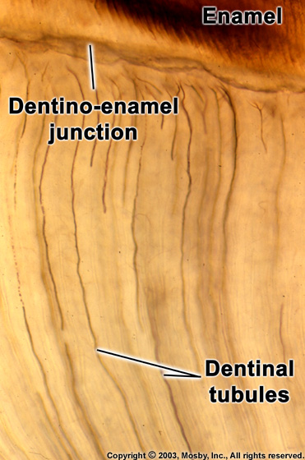

Slide 9
The ratio between the outer and inner surfaces of dentin is about 5:1.
The ratio between the numbers of tubules per unit area on the pulpal and outer surfaces of dentin is about 4:1.
There are more tubules per unit area in the crown than in the root.
The dentinal tubules have lateral branches throughout dentin, which are termed canaliculi or microtubules.
A few dentinal tubules extend through the dentinoenamel junction into the enamel. These are termed enamel spindles.

Slide 10
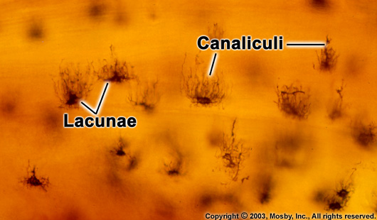

Slide 11
PERITUBULAR DENTIN
The dentin that immediately surrounds the dentinal tubules.
It is more highly mineralized than intertubular dentin.
It is twice as thick in outer dentin (approx. 0.75um) than in inner dentin (0.4um).

Slide 12
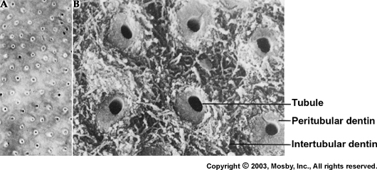

Slide 13
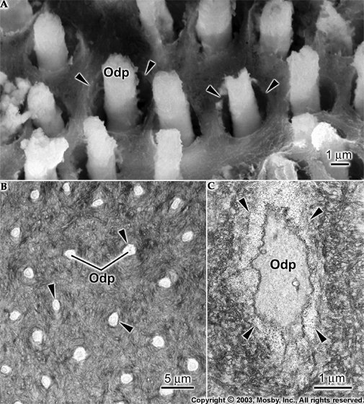

Slide 14
INTERTUBULAR DENTIN
Forms the main body of dentin.
It is located between the dentinal tubules or, more specifically, between the zones of peritubular dentin.
Its organic matrix is retained after decalcification.
About one-half of its volume is organic matrix, specifically collagen fibers. The fibrils range from 0.5 to 0.2um in diameter and exhibit crossbanding at 64um intervals, which is typical for collagen.

Slide 15
PREDENTIN
Is located adjacent to the pulp tissue.
Is 2 to 6 um wide, depending on the activity of the odontoblast.
It is the first formed dentin and is not mineralized.
As the collagen fibers undergo mineralization at the predentin- dentin front, the predentin then becomes dentin and a new layer of predentin forms circumpulpally.

Slide 16
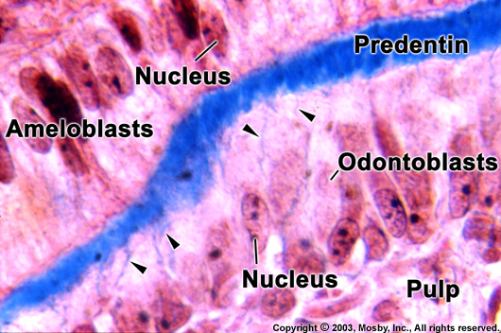

Slide 17
ODONTOBLAST PROCESS
They are the cytoplasmic extensions of the odontoblasts.
The odontoblasts reside in the peripheral pulp at the pulp- predentin border and their processes extend into the dentinal tubules.
The processes are largest in diameter near the pulp and taper further into dentin.
The odontoblast cell bodies are approximately 7um in diameter and 40um in length.

Slide 18
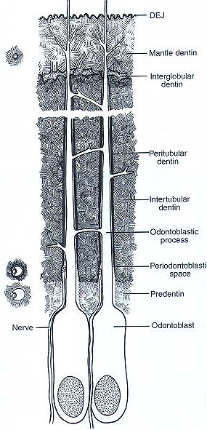
RELATIONSHIP BETWEEN ODONTOBLASTIC PROCESS AND DENTINAL TUBULE

Slide 19
PRIMARY DENTIN
Mantle dentin is the first formed dentin in the crown underlying the dentinoenamel junction.
It is the outer or most peripheral part of the primary dentin & is about 20um thick.
The fibrils found in this zone are perpendicular to the dentinoenamel junction.
Circumpulpal dentin forms the remaining primary dentin or bulk of the tooth.
Represents all of the dentin formed prior to root completion.
The fibrils are much smaller in diameter & are more closely packed together.
Slightly more mineral content than mantle dentin.

Slide 20
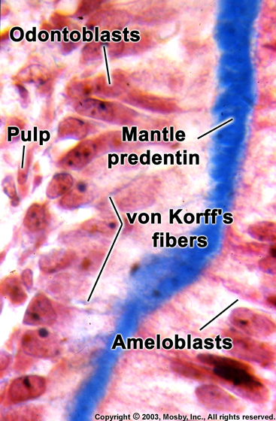

Slide 21
SECONDARY DENTIN
A narrow band of dentin bordering the pulp and representing the dentin formed after root completion.
Contains fewer tubules than primary dentin.
There is usually a bend in the tubules where primary and secondary dentin interface.

Slide 22
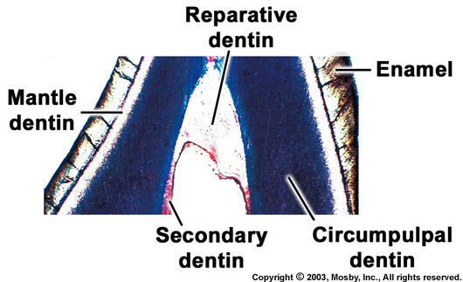

Slide 23
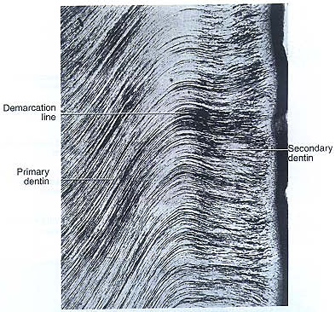

Slide 24
INCREMENTAL LINES
The incremental lines (von ebner), or imbrication lines, appear as fine lines or striations in dentin.
They run at right angles to the dentinal tubules.
These lines reflect the daily rhythmic, recurrent deposition of dentin matrix as well as hesitation in the daily formative process.
The course of the lines indicates the growth pattern of the dentin.
Some of the incremental lines are accentuated because of disturbances in the matrix and mineralization process. Such lines are known as contour lines of owen.

Slide 25
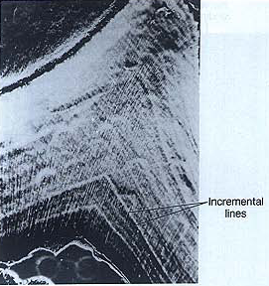

Slide 26
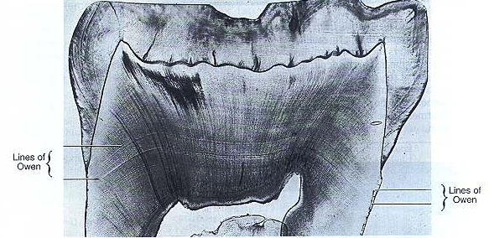

Slide 27
These lines represent hypocalcified bands.
In the deciduous teeth and in the first permanent molars, the prenatal and postnatal dentin is separated by an accentuated contour line. This is termed the neonatal line.
This line reflects the abrupt change in environment that occurs at birth.
The dentin matrix formed prior to birth is usually of better quality than that formed after birth.

Slide 28
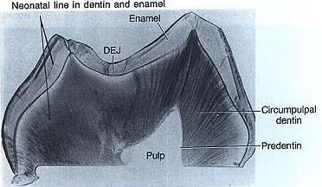

Slide 29
INTERGLOBULAR DENTIN
Sometimes mineralization of dentin begins in small globular areas that fail to fuse into a homogenous mass. This results in zones of hypomineralization between the globules. These zones are called interglobular dentin.
Forms in crowns of teeth in the circumpulpal dentin just below the mantle dentin.
Follows an incremental pattern.
The dentinal tubules pass uninterruptedly, thus demonstrating a defect of mineralization & not of matrix formation.

Slide 30
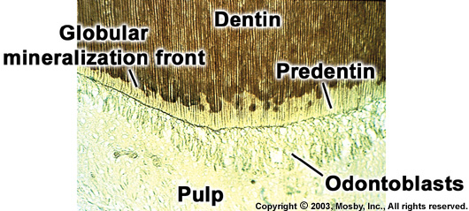

Slide 31
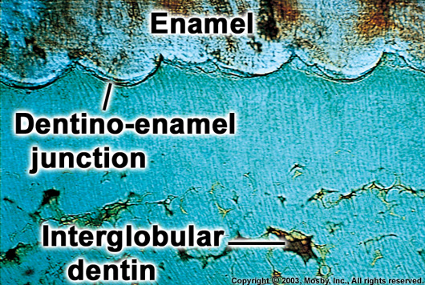

Slide 32
Tomes’GRANULAR LAYER
There is a zone adjacent to the cementum that appears granular. This is known as Tomes’ granular layer.
Caused by coalescing and looping of the terminal portions of the dentinal tubules.

Slide 33
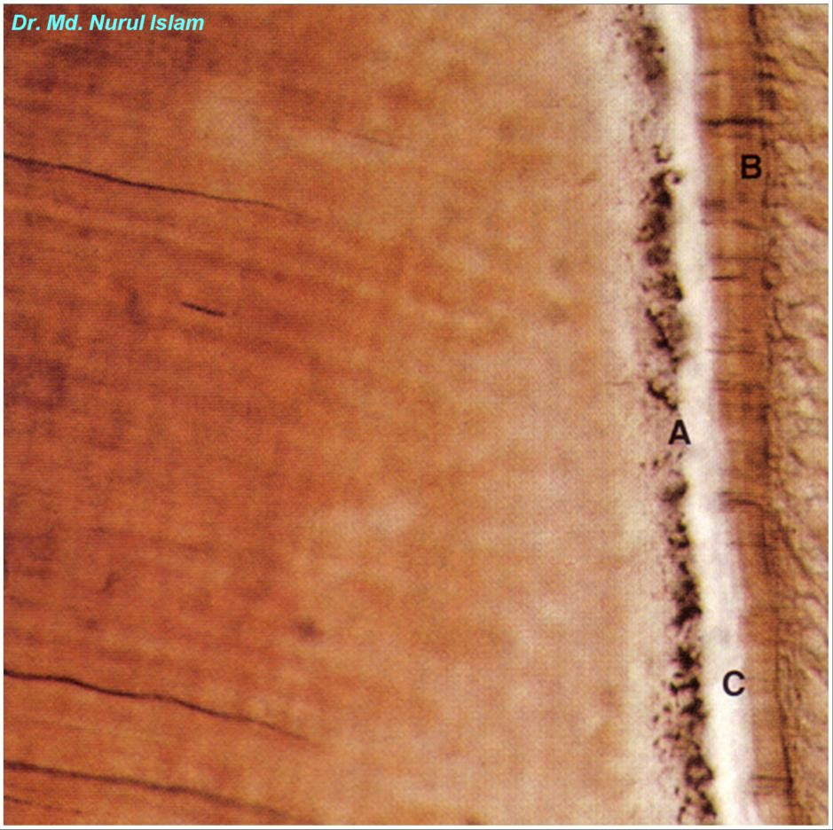
Dentin
Cementum
Granular layer
of Tomes
Hyaline layer

Slide 34
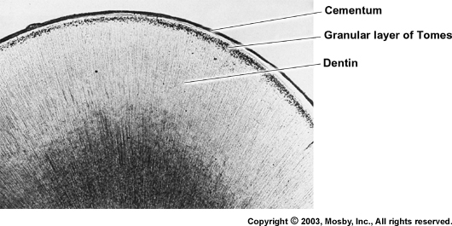

Slide 35
THEORIES OF PAIN TRANSMISSION THROUGH DENTIN
Direct conduction theory in which stimuli directly effect the nerve endings in the tubules.
Transduction theory in which the membrane of the odontoblast process conducts an impulse to the nerve endings in the predentin, odontoblast zone, and pulp.
Fluid or hydrodynamic theory in which stimuli cause an inward or outward movement of fluid in the tubule, which in turn produces movement of the odontoblast and its processes.

Slide 36
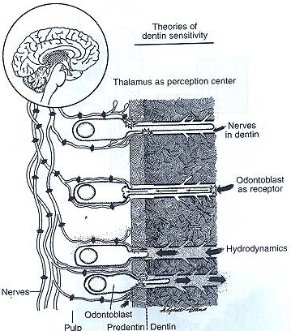

Slide 37
DEAD TRACTS
The odontoblast processes disintegrate, & the empty tubules are filled with air.
Appear black in transmitted light & white in reflected light.
Often observed in the area of narrow pulpal horns because of crowding of odontoblasts.
Demonstrate decreased sensitivity.
Appear to a greater extent in older teeth.
Probably the initial step in the formation of sclerotic dentin.

Slide 38
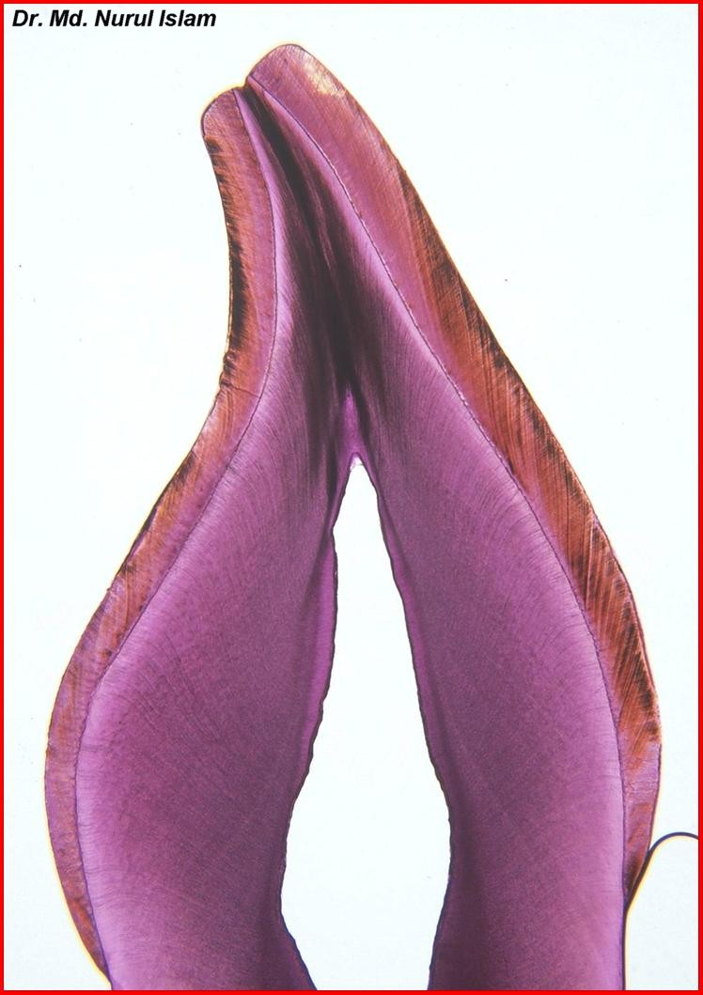
Dead tracts
Tertiary
dentin
Secondary
physiological
dentin
Primary
physiological
dentin

Slide 39
SCLEROTIC OR TRANSPARENT DENTIN
Collagen fibers and apatite crystals begin appearing in the dentinal tubules.
Apatite crystals are initially only sporadic in a dentinal tubule but gradually fill it with a fine meshwork of crystals.
Gradually, the tubule lumen is obliterated with mineral, which appears very much like the peritubular dentin.
The refractive indices of dentin in which the tubules are occluded are equalized, and such areas become transparent.
Found specially in roots.
Transparent or light in transmitted and dark in reflected light.

Slide 40
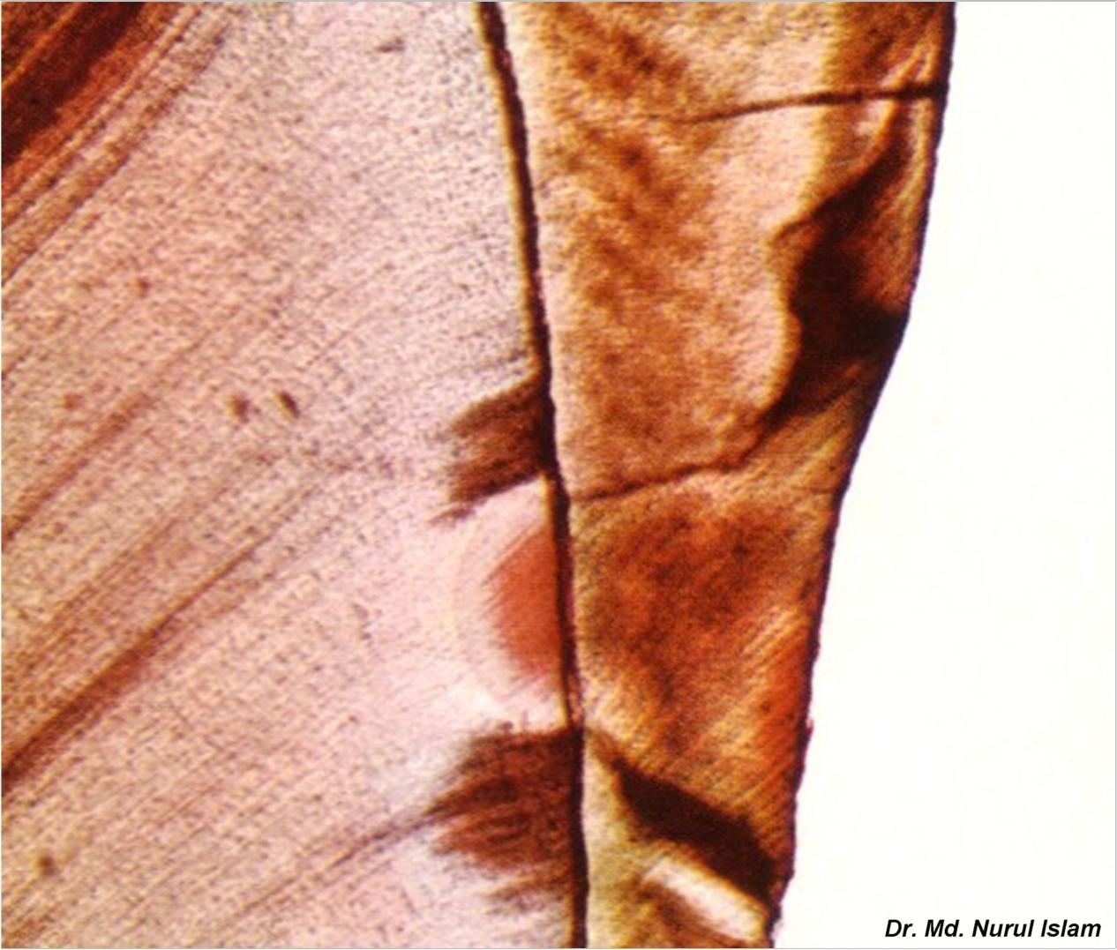
Sclerotic dentin
Deantal caries

Slide 41
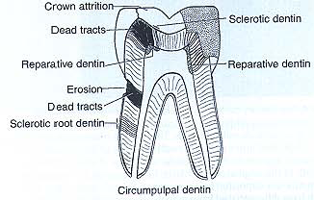

Slide 42
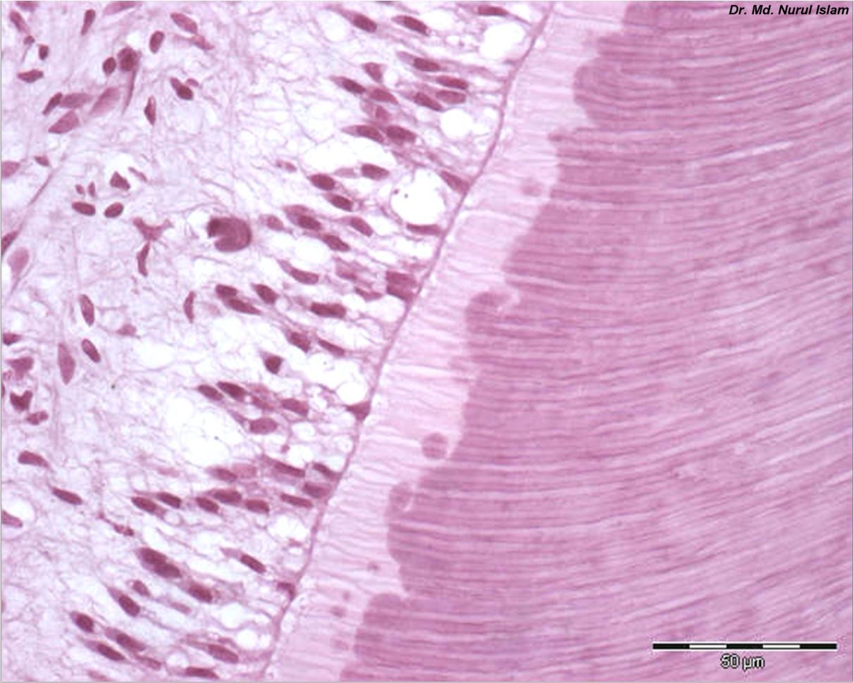
Odontoblast layer
Predentin
Dentinal tubules

