Slide 1

Impression techniques for partial edentulous area
Dr. Nagham Bahjat

Slide 2
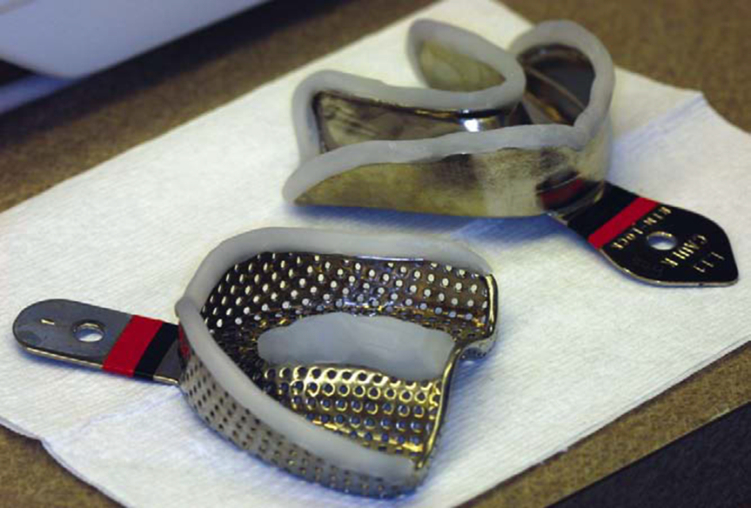
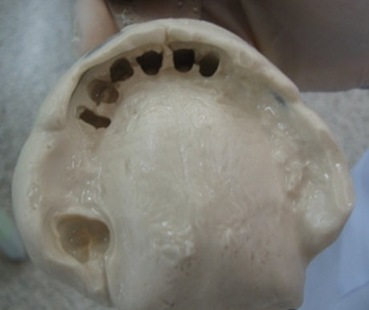
Primary impression
An impression of the partially edentulous arch must record accurately the
anatomic form of the teeth and
surrounding tissues.
This is necessary so that the prosthesis may be designed to follow a definite path of placement and removal and so that support, stability, and retention derived from the abutment teeth may be precise and accurate.

Slide 3
Secondary or definitive impression
An imprint that record the entire functional denture-bearing area to ensure maximum support, retention and stability for the denture during use.
Primary purpose
To record accurately the tissues of the denture bearing areas, in addition to recording the functional width and depth of the sulci.

Slide 4
Secondary impression
conventional
selective
functional

Slide 5
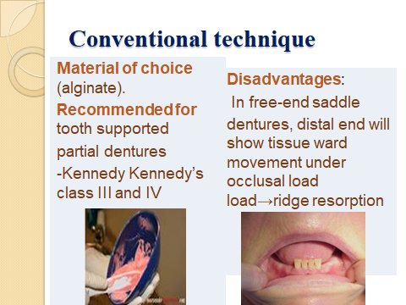

Slide 6
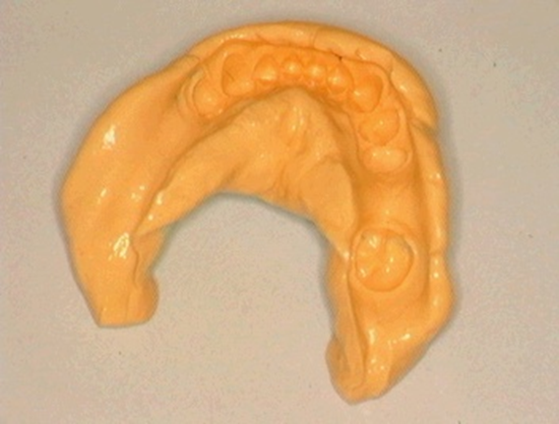
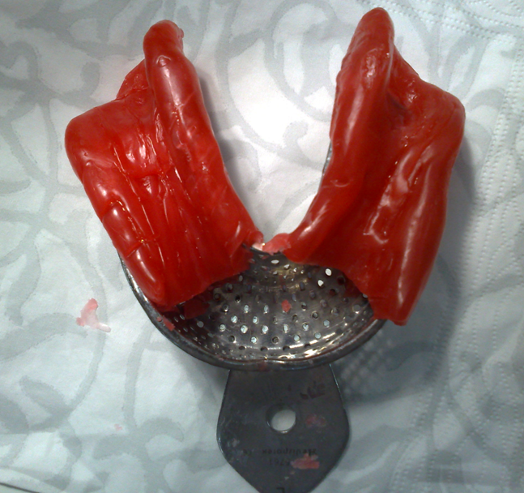
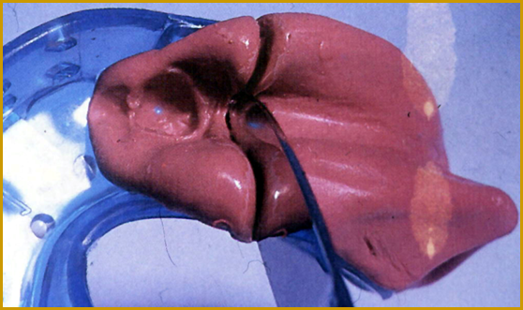
Conventional technique
Also known as
Anatomical or Mucostatic
The surface contour of the ridge is
recorded at its resting form ( no occlusal load)

Slide 7
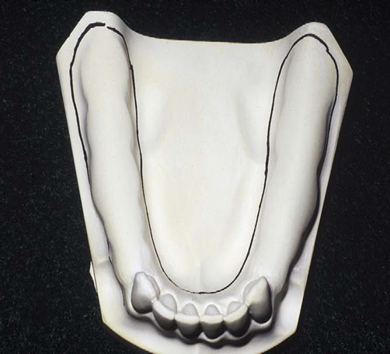
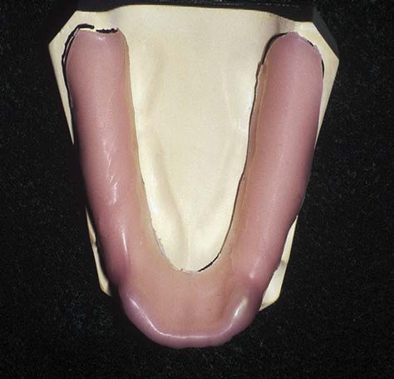
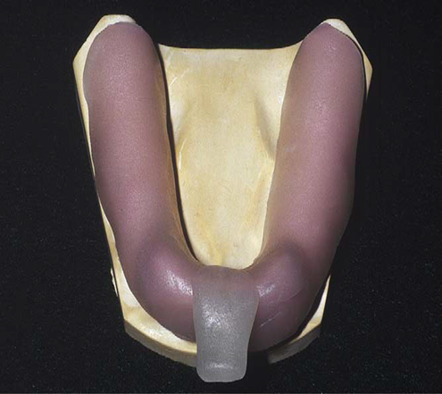
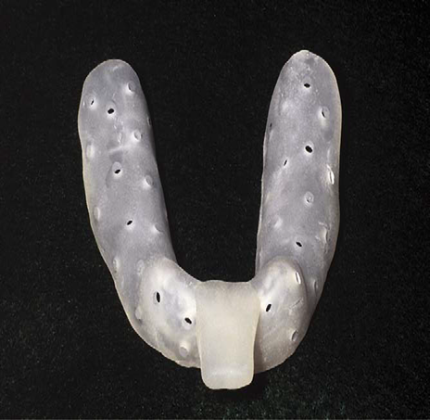

Slide 8
Selective pressure technique
Mucostatioc impression
AND
Mucocompressive impression

Slide 9
Support in free end saddle
Support from tooth (rest seat) and soft tissue (mucosa)
Tooth is rigid, mucosa is soft and displaceable during function, the free end saddle will be pushed towards the tissue and then bounces back. This movement may cause loosening of abutment tooth and resorption of alveolar bone.
The aim is to create minimum movement of the
denture base during function
Therefore, selective pressure technique may be used to achieve this.

Slide 10
2 techniques to achieve selective pressure impression
Functional dual impression technique
Altered cast technique

Slide 11
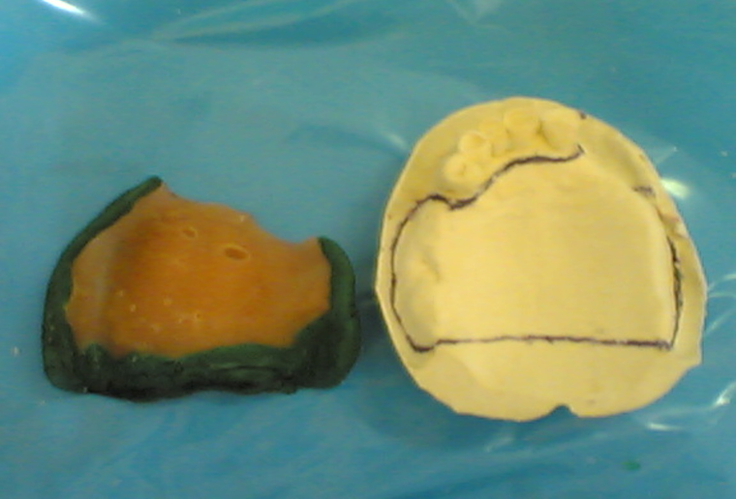
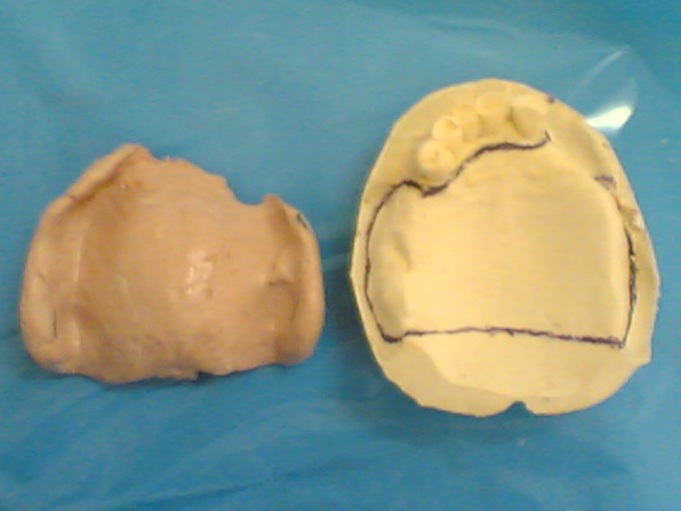
Functional dual impression
Impression of the edentulous ridge is made.
The 2nd impression made over functional impression and record structures in their anatomic form their form.

Slide 12
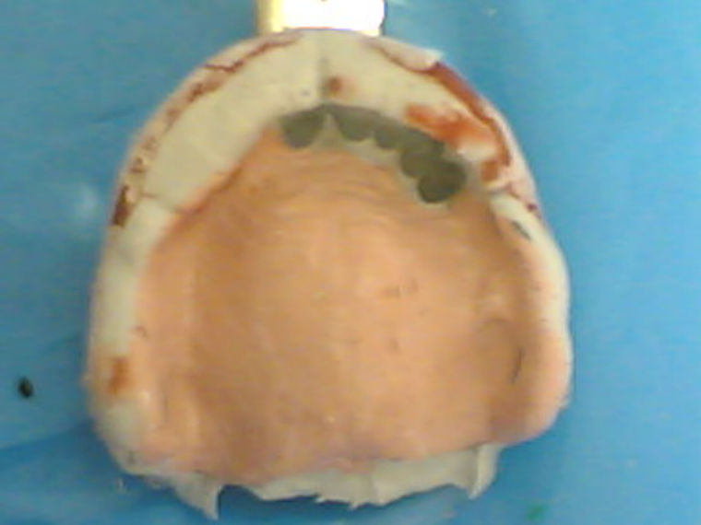

Slide 13
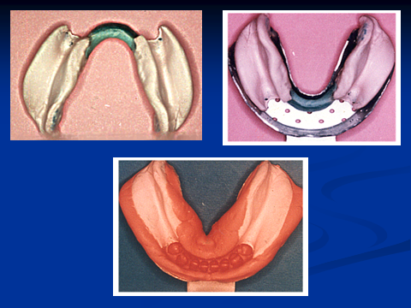

Slide 15
Altered cast technique
Anatomical master impression of oral structure is made.
Construct master cast and refractory cast.
Construct metal framework with temporary self self-cured acrylic resin saddle.

Slide 16
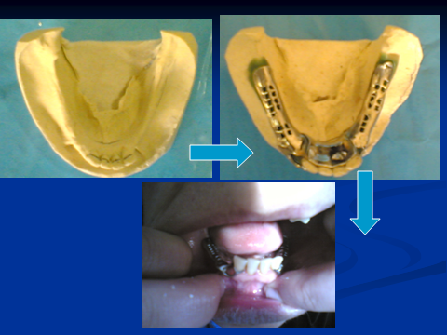

Slide 17
Special tray construction for selective pressure technique

Slide 18
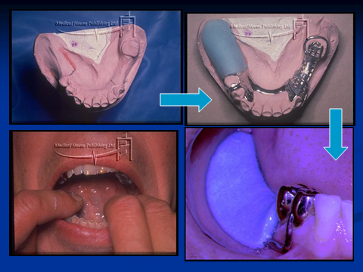

Slide 19
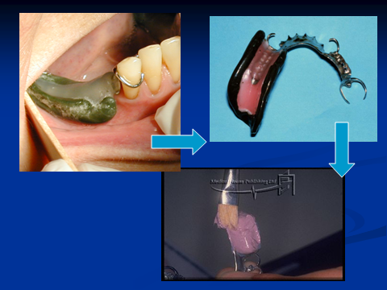

Slide 20
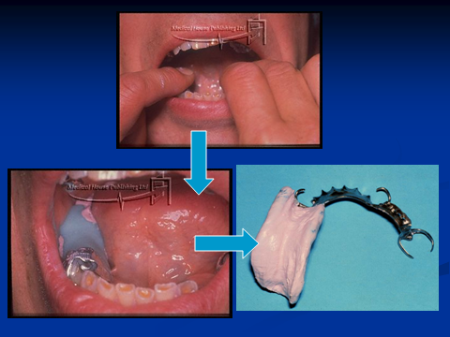

Slide 21
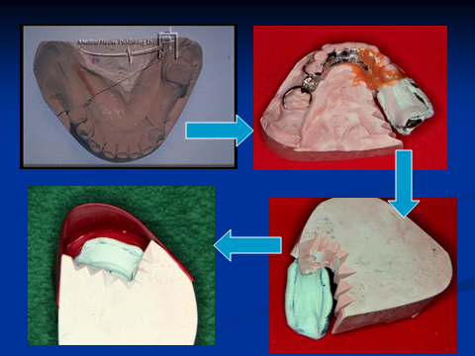

Slide 22
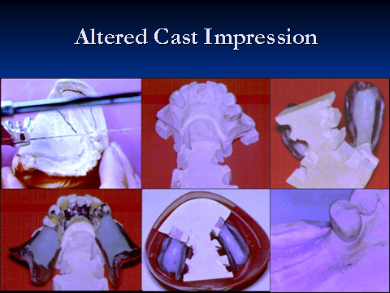

Slide 23
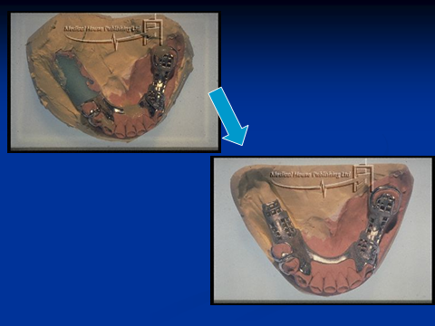

Slide 24

Thank you

