Slide 1
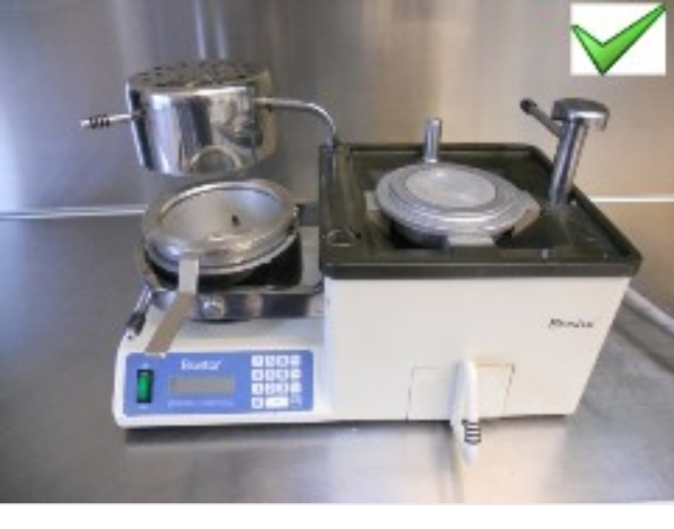
Technical Devices
Biostar Vacuum device
Dr. Nagham Bahjat
Dr. Teeba Amer
Lecturer. Shaymaa Majid
Tec. Sawsab Mohsen

Slide 2
Vacuum formers in the dental industry are used to
imprint opposing bite and fabricate other dental
appliances like sports mouth guards, bleach trays
and orthodontic appliances.
These formers can use a variety of thermoplastics
depending on necessary thickness and flexibility
needed.

Slide 3
• A vacuum former should be composed of a vacuum pump and a heating element also known as thermoforming

Slide 4
Upper Frame
Stop Hole
Hexagon Post
Hole Plate
Handle for Sliding Plate
Sliding Plate (Clamp)
Release Handle
Main Frame
Timer
Indicate Light
Switch

Slide 5
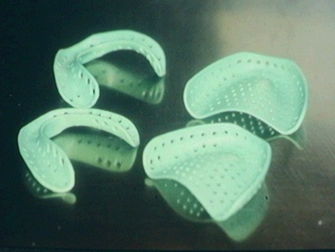
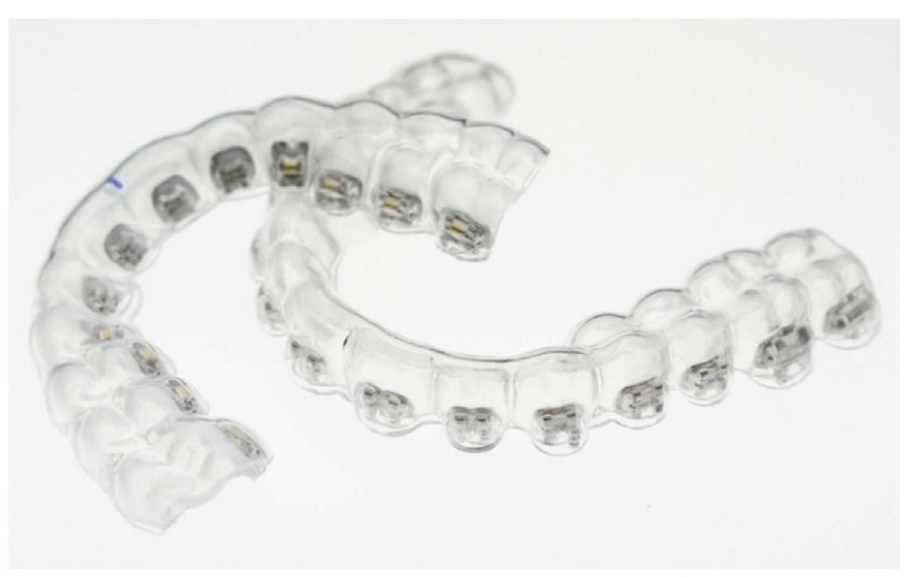
Uses of vacuum formers
Retainers
Indirect Bonding Trays
Special Trays
Bleaching Trays
Splints or mouth Guard
Temporary Base Plates
Temporary Crowns

Slide 6
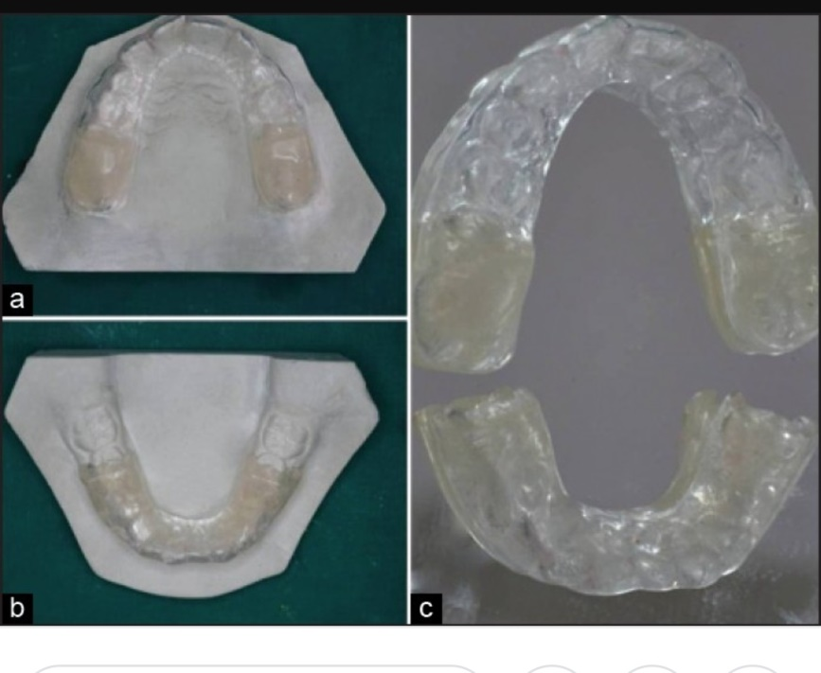
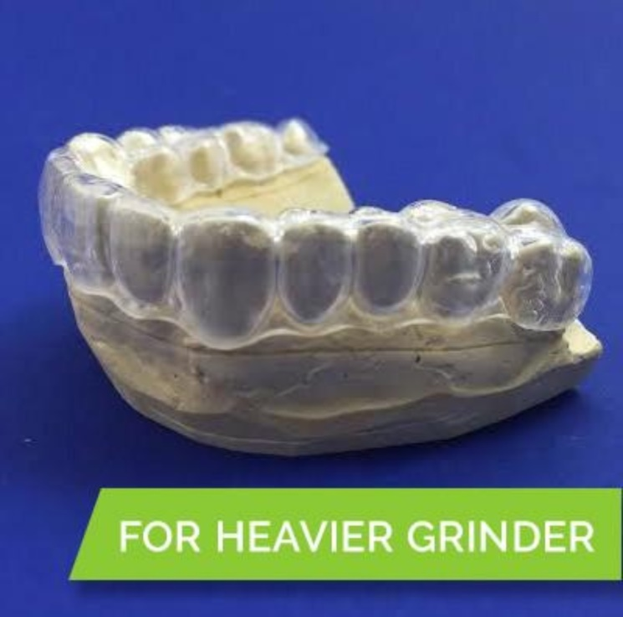
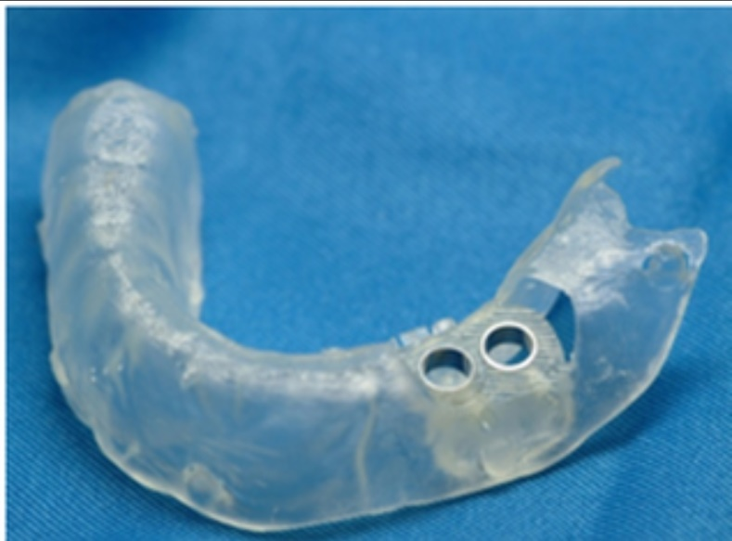
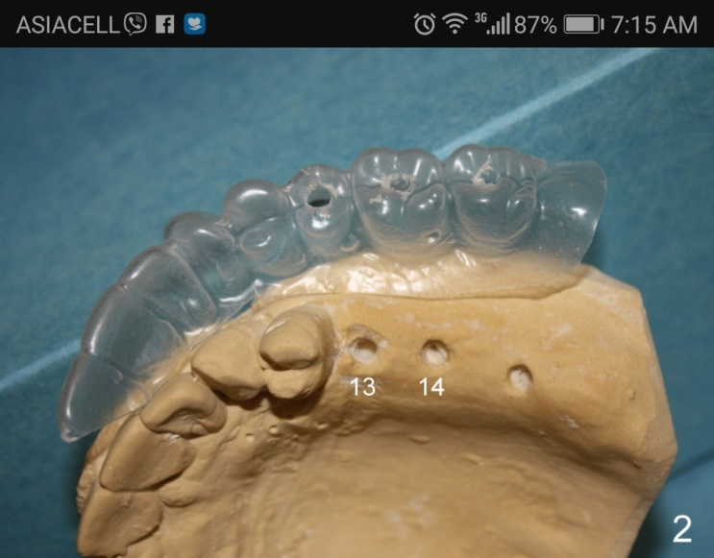
Uses of vacuum former

Slide 7

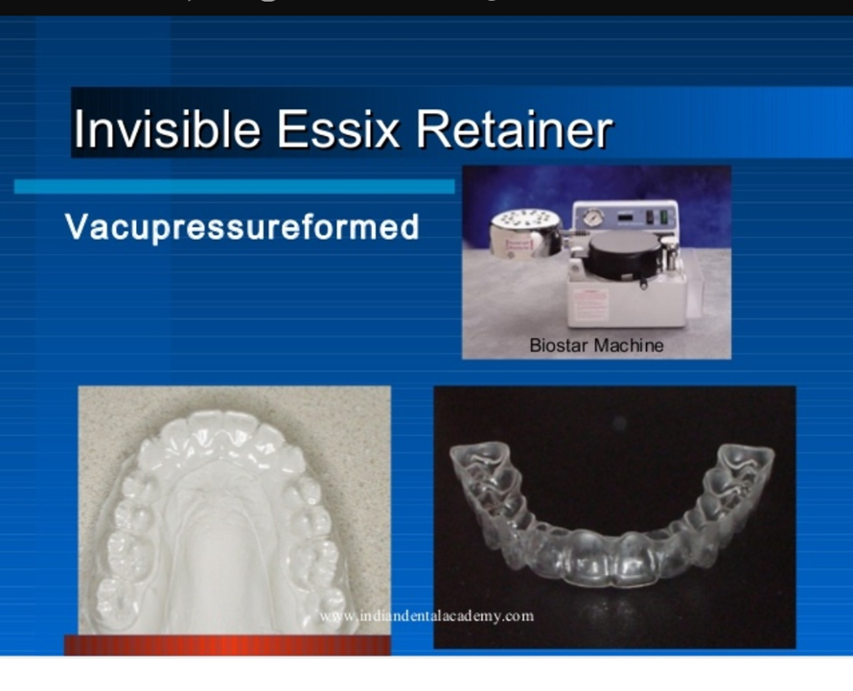

Slide 8

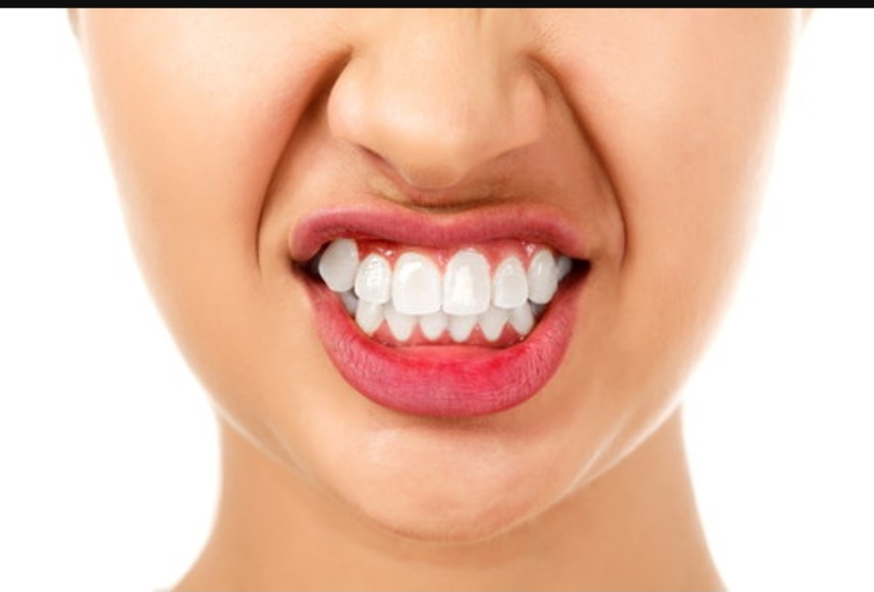
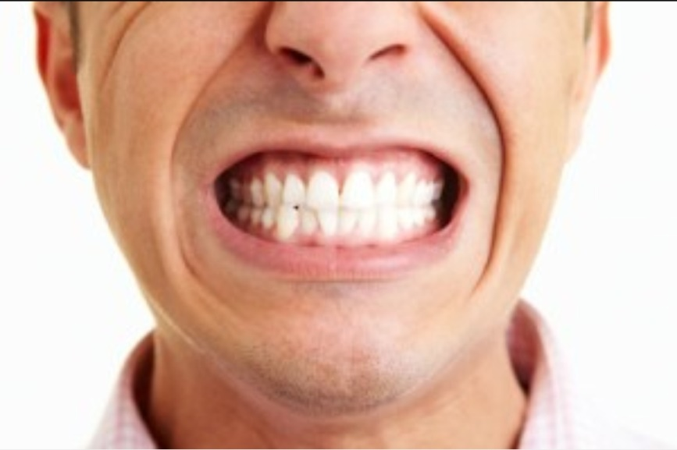

Slide 9

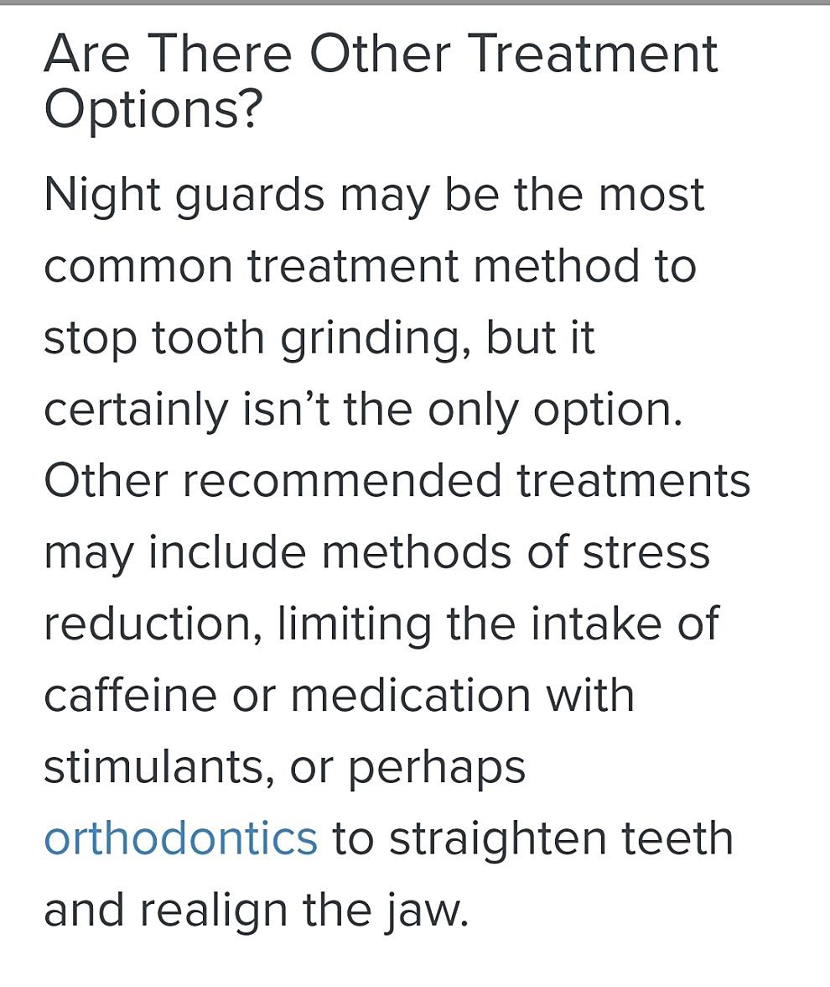

Slide 10
Types
Mini Star Pressure Forming
Machine
Uses a pressure thermoforming
machine to produce orthodontic retainers, appliances, mouth guards and bleaching stents.
• The Ministar provides the highest accuracy for the patient by using air pressure to mould the appliance specifically to the
patient’s oral cavity to ensure a perfect fit.

Slide 11
KEYSTONE -Proline Air Vac2000
The powerful pressure unit provides
superior adaptation for dental plastics
using laboratory or operatory internal air compressors.
• Because the unit has no motor, it is
compact and very quiet. Also, the
vacuum pressure from an office
compressor is usually greater than the pressure generated from smaller
vacuum units.
• The greater the pressure, the better
definition and adherence the dental
appliances will have.

Slide 12
A pressure molding device for all applications of the dental thermoforming technique in the
laboratory and in the practice.
• The thermic-controlled IR-radiator gets
the working temperature within a short
Time. Heating and cooling times are
programmable
• The heating of the sheets takes place
on the model-turned-side.
Optically and acoustically messages.
• Big display-indication.
• Simple operation.
• The constructive design enables full
utilization of the degree of
thermoforming and the precise
forming definition
• Low air consumption levels.
RSB DUNAFORM
RSB DUNAFORM

Slide 13
Is a vacuum forming machine for making bleaching tray, splints, or any other vacuum formed orthodontic appliances.
• Thanks to its technical anesthetic advantages, it is ideal for both laboratories or dental offices.
FORMAX

Slide 14
Procedure
Step 1
• Insert selected sheet
resin material into the
clamping frame. The S
or screw-handle clamps
allow adjustment of the
frame according to the
thickness of the material used.

Slide 15
Step 2
• Place model or cast on vacuum plate.

Slide 16
Step 3
Slide clamping frame
upward until it locks
into position. Turn
main switch on.
Allow appropriate time (usually 2-4 minutes) for the material to heat sufficiently to achieve optimal sag for vacuum forming.
Wait 2-4 minutes

Slide 17
Step 4
When the desired sag has been achieved, lower the clamping frame over the model.
Activate the vacuum. A smooth, controlled lowering is recommended for thin materials.

Slide 18
Step 5
Run vacuum motor for 10-20 seconds for thin plastics and 20-40 seconds for thick materials to ensure adaptation.
Turn off main switch. Allow material to cool until it is comfortable enough to handle.

Slide 19
Step 6
Trimming of the appliance.

Slide 20
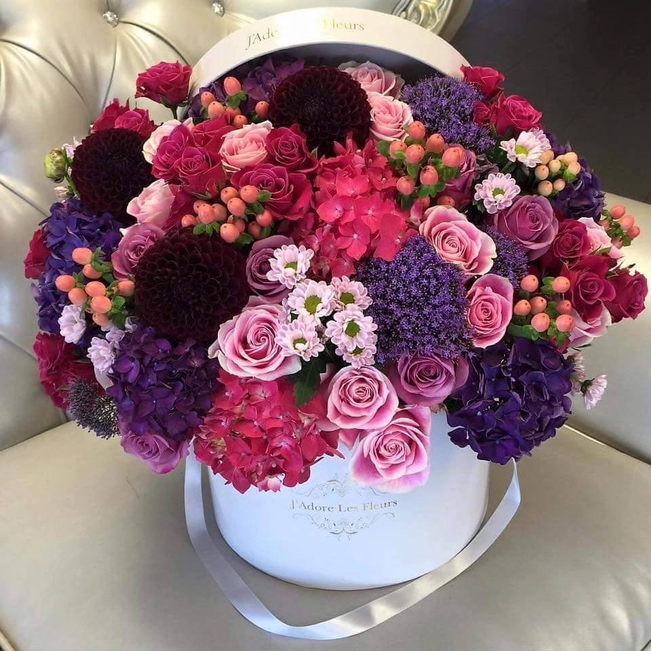
Thank you

