Slide 1
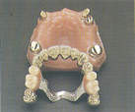
Telescopic Denture
Lecturer Dr. Nagham Bahjat Kamil

Slide 2
The ideal goal of good dentist is to restore the
missing part of oral structure.
phonetics and look of the patient.
The most important is restored the normal health of the patient.
In modern dentistry, though the dental implants or fixed partial denture is the better options, but they have certain limitations.
Telescopic denture is the overlooked technology in dentistry.

Slide 3
Definition
A telescopic denture is a prosthesis which consists of a primary coping which is cemented to the abutments in a patient’s mouth and a secondary coping which is attached to the prosthesis and which fits on the primary coping
(overlay denture, overlay prosthesis, and superimposed prosthesis.)

Slide 4
Indication
Telescopic denture is especially indicated in distal edentulous area with minimum two teeth bilaterally present with a good amount of periodontal support; which in a conservative manner preserve the remaining teeth and helps in conservation of alveolar bone.

Slide 5
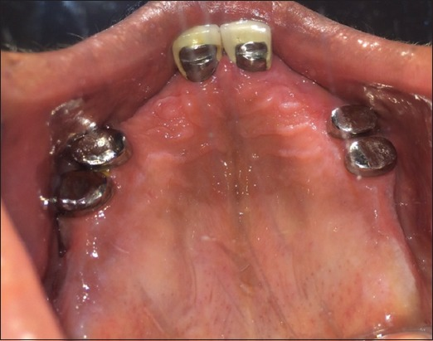

Slide 6
Advantages
Creation of a common path of insertion.
Easy to perform routine oral hygiene.
Rigid splinting action.
Provision of suitable abutments for RPDs even when the remaining teeth are periodontal compromised.
Much easier insertion and removal for the patient.
Accommodates future changes in the treatment plan.
Psychologically well-tolerated by patient.
Distribution of stresses to the abutment teeth.

Slide 7
Disadvantages
Increased cost
Complex laboratory procedures
Extensive tooth reduction required
Increased number of dental appointments.
Difficulty in achieving esthetics.

Slide 8
component
Telescoping refers to the use of a primary full-coverage casting( coping/male telescopic portion) lute to the prepared tooth with a secondary casting (superstructure/secondary crown/female telescopic portion), which is a part of the denture framework and is connected by means of interfacial surface tension over the primary casting.

Slide 9
component

Slide 10
requirements
Careful assessment of the inter arch space is very
important for the successful fabrication of the
telescopic dentures.
Sufficient space must be present to accommodate the primary and secondary copings, to have a sufficient denture base thickness to avoid fracture, space for the
arrangement of the teeth to fulfill the aesthetic
requirements.

Slide 11
Interarch distance should be ≥ 10 mm, in order to have sufficient space for the copings, denture base, teeth placement and adequate closest speaking space.

Slide 12
The selected abutments should be periodontal sound with adequate bone support and no/ minimal
mobility.
There should be at least one healthy abutment in each quadrant. An even distribution of the abutment in each quadrant of the arch is preferable for better stress distribution and for increased retention and stability of the prosthesis.

Slide 13
Mode of action
They act by transferring forces along the direction of the long axis of the abutment
teeth and provide guidance, support, and protection from movements that might dislodge the RPDs.
Telescopic crowns can also be used as indirect retainers to prevent dislodgement of the distal extension base away from the edentulous ridge.

Slide 14
conclusion
Tooth-supported, removable over dentures with telescopic crowns may be considered as a good alternative to the conventional removable dentures, because they provide better
retention, stability, support, stable occlusion, decrease in the forward sliding of the prosthesis, better control of the mandibular movements because of the proprioception feedback which increases the chewing efficiency and even phonetics, as compared to the conventional complete dentures.
Also, the rate of the residual ridge resorption was decreased because of the transfer of compressive forces into the tensile
forces by the periodontal ligament and better stress distribution.

Slide 15
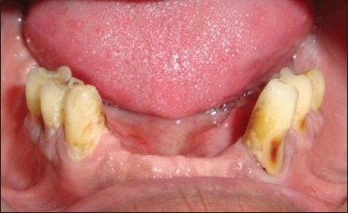
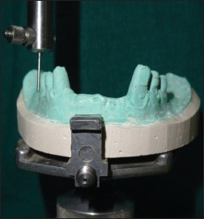





Slide 16

Thank you

