Slide 1
Vital signs

Slide 2
Vital signs reflect the functional status of vital organs in the body and they include:
Temperature,
Blood pressure,
Pulse,
Respiratory rate,
Oxygen saturation,
Blood glucose.

Slide 3
Temperature
units are either centigrade (C) or Fahrenheit (F) and to change Fahrenheit to centigrade, the formula used is (F – 32) X 5/9 = ˚C and to change centigrade to Fahrenheit, it is (C X 9/5) + 32 = ˚F.

Slide 4
Temperature | Condition
36.6 – 37.2 ˚C | Normal
< 35 ˚C | Hypothermia
< 36.6˚ C | Subnormal
> 37.2˚ C | Febrile (pyrexia)
> 41.6˚ C | Hyperpyrexia

Slide 5
Temperature: record the patient's temperature using either a mercury or electronic thermometer. The recording will vary according to:
1. Site of measurement: Normal oral temperature is usually considered, whereas rectal route is 0.5 °C higher and axillary route is 0.5 °C lower. 2. Diurnal variation in body temperature, with peak temperatures occurring between 6 pm - 10 pm, lowest between 2 am - 4 am. 3. Menstrual cycle can elevate temperature by 1 °C degree. 4. Physical activity. 5. Strong emotion. 6. Eating. 7. Heavy clothing. 8. Medications. 9. High room temperature. 10. High humidity.

Slide 6
Clinical conditions:
Persistent pyrexia may be a sign of typhoid fever. Intermittent pyrexia can be seen in pyogenic infections such as TB. Relapsing pyrexia occurs in patient with Hodgkin's disease and is characterized by 4 days of persistent fever which then returns to baseline before rising again.

Slide 7
Any rigors (uncontrollable shaking) which may accompany high fever are often characteristic of biliary sepsis or pyelonephritis. Hypothermia occurs usually from cold exposure or following excess alcohol or in the elderly with hypothyroidism (e.g. myxoedema). Patients typically lose consciousness at temperatures < 27 °C. Brain damage from a fever generally will not occur unless the fever is over 107.6°F (42°C). Heatstroke is a dangerous type of high temperature, because the body is not able to stop the temperature from rising continuously. It can happen when a child is left in a hot car or when someone exercises too strenuously without enough water drink.

Slide 8
Procedure: Oral route
-Hold the thermometer from the end away from the bulb with your thumb and index finger.
-Lower the mercury level by shaking the thermometer to below 35˚ C.
-Wash the thermometer by antiseptic solution with cotton wool.
-Place the bulb of thermometer underneath the tongue and ask the patient to close his lips and breathe from his nose, for 2 min. then read the temp. At the level of mercury column .wash the thermometer and put it place.

Slide 9
Its unit in mmHg. B.P. = cardiac output (COP) x peripheral vascular resistance (PVR) COP = heart rate (HR) x stroke volume (SV) Systolic pressure: The highest arterial pressure during each cardiac cycle. It is measured after the heart contract and blood is ejected into the arterial system. Diastolic pressure: lowest arterial pressure during each cardiac cycle. It is measured when the heart is relaxed.

Slide 10
Pulse pressure: is the difference between systolic and diastolic pressure. Mean arterial pressure: is the average of arterial pressure with respect to time. (mean arterial pressure = diastolic pressure + 1/3 pulse pressure. B.P. affected by the following factors: 1. COP directly correlated with systolic B.P. 2. PVR directly correlated with diastolic B.P.

Slide 11
Methods to measure B.P.:
A. Directly through cannula in the artery. B. Indirectly through: 1. Oscillometric methods with an electronic pressure sensor (transducer) fitted in to detect blood flow with a numerical readout of blood pressure. This method is a subject to the errors and drift of calibration. 2. Auscultatory - palpatory method uses a stethoscope, sphygmomanometer which comprises an inflatable cuff placed around the upper arm at roughly the same vertical height as the heart, attached to a mercury or aneroid manometer. This method is not subject to the errors.

Slide 12
Procedure:
Rest the patient for five minutes
1- In ambulant patients, measurements are normally made with the patient seated. Either arm can be used (difference between left and right should be < 10 mmHg). 2- Check the proper size of air bag within the cuff which should extend for at least 2/3 of the circumference of the arm.
2- Support the patient's arm comfortably at about heart level.
3- Apply the cuff to the upper arm with the center of the bladder over the brachial artery above the cubital fossa by 2.5 cm, wrapping should be neither tight nor loose.

Slide 13
4- Palpate the brachial pulse.
5- Inflate the cuff until the pulse is impalpable. Note the pressure on the manometer. This is a rough estimate of systolic pressure.
6- Now inflate the cuff another 10 mmHg and listen through the stethoscope over the brachial artery.
7- Deflate the cuff slowly until regular sounds are first heard. Note the reading to the nearest 2 mmHg. This is the systolic pressure (first Korotkoff sound).
8- Continue to deflate the cuff slowly until the sounds disappear (fifth Korotkoff sound). Record the pressure at which the sounds completely disappear as diastolic pressure. Occasionally muffled sounds persist and do not disappear, in which case the point of muffling is the best guide to the diastolic pressure.. Note: The cuff size should be correct: undersized cuffs yields too high pressure, whereas oversized cuffs yields too low pressure.

Slide 15
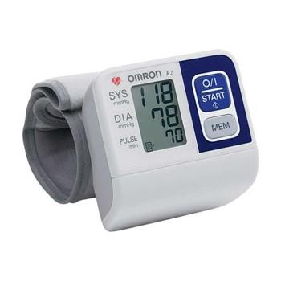
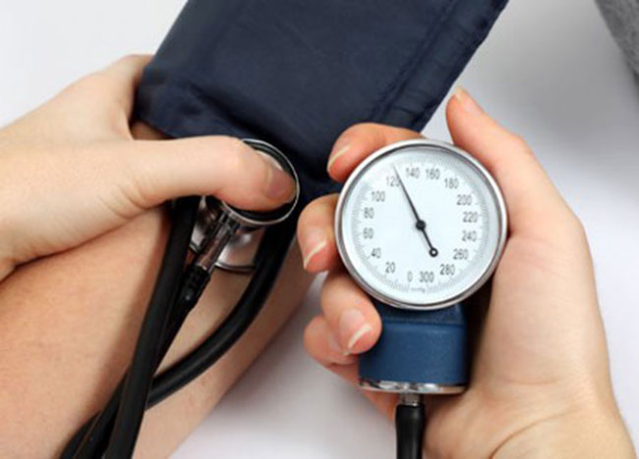

Slide 16
Clinical points:
Blood pressure varies with excitement, stress and environment. Repeated measurements, made 0n 0ne week apart, in a stress-free environment, are required to diagnose hypertension. In some patients simply measuring blood pressure can cause it to rise - so-called 'white coat' hypertension. Ambulatory blood pressure monitoring removes the stress of the clinic environment and helps identify this problem. Numerous devices can be set to make BP measurements at set intervals for 24 hours. Many patients also can use automatic machines which allow them to measure their own BP at home.

Slide 17
category | systolic | Diastolic
Normal | <120 | 80>
Prehypertension | 130-139 | 85-89
Stage I hypertension | 140-159 | 90-99
Stage II hypertension | ≥160 | ≥100
Hypertensive crisis | > 180 | > 110

Slide 18
Hypertension has no specific symptoms but, if untreated, can lead to death or morbidity from heart failure, cerebrovascular accident or renal failure. It is a major risk factor for coronary heart disease and atrial fibrillation. Pulse rate: Assess the radial pulse to determine rate, rhythm, and volume.

Slide 19
Radial pulse 1- Place your three middle fingers over the right radial pulse at the wrist, lateral to the flexor carpi radialis tendon. 2- Use the pads of your fingers to assess the rate, rhythm and volume (Fig. 3.11A). 3- Count the pulse for 15 seconds and multiply by four to obtain the pulse rate in beats per minute (bpm). 4- Now palpate the left radial pulse. If either pulse feels diminished in volume, confirm any difference by simultaneous palpation. Brachial pulse 1- Use your thumb (right thumb for right arm and vice versa) with your fingers cupped round the back of the elbow. 2- Feel in the antecubital fossa medial to the tendon of the biceps muscle to find the pulse and assess its character. Carotid pulse 1- Palpate the carotid pulse with the patient lying on couch in case you induce a

Slide 20
reflex bradycardia. 2- Never compress both carotid arteries simultaneously. 3- Use your left thumb for the right carotid pulse and vice versa. 4- Place the tip of your thumb between the larynx and the anterior border of the sternocleidomastoid muscle. 5- Press your thumb gently backwards to feel the pulse.

Slide 21
Normal findings
A normal adult resting pulse rate is between 60-100 bpm. Bradycardia is a pulse rate of < 60 bpm (as in cases of sleep, athlete, and hypothyroidism) and tachycardia > 100 bpm (as in cases of anemia, pain, exercise, anxiety, fever, and thyrotoxicosis).
A normal cardiac rhythm is called sinus rhythm because it arises from the sinoatrial node. Sinus rhythm seldom produces a completely regular pulse because the heart speeds up during inspiration and slows at the beginning of expiration in response to changes in vagus nerve activity. This sinus arrhythmia is most obvious in children, young adults and athletes. Cases of abnormal rhythm called dysrhythmia or arrhythmia which could be associated with tachycardia (tachyarrhythmia as in supraventricular tachycardia and atrial fibrillation) or associated with bradycardia (bradyarrythmia as in cases of heart block).

Slide 22
Volume
Volume is the movement imparted to your fingers and reflects the pulse pressure.
A large volume pulse may be due to high cardiac output state as in cases of exercise, emotion, heat, pregnancy, fever, thyrotoxicosis, or anaemia. A low volume pulse (thin and thready) is associated with reduced stroke volume due to heart failure, or hypovolaemia due to haemorrhage or dehydration.
Respiratory rate: Count chest expansions over 15 seconds and multiply by four (normal rate = 12 – 18 breath per minute, else if higher it is tachypnea or lower which is bradypnea).

Slide 23
Oxygen saturation measured by pulse oximetry which is a non-invasive probe attached to fingertip or earlobe to assess peripheral O₂ saturation which is if < 92 % indicates hypoxia and need to check arterial blood gases (ABG) as PaCO₂ and PaO₂.
Blood glucose: using glucometer or glucose Stix test to check if there is normoglycemia, hypoglycemia, or hyperglycemia (refer to biochemistry values).

