Slide 1
3ed year Haemolytic anaemias
Prof. Abeer Anwer Ahmed

Slide 2
Normal red cell destruction
Red cell destruction usually occurs after a mean lifespan
of 120 days when the cells are removed extravascularly by
the macrophages of the reticuloendothelial (RE) system,
especially in the marrow but also in the liver and spleen.
The breakdown of haem from haemoglobin liberates iron for recirculation via plasma transferrin mainly to marrow erythroblasts
and protoporphyrin, which is broken down to bilirubin. Bilirubin circulates to the liver where it is conjugated to glucuronides, which are excreted into the gut via bile and converted to stercobilinogen and stercobilin (excreted in faeces)

Slide 3
Stercobilinogen and stercobilin are partly reabsorbed and excreted in urine as urobilinogen and urobilin.
Globin chains are broken down to amino acids
which are reutilized for general protein synthesis in the body.
Haptoglobins are proteins in normal plasma which bind
haemoglobin. The haemoglobin–haptoglobin complex is
removed by the RE system.
Intravascular haemolysis (breakdown
of red cells within blood vessels) plays little or no part in
normal red cell destruction.

Slide 4
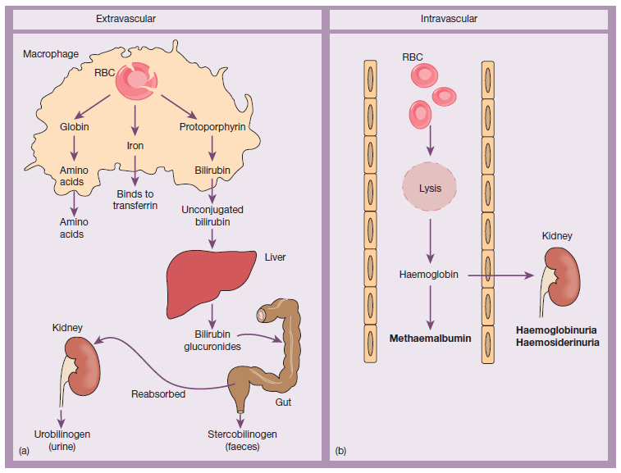
(a) Normal red blood cell (RBC) breakdown. This takes place extravascularly in the macrophages of the reticuloendothelial system. (b) Intravascular haemolysis occurs in some pathological disorders

Slide 5
Introduction to haemolytic anaemias
Haemolytic anaemias are defined as
anaemias that result from an increase in the rate of red cell destruction.
The normal adult marrow, after full expansion, is
able to produce red cells at 6–8 times the normal rate provided this is ‘effective’.
It leads to a marked reticulocytosis. Therefore,
anaemia due to haemolysis may not be seen until the red cell lifespan is less than 30 days.

Slide 6
Classification of haemolytic anaemias.
1-Hereditary
Membrane
Hereditary spherocytosis, hereditary elliptocytosis
Metabolism
G6PD deficiency, pyruvate kinase deficiency
Haemoglobin
Genetic abnormalities (Hb S, Hb C, unstable)

Slide 7
2-Acquired
Immune
Autoimmune
Warm antibody type
Cold antibody type
Alloimmune
Haemolytic transfusion reactions
Haemolytic disease of the newborn
Allografts, especially marrow transplantation
Drug associated
Red cell fragmentation syndromes
See Table 6.6
March haemoglobinuria
Infections
Malaria, clostridia
Chemical and physical agents
Especially drugs, industrial/domestic substances, burns
Secondary
Liver and renal disease
Paroxysmal nocturnal haemoglobinuria

Slide 8
Clinical features
- pallor of the mucous membranes
- mild fluctuating jaundice
- splenomegaly.
-No bilirubin in urine but this may turn dark on standing because of excess urobilinogen.
-Pigment (bilirubin) gallstones may complicate the condition
and some patients (particularly with sickle cell disease) develop ulcers around the ankle
-Aplastic crises may occur, usually precipitated by infection with
parvovirus which ‘switches off’ erythropoiesis, and are characterized
by a sudden increase in anaemia and drop in reticulocyte
count
Rarely, folate deficiency may cause an aplastic crisis in
which the bone marrow is megaloblastic

Slide 9
Laboratory findings
The laboratory findings are conveniently divided into three groups.
1 Features of increased red cell breakdown:
(a) serum bilirubin raised, unconjugated and bound to albumin;
(b) urine urinobilinogen increased;
(c) serum haptoglobins absent because the haptoglobins become saturated with haemoglobin and the complex is removed by RE cells.
2 Features of increased red cell production:
(a) reticulocytosis;
(b) bone marrow erythroid hyperplasia; the normal marrow
myeloid : erythoid ratio of 2 : 1 to 12 : 1 is reduced to 1 : 1 or reversed
3 Damaged red cells:
(a) morphology (e.g. microspherocytes, elliptocytes, fragments);
(b) osmotic fragility;
(c) specific enzyme

Slide 10
Intravascular and extravascular haemolysis
There are two mechanisms whereby red cells are destroyed in haemolytic anaemia.
-Extravascular haemolysis :excessive removal of red cells by cells of the RE system .
-Intravascular haemolysis broken down directly in the circulation .

Slide 11
Causes of intravascular haemolysis
-Mismatched blood transfusion (usually ABO)
-G6PD deficiency with oxidant stress
-Red cell fragmentation syndromes
-Some severe autoimmune haemolytic anaemias
-Some drug‐ and infection‐induced haemolytic anaemias
-Paroxysmal nocturnal haemoglobinuria
-March haemoglobinuria
-Unstable haemoglobin
-G6PD, glucose‐6‐phosphate dehydrogenase

Slide 12
The main laboratory features of intravascular haemolysis
1 Haemoglobinaemia and haemoglobinuria.
2 Haemosiderinuria.
3 Methaemalbuminaemia

Slide 13
Hereditary haemolytic anaemias
Membrane defects
Hereditary spherocytosis is the most common hereditary haemolytic anaemia in Northern Europeans.
Pathogenesis
HS is usually caused by defects in the proteins involved in
the vertical interactions between the membrane skeleton and
the lipid bilayer of the red cell
The marrow produces red cells of normal biconcave shape but these
lose membrane and become increasingly spherical (loss of
surface area relative to volume) as they circulate through the
spleen and the rest of the RE system.
The loss of membrane may be caused by the release of parts of the lipid bilayer that are not supported by the skeleton. Ultimately, the spherocytes
are unable to pass through the microcirculation, especially in the spleen, and die prematurely

Slide 14
The inheritance is autosomal dominant with variable expression; rarely it may be autosomal recessive.
The anaemia can present at any age from infancy to old age.
Jaundice is typically fluctuating and is particularly marked if the haemolytic anaemia is associated with Gilbert’s disease (a defect of hepatic conjugation of bilirubin);
splenomegaly occurs in most patients.
Pigment gallstones are frequent
Aplastic crises, usually precipitated by parvovirus infection, may cause a sudden increase in severity of anaemia

Slide 15
Hereditary elliptocytosis
This has similar clinical and laboratory features to HS except
for the appearance of the blood film
usually a clinically milder disorder. It is predominantly discovered
by chance on a blood film and there may be no evidence of
haemolysis.
Occasional patients require splenectomy.
The basic defect is a failure of spectrin heterodimers to self‐associate
into heterotetramers. A number of genetic mutations affecting
horizontal interactions have been detected .
Patients with homozygous or doubly heterozygous elliptocytosis
present with a severe haemolytic anaemia termed hereditary
pyropoikilocytosis.

Slide 16
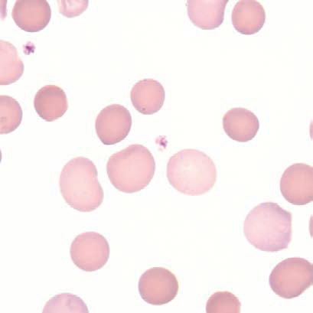
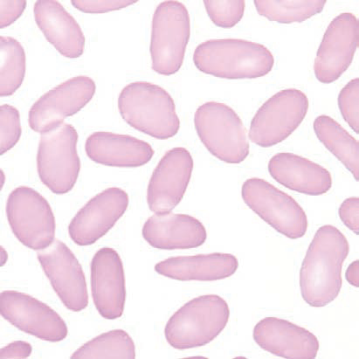
(a) Blood film in hereditary spherocytosis. The spherocytes are deeply staining and of small diameter. Larger polychromatic cells are reticulocytes (confirmed by supravital staining). (b) Blood film in hereditary elliptocytosis.

Slide 17
Defective red cell metabolism
Glucose‐6‐phosphate dehydrogenase deficiency
Glucose‐6‐phosphate dehydrogenase (G6PD) functions to
reduce nicotinamide adenine dinucleotide phosphate (NADP).
It is the only source of NADPH which is needed for the production of reduced glutathione; a deficiency renders the red cell susceptible to oxidant stress

Slide 18
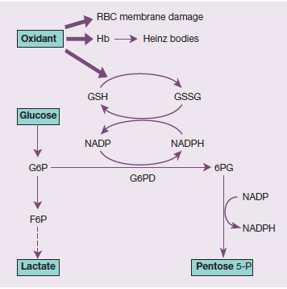

Slide 19
Epidemiology
There is a wide variety of normal genetic variants of the
enzyme G6PD.
the most common being type B (Western)
and type A in Africans.
In addition, more than 400 variants caused by point mutations or deletions of the enzyme G6PD have been characterized which show less activity than normal.
The inheritance is sex‐linked, affecting males, and carried
by females who show approximately half the normal red cell
G6PD values.

Slide 20
Clinical features
G6PD deficiency is usually asymptomatic with a normal
blood count between attacks of haemolysis.
1 Acute haemolytic anaemia in response to oxidant stress,
e.g. drugs, fava beans or infections .
Fava beans(Vica fava) contain an oxidant chemical, divicine. The
acute haemolytic anaemia is caused by rapidly developing
intravascular haemolysis with haemoglobinuria .
The anaemia may be self‐limiting as new young red cells
are made with near normal enzyme levels.
2 Neonatal jaundice.
3 Rarely, a congenital non‐spherocytic haemolytic anaemia.
These syndromes may result from different types of severe
enzyme deficiency

Slide 21
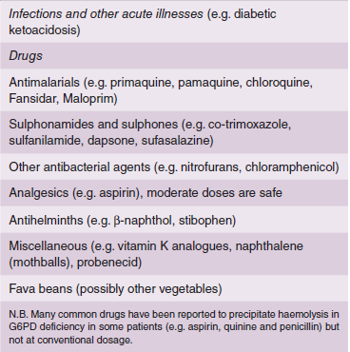
Agents that may cause haemolytic anaemia in glucose‐6‐phosphate dehydrogenase (G6PD) deficiency

Slide 22
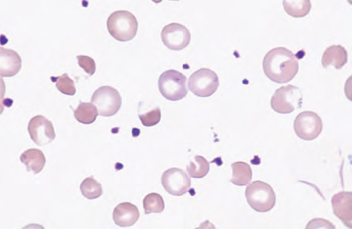
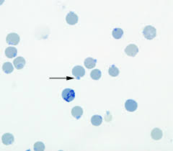
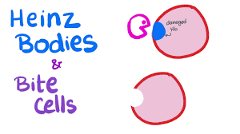
Blood film in G6PD deficiency with acute haemolysis after an oxidant stress. Some of the cells show loss of cytoplasm with separation of remaining haemoglobin from the cell membrane
(‘blister’ cells). There are also numerous contracted and deeply staining cells.

Slide 23
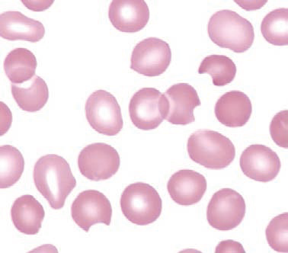
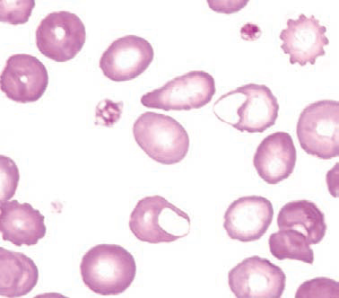
Bite and blister cells are the result of splenic pitting of Heinz bodies

Slide 24
Diagnosis
Between crises the blood count is normal. The enzyme deficiency
is detected by one of a number of screening tests or
by direct enzyme assay on red cells.
During a crisis the blood film may show contracted and fragmented cells, ‘bite’ cells and ‘blister’ cells ,which have had Heinz bodies removed by the spleen.
Heinz bodies (oxidized, denatured haemoglobin) may be seen in the reticulocyte preparation, particularly if the spleen is absent.
There are also features of intravascular haemolysis.
Because of the higher enzyme level in young red cells, red
cell enzyme assay may give a ‘false’ normal level in the phase
of acute haemolysis with a reticulocyte response. Subsequent
assay after the acute phase reveals the low G6PD level when the
red cell population is of normal age distribution.

Slide 25
Treatment
The offending drug is stopped, any underlying infection is treated,
a high urine output is maintained and
blood transfusion undertaken where necessary for severe anaemia.
G6PDdeficient babies are prone to neonatal jaundice and in severe cases phototherapy and exchange transfusion may be needed.
The jaundice is usually not caused by excess haemolysis but by deficiency of G6PD affecting neonatal liver function.

Slide 26
Glycolytic (Embden–Meyerhof) pathway defects
These are all uncommon and lead to a congenital non‐spherocytic
haemolytic anaemia. The most frequently encountered is
pyruvate kinase (PK) deficiency .
This is inherited as an autosomal recessive, the affected patients
being homozygous or doubly heterozygous.
Over 100 different mutations have been described.
The red cells become rigid as a result of reduced adenosine triphosphate (ATP) formation.
The severity of the anaemia varies widely (haemoglobin (40–100 g/L) and causes relatively mild symptoms because of a shift to the right in the oxygen (O2) dissociation curve caused by a rise in intracellular 2,3‐diphosphoglycerate (2,3‐DPG).
Clinically, jaundice is usual and gallstones are frequent. Frontal
bossing may be present. The blood film shows poikilocytosis
and distorted ‘prickle’ cells, particularly post‐splenectomy.

Slide 27
Acquired Hemolytic Anemias

Slide 28
Immune Hemolytic Anemias
Antibody mediated hemolysis is an important cause of acquired hemolytic anemia.
Antibodies may be:
autoantibodies produced by the patiet’s own immune system & directed against his own red cell antigens, or they may be
alloantibodies produced by the patient & directed against antigens not present on his own red cells but introduced either by transfusion or secondarily acquired as in drug induced hemolysis.
The immune hemolytic anemias are characterized by a positive direct Coomb’s test.

Slide 29
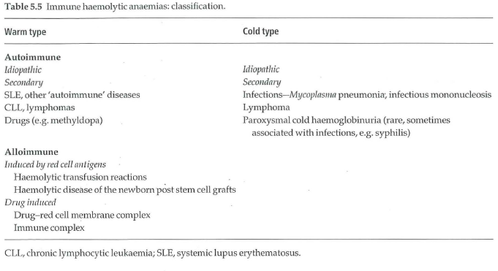

Slide 30
Autoimmune Hemolytic Anemias

Slide 31
Warm autoimmune hemolytic anemia:
The autoantibodies are :
polyclonal
IgG in type
They react best at 37ºC.
Red cells coated with IgG are taken up by macrophages especially in the spleen .
Part of the coated membrane is lost so the cell becomes progressively more spherical to maintain its volume & is ultimately prematurely destroyed predominantly in the spleen.

Slide 32
Clinical features:
the disease can occur at any age in both sexes & presents as a hemolytic anemia of variable severity.
The spleen is often enlarged.
It is classified as:
Idiopathic
Secondary to: autoimmune disoders, lymphoma, CLL, drugs

Slide 33
Laboratory findings:
  Features of hemolytic anemia:
  Anemia
  Reticulocytosis
  jaundice.
  Direct Coomb’s test is positive.
  Blood film shows
  Spherocytes
  polychromasia & nucleated red cells.

Slide 34
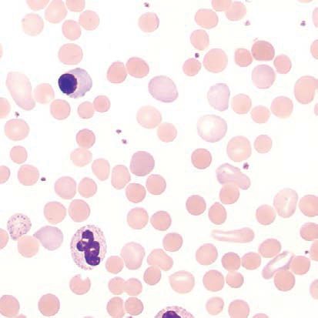
Peripheral Blood: immune hemolytic anemia
1-Spherocytes, 2- polychromasia, 3-nucleated erythrocytes
3
2
1

Slide 35
Cold autoimmune hemolytic anemia:
The cold autoantibody attaches to red cells mainly in the peripheral circulation where blood temperature is cooled.
The antibody is usually IgM & binds to red cells best at 4ºC. Agglutination of red cells by the antibody causes acrocyanosis.
The antibody then detaches from red cells when they pass to the warmer central circulation & if the complement sequence is completed on the red cell surface; intravascular hemolysis will result.

Slide 36
Etiology: types of cold autoimmune hemolytic anemia are:
-Idiopathic (cold hemagglutinin disease): monoclonal antibody.
-Secondary to lymphoproliferative disease: monoclonal antibody.
-Secondary to infection (Mycoplasma pneumoniae or infectious mononucleosis): polyclonal antibody.

Slide 37
Clinical features:
the patient may have chronic hemolytic anemia aggravated by cold & often associated with intravascular hemolysis.
The patient may develop acrocyanosis (purplish skin discoloration) at the tip of the nose, ears, fingers & toes due to the agglutination of red cells in small vessels.
Mild jaundice & splenomegaly may be present.

Slide 38
Laboratory findings:
Features of hemolytic anemia.
Direct Coomb’s test is positive.
Blood film shows red cell autoagglutination.

Slide 39
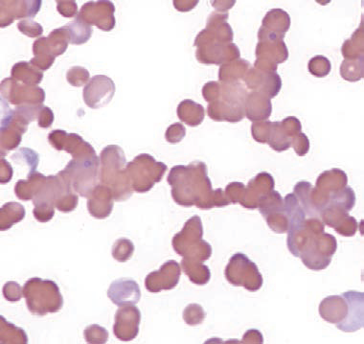
Autoagglutination

Slide 40
Alloimmune Hemolytic Anemias

Slide 41
Rh Hemolytic disease of the newborn:
This results from passage of IgG antibodies from the maternal circulation across the placenta into fetal circulation where they react with fetal red cells & mediate destruction by fetal reticuloendothelial system.

Slide 42
In Rh D negative woman pregnant with an Rh D positive fetus,
when fetal red cells cross into the maternal circulation (usually at delivery) they will sensitize the mother to produce anti-D antibodies.
The mother could also be sensitized by a previous miscarriage, amniocentesis or other trauma to the placenta or by blood transfusion.
Anti-D antibodies will cross the placenta to the fetus during the next pregnancy with a D-positive fetus, coat fetal red cells & result in their destruction causing anemia & jaundice.

Slide 43
Clinical features:
The severity is variable.
In severe disease: intrauterine death results from hydrops fetalis.
In moderate disease; the baby is born with severe anemia, jaundice, edema & hepatosplenomegaly. Kernicterus may result.

Slide 44
Laboratory findings:
Cord blood: there is variable anemia, reticulocytosis & jaundice.
The baby is Rh positive.
Direct Coomb’s test is positive.
In moderate & severe cases many erythroblasts are seen in the blood film (erythroblastosis fetalis).
The mother is Rh D negative & has a high level of anti-D.

Slide 45
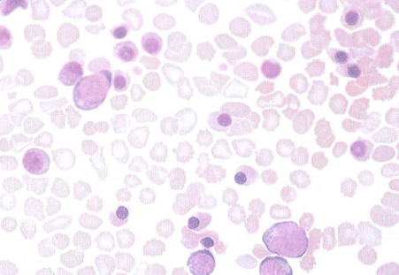

Slide 46
Non Immune Hemolytic Anemias

Slide 47
Red cell fragmentation syndromes:
These arise through physical damage to red cells either on
abnormal sufaces (e.g. artificial heart valves) or
microangiopathic hemolytic anemia caused by red cells passing through fibrin strands deposited in small vessels due to DIC or
passing through damaged small vessels in malignant hypertension, the hemolytic uremic syndrome or meningococcal sepsis.
Blood film shows many red cell fragments.

Slide 48
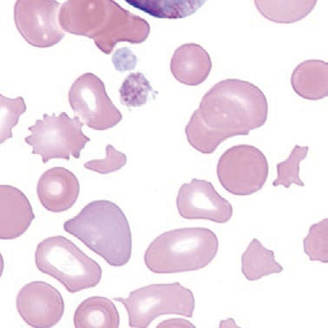
Schistocytes.:Fragmented erythrocytes; many sizes and shapes may be present on a smear; often display pointed extremities
ASSOCIATED WITH: Microangiopathic hemolytic anemia (hemolytic uremic syndrome, thrombotic thrombocytopenic purpura, disseminated intravascular coagulation), severe burns, renal graft rejection

