Slide 1
Megaloblastic anaemias and other macrocytic anaemias
Prof. Abeer Anwer Ahmed

Slide 2
Introduction to macrocytic anaemia
In macrocytic anaemia the red cells are abnormally large (mean corpuscular volume, MCV >98 fL).
There are several causes but they can be broadly subdivided into:
megaloblastic
and non‐megaloblastic
based on the appearance of developing erythroblasts in the bone marrow.

Slide 3
Megaloblastic anaemias
This is a group of anaemias in which the erythroblasts in the bone marrow show a characteristic abnormality .
Maturation of the nucleus being delayed relative to
that of the cytoplasm.
The underlying defect accounting for the asynchronous maturation of the nucleus is defective DNA synthesis .

Slide 4
Causes of megaloblastic anaemia
-Vitamin B12 deficiency
-Folate deficiency
-Abnormalities of vitamin B12 or folate metabolism (e.g.
transcobalamin deficiency, nitrous oxide, antifolate drugs)
-Other defects of DNA synthesis
Congenital enzyme deficiencies (e.g. orotic aciduria)
Acquired enzyme deficiencies (e.g. alcohol, therapy with
hydroxyurea, cytosine arabinoside)

Slide 5
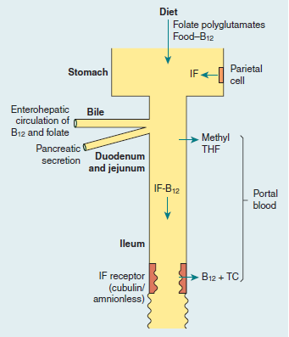

Slide 6
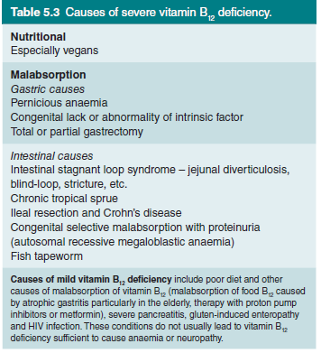
Causes of B12 deficiency

Slide 7
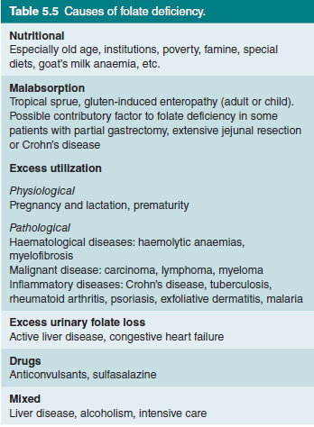
Causes of Folate deficiency

Slide 8
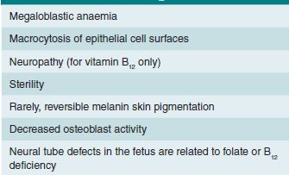
Effects of vitamin B12 or folate deficiency

Slide 9
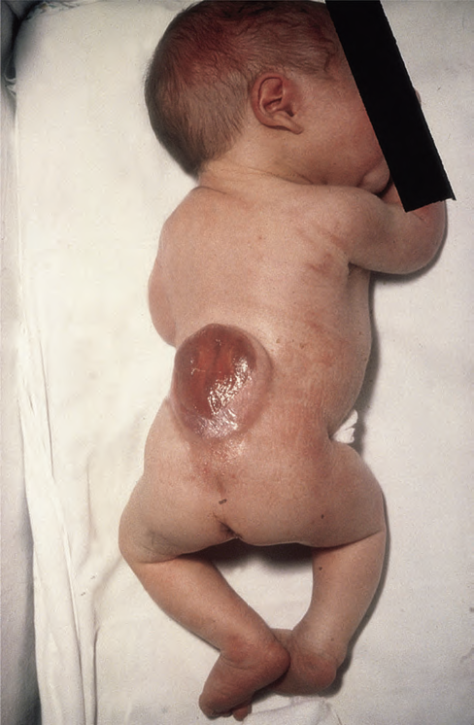
A baby with neural tube defect (spina bifida).

Slide 10
Clinical features of megaloblastic anaemia
-The onset is usually insidious with gradually progressive symptoms and signs of anemia .
-The patient may be mildly jaundiced (lemon yellow) because of the excess breakdown of haemoglobin resulting from increased ineffective erythropoiesis in the bone marrow.
-Glossitis (a beefy‐red sore tongue)
-angular cheilosis
-and mild symptoms of malabsorption with loss of weight may be present because of the epithelial abnormality. Purpura as a result of thrombocytopenia and widespread melanin pigmentation (the cause of which is unclear) are less frequent presenting features
-Many asymptomatic patients are diagnosed when a blood count that has been performed for another reason reveals macrocytosis.

Slide 11
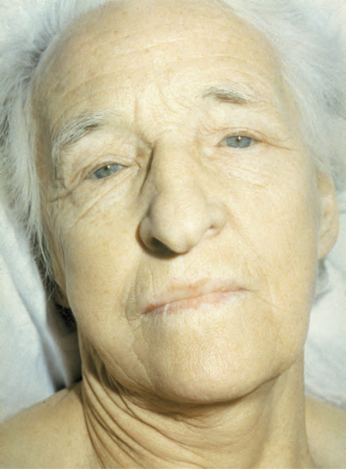

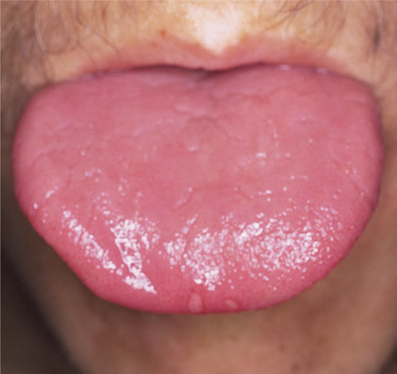

Slide 12
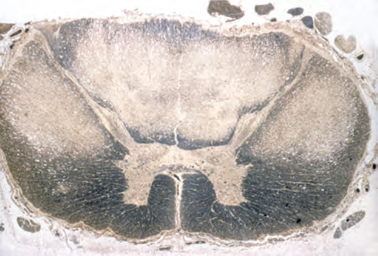
Cross‐section of the spinal cord in a patient who died with subacute combined degeneration of the cord (Weigert–Pal stain). There is demyelination of the dorsal and dorsolateral columns.

Slide 13
Laboratory findings
-The anaemia is macrocytic (MCV >98 fL and often as high as
120–140 fL in severe cases) and the macrocytes are typically oval .
If iron deficiency is also present the MCV maybe normal.
-The reticulocyte count is low .
-the total white cell and platelet counts may be moderately reduced, especially in severely anaemic patients.
-A proportion of the neutrophils show hypersegmented nuclei (with six or more lobes).
- The bone marrow is usually hypercellular and the erythroblasts are large and show an open, fine, lacy primitive chromatin pattern but normal cytoplasmic haemoglobinization .
Giant and abnormally shaped metamyelocytes are characteristic.
-The serum unconjugated bilirubin and lactate dehydrogenase
are raised as a result of marrow cell breakdown.

Slide 14
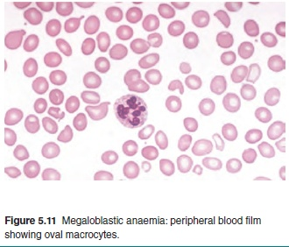
Megaloblastic anaemia: peripheral blood film showing oval macrocytes and hypersegmented neutrophil

Slide 15
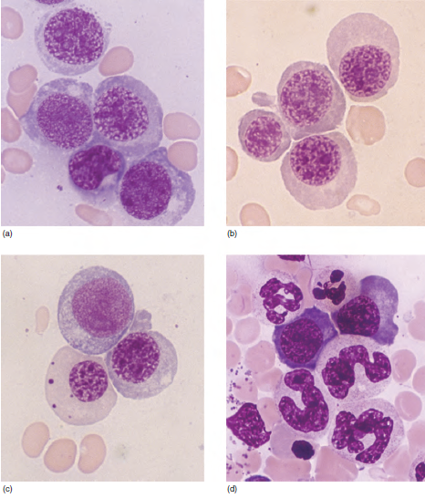
Megaloblastic changes in the bone marrow in a patient with severe megaloblastic anaemia. (a–c) Erythroblasts showing fine, open stippled (primitive) appearance of the nuclear chromatin even in late cells (pale cytoplasm with some haemoglobin formation).
(d) Abnormal giant metamyelocytes and band forms.

Slide 16
Pernicious anaemia (PA)
This is caused by autoimmune attack on the gastric mucosa leading to atrophy of the stomach.
The wall of the stomach becomes :
-Thin
-with a plasma cell and lymphoid infiltrate of the lamina propria.
-Intestinal metaplasia may occur.
-There is achlorhydria and secretion of IF is absent or
almost absent.
-Serum gastrin levels are raised.
-Helicobaterpylori infection may initiate an autoimmune gastritis which presents in younger subjects as iron deficiency and in the elderly as PA.

Slide 17
Antibodies
Ninety per cent of patients show parietal cell antibody in the serum directed against gastric
H+/K+‐ATPase.
The more common parietal cell antibody is less specific as it occurs quite commonly in older subjects
PA is distinguished from simple atrophic or autoimmune gastritis by the presence of antibodies to IF.

Slide 18
Fifty per cent of PA patients show in serum an antibody to IF which inhibits IF binding to B12.
IF antibodies also occur in PA in gastric juice.
IF antibodies are virtually specific for PA but as they occur in the serum of only half of patients, their absence from serum
does not exclude the diagnosis.
second antibody blocking IF attachment to its ileal binding site is less frequent

Slide 19
Pernicious anaemia: associations.
Female Vitiligo
Blue eyes Myxoedema
Early greying Hashimoto’s disease
Northern European Thyrotoxicosis
Familial Addison’s disease
Blood group A Hypoparathyroidism
Hypogammaglobulinaemia
Carcinoma of the stomach

Slide 20
Other macrocytic anemia
There are many non‐megaloblastic causes of macrocytic anaemia .
The exact mechanisms creating large red cells in each of these conditions is not clear although
-Increased lipid deposition on the red cell membrane
- alterations of erythroblast maturation time in the marrow.

Slide 21
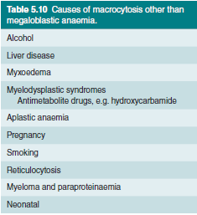
Causes of macrocytosis other than megaloblastic anemia.

Slide 22
Aplastic Anemia
Aplastic anemia is defined as pancytopenia (anemia+ leucopenia+ thrombocytopenia) resulting from aplasia of the bone marrow.

Slide 23
Pathogenesis: the underlying defect in all cases appears to be
substantial reduction in the number of stem cells
& a fault in the remaining stem cells
or an immune reaction against them.
This makes them unable to divide & differentiate sufficiently to populate the bone marrow.
A primary fault in the marrow microenvironment has also been suggested but the success of bone marrow transplantation shows this can only be a rare cause since normal donor stem cells are usually able to thrive in the recipient’s marrow cavity.

Slide 24
Clinical features:
The onset is at any age with a peak incidence around 30 years & a slight male predominance.
It can be insidious or acute with symptoms & signs resulting from anemia, neutropenia or thrombocytopenia.
Infections, particularly of the mouth & throat, are common. Generalized infections are frequently life threatening.
Bruising, bleeding gums, epistaxes & menorragia are the most frequent hemorrhagic manifestations & the usual presenting features.
Symptoms of anemia.
The lymph nodes, liver& spleen are not enlarged.

Slide 25
Laboratory findings:
  -Anemia is normochromic normocytic or macrocytic.
  -The retic count is reduced.
  -Leucopenia. There is selective neutropenia usually but not always to below 1.5 x 10⁹/L. The neutrophils appear normal.
  -Thrombocytopenia is always present & in severe cases is less than 10x10⁹/L.
  There are no abnormal cells in the peripheral blood.

Slide 26
  Bone marrow shows hypoplasia with loss of hemopoietic tissue & replacement by fat. Bone marrow biopsy is essential & may show patchy cellular areas in a hypocellular background.
  The main cells present are lymphocytes & plasma cells.

Slide 27
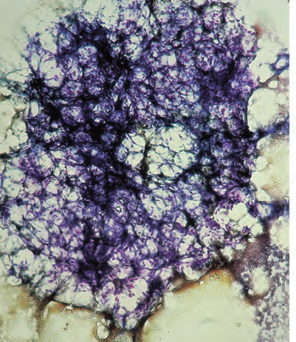
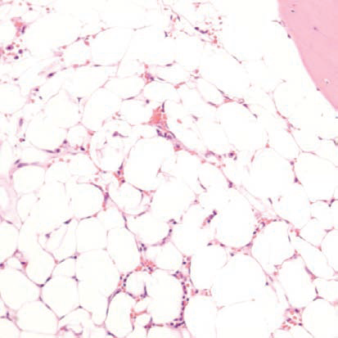
Aplastic anaemia: low power views of bone marrow show severe reduction of haemopoietic cells with an increase in fat spaces. (a) Aspirated fragment. (b) Trephine biopsy

Slide 28
Fanconi anaemia (FA)
autosomal recessive pattern of inheritance
and is often associated with :
-growth retardation
-congenital defects:
of the skeleton (e.g. microcephaly, absent radii or thumbs)
of the renal tract (e.g. pelvic or horseshoe kidney)
or skin (areas of hyper‐ and hypopigmentation);
sometimes there is learning disability.

Slide 29
The usual age of presentation of FA is 3–14 years. Approximately 10% of patients develop acute myeloid leukaemia.
Treatment
is usually with androgens and/or SCT.
The blood count usually improves with androgens but side‐effects, especially in children, are distressing (virilization and liver abnormalities);
remission rarely lasts more than 2 years.
SCT may cure the patient.

Slide 30
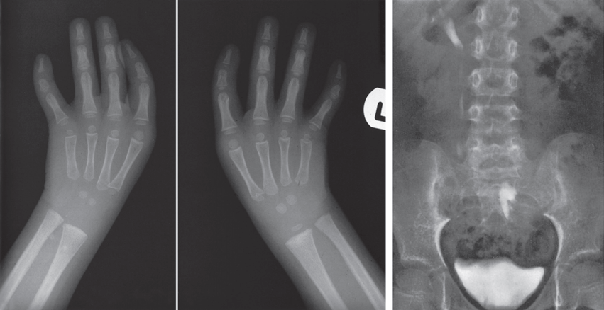
a) X-rays showing absent thumbs in a patient with Fanconi anaemia (FA). (b) Intravenous pyelogram in a patient with FA showing a normal right kidney but a left kidney abnormally placed in the pelvis.

Slide 31
Differential diagnosis:
Other causes of pancytopenia are:
    Bone marrow infiltration e.g. carcinoma, lymphoma.
    Leukemia, MDS, myeloma.
    Hypersplenism.
    Megaloblastic anemia.
    Myelofibrosis.

