Slide 1
3ed year Genetic disorders of haemoglobin
Prof. Abeer Anwer Ahmed

Slide 2
Normal adult blood contains three types of haemoglobin
Hb A Hb F Hb A2
Structure α2β2 α2γ2 α2δ2
Normal (%) 96–98 0.5–0.8 1.5

Slide 3
Switch from fetal to adult haemoglobin
the main switch to adult haemoglobin occurs :
3–6 months
after birth when synthesis of the γ chain is replaced by β chains

Slide 4
Haemoglobin abnormalities
These result from the following:
1 Synthesis of an abnormal haemoglobin.
2 Reduced rate of synthesis of normal α‐ or
β‐globin chains
The genetic defects of haemoglobin are the most common genetic disorders worldwide

Slide 5
α‐Thalassaemia syndromes
These are caused by α‐globin gene deletions or less frequently
mutations .
The clinical severity is related to the number of the four α‐globin genes missing or inactive.
Loss of all four genes completely suppresses α‐chain synthesis
and because the a chain is essential in fetal as well as in adult
haemoglobin this is incompatible with life and leads to death in utero (hydrops fetalis).

Slide 6
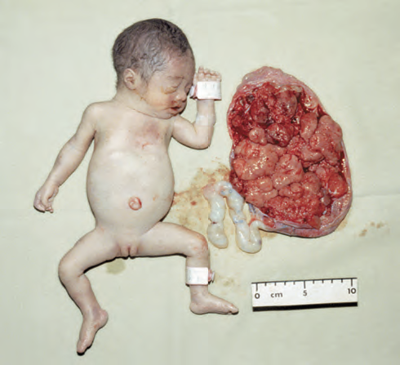
α‐Thalassaemia: hydrops fetalis, the result of deletion of all four α‐globin genes (homozygous α0‐thalassaemia). The main haemoglobin present is Hb Barts (γ4). The condition is incompatible with life beyond the fetal stage

Slide 7
Three α gene deletion leads to a moderately severe (haemoglobin 70–110 g/L) microcytic, hypochromic anaemia .with splenomegaly. This is known as Hb H disease because haemoglobin H (β4) can be
detected in red cells of these patients by electrophoresis or in reticulocyte preparations
In fetal life, Hb Barts (γ4) occurs
loss of one or two genes The α‐thalassaemia traits are usually not associated with anaemia.

Slide 8
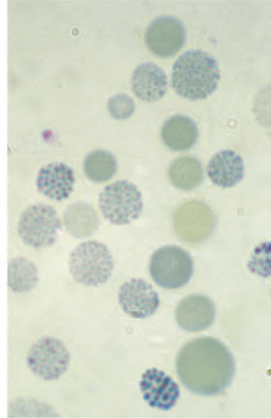
α‐Thalassaemia: haemoglobin H disease. Supravital staining with brilliant cresyl blue reveals multiple fine, deeply stained deposits (‘golf ball’ cells) caused by precipitation of aggregates of β‐globin chains.

Slide 9
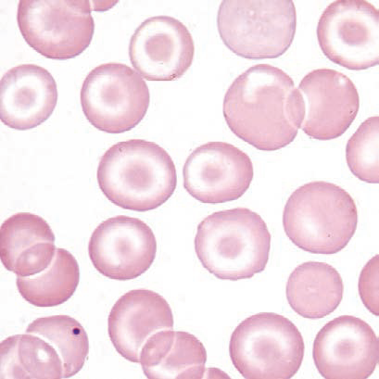
α‐Thalassaemia: haemoglobin H disease (three α‐globin gene deletion). The blood film shows marked hypochromic, microcytic cells with target cells and poikilocytosis

Slide 10
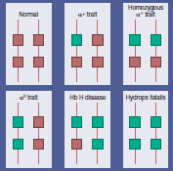
The genetics of α‐thalassaemia. Each α gene may be deleted or (less frequently) dysfunctional. The orange boxes represent normal genes, and the blue boxes represent gene deletions or dysfunctional genes

Slide 11
Lab. finding
The mean corpuscular volume (MCV) and mean corpuscular haemoglobin (MCH) are low and the red cell count is over 5.5 × 10¹²/L. Haemoglobin electrophoresis is normal and DNA analysis is needed to be certain of the diagnosis

Slide 12
β‐Thalassaemia syndromes
β‐Thalassaemia major
This condition occurs on average in one in four offspring if both parents are carriers of the β‐thalassaemia trait.
Either no β chain (β0)
or
small amounts (β+) are synthesized

Slide 13
Pathogenesis
Excess α chains precipitate in erythroblasts and in mature red cells causing severe ineffective erythropoiesis and haemolysis that are typical of this disease
Unlike α‐thalassaemia, the majority of genetic lesions are point mutations rather than gene deletions

Slide 14
Clinical features
1 .Severe anemia becomes apparent at 3–6 months after
birth when the switch from γ‐ to β‐chain production should take place.
Typically the infant presents in the first
year with failure to thrive, pallor and a swollen abdomen

Slide 15
2 .Enlargement of the liver and spleen
occurs as a result of
excessive red cell destruction
extramedullary haemopoiesis
and later because of iron overload

Slide 16
3. Expansion of bones caused by :
intense marrow hyperplasia
leads to a thalassaemic facies and to thinning of
the cortex of many bones with a tendency to fractures and bossing of the skull with a ‘hair‐on‐end’ appearance on Xray

Slide 17
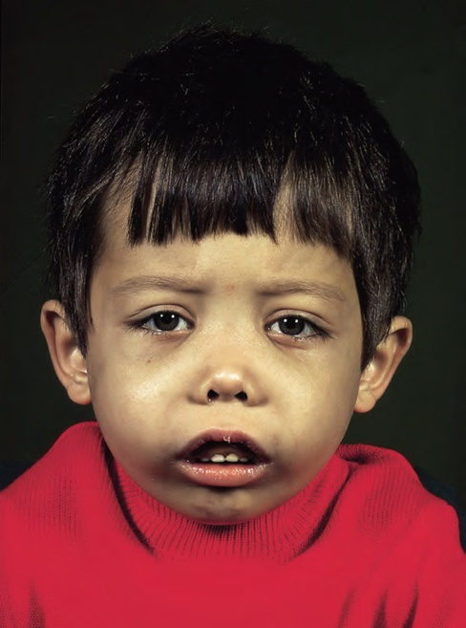
The facial appearance of a child with β‐thalassaemia major. The skull is bossed with prominent frontal and parietal bones; the maxilla is enlarged

Slide 18
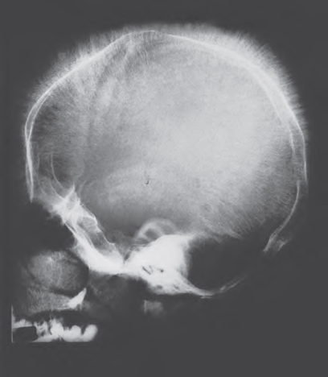
Skull X‐ray in β‐thalassaemia major. There is a ‘hairon‐ end’ appearance as a result of expansion of the bone marrow into cortical bone.

Slide 19
4. Thalassaemia major is the disease that most frequently underlies transfusional iron overload
In the children, failure of growth
and delayed puberty are frequent, and without iron chelation,
death from cardiac damage usually occurs in teenagers.
The clinical features (due to hepatic, endocrine and
cardiac iron overload)

Slide 20
5. Infections occur frequently.
-In infancy, without adequate transfusion, anaemia predisposes to bacterial infections.
-Pneumococcal, Haemophilus and meningococcal infections are likely if splenectomy has been carried out
-Iron overload itself also predisposes to bacterial infection, e.g. Klebsiella, and to fungal infection.
-Transfusion of viruses by blood transfusion may occur

Slide 21
6 .Liver disease in thalassaemia is most frequently a result of
hepatitis C but hepatitis B is also common where the virus is endemic.
Human immunodeficiency virus (HIV) has
been transmitted to some patients by blood transfusion.
Iron overload may also cause liver damage

Slide 22
7 Osteoporosis may occur in well‐transfused patients. It is more common in diabetic patients with endocrine abnormalities.
8 Hepatocellular carcinoma incidence is increased in those with iron overload and chronic hepatitis B or C.

Slide 23
Laboratory diagnosis
1. There is a severe hypochromic, microcytic anaemia with
normoblasts, target cells and basophilic stippling in the
blood film.
2. High performance liquid chromatography (HPLC) is now
usually used as the first‐line method to diagnose haemoglobin
disorders .
HPLC or haemoglobin electrophoresis reveals absence or almost complete absence of Hb A, with almost all the circulating haemoglobin being Hb F. The Hb A2 percentage is normal, low or slightly raised.
DNA analysis is used to identify the defect on each allele important in antenatal diagnosis

Slide 24
β‐Thalassaemia trait (minor)
This is a common, usually symptomless, abnormality characterized
like α‐thalassaemia trait by a hypochromic, microcytic
blood picture (MCV and MCH very low) but high red
cell count (>5.5 × 1012/L) and mild anaemia (haemoglobin
100–120 g/L).
It is usually more severe than α thalassaemia trait.
A raised Hb A2 (>3.5%) confirms the diagnosis.
The diagnosis allows the possibility of prenatal counselling. If the partner also has β‐thalassaemia trait there is a 25% risk of a thalassaemia major child.

Slide 25
Non‐transfusion dependent thalassaemia
(thalassaemia intermedia)
This is thalassaemia of moderate severity (haemoglobin 70–100 g/L)
without the need for regular transfusions

Slide 26
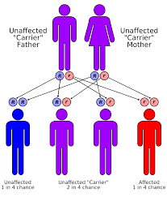
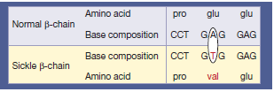
Sickle cell disease
inheritance: autosomal recessive
The sickle β‐globin abnormality is caused by substitution of valine for glutamic acid in position 6 in the β chain

Slide 27
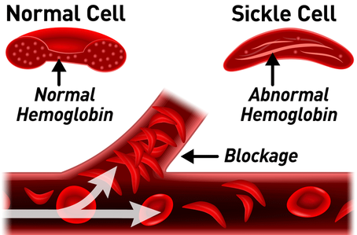
Hb S(Hb α2β2S)
is insoluble and forms crystals
when exposed to
low oxygen tension
The red cells sickle and may block different areas of the microcirculation or large vessels causing infarcts of various organs.

Slide 28
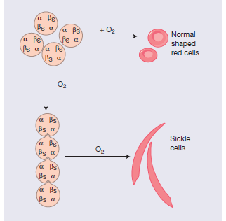
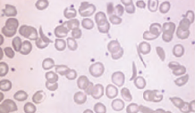

Slide 29
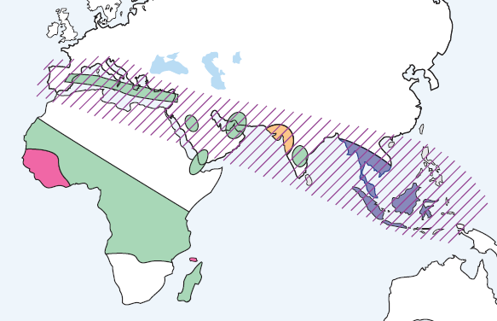
Epidemiology
The prevalence of the SCD is high in sub-Saharan Africa, Mediterranean Basin, Middle East and India because of the level of protection that the sickle cell trait provides against severe Malaria.

Slide 30
Clinical features
Homozygous disease
severe haemolytic anaemia punctuated by crises.
The symptoms of anaemia are often mild in relation to
the severity of the anaemia because Hb S gives up oxygen (O2) to tissues relatively easily compared with Hb
The clinical expression of Hb SS is very variable, some patients an almost normal life, free of crises, but others develop severe crises even as infants and may die in early childhood or as young adults

Slide 31
crises
Vaso‐occlusive crises
Aplastic crises
Haemolytic crises

Slide 32
Vaso‐occlusive crises
Painful : These are the most frequent. precipitated by :
Infection
Acidosis
dehydration
deoxygenation (e.g. altitude, operations, obstetric delivery,
stasis of the circulation, exposure to cold, violent exercise).
Infarcts causing severe pain occur in the bones (hips, shoulders and vertebrae are commonly affected)
The ‘hand– foot’ syndrome (painful dactylitis caused by infarcts of the small bones) is frequently the first presentation of the disease and may lead to digits of varying lengths

Slide 33
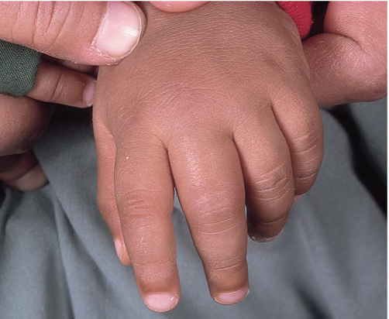
painful swollen fingers (dactylitis) in a child

Slide 34
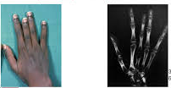
hand–foot’ syndrome

Slide 35
Visceral:
These are caused by sickling within organs causing infarction and pooling of blood, often with a severe exacerbation of anaemia.
-The acute sickle chest syndrome is the most common cause of death
both in children and adults.
It presents with dyspnoea, falling arterial PO2, chest pain and pulmonary infiltrates on chest X‐ray.

Slide 36
-Splenic sequestration is typically seen in infants and presents with an enlarging spleen, falling haemoglobin and abdominal pain.
Treatment is with transfusion.
Attacks tend to be recurrent and splenectomy is often needed.
-Priapism and liver and kidney damage due to repeated small infarcts are other complications

Slide 37
Aplastic crises
These occur as a result of:
- infection with parvovirus
- folate deficiency
characterized by:
a sudden fall in haemoglobin
and reticulocytes.
usually requiring transfusion

Slide 38
Haemolytic crises
These are characterized by :
-an increased rate of haemolysis and
-fall in haemoglobin
-but rise in reticulocytes
- and usually accompany a painful crisis

Slide 39
Other organ damage
The most serious is of the brain (a stroke occurs in 7% of all patients) or spinal cord.
Up to a third of children have had a
silent cerebral infarct by the age of 6 years.
Ulcers of the lower legs are common, as a result of vascular stasis and local ischaemia

Slide 40
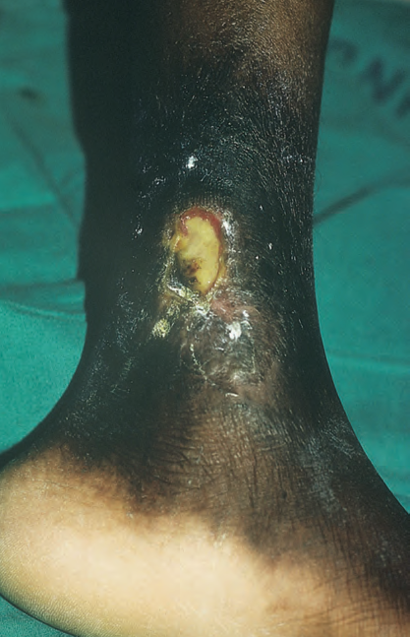
necrosis and ulceration

Slide 41
-spleen is enlarged in infancy and early childhood but later is often reduced in size as
a result of infarcts (autosplenectomy).
-Pulmonary hypertension
-Infections are frequent partly due to hyposplenism.
Pneumonia, urinary tract infections and Gram‐negative septicaemia are common. Osteomyelitis may also occur, usually from Salmonella spp.

Slide 42
Laboratory findings
1 The haemoglobin is usually 60–90 g/L – low in comparison
to mild or no symptoms of anaemia.
2 Sickle cells and target cells occur in the blood .
Features of splenic atrophy (e.g. Howell–Jolly bodies) may
also be present.
3 Screening tests for sickling are positive when the blood is
deoxygenated .
4 HPLC or haemoglobin electrophoresis :in Hb
SS, no Hb A is detected. The amount of Hb F is variable
and is usually 5–15%, larger amounts are usually associated
with a milder disorder.

Slide 43
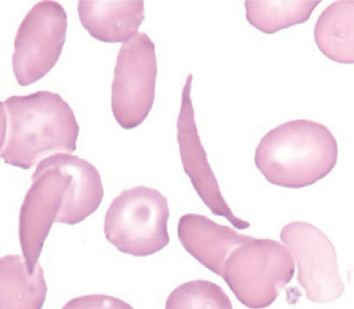
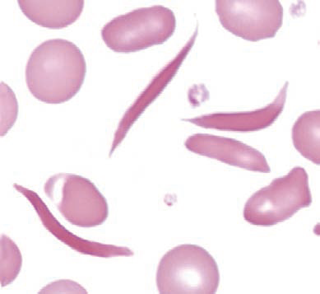
Sickle cell anaemia: peripheral blood film showing deeply staining sickle cells, target cells and polychromasia.

Slide 44
Sickle cell trait
This is a benign condition with no anaemia and normal appearance of red cells in a blood film. Haematuria is the most common symptom and is thought to be caused by minor infarcts of the renal papillae.
Hb S varies from 25–45% of the
total haemoglobin
Care must be taken with anaesthesia,
pregnancy and at high altitudes.

