Slide 1
3ed practical anemia
Prof. Abeer Anwer Ahmed

Slide 3
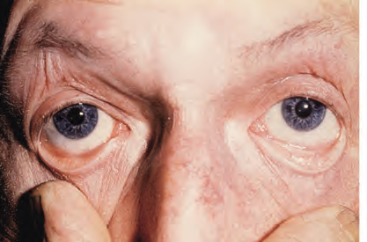
Pallor of the conjunctival mucosa in patient with severe anaemia

Slide 4
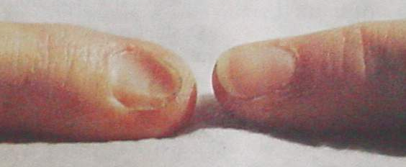
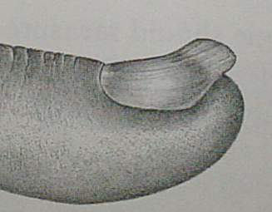
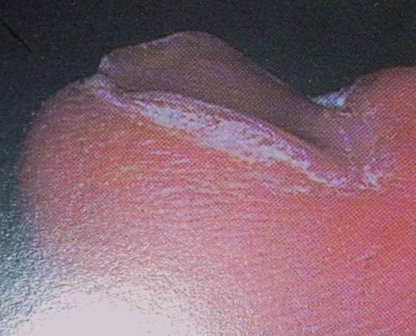
Koilonychia - spoon shaped nail

Slide 5
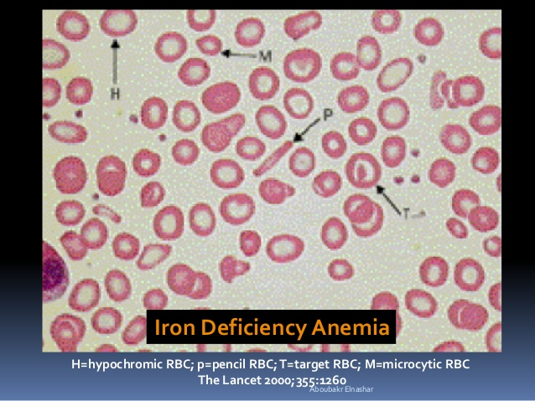

Slide 6
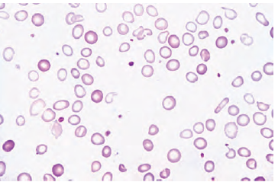
Blood film of IDA: Hypochromic microcytic RBCs with occational target cells and pencil shape poikelocyte

Slide 7
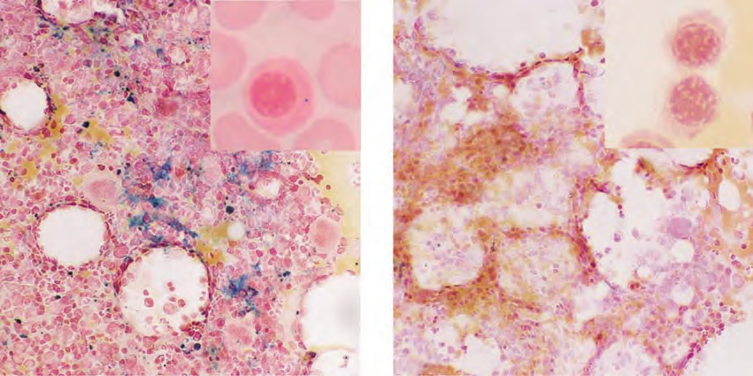
Bone marrow iron assessed by Perls’ stain
Normal iron stores indicated by blue staining in the macrophages. Inset: normal siderotic granule in erythroblast.

Slide 8
Bone marrow iron assessed by Perls’ stain.
(Absence of blue staining (absence of haemosiderin) in iron deficiency. Inset: absence of siderotic granules in erythroblasts.

Slide 9
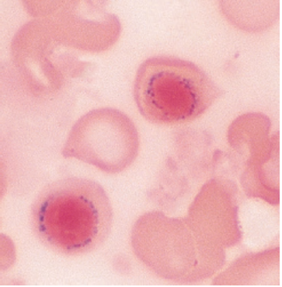
Ring sideroblasts with a perinuclear ring of iron granules in sideroblastic anaemia.

Slide 10
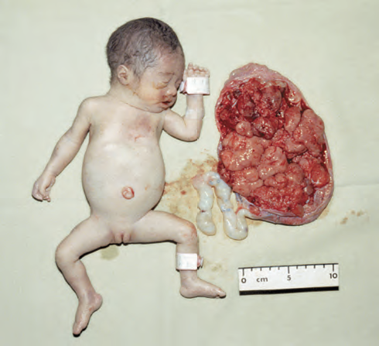
α‐Thalassaemia: hydrops fetalis, the result of deletion of all four α‐globin genes (homozygous α0‐thalassaemia). The main haemoglobin present is Hb Barts (γ4). The condition is incompatible with life beyond the fetal stage

Slide 11
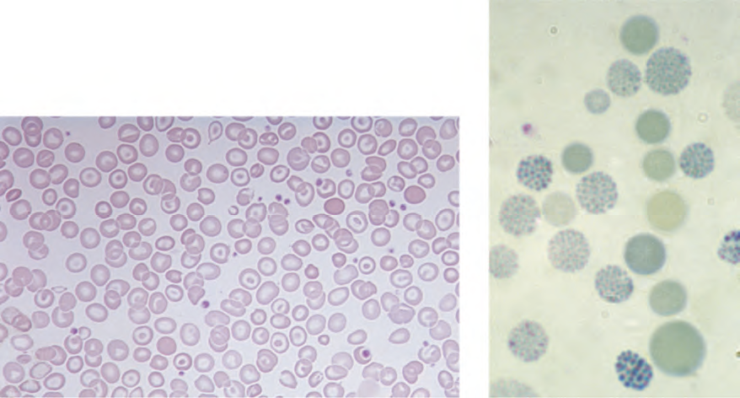
α‐Thalassaemia: haemoglobin H disease. Supravital staining with brilliant cresyl blue reveals multiple fine, deeply stained deposits (‘golf ball’ cells) caused by precipitation of aggregates of β‐globin chains.

Slide 12
α‐Thalassaemia: haemoglobin H disease (three α‐globin gene deletion). The blood film shows marked hypochromic, microcytic cells with target cells and poikilocytosis

Slide 13
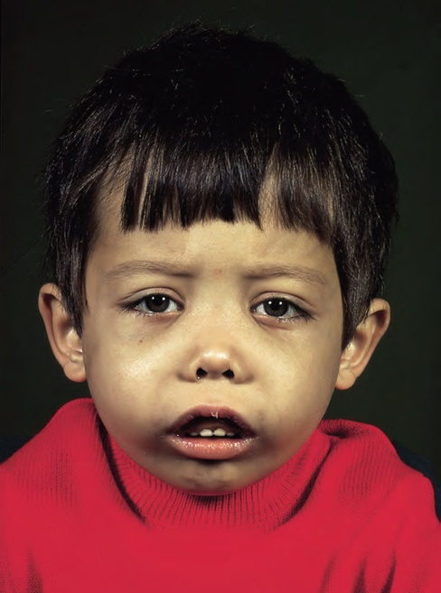
The facial appearance of a child with β‐thalassaemia major. The skull is bossed with prominent frontal and parietal bones; the maxilla is enlarged

Slide 14
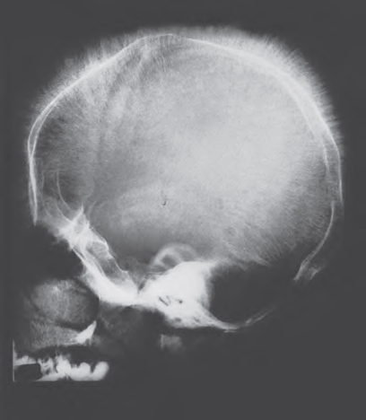
Skull X‐ray in β‐thalassaemia major. There is a ‘hairon‐ end’ appearance as a result of expansion of the bone marrow into cortical bone.

Slide 15

Sickle cell disease is a group of haemoglobin disorders resulting from the inheritance of the sickle β‐globin gene.
Sickle cell disease (SCD) is an
autosomal recessive

Slide 16
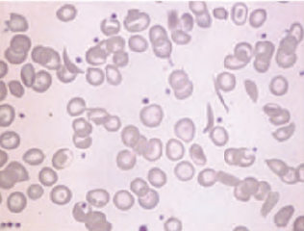
Sickle cell anaemia: peripheral blood film showing deeply staining sickle cells, target cells and polychromasia.

Slide 17
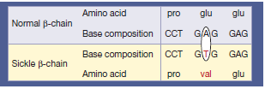
The sickle β‐globin abnormality is caused by substitution of valine for glutamic acid in position 6 in the β chain

Slide 18
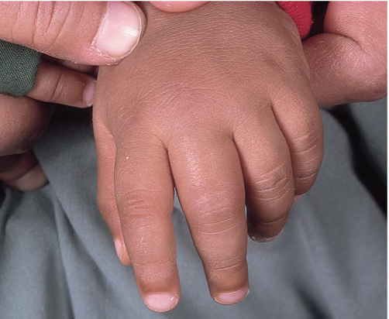
painful swollen fingers (dactylitis) in a child

Slide 19
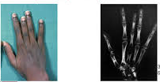
hand–foot’ syndrome

Slide 20
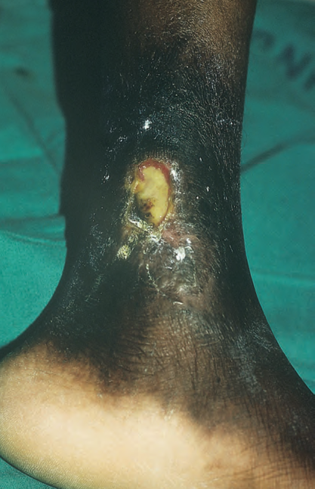
necrosis and ulceration

Slide 21
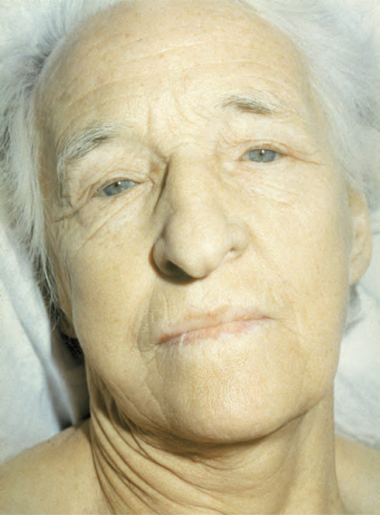
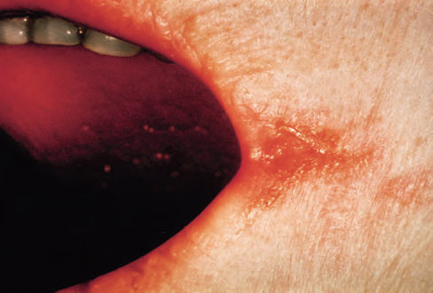
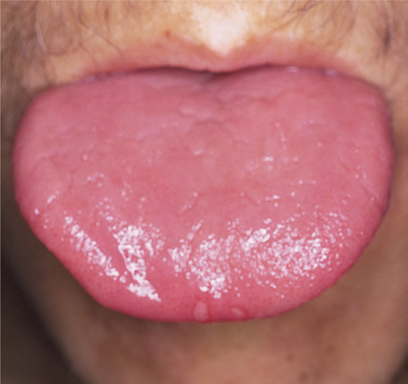

Slide 22
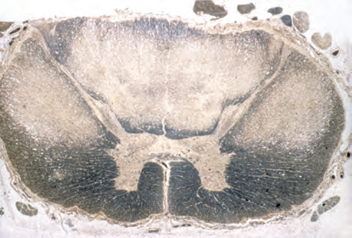
Cross‐section of the spinal cord in a patient who died with subacute combined degeneration of the cord (Weigert–Pal stain). There is demyelination of the dorsal and dorsolateral columns.

Slide 23
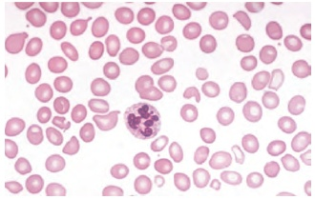
Megaloblastic anaemia: peripheral blood film showing oval macrocytes

Slide 24
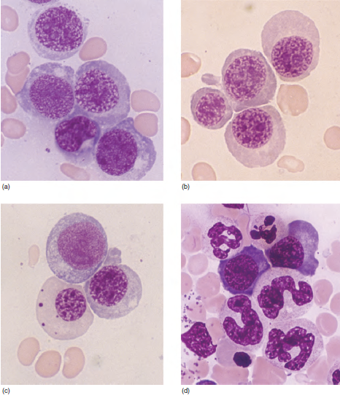
Megaloblastic changes in the bone marrow in a patient with severe megaloblastic anaemia. (a–c) Erythroblasts showing fine, open stippled (primitive) appearance of the nuclear chromatin even in late cells (pale cytoplasm with some haemoglobin formation).
(d) Abnormal giant metamyelocytes and band forms.

Slide 25
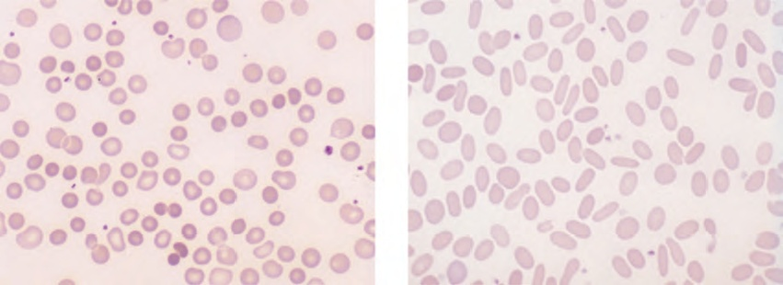
(a) Blood film in hereditary spherocytosis. The spherocytes are deeply staining and of small diameter. Larger polychromatic cells are reticulocytes (confirmed by supravital staining). (b) Blood film in hereditary elliptocytosis.

Slide 26
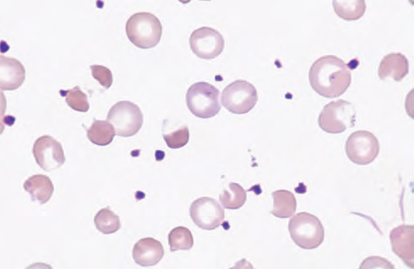
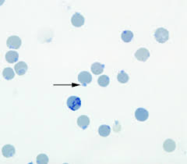
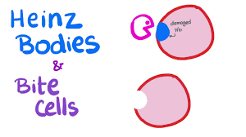
Blood film in G6PD deficiency with acute haemolysis after an oxidant stress. Some of the cells show loss of cytoplasm with separation of remaining haemoglobin from the cell membrane
(‘blister’ cells). There are also numerous contracted and deeply staining cells.

Slide 27
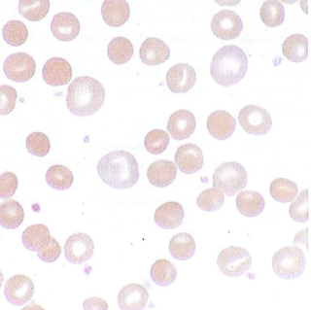
Blood film in warm autoimmune haemolytic anaemia. Numerous microspherocytes are present and larger polychromatic cells (reticulocytes)

Slide 28
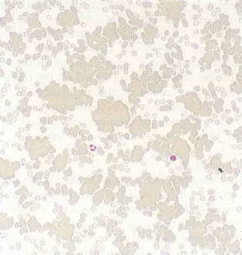
Blood film in cold autoimmune haemolytic anaemia. Marked red cell agglutination is present in films made at room temperature. The background is caused by the raised plasma protein concentration

Slide 29
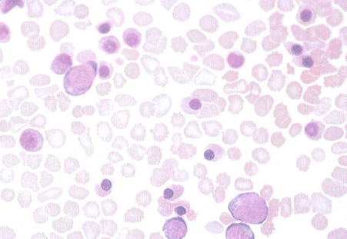

Slide 30
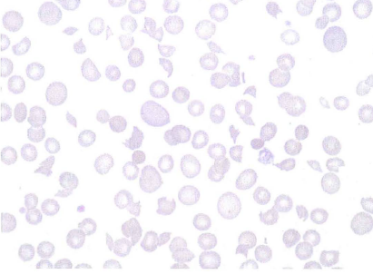
Blood film in microangiopathic haemolytic anaemia
(in this patient Gram‐negative septicaemia). Numerous contracted and deeply staining cells and cell fragments are present

Slide 31
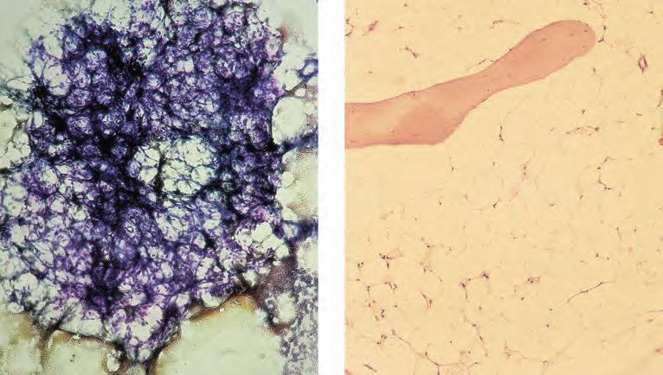
Aplastic anaemia: low power views of bone marrow show severe reduction of haemopoietic cells with an increase in fat spaces. (a) Aspirated fragment. (b) Trephine biopsy

Slide 32
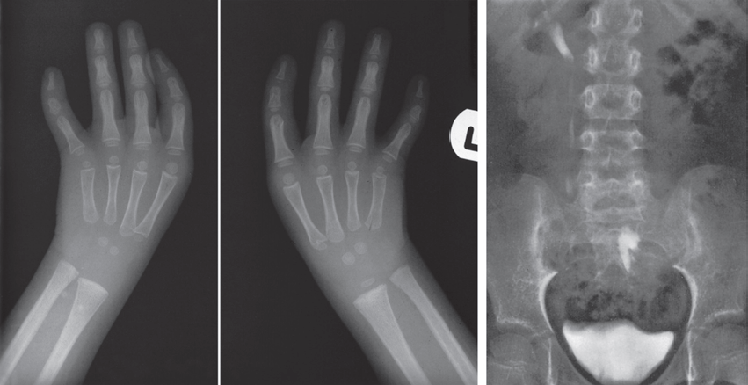
a) X-rays showing absent thumbs in a patient with Fanconi anaemia (FA). (b) Intravenous pyelogram in a patient with FA showing a normal right kidney but a left kidney abnormally placed in the pelvis.

