Slide 1
L3 Hypochromic anaemias
Prof.Abeer Anwer Ahmed

Slide 2
iron deficiency is the most common cause of
anaemia, affecting about 500 million people worldwide.
It is particularly frequent in low‐income populations, such as in sub‐Saharan Africa or South Asia, where the diet can be of poor quality and parasites (e.g. hookworm or schistosomiasis), which cause iron loss due to haemorrhage, may be present.
Moreover the body has limited ability to absorb iron

Slide 3
Iron deficiency is the major cause of a microcytic, hypochromic anaemia, in which the two red cell indices, mean corpuscular volume(MCV) and mean corpuscular haemoglobin (MCH), are
reduced and the blood film shows small (microcytic) and pale (hypochromic) red cells. This appearance is caused by a
defect in haemoglobin synthesis

Slide 4
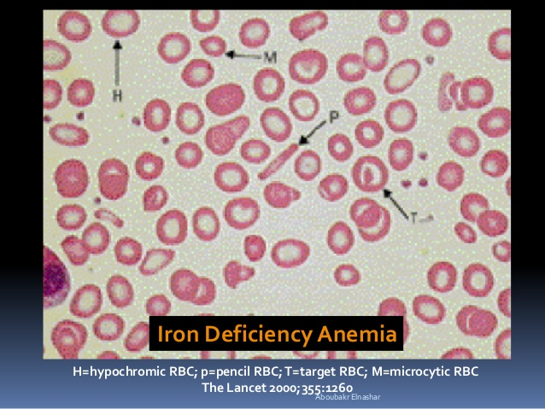

Slide 5
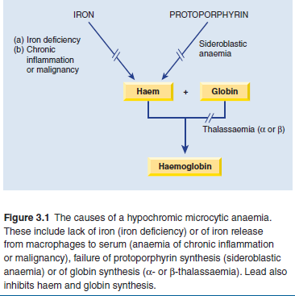

Slide 6
Body iron distribution and transport
The transport and storage of iron is largely mediated by
three proteins:
transferrin
transferrin receptor 1 (TfR1)
and ferritin.
Transferrin molecules can each contain up to two atoms of
iron. Transferrin delivers iron to tissues that have transferrin
receptors, especially erythroblasts in the bone marrow which
incorporate the iron into haemoglobin.
The transferrin is then reutilized.

Slide 7
At the end of their life, red cells are broken down in the macrophages of the reticuloendothelial
system and the iron is released from haemoglobin, enters the plasma and provides most of the iron on transferrin.
Only a small proportion of plasma transferrin iron comes from dietary iron, absorbed through the duodenum and jejunum.

Slide 8
Some iron is stored in the macrophages as ferritin and
haemosiderin, the amount varying widely according to overall
body iron status.
Ferritin is a water‐soluble protein–iron complex. It is made up of an outer protein shell, apoferritin, consisting of 22 subunits and an iron–phosphate–hydroxidecore. It contains up to 20% of its weight as iron and is not visible by light microscopy.
Haemosiderin is an insoluble protein–iron complex of
varying composition containing approximately 37% iron by
weight. It is derived from partial lysosomal digestion of ferritin
molecules and is visible in macrophages and other cells by light microscopy after staining by Perls’ (Prussian blue) reaction

Slide 9
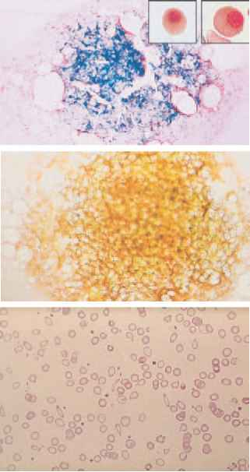

Slide 10
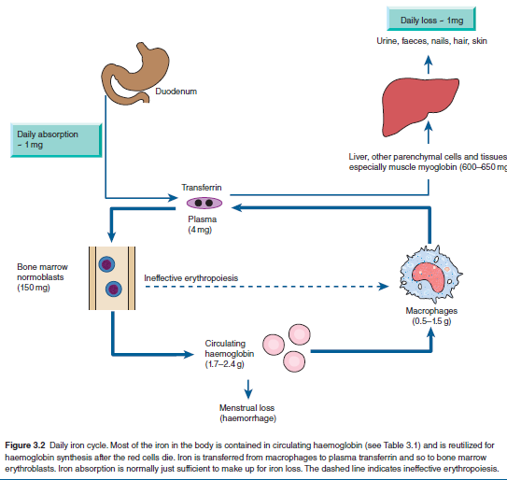
Daily iron cycle. Most of the iron in the body is contained in circulating haemoglobin and is reutilized for synthesis after the red cells die. Iron is transferred from macrophages to plasma transferrin and so to bone marrow erythroblasts. Iron absorption is normally just sufficient to make up for iron loss. The dashed line indicates ineffective erythropoiesis

Slide 11
Iron in ferritin and haemosiderin is in the ferric form.
It is mobilized after reduction to the ferrous form.
A copper‐containing enzyme, caeruloplasmin, catalyses oxidation of the iron to the ferric form for binding to plasma transferrin.
Iron is also present in muscle as myoglobin and in most
cells of the body in iron‐containing enzymes (e.g. cytochromes
or catalase) .
This tissue iron is less likely to become depleted than haemosiderin, ferritin and haemoglobin in states
of iron deficiency, but some reduction of these haem‐containing enzymes may occur

Slide 12
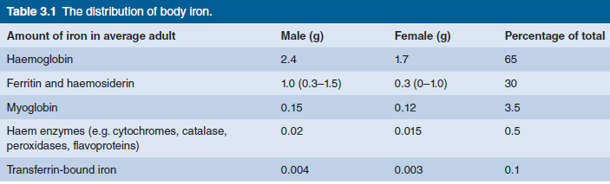

Slide 13
Regulation of ferritin and transferrin receptor 1 synthesis
The levels of ferritin, TfR1, δ‐aminolaevulinic acid synthase
(ALA‐S) and divalent metal transporter 1 (DMT‐1) are linked
to iron status
iron overload causes a rise in tissue ferritin and a fall in TfR1 and DMT‐1,
whereas in iron deficiency ferritin and ALA‐S are low and TfR1 increased.
This linkage arises through the binding of an iron regulatory protein (IRP)
to iron response elements (IREs) on the ferritin, TfR1, ALA‐S and DMT‐1
mRNA molecules.
Iron deficiency increases the ability of IRP to bind to the IREs whereas
iron overload reduces the binding.
The site of IRP binding to IREs, whether upstream (5′) or downstream (3′) from the coding gene, determines whether the amount of mRNA and so protein produced is increased or decreased .

Slide 14
Regulation of transferrin receptor 1 (TfR1)
divalent metal transporter 1 (DMT‐1)
and ferritin expression by iron regulatory protein (IRP) sensing of intracellular iron levels.
IRPs are able to bind to stem‐loop structures called iron response
elements (IREs).
IRP binding to the IRE within the 3′ untranslated region of TfR1 and DMT‐1 leads to stabilization of the mRNA and increased protein synthesis,
whereas IRP binding to the IRE within the 5′ untranslated region of ferritin and δ‐aminolaevulinic acid synthase (ALA‐S) mRNA reduces translation. IRPs can exist in two states:
at times of high iron levels the IRP binds iron and exhibits a reduced affinity for the IREs,
whereas when iron levels are low the binding of IRPs to IREs is increased. In this way synthesis of TfR, ALA‐S, DMT‐1 and ferritin is coordinated physiological requirements.

Slide 15
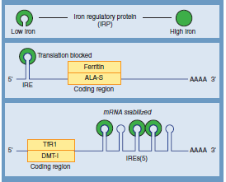

Slide 16
Upstream binding reduces translation, whereas downstream binding stabilizes the mRNA, increasing translation and so protein synthesis.
When plasma iron is raised and transferrin is saturated, the amount of iron transferred to parenchymal cells (e.g. those of the liver, endocrine organs and heart) is increased and this is the basis of the pathological changes associated with iron loading conditions.
There may also be free iron in plasma which is toxic to different organs

Slide 17
Hepcidin
Hepcidin is a polypeptide produced by liver cells.
It is the major hormonal regulator of iron homeostasis
It iron release from macrophages and from intestinal epithelial cells by its interaction with the transmembrane iron exporter, ferroportin.
It accelerates degradation of ferroportin mRNA.
Raised hepcidin levels therefore profoundly affect
iron metabolism by reducing its absorption and release from macrophages

Slide 18
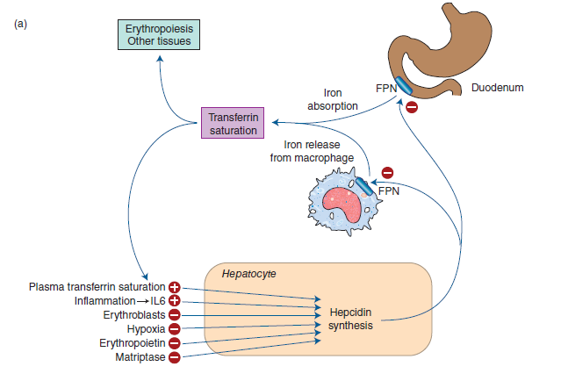
Hepcidin reduces iron absorption and release from macrophages by stimulating degradation of ferroportin.
Its synthesis is increased by transferrin saturation and inflammation but reduced by increased erythropoiesis, erythropoietin, hypoxia and matriptase

Slide 19
Control of hepcidin expression
Membrane‐bound hemojuvelin (HJV) is a co‐receptor with bone morphogenetic protein (BMP) which stimulates hepcidin expression .
A complex between HFE and transferrin receptor 2 (TfR2) promotes HJV binding to BMP.
The amount of HFE–TfR2 complex is determined by the degree of iron saturation of transferrin as follows:
Diferric transferrin competes with TfR1 for binding to HFE.
The more diferric transferrin, the less TfR1 is bound to HFE and more HFE is available to bind to TfR2, with consequently increased hepcidin synthesis.
Low concentrations of diferric transferrin, as in iron deficiency, allow HFE binding to TfR1, reducing the amount of HFE able to bind TfR2 and thus reducing hepcidin secretion.
HFE also increases BMP expression, directly increasing hepcidin synthesis.

Slide 20
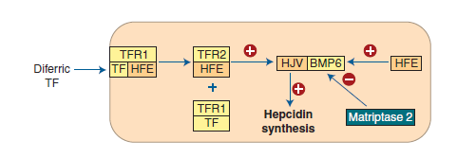
The proposed mechanism by which the degree of transferrin saturation by iron affects hepcidin synthesis.
BMP, bone morphogenetic protein; HJV, hemojuvelin; TFR1 and 2, transferrin receptor 1 and 2.
BMP stimulates hepcidin synthesis and this is enhanced by HJV binding to BMP.
Diferric transferrin competes with TFR1 for binding of HFE.
The more diferric transferrin, the less TRF1 is bound to HFE and more HFE is available to bind to TFR2. The HFE/TFR2 complex promotes HJV binding to BMP and so promotes hepcidin synthesis.
Low concentrations of diferric transferrin, as in iron defciency, allow HFE binding to TFR1, reducing the amount of HFE able to bind TFR2 and thus reducing HJV binding to BMP and so reducing hepcidin secretion.
HFE also enhances BMP expression directly but mutated HFE inhibits its expression

Slide 21
Matriptase 2 digests membrane‐bound HJV.
In iron deficiency, increased matriptase activity therefore results in decreased hepcidin synthesis.
Erythroblasts secrete two proteins, erythroferrone and GDF 15, which suppress hepcidin secretion.
In conditions with increased numbers of early erythroblasts in the marrow (e.g. conditions of ineffective erythropoiesis, such as thalassaemia major), iron absorption is increased because of suppression of hepcidin secretion by these proteins.
Hypoxia also suppresses hepcidin synthesis, whereas
in inflammation interleukin 6 (IL‐6) and other cytokines
increase hepcidin synthesis

Slide 22
Dietary iron
Iron is present in food as ferric hydroxides, ferric–protein and haem–protein complexes.
Both the iron content and the proportion of iron absorbed differ from food to food;
In general meat, in particular liver, is a better source than vegetables, eggs or dairy foods. The average Western diet contains 10–15 mg
iron daily from which only 5–10% is normally absorbed.
The proportion can be increased to 20–30% in iron deficiency or pregnancy but even in these situations most dietary iron remains unabsorbed

Slide 23
Iron absorption
Organic dietary iron is partly absorbed as haem and partly
broken down in the gut to inorganic iron.
Absorption occurs through the duodenum. Haem is absorbed through a receptor, yet to be identified, on the apical membrane of the duodenal enterocyte.
Haem is then digested to release iron.
Inorganic iron absorption is favoured by factors such as acid and reducing agents that keep iron in the gut lumen in the Fe2+ rather than the Fe3+ state.
The protein DMT‐1 is involved in transfer of iron from the lumen of the gut across the enterocyte microvilli

Slide 24
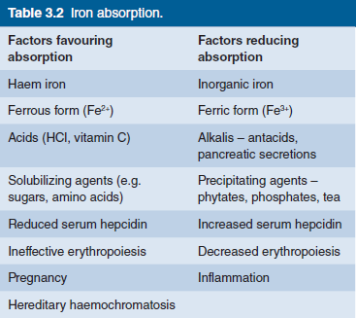

Slide 25
Ferroportin at the basolateral surface controls
exit of iron from the cell into portal plasma.
The amount of iron absorbed is regulated according to the body’s needs by changing the levels of DMT‐1 and ferroportin.
For DMT‐1 this occurs by the IRP/IRE binding mechanism and
for ferrroportin by hepcidin Ferrireductase present at the apical surface converts iron
from the Fe3+ to Fe2+ state and another enzyme,
(ferrioxidase), converts Fe2+ to Fe3+ at the basal surface prior to binding to transferrin.

Slide 26
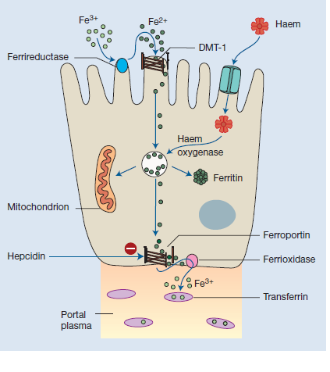
The regulation of iron absorption. Dietary ferric (Fe3+) iron is reduced to Fe2+ and its entry to the enterocyte is through the divalent cation binder DMT‐1. Its export into portal plasma is controlled by ferroportin.
It is oxidized before binding to transferrin in plasma.
Haem is absorbed after binding to its receptor protein.

Slide 27
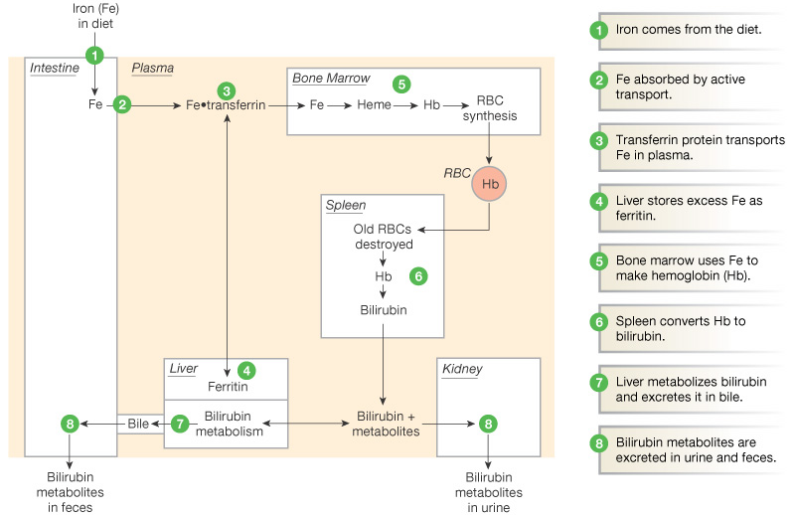
Iron Metabolism:
Figure 16-8: Iron metabolism

Slide 28
Iron requirements
The amount of iron required each day to compensate for losses
from the body and for growth varies with age and sex;
it is highest in pregnancy, adolescent and menstruating females
Therefore these groups are particularly likely to
develop iron deficiency if there is additional iron loss or prolonged reduced intake.

