Slide 1
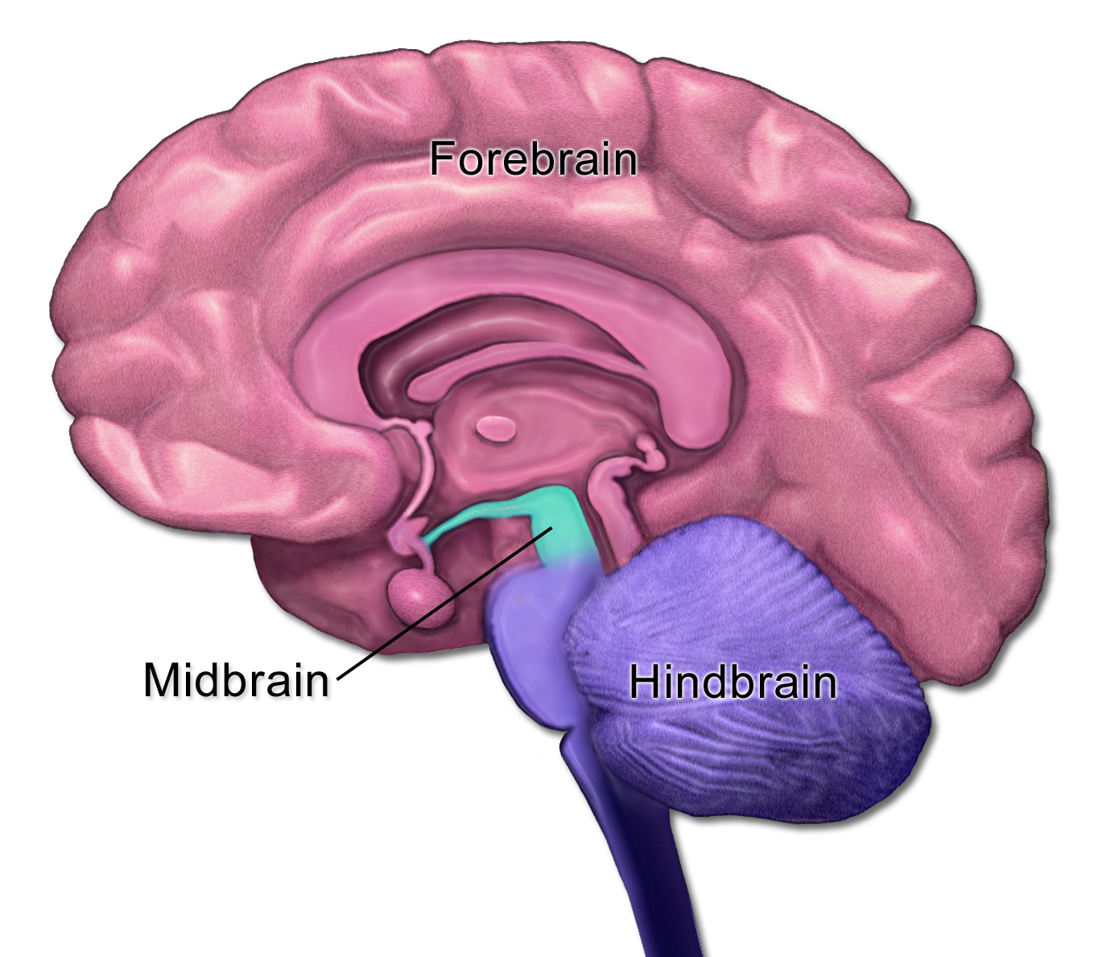
The Brainstem
OBJECTIVES
Recognize the position & external features of the brainstem.
Understand the general divisions of each part
Study the internal structures of each part by cross sections at different levels

Slide 2
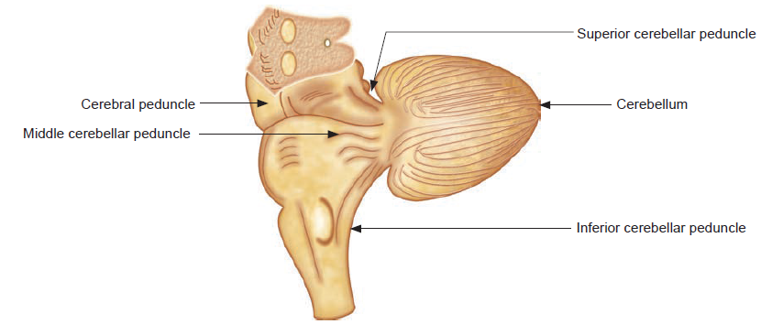
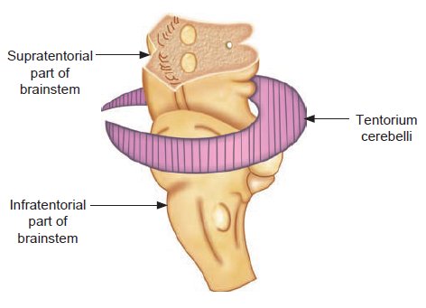
Position & relation to the cerebellum
The midbrain is supratentorial while the pons, MO & cerebellum are infratenteorial.
The cerebellum attaches to the midbrain by the superior cerebellar peduncles, to the pons by the middle cerebellar peduncles & to the medulla oblongata (MO) by the inferior cerebellar peduncles.

Slide 3
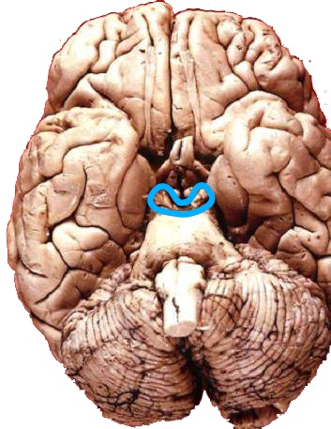
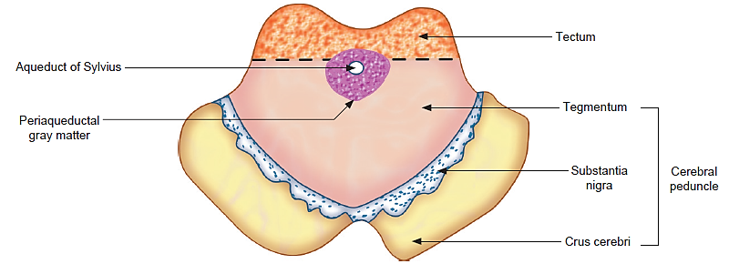
Midbrain: Position & Parts
Uppermost & shortest (2x2 cm) part of the brainstem connecting the forebrain to the hindbrain, connecting to the forebrain by the crura cerebri.
It passes through the tentorial notch & most of it lies in the posterior cranial fossa.
Formed of right & left halves. The cavity of the MB (cerebral aqueduct) divides each half into a tectum (=roof) posteriorly & tegmentum (=covering) anteriorly . The duct is surrounded by periaqueductal grey mater.

Slide 4
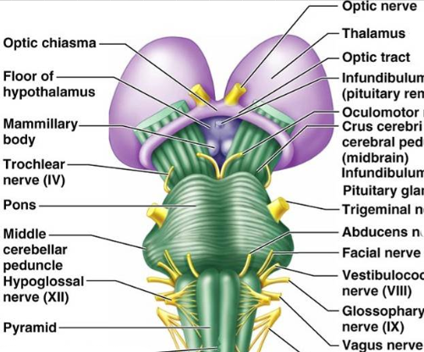
Midbrain: Ventral (ant.) Surface
The crura cerebri lie in a V-shaped manner cranial to the pons. They converge down towards the upper border of the pons from their point of emergence below the thalamus.
CN III emerge at the medial margin of each crus & CN IV winds on the lateral side of each crus from behind.
The optic tract curls around each crus cerebri.
Between the 2 crura lie the interpeduncular structures.

Slide 5
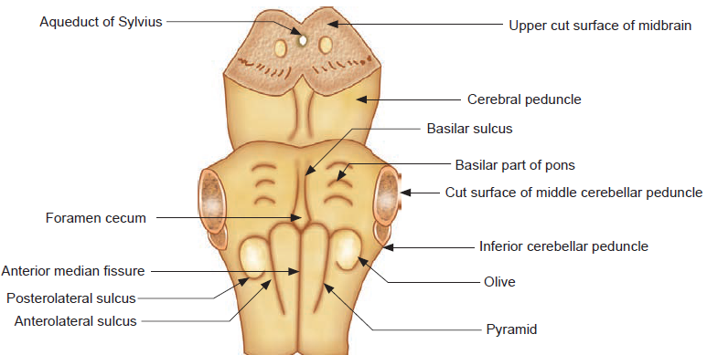
Pons: Ventral Surface
Ventral surface of pons is convex in both directions from the central basilar sulcus & curves at the sides into the middle cerebellar peduncles.
It’s striated transversely= basilar part. The convex bulges on each side of the basilar sulcus are caused by the bulk of the pontine nuclei
It lies along the clivus, separated from the bone by the pontine cistern.

Slide 6
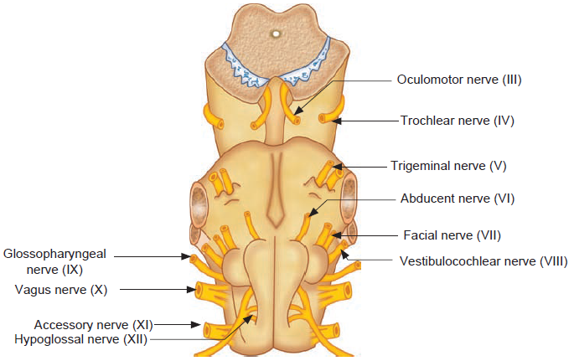
Pons: Cranial Nerves
CN V nerve emerges from the ventral surface of pons at its junction with the middle cerebellar peduncle by a small motor root and a large sensory root.
CN VI emerges ventral near the midline between the lower border of the pons & the pyramid of MO.
CN VII & VIII nerves emerge lateral to the VI at the pontomedullary junction above the olive.

Slide 7
MO : Ventral Surface
In the midline is the anterior median fissure which ends at the pontomedullary junction in a small depression called foramen cecum.
The pyramids ( caused by the underlying pyramidal decussation)lie on each side of the fissure and lateral to them is the ant.lat sulcus which separates them from the olive (caused by the underlying olivary nucleus). The post. lat. sulcus separates the olive from the inferior cerebellar peduncle behind.

Slide 8
MO: Cranial Nerves
The rootlets of CN IX, X & cranial XI emerge behind the olive from above downwards from the post.lat. sulcus.
The rootlets of CN XII emerge between the pyramid & the olive from the ant.lat. sulcus.

Slide 9
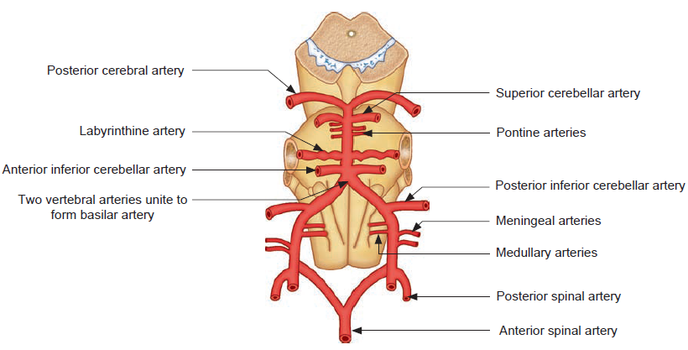
Brainstem: Ventral Surface (Arteries)

Slide 10
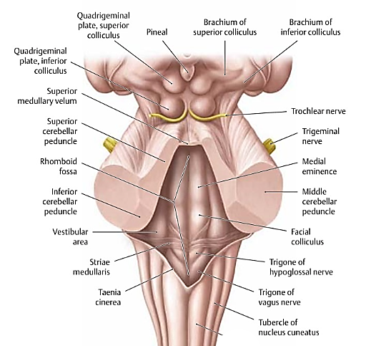
Midbrain: Dorsal (post.) Surface
Dorsally, the MB shows two pairs of rounded eminences called the sup.& inf. colliculi (=corpora quadrigemina)
The superior colliculi lie below the pineal body & the splenium of the CC, overlapped by the pulvinar & connects to LGB by the superior brachium. (Visual)
From the inferior colliculus, the inferior brachium passes sup.lat. towards MGB. (Auditory).
CN IV emerges from the dorsal surface & curves below the inf. colliculi to wind around the crura.
Below the inferior colliculi, the superior cerebellar peduncles converge from the cerebellum into the dorsal surface of the MB.

Slide 11
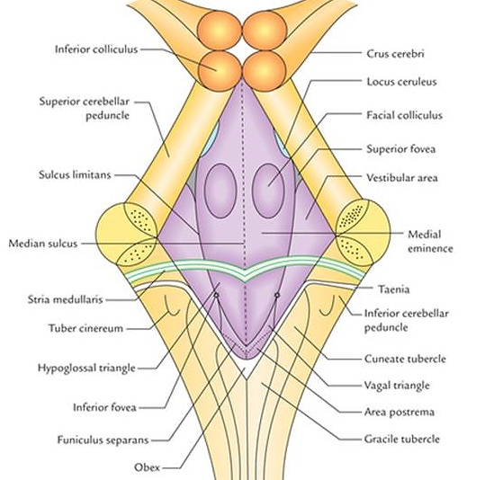
Pons: Dorsal Surface
The dorsal surface of the entire pons & upper ½ of MO (open medulla) is hidden by the cerebellum & form the floor of the 4th ventricle. The lower ½ of MO is the closed part.
A median sulcus runs along the floor in both the pons & MO.
The striae medullaris are glistening white fibers that emerge from the median sulcus & run transversely separating the pons from MO.

Slide 12
Pons: Dorsal Surface
The medial eminence is slightly eleveated area on each side of the median sulcus.
The facial colliculus is a small round elevation in the upper part of the eminence caused by the underlying VII nerve fibers as they wind around the CN VI nucleus.
The vestibular area (over the vestibular nuclei) lies lat. to the eminence & is separated from it by the sulcus limitans.
At the upper end of the vestibular area is a small depression called the superior fovea.

Slide 13
Open MO: Dorsal Surface
A faint groove passes from the inferior angle up towards the vestibular area to a small depression called the inferior fovea, dividing the floor on each side into two triangles:
The upper larger one is the hypoglossal triangle overlying CN XII nucleus.
The smaller lower one is the vagal triangle overlying the dorsal nucleus of the CN X.

Slide 14
Closed MO: Dorsal Surface
Two elevations lie on each side of the posterior median fissure: The gracile tubercle medially & the cuneate tubercle laterally (caused by the underlying nucleus gracilis & nucleus cuneatus). The inferior cerebellar peduncle lies lat. to the cuneate tubercle.

Slide 15
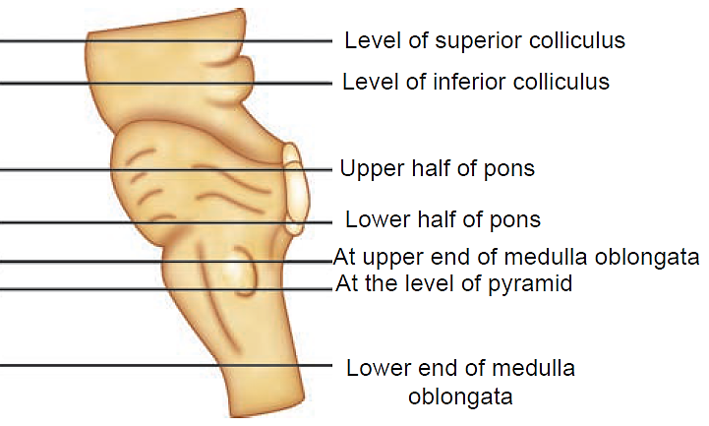
Studying the internal structure
1
2
3
4
5
6
7

Slide 16
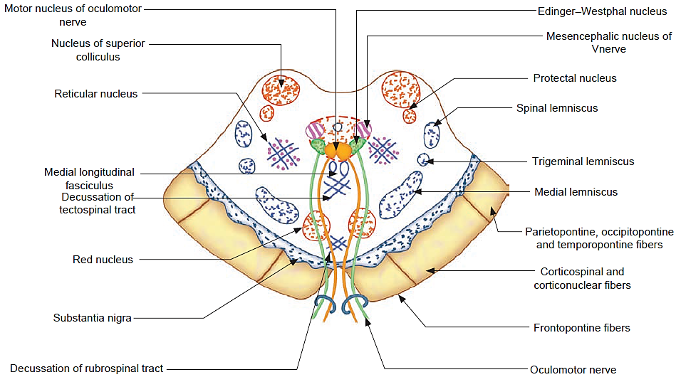
MB: Sup. Colliculus Section
Grey Mater
Nucleus | Position | Function
Nucleus of superior colliculus | Tectum (post.lat.) | General visual reflexes
Optic tract→ LGB→Sup. Brachium→ N. of Sup Coll→ tectobulbar & tectospinal fibers→ Brainstem & spinal cord

Slide 17
MB :Sup. Colliculus Section
Grey Mater
Nucleus | Position | Function
Pretectal nucleus | Just cranial to the sup. colliculus at the junction of the MB & diencephalon | Pupillary light reflex (aff.)
Optic tract & visual cortes→ Pretectal nucleus → Edinger-Westphal nucleus (bilaterally)

Slide 18
MB: Sup. Colliculus Section
Grey Mater
Nucleus | Position | Function
Motor nucleus of CN III | Ventromedial to aqueduct | Motor to extraocular mm.
Edinger-Westphal nucleus | Post.lat. to CN III motor n. | Pupillary light reflex (eff.)
Mesencephalic nucleus of CN V | Lateral to aqueduct | Receives properioception from the masticatory, facial, ocular & lingual muscles.

Slide 19
MB: Sup. Colliculus Section
Grey Mater
Nucleus | Position | Function
Reticular nuclei | Lat. tocentral grey matter | Controls alertness, circadian rhythm…etc.

Slide 20
MB: Sup. Colliculus Section
Grey Mater
Nucleus | Position | Function
Red nucleus | Paramedian behind substantia nigra | Part of the extrapyramidal system
Substantia nigra | Between tegmentum & crus cerebri | Negrostriate fibers secrete dopamine

Slide 21
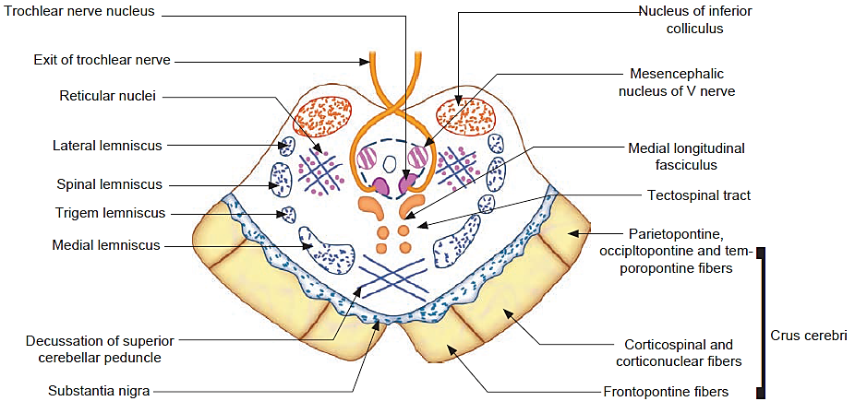
MB: Inf. Colliculus Section
Grey Mater
Nucleus | Position | Function
Nucleus of inferior colliculus | Tectum (post.lat.) | General auditory reflex
Cochlear nuclei→ lat. lemniscus→ N. of inf. colliculus→ inf. brachium → MGB

Slide 22
MB: Inf. Colliculus Section
Grey Mater
Nucleus | Position | Function
Mesencephalic nucleus of CN V | Lateral to aqueduct | Receives properioception from the masticatory, facial, ocular & lingual muscles.
Trochlear nerve nucleus | Ventromedial to aqueduct | Motor neurons tosuperior oblique muscle

Slide 24
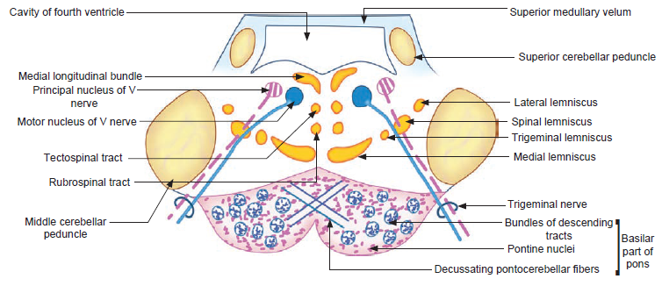
Upper Pons Section
Grey Mater
The numerous pontine nuclei occupy the ventral region (basilar part) scattered among white matter fibers. They receive the corticopontine fibers of the crura cerebri (afferent). Their efferent fibers emerge to cross to the opposite side as pontocerebellar decussation to reach the opposite cerebellar hemisphere forming the middle cerebellar peduncle. They are part of the cortico-ponto-cerebellar pathway. Longitudinal fibers lie among the pontine nuclei

Slide 25
Upper Pons Section
Grey Mater
Nucleus | Position | Function
Principal nucleus of V nerve | Ventral to the lateral part of the 4th ventricle | Receives touch impulses from the face
Motor nucleus of V nerve | Medial to the principal nucleus | Provides motor fibers to V3 nerve

Slide 26
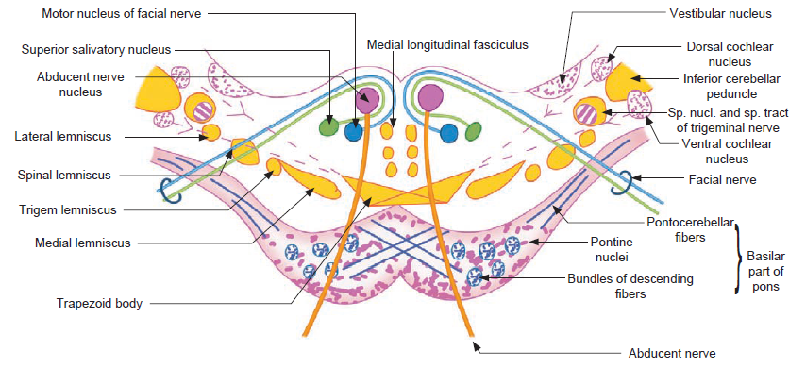
Lower Pons Section
Grey Mater
Nucleus | Position | Function
CN VI nucleus | Ventral to the facial colliculus | Motor fibers to lateral rectus muscle
Motor nucleus of CN VII | Ventrolateral to the VI nucleus | Provides motor innervations of muscles of facial expression
Superior salivary nucleus | Alongside the upper part of the VII nucleus | Parasympathetic fibers through the nervus intermedius part of the CN VII to pterygopalaine & submandibular ganglia

Slide 27
Lower Pons Section
Grey Mater
Nucleus | Position | Function
Spinal nucleus (& tract) of CN V | Lateral to VII nucleus | Receives facial pain & temperature
Ventral & Dorsal cochlear nuclei | In relation to ICP (Pons & MO) | Receive auditory information
Vestibular nuclei (Med., Lat. Sup. Inf.) | Ventral to the floor of the lateral angle of the 4th ventricle (Pons & MO) | Receive equilibrium info. from the vestibular nerve & give efferents to the cerebellum via the middle & inf. cerebellar peduncles

Slide 28
PONTINE DECUSSATION
Trapezoid body
The Trapezoid body lies near the midline between the basilar part & the long lemnisci & is composed of decussating fibers of the ventral cochlear nuclei of both sides

Slide 30
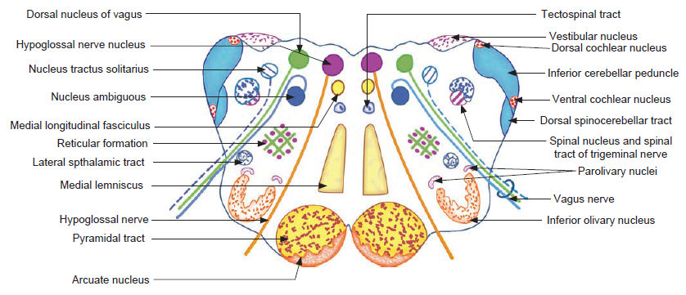
Upper Open (Upper) MO Section
Grey Mater
Vestibular & cochlear nuclei lie near the ICP

Slide 31
Upper Open (Upper) MO Section
Grey Mater
Nucleus | Position | Function
CN XII nucleus | Ventral to the XII trigone on each side of the midline | Fibers of the XII nerve for lingual muscles
Dorsal nucleus of X nerve | Lateral to XII nucleus (ventral to vagal trigone) | Contains motor cell bodies for cardiac & visceral muscles and gives rise to secretomotor fibers for glands
Inferior salivary nucleus | At the pontomedullary junction & upper MO | Parasympathetic fibers join the IX nerve to reach the otic ganglion

Slide 32
Upper Open (Upper) MO Section
Grey Mater
Nucleus | Position | Function
Nucleus of tractus solitarius | Ventrolateral to dorsal X nucleus | - The upper part receives taste fibers from the chorda tympani of CN VII, IX nerve & internal laryngeal branch of the X nerve - The lower part receives afferent fibers from the IX & X nerves from thoracic & abdominal viscera (including baroreceptors & chemoreceptors)

Slide 33
Lower Open (Upper) MO Section
Grey Mater
Nucleus | Position | Function
Nucleus ambiguous | Ventral to dorsal X nucleus | Sends motor fibers to skeletal muscles of the larynx, soft palate, pharynx & upper esophagus (all through CN X & cranial XI except fibers for stylopharyngeus which pass through CN IX)
Inferior olivary nucleus | Deep to the olive as a wrinkled C-shaped sac with its open mouth facing the opposite ICP | Its olivocerebellar fibers decussate across the midline to join the opposite ICP
Arcuate nucleus | Deep to pyramid | Chemoreception and breathing control

Slide 34
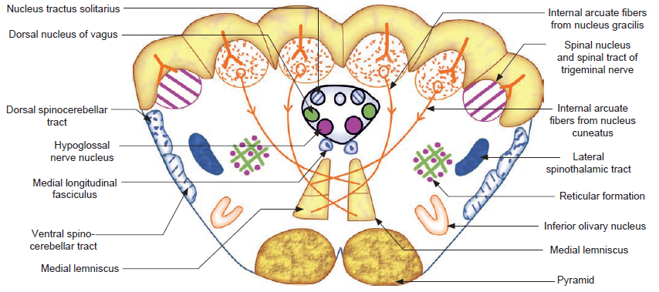
Closed (lower) MO Section: Level of Sensory Decussation
Grey Mater
The medulla is closed, and the central canal runs in the midline in continuation with the central canal of the spinal cord. Grey mater lies around the central canal & deep to the tubercles.

Slide 35
Closed (lower) MO Section: Level of Sensory Decussation
Grey Mater
 | Position | Function
Cuneate & Gracile nuclei | Deep to the corresponding tubercles | Contain the cell bodies on which the incoming fibers of the gracile & cuneate tracts of the spinal cord terminate. They give rise to the internal arcuate fibers that decussate to the medial lemniscus.
Nucleus of tractus solitarius,, dorsal nucleus of CN X & & CN XII nucleus lie around the central canal from post. to ant. Lower part of olivary nucleus deep to pyramid.

Slide 36
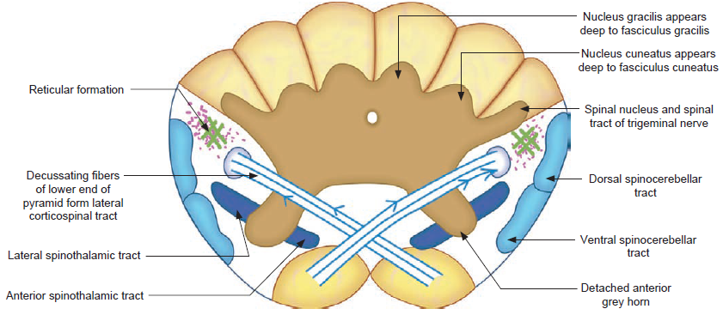
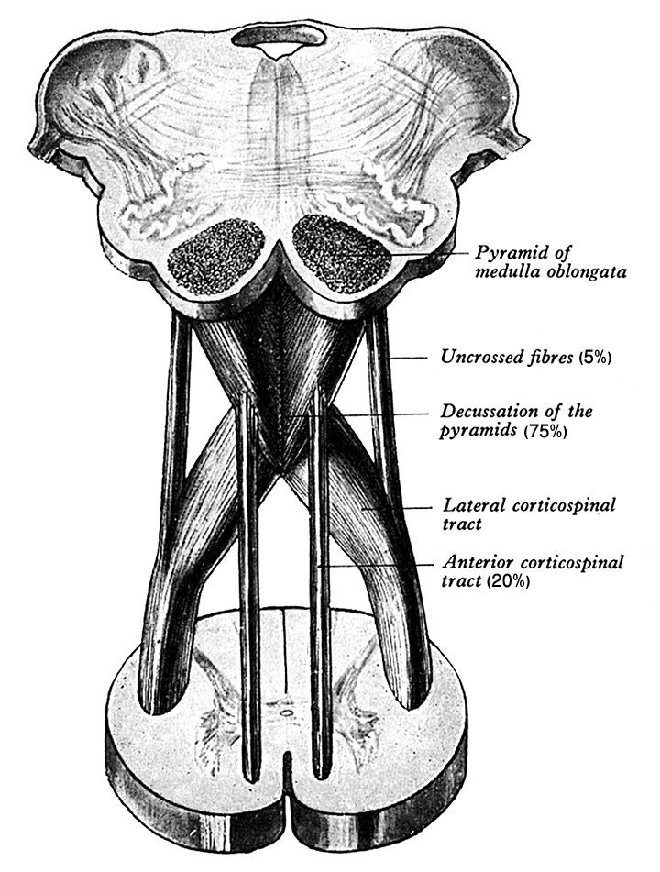
Closed (lower) MO Section: Level of Pyramidal Decussation
Nucleus gracilis & cuneatus enlarge to surround the central canal & have anterior grey horn. The anterior & lateral spinothalamic tracts lie ant. & lat. to the horns.
Descending fibers decussate at the pyramidal decussation forming the lateral corticospinal tract .
The decussation pushes the reticular formation laterally, deep to the spinocerebellar tracts.

Slide 38
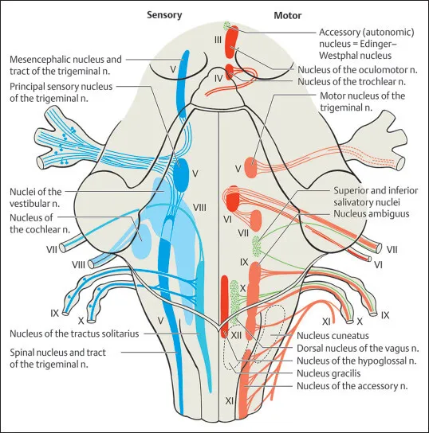

Slide 39
The Brainstem White Mater
White mater tracts
Descending
Pyramidal
Extrapyramidal
Ascending
To Thalamus (5)
Corticobulbar
Corticospinal
Tectospinal
Rubrospinal
Vestibulospinal
Reticulospinal
To cerebellum (3)
To Reticular formation (1)
To Midbrain (1)
Connecting (1)

Slide 40
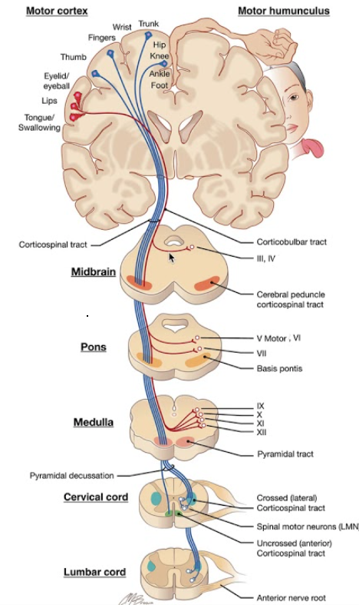
Descending Pyramidal Tracts
Corticobulbar
Corticospinal

Slide 41
PYRAMIDAL CONTRALITY
(corticospinal 75%) Decussation

Slide 42
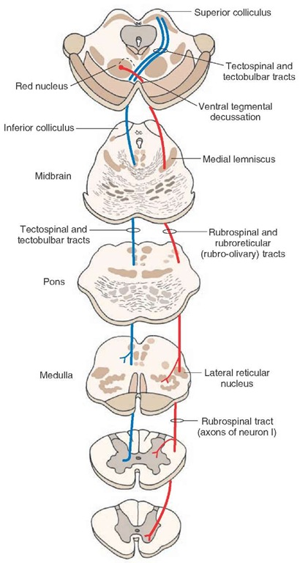
MIDBRAIN CONTRALITY+DECUSSATIONS
Decussation | Position | Function
Tectospinal decussation | Midline ventral to medial longitudinal bundle | Decussating descending fibers from the colliculi (tectum) to the spinal cord & medulla
Rubrospinal decussation | Midline between the 2 red nuclei | Decussating descending fibers from the red nucleus to the spinal cord

Slide 43
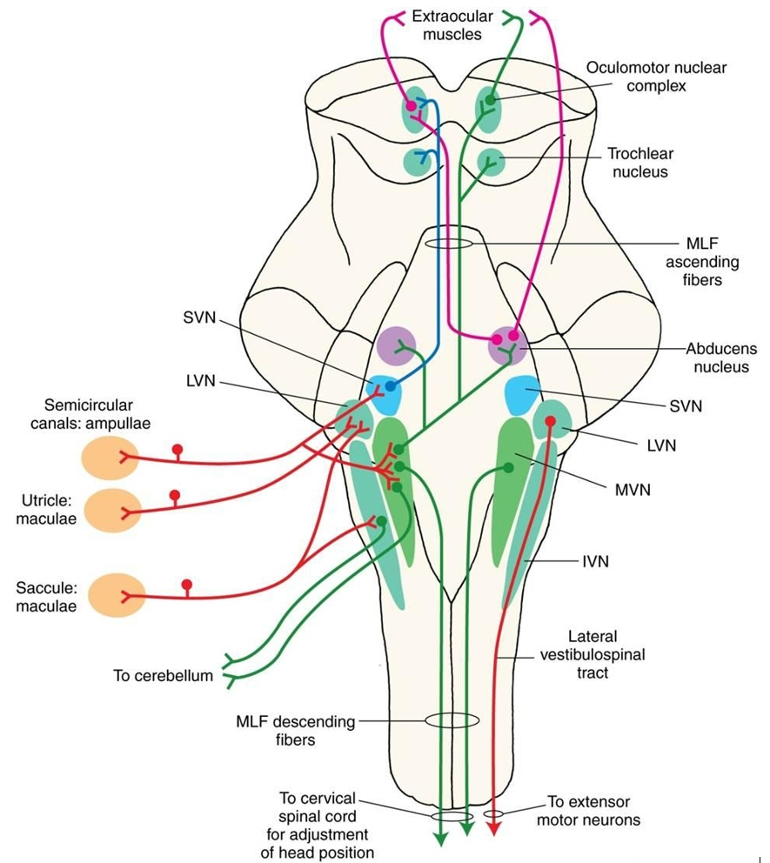
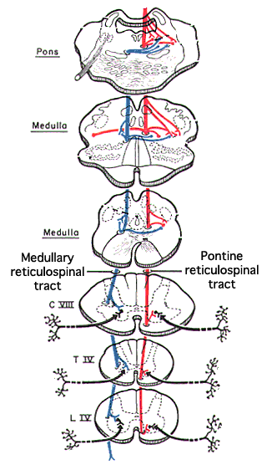
PONTINE LATERALITY
Vestibulospinal tracts
PONTOMEDULLARY LATERALITY:
Reticulospinal tracts

Slide 45
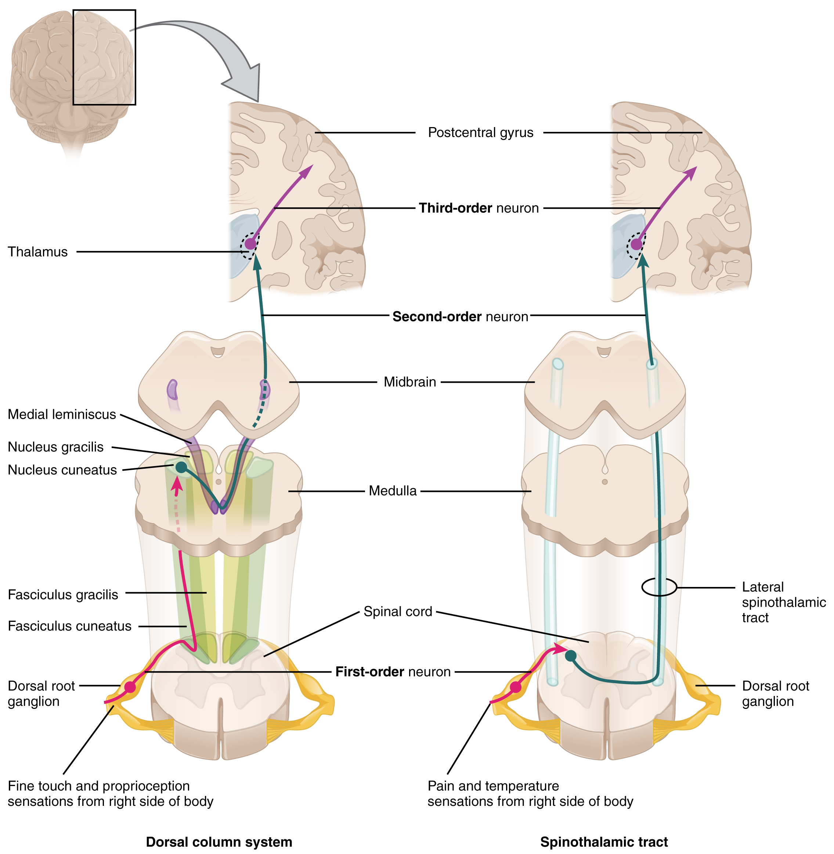
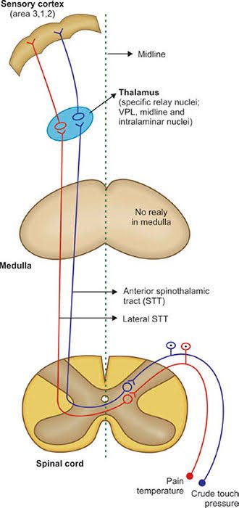
Crude touch & Pressure
Lateral
Anterior Spinothalmic tract

Slide 46
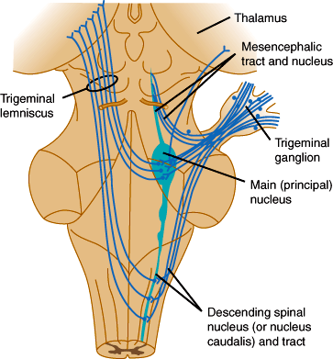
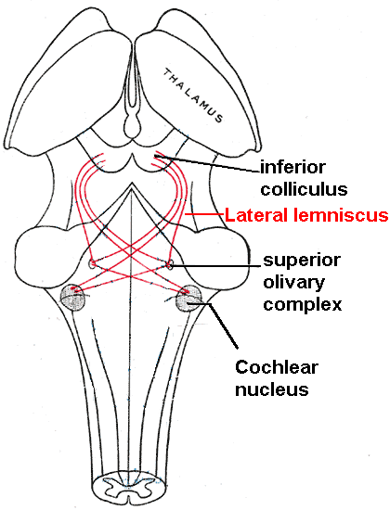

Slide 47
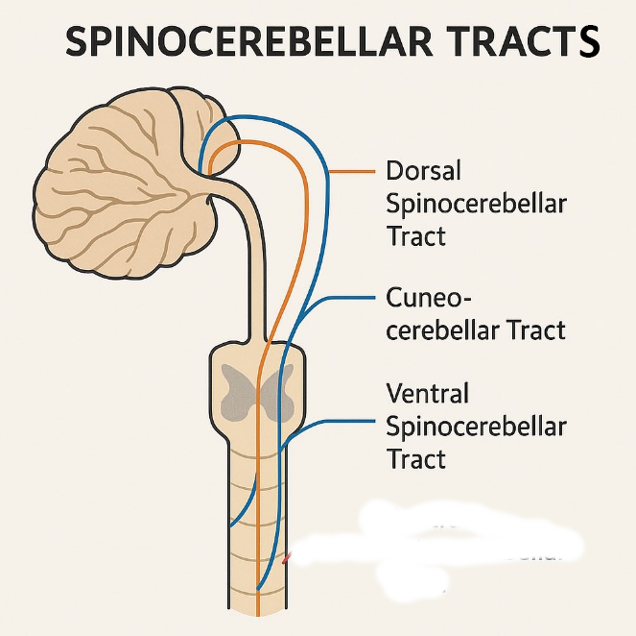

Slide 48
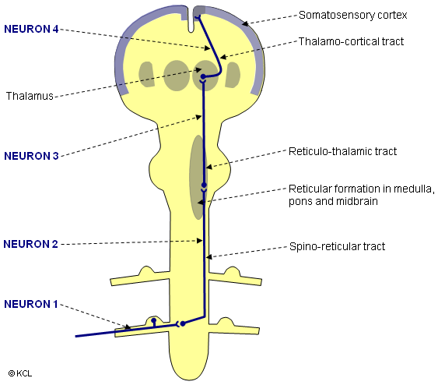

Slide 49
