Slide 1
Structure-function Relationship
The functions of proteins are maintained because of their ability to recognize and interact with a variety of molecules.
three-dimensional structural conformation provides and maintains the functional characteristics.

Slide 2
In the three-dimensional structure of proteins, the hydrophilic polar charged residues are seen on the outer surface and then non-polar hydrophobic residues inside, out of contact with water.

Slide 3
The three-dimensional structure, in turn, is dependent on the primary structure. So, any difference in the primary structure may produce a protein which cannot serve its function.

Slide 4
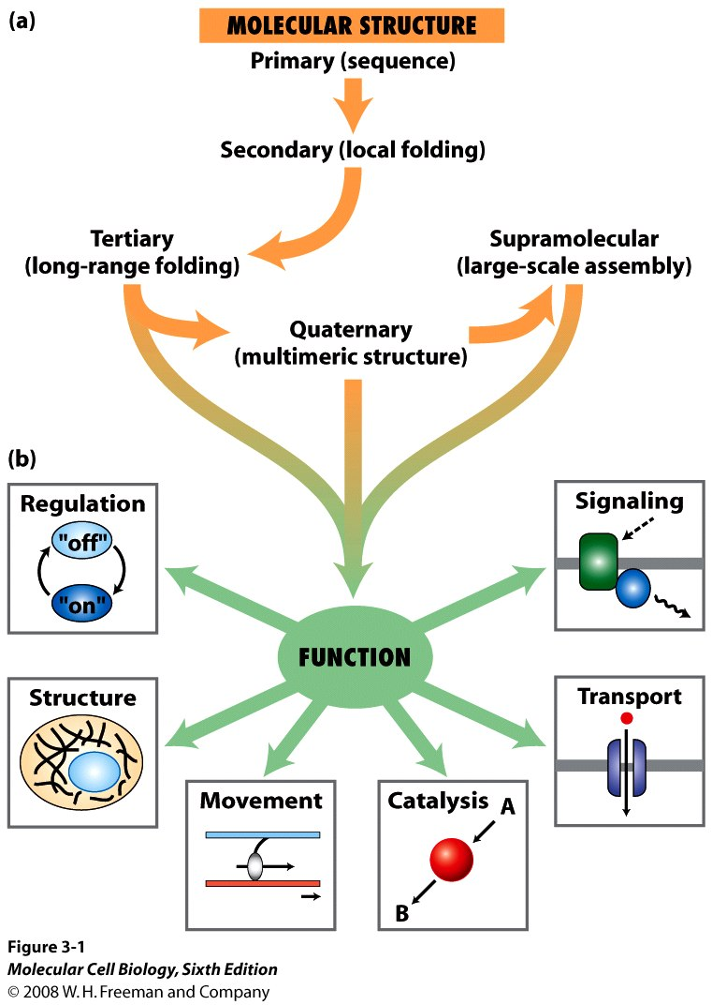

Slide 5
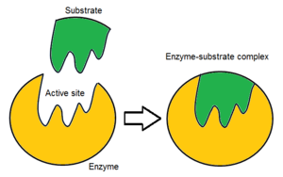
Enzymes
The first step in enzymatic catalysis is the binding of them enzyme to the substrate. This, in turn, depends on them structural conformation of the active site of the enzyme, which is precisely oriented for substrate binding

Slide 6
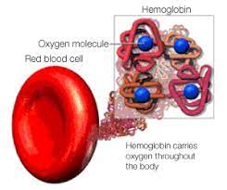
Transport Proteins
Hemoglobin, the transporter of oxygen is a tetrameric protein (alpha 2, beta 2), with each monomer having a heme unit. Binding of oxygen to one heme facilitates oxygen binding by other subunits.

Slide 7
Structural Proteins
Collagen is the most abundant protein in mammals and is the main fibrous component of skin, bone, tendon, cartilage and teeth. Collagen forms a superhelical cable where the 3 polypeptide chains are wound around itself. In collagen, every 3rd residue is a glycine.

Slide 8
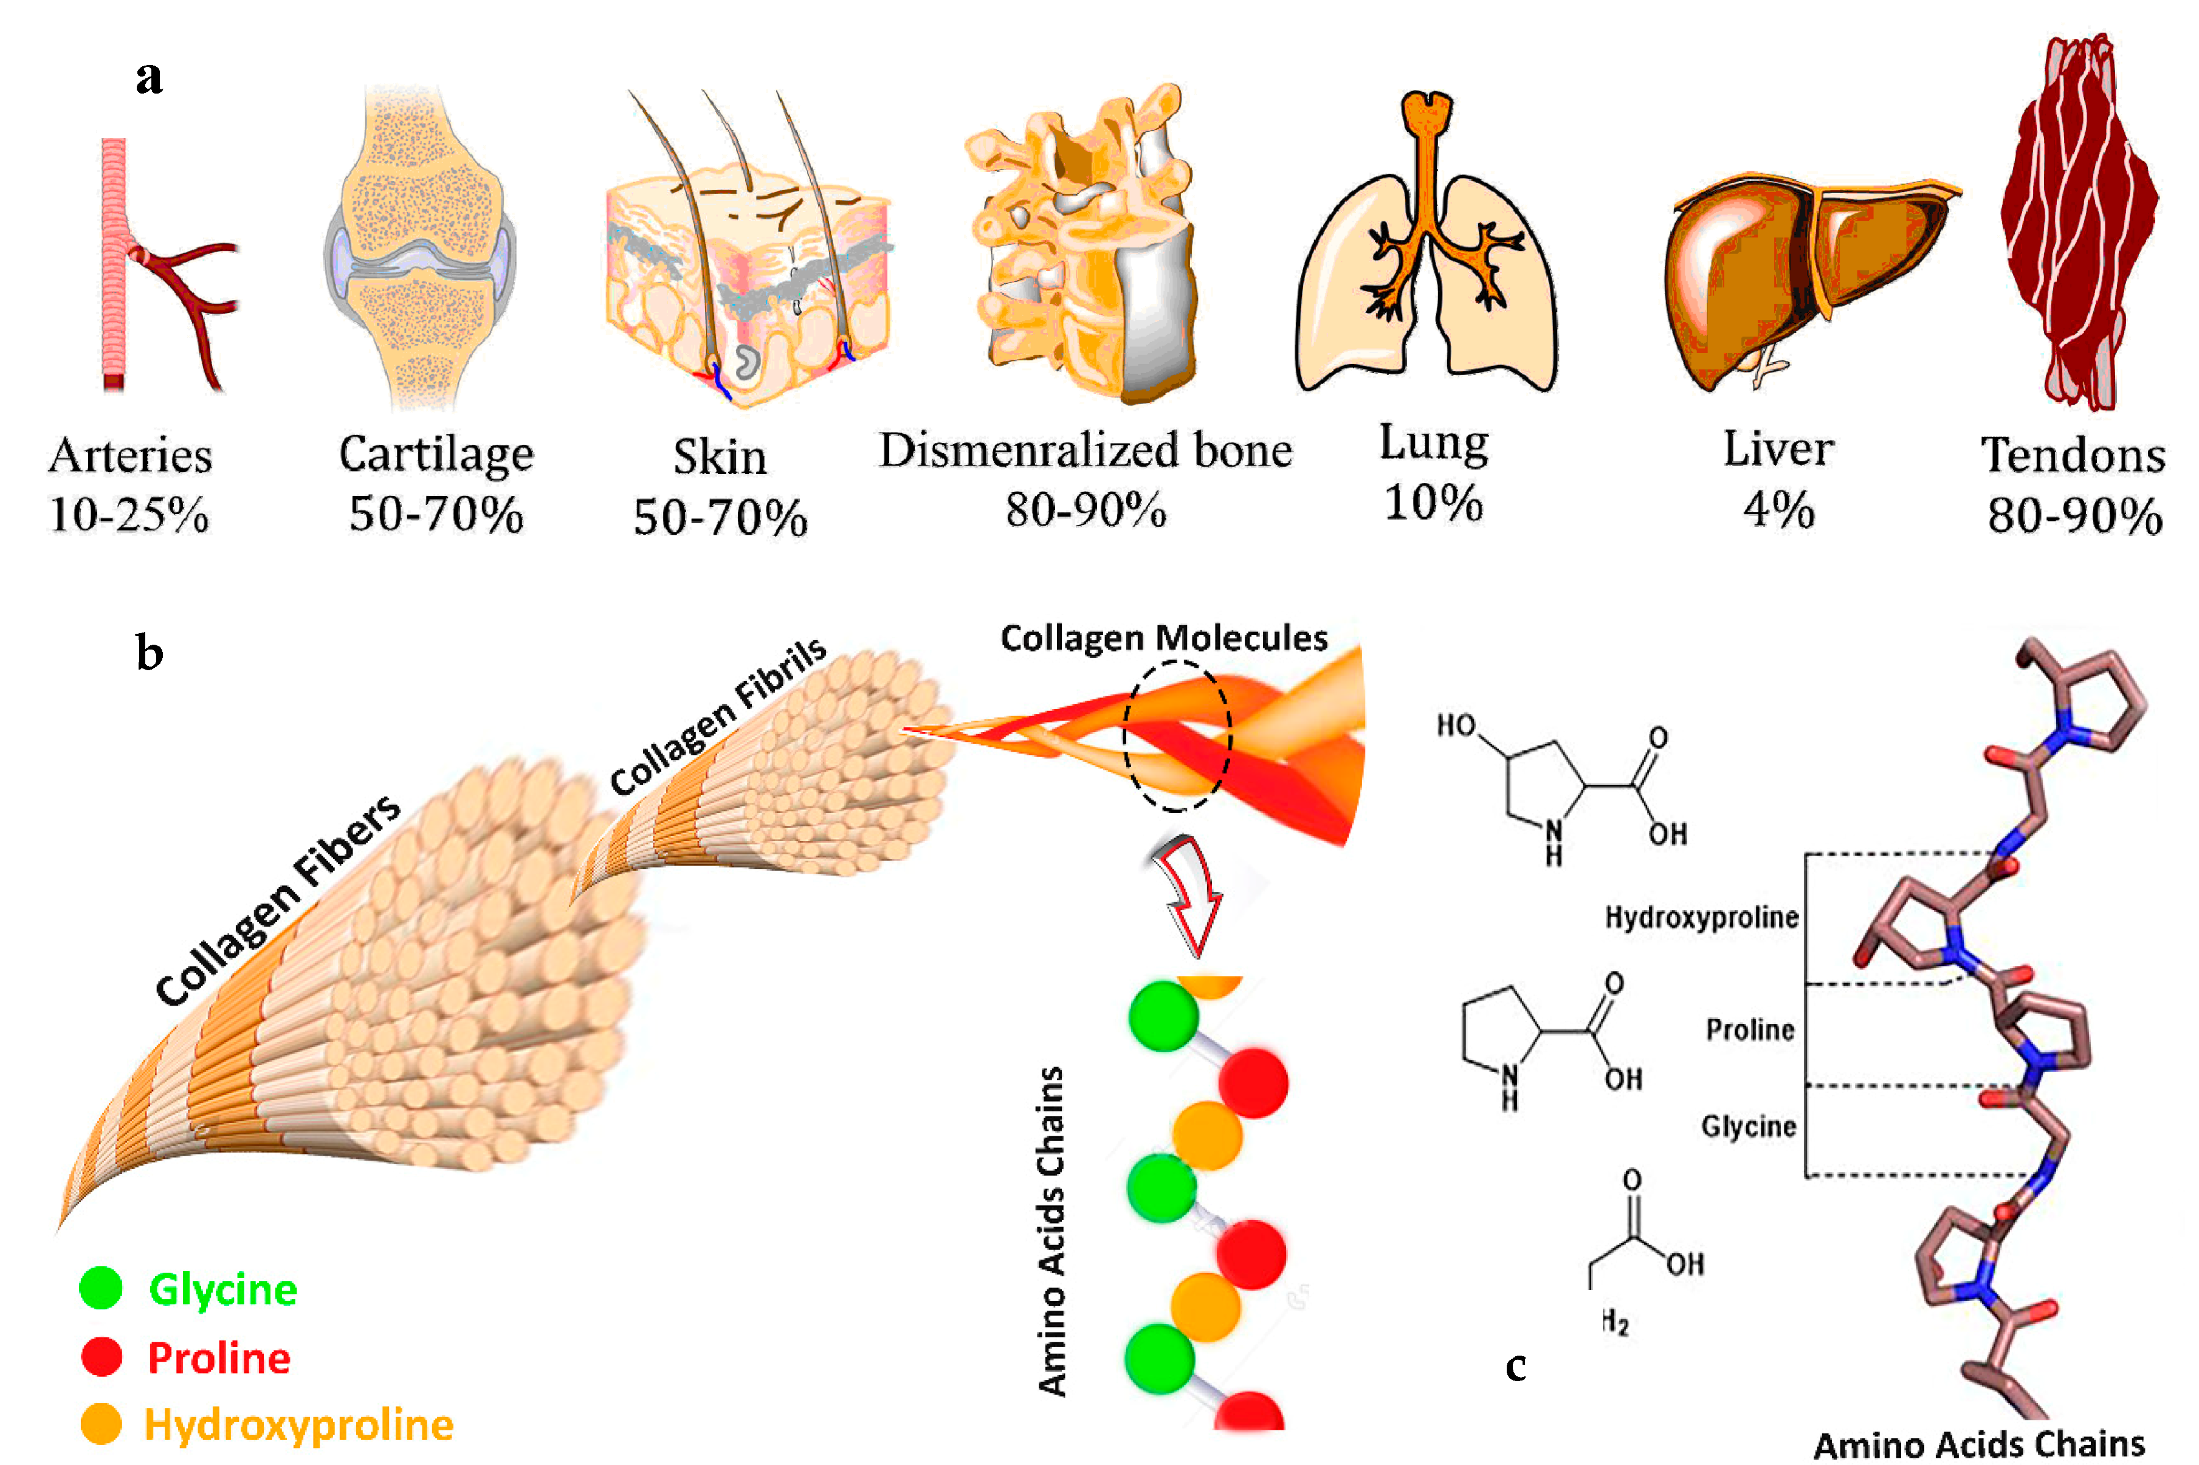

Slide 9
The only amino acid that can fit into the triple stranded helix is glycine. Replacement of the central glycine by mutations can lead to brittle bone disease.
The triple helix of collagen is stabilized by the steric repulsion of the rings of hydroxyproline and also by the hydrogen bonds between them.

Slide 10
In vitamin C deficiency, failure of hydroxylation of proline leads to reduced hydrogen bonding and consequent weakness of collagen.
The quarter staggered triple helical structure of collagen is responsible for its tensile strength.

Slide 11
Physical Properties Of Proteins
Protein solutions exhibit colloidal properties and therefore scatter light and exert osmotic pressure. Osmotic pressure of plasma proteins is clinically important

Slide 12
Molecular weights of some of the proteins are: Insulin (5,700)
Hemoglobin (68,000)
Albumin (69,000)
Immunoglobulins (1,50,000)

Slide 13
Shape of the proteins also vary.
Insulin is globular
Albumin is oval in shape
Fibrinogen molecule is elongated.
Bigger and elongated molecules will increase the viscosity of the solution.

Slide 14
Isoelectric pH
Since proteins are made of amino acids, the pI of all the constituent amino acids will influence the pI of the protein.

Slide 15
CLASSIFICATION OF PROTEINS
Classification Based on Functions
1. Catalytic proteins, e.g. enzymes
2. Structural proteins, e.g. collagen, elastin
3. Contractile proteins, e.g. myosin, actin.
4. Transport proteins, e.g. hemoglobin, myoglobin, albumin, transferrin

Slide 16
5. Regulatory proteins or hormones, e.g. ACTH, insulin, growth hormone
6. Genetic proteins, e.g. histones
7. Protective proteins, e.g. immunoglobulins, interferons, clotting factors.

Slide 17
Classification based on Composition and Solubility
I- Simple proteins:
on hydrolysis gives only amino acids Examples:
1- Albumin and globulins: present in egg, milk and blood. They are proteins of high biological value i.e. contain all essential amino acids and easily digested.

Slide 18
● Albumin is a protein made by the liver.
● It makes up about 60% of the total protein in the blood and plays many roles:
● keeps fluid from leaking out of blood vessels
● transports hormones, vitamins, drugs, and substances like calcium throughout the body

Slide 19
Levels of albumin may decrease, to a greater or lesser degree, when :
●conditions interfere with its production by the liver,
● increase protein breakdown
● increase protein loss via the kidneys
● expand plasma volume (diluting the blood).

Slide 20
Two important causes of low blood albumin include:
Sever Liver disease: since albumin is produced by the liver, its level can decrease with loss of liver function; however, this typically occurs only when the liver has been severely affected.

Slide 21
Kidney disease : one of the kidneys functions is to conserve plasma proteins such as albumin so that they are not released along with waste products when urine is produced.
However, if a person's kidneys become damaged or diseased, they begin to lose their ability to conserve albumin and other proteins.

Slide 22
This is frequently seen in
◊ chronic diseases, such as diabetes and hypertension.
◊ nephrotic syndrome very high amounts of albumin are lost through the kidneys.

Slide 23
Types of globulins
α1 globulin: e.g. antitrypsin: trypsin inhibitor serum protein
α2 globulin: e.g. hepatoglobin: protein that binds hemoglobin to prevent its excretion by the kidney
β-globulin: e.g. transferrin: protein that transport iron
γ-globulins = Immunoglobulins (antibodies) :
responsible for immunity.

Slide 24
2- Globins (Histones): They are basic proteins rich in histidine amino acid.
They are present in :
a - combined with DNA
b - combined with heme to form hemoglobin of RBCs.

Slide 25
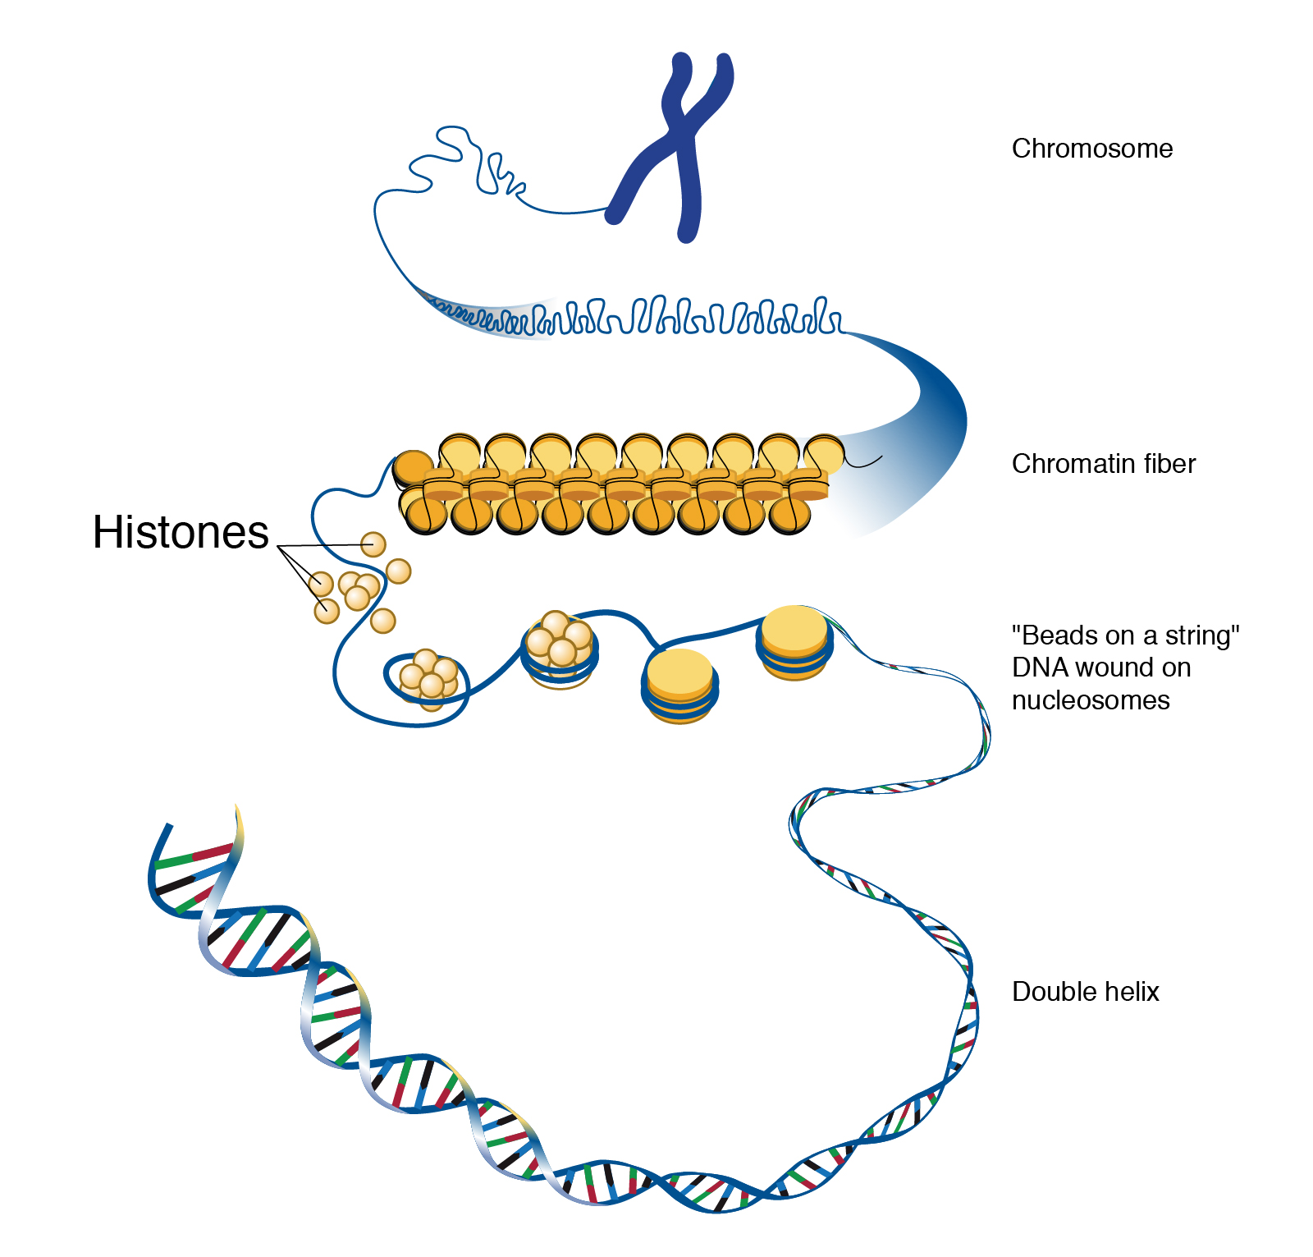

Slide 26
3- Gliadines are the proteins present in cereals.
4- Scleroproteins: They are structural proteins, not digested. include: keratin, collagen and elastin.

Slide 27
a- α-keratin:
protein found in hair, nails, enamel of teeth and outer layer of skin.
It is rich in cysteine and hydrophobic (non polar) amino acids so it is water insoluble.

Slide 28
b- collagens:
protein of connective tissues found in bone, teeth , cartilage, tendons, skin and blood vessels.
Collagen may be present as gel e.g. in extracellular matrix or in vitreous humor of the eye.
Collagens are the most important protein in mammals.

Slide 29
They form about 30% of total body proteins. There are more than 20 types of collagens, the most common type is collagen I which constitutes about 90% of cell collagens.

Slide 30
C- Elastin:
present in walls of large blood vessels (such as aorta). It is very important in lungs, elastic ligaments, skin, cartilage.
It is elastic fiber that can be stretched to several times as its normal length.

Slide 31
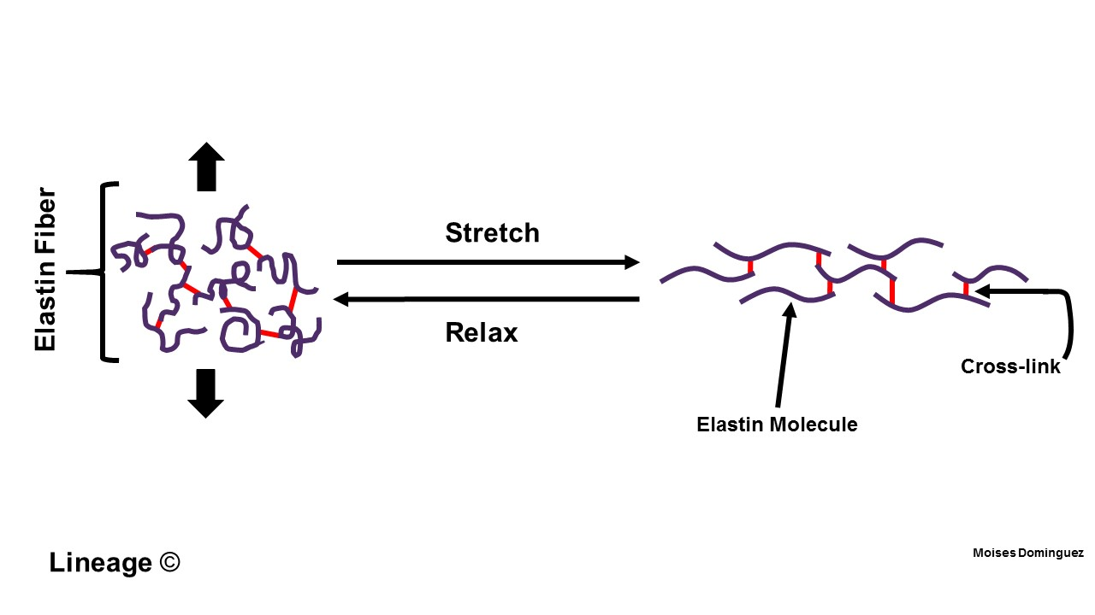
Structure

Slide 32
Conjugated proteins
They are combinations of protein with a non-protein part, called prosthetic group
Conjugated proteins may be classified as :

Slide 33
Glycoproteins
These are proteins combined with carbohydrates. Hydroxyl groups of serine or threonine and amide groups of asparagine and glutamine form linkages with carbohydrate residues.
Blood group antigens and many serum proteins are glycoproteins. When the carbohydrate content is more than 10% of the molecule, the viscosity is correspondingly increased; they are sometimes known as mucoproteins or proteoglycans

Slide 34
Lipoproteins: These are proteins loosely combined with lipid components. They occur in blood and on cell membranes.
Nucleoproteins: These are proteins attached to nucleic acids, e.g. Histones. The DNA carries negative charges, which combines with positively charged proteins

Slide 35
Chromoproteins: These are proteins with coloured prosthetic groups.
Hemoglobin (Heme, red)
Flavoproteins (Riboflavin, yellow)
Visual purple (Vitamin A, purple)

Slide 36
Phosphoproteins: These contain phosphorus.
●Casein of milk and vitellin of egg yolk
● The phosphoric acid is esterified to the hydroxyl groups of serine and threonine residues of proteins.

Slide 37
Metalloproteins: They contain metal ions.
Hemoglobin (Iron)
Cytochrome (Iron)
Tyrosinase (Copper)
Carbonic anhydrase (Zinc).

Slide 38
Classification Depending on The Shape
Fibrous
polypeptides arranged in long strands or sheets
water insoluble (lots of hydrophobic AA’s)
strong but flexible
Structural (keratin, collagen)

Slide 39
Globular
polypeptide chains folded into spherical or globular form
water soluble
contain several types of secondary structure
diverse functions (enzymes, regulatory proteins)

Slide 40
Classification Based on Nutritional Value
Nutritionally Rich Proteins
They are also called as complete proteins or first-class proteins. They contain all the essential amino acids in the required proportion. On supplying these proteins in the diet, children will grow satisfactorily. A good example is casein of milk.

Slide 41
Incomplete Proteins
They lack one essential amino acid. They cannot promote body growth in children; but may be able to sustain the body weight in adults.

Slide 42
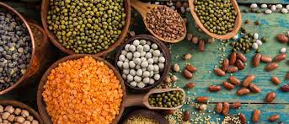
Proteins from pulses are deficient in methionine

Slide 43
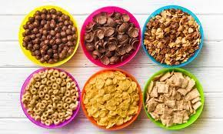
proteins of cereals lack in lysine. If both of them are combined in the diet, adequate growth may be obtained.

Slide 44
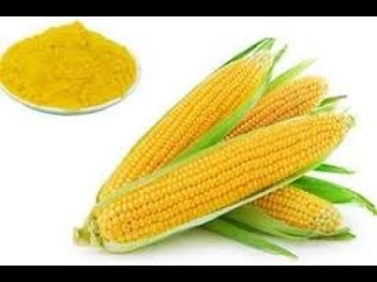
Poor Proteins
They lack in many essential amino acids and a diet based on these proteins will not even sustain the original body weight. Zein from corn lacks tryptophan and lysine.

Slide 45
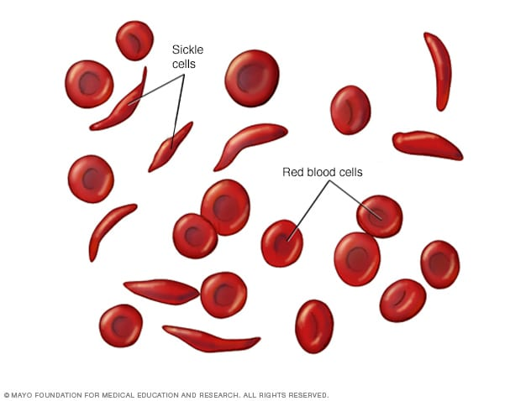
Diseases caused by changes in protein structure
Sickle Cell Anemia – single amino acid change in hemoglobin related to disease.

Slide 46
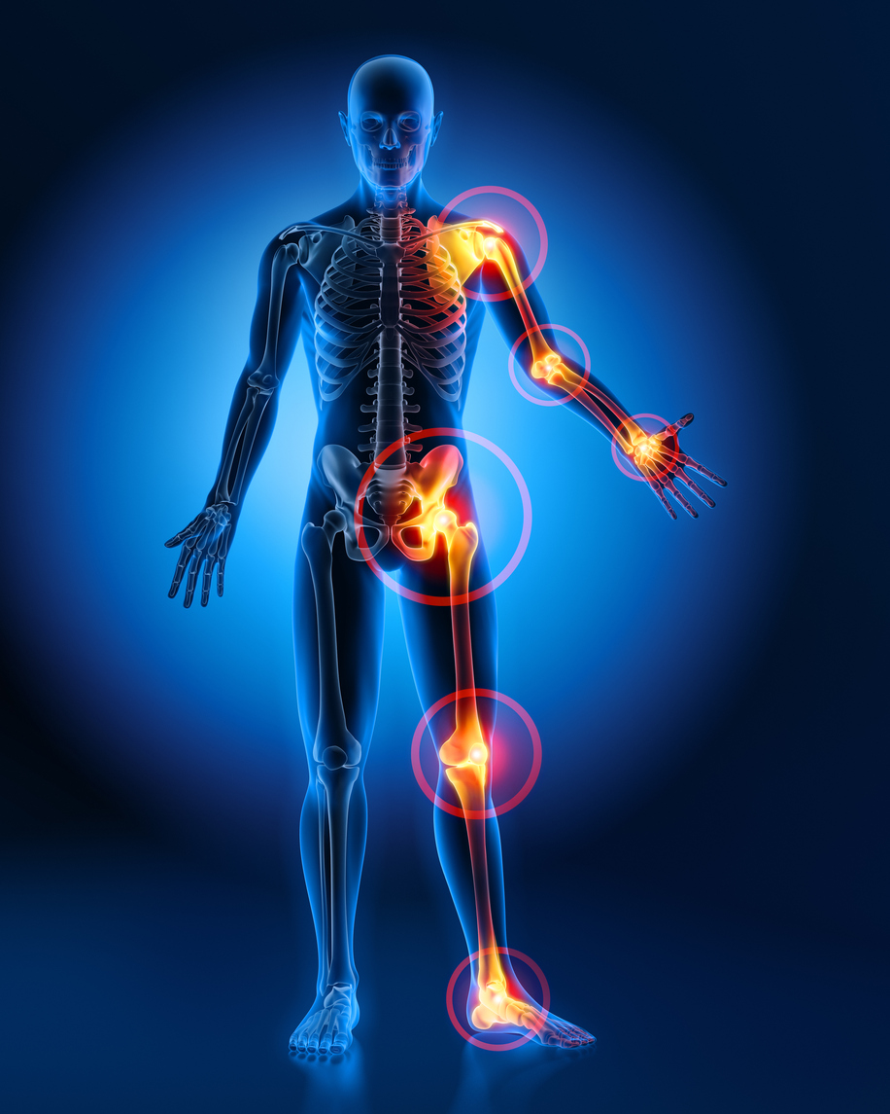
Diseases caused by changes in protein structure
Osteoarthritis – single amino acid change in collagen protein causes joint damage

