Slide 1
Peptides and Proteins
20 amino acids are commonly found in protein. These 20 amino acids are linked together through “peptide bond forming peptides and proteins
The chains containing less than 50 amino acids are called “peptides”, while those containing greater than 50 amino acids are called “proteins”.

Slide 2
Peptide bond formation: α-carboxyl group of one amino acid (with side chain R1) forms a covalent peptide bond with α-amino group of another amino acid ( with the side chain R2) by removal of a molecule of water.
The result is :
Dipeptide ( i.e. Two amino acids linked by one peptide bond). By the same way, the dipeptide can then form a second peptide bond with a third amino acid (with side chain R3) to give Tripeptide. Repetition of this process generates a polypeptide or protein of specific amino acid sequence.

Slide 3
Peptide Bond

Slide 4
Peptide bond formation: - Each polypeptide chain starts on the left side by free amino group of the first amino acid enter in chain formation . It is termed (N- terminus). - Each polypeptide chain ends on the right side by free COOH group of the last amino acid and termed (C-terminus).
Fullname:Alanyltyrosylaspartylglycine

Slide 5
Examples on Peptides:
  1- Dipeptide (two amino acids joined by one peptide bond): Example: Aspartame which acts as sweetening agent being used in replacement of cane sugar. It is composed of aspartic acid and phenyl alanine.
  2-Tripeptides (3 amino acids linked by two peptide bonds). Example: Glutathion which is formed from 3 amino acids: glutamic acid, cysteine and glycine. It helps in protects against free radical which causes cell damage.

Slide 6
  3- octapeptides: (8 amino acids) Examples: Two hormones; oxytocine and vasopressin (ADH).
  4- Oligopeptide: short polymer of residues linked by peptide bonds; up to10-20 residues.
  5- polypeptides: longer polymer of residues linked by peptide bonds; larger sizes.
  6- Protein: one or more polypeptide chains

Slide 7
Notes:
• Residue – an amino acid (or peptide unit) in an oligopeptide, polypeptide or protein

Slide 8
Protein structure:
There are four levels of protein structure (primary, secondary, tertiary and quaternary)

Slide 9
1-Primary structure:
Primary structure denotes the number, type and sequence of amino acids in the protein.
The higher levels of organization are decided by the primary structure.
Each polypeptide chain has a unique amino acid sequence decided by the genes.
The primary structure is maintained by the covalent bonds of the peptide linkages.

Slide 10
At one end is an amino acid with a free amino group the (the N-terminus) and at the other is an amino acid with a free carboxyl group the (the C-terminus).
the term “sequence”. as the following example:
Gly - Ala - Val (1)
Gly - Val - Ala (2)

Slide 11
Branched and Circular Proteins
Generally, the polypeptide chains are linear. However branching points in the chains may be produced by interchain disulphide bridges.
The covalent disulphide bonds between different polypeptide chains in the same protein (interchain) or portions of the same polypeptide chain (intrachain) are also part of the primary structure.

Slide 12
Rarely, instead of the alpha COOH group, the gamma carboxyl group of glutamic acid may enter into peptide bond formation, e.g. Glutathione (gammaglutamyl- cysteinyl-glycine)

Slide 13
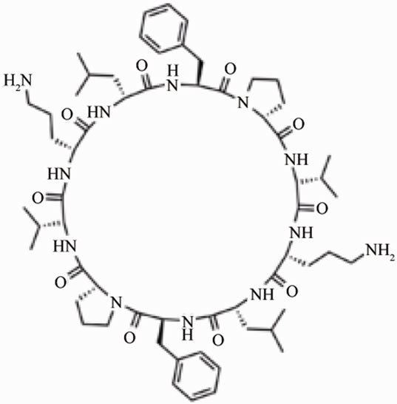
The term pseudopeptide is used to denote such a peptide bond formed by carboxyl group, other than that present in alpha position.
Very rarely, protein may be in a circular form, e.g. Gramicidin.

Slide 14
Primary Structure of Insulin
As an example of the primary structure of a protein, that was originally described by Sanger in 1955 who received the Nobel prize in 1958.

Slide 15
1- Insulin has two polypeptide chains. The A chain (Glycine chain) has 21 amino acids and B (Phenylalanine) polypeptide chain has 30 amino acids.

Slide 16
2- They are held together by two interchain disulfide bonds. A chain 7th cysteine and B chain 7th cysteine are connected. Similarly, A chain 20th cysteine and B chain 19th cysteine are connected. There is another intrachain disulfide bond between 6th and 11th cysteine residues of A chain.

Slide 17
3- The species variation is restricted to amino acids in position 8, 9 and 10 in A chain and in C-terminal of B chain. The amino acid sequence has been conserved to a great extent during evolution.
Human insulin required for replacement therapy, is now produced by recombinant DNA technology.

Slide 19
Primary Structure Determines Biological Activity
A protein with a specific primary structure will automatically form its natural three-dimensional shape. So, the higher levels of organization are dependent on the primary structure.

Slide 20
Even a single amino acid change (mutation) in the linear sequence may have profound biological effects on the function, e.g. in HbA (normal hemoglobin) the 6th amino acid in the beta chain is glutamic acid; it is changed to valine in HbS (sickle cell anemia).

Slide 21
2- Secondary structure:
Results from hydrogen bond formation between hydrogen of –NH group of peptide bond and the carbonyl oxygen of another peptide bond.
According to H-bonding there are two main forms of secondary structure:

Slide 22
α-helix: It is a spiral structure resulting from hydrogen bonding between one peptide bond and the fourth one.
β-sheets: is another form of secondary structure in which two or more polypeptides (or segments of the same peptide chain) are linked together by hydrogen bond between H- of NH- of one chain and carbonyl oxygen of adjacent chain (or segment).

Slide 23
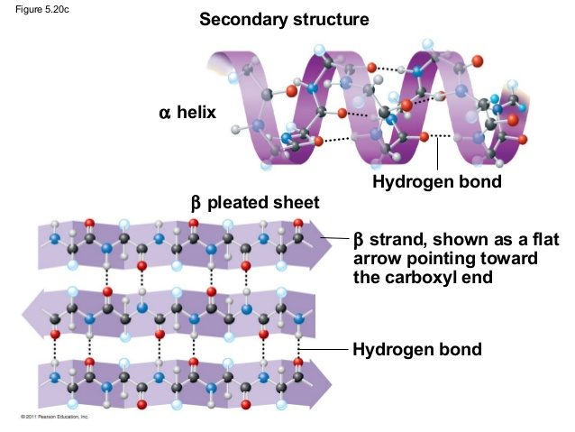

Slide 24
3-Tertiary structure:
Tertiary: chain folding: fibrous and globular.
Chain folding causes changes in physical properties and biological function
Fibrous proteins tend to have length >> diameter, tend to be water insoluble.
Globular proteins have spherical shape.
Contributing factors are the hydrophobic effect, hydrogen bonding, ionic bond , and disulfide linkages by cysteine units.

Slide 25
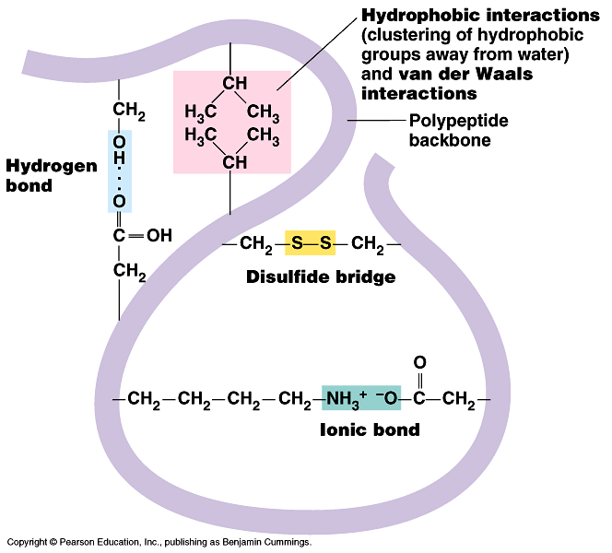

Slide 26
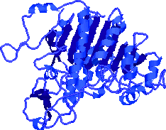

Slide 27
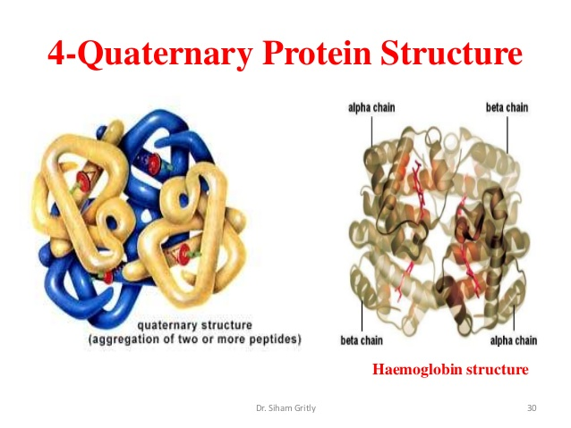

Slide 28
Some systems exist as larger "assemblies" several polypeptide chains.
Quaternary structures are held together by a variety of interactions including hydrogen bonding, Van der Waals interactions, ionic bonding and occasionally disulfide bonds.
Ex: Collagen is a fibrous protein of three polypeptides (trimeric),
Hemoglobin polypeptide is a globular protein with four polypeptide chains (tetrameric) – Insulin : two chains (dimeric).

Slide 29
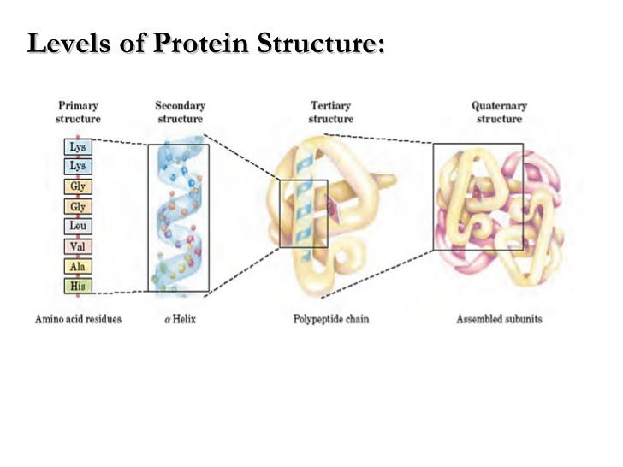

Slide 30
