Slide 1
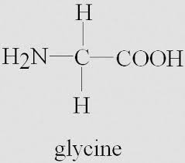
PROPERTIES OF AMINO ACIDS
A. Isomerism: Two types of isomerism are shown by amino acids basically due to the presence of asymmetric carbon atom. Glycine has nonsymmetrical carbon atom in its structure hence is optically inactive.

Slide 2
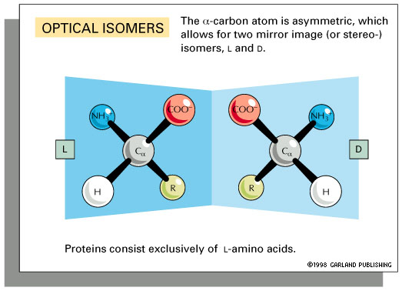

Slide 3
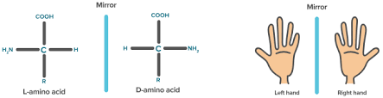
Stereoisomerism: All amino acids except glycine exist in D and L isomers.
In D-amino acids– NH2 group is on the right hand while in L-amino acids it is oriented to the left.

Slide 4
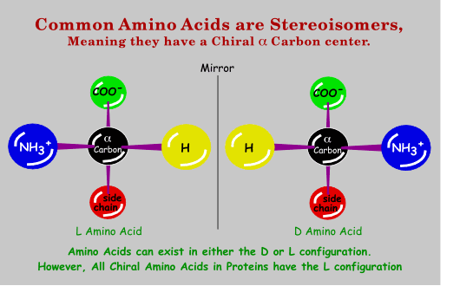
Natural proteins of animals and plants generally contain L-amino acids. D-amino acids occur in bacteria.

Slide 5
B. Amphoteric Nature and Isoelectric pH: The -NH2 and -COOH groups of amino acids are ionizable groups. Further, charged polar side chains of few amino acids also ionize.
Depending on the pH of the solution these groups act as proton donors (acids) or proton acceptors (bases).
This property is called as amphoteric and therefore amino acids are called as ampholytes.

Slide 6
► At a specific pH the amino acid carries both the charges in equal number and exists as dipolar ion or “Zwitterion”.
At this point the net charge on it is zero.
►The pH at which amino acid occurs without any charge on it is called pI or isoelectric pH. Therefore at isoelectric point, there is no mobility in an electrical field.

Slide 7
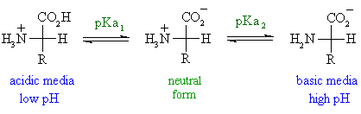
On the acidic side of its pI amino acids exist as a cation by accepting a proton and on alkaline as anion by donating a proton.

Slide 8
The iso-electric pH (pI) for mono amino mono carboxylic amino acids can be calculated :(pK1+pK2) /2
e.g. pI of glycine = (2.4 + 9.8)/2 = 6.1.

Slide 9
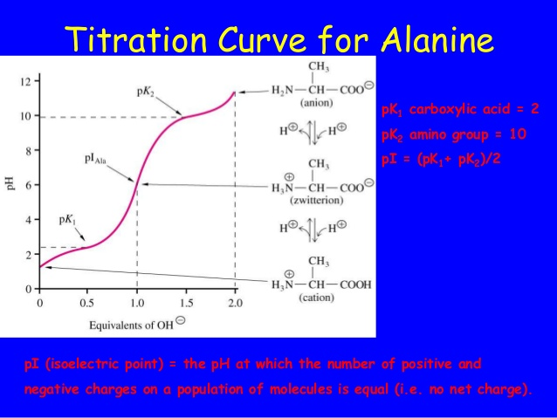

Slide 10
In the case of amino acids having more than two ionizable groups, correspondingly there will be more pK values, e.g. Aspartic acid .
It can be seen that at physiological pH of 7.4, both carboxyl and amino groups of amino acids are completely ionized. Thus to be very correct, zwitterion forms are to be shown as the structures of amino acids.

Slide 11
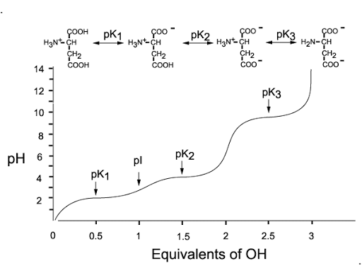

Slide 12
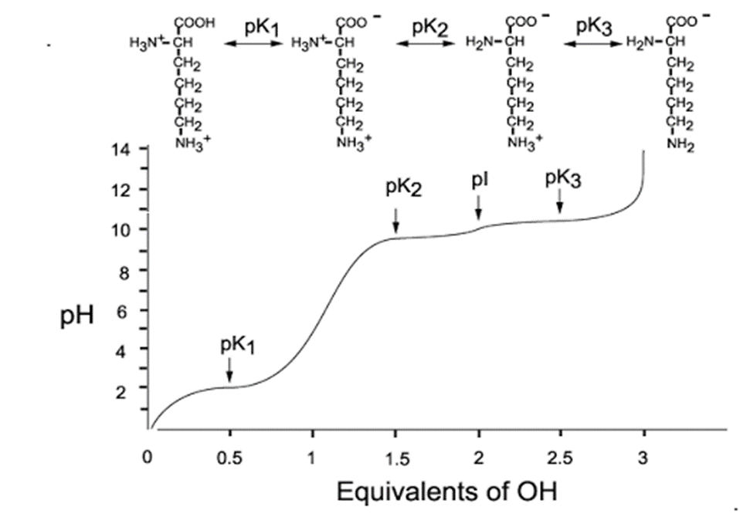

Slide 13
C. Physical Properties: They are
Colorless
Crystalline substances
more soluble in water than in polar solvents
They have high melting point usually more than 200°C.
They have a high dielectric constant.
They possess a large dipole moment.

Slide 14
D. Chemical Properties
I. Due to Carboxylic (—COOH) Group
1. Decarboxylation
The amino acids will undergo alpha decarboxylation to form the corresponding amine.

Slide 15
Thus, some important amines are produced from amino acids. For example,
Histidine → Histamine + CO2
Tyrosine → Tyramine + CO2
Tryptophan → Tryptamine + CO2
Glutamic acid→Gamma amino butyric acid (GABA)+CO2

Slide 16
2-Amide Formation
The-COOH group of dicarboxylic amino acids (other than alpha carboxyl) can combine with ammonia to form the corresponding amide. For example,
Aspartic acid + NH3 → Asparagine
Glutamic acid + NH3 → Glutamine
These amides are also components of protein structure. The amide group of glutamine serves as the source of nitrogen for nucleic acid synthesis.

Slide 18
Due to Amino Group
Transamination
The alpha amino group of amino acid can be transferred to alpha keto acid to form the corresponding new amino acid and alpha keto acid.

Slide 19
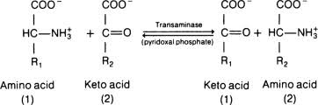
This is an important reaction in the body for the inter conversion of amino acids and for synthesis of non-essential amino acids.

Slide 20
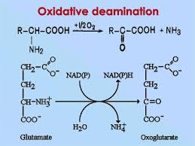
Oxidative Deamination
The alpha amino group is removed from the amino acid to form the corresponding keto acid and ammonia. In the body, Glutamic acid is the most common amino acid to undergo oxidative deamination.

Slide 21
Formation of Carbamino Compound
Carbon dioxide adds to the alpha amino group of amino acids to form carbamino compounds.
The reaction occurs at alkaline pH and serves as a mechanism for the transport of carbon dioxide from tissues to the lungs by hemoglobin
Hb-NH2 + CO2 → Hb-NH-COOH (Carbamino-Hb)

Slide 22
Due to Side Chains
Transmethylation
The methyl group of Methionine, after activation, may be transferred to an acceptor, which becomes methylated.
Methionine + Acceptor → Methylated Acceptor + Homocysteine

Slide 23
Ester Formation by the OH Group
The hydroxy amino acids can form esters with phosphoric acid. In this manner, the Serine and Threonine residues of proteins are involved in the formation of phosphoproteins.
Similarly, these hydroxyl groups can form O-glycosidic bonds with carbohydrate residues to form glycoproteins.

Slide 24
Reaction of the Amide Group
The amide groups of Glutamine and Asparagine can form N-glycosidic bonds with carbohydrate residues to form glycoproteins.

Slide 25
Reactions of SH Group
Cysteine has a sulfhydryl (SH) group and it can form a disulfide (S-S) bond with another cysteine residue.

Slide 26
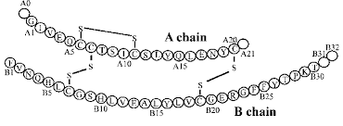
The two cysteine residues can connect two polypeptide chains by the formation of interchain disulfide bonds or links. The dimer formed by two cysteine residues is sometimes called Cystine or Dicysteine

Slide 27
III. Properties of Amino acids Due to Both NH2 and COOH Groups
In addition to the property of reacting with both cation and anion, the amino acids form chelated, co-ordination complexes with certain heavy metals and other ions.
These include Cu++, Co++, Mn++ and Ca++.

