Slide 1
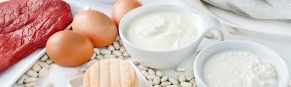
Proteins

Slide 2
AMINO ACID: STRUCTURE AND CLASSIFICATION.
Amino Acids are the building units of proteins. There are about 300 amino acids occur in nature. Only 20 of them enter in proteins synthesis.
Structure of amino acids:
Four different groups are attached to α- carbon: amino group
COOH group
Hydrogen atom
and side Chain (R).

Slide 4
At physiological pH (7.4), -COOH group is dissociated forming a negatively charged carboxylate ion (COO- ) and amino group is protonated forming positively charged ion (NH3 + ) forming Zwitter ion .

Slide 5
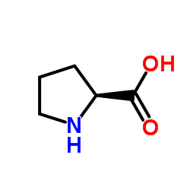
• Proline is an imino acid not amino acid .

Slide 6
Classification of Amino Acids:
I. Classification by R group
II. Chemical Classification
III. Nutritional Classification
IV. Metabolic Classification

Slide 7
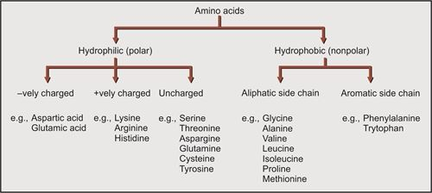
Classification by R group

Slide 8
Classification according to polarity of side chain (R):
Polar amino acids: in which R contains polar hydrophilic group so can forms hydrogen bond with H2O. In those amino acids, R may contain:
OH group : as in serine, threonine and tyrosine
SH group : as in cysteine
amide group: as in glutamine and aspargine
NH2 group or nitrogen act as a base (basic amino acids ): as lysine, arginine and histidine.
COOH group (acidic amino acids): as aspartic and glutamic .

Slide 9
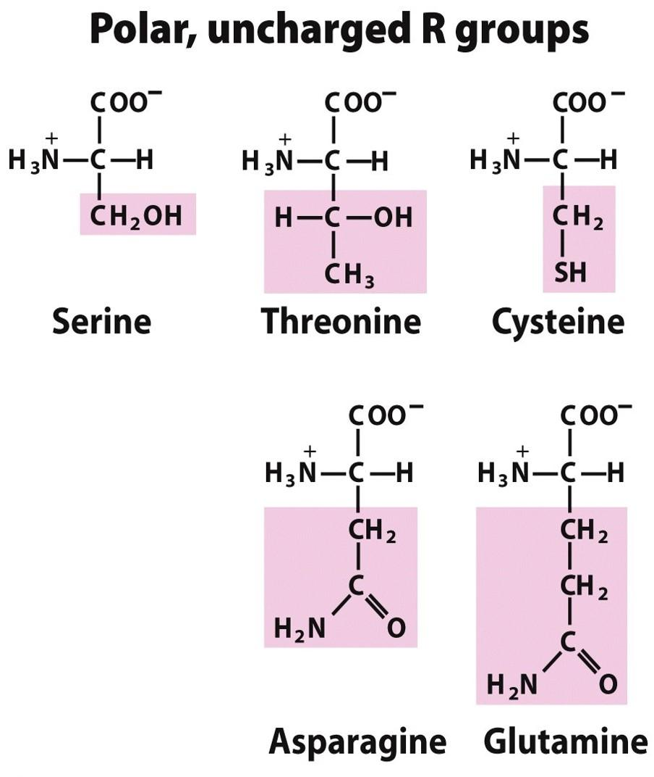

Slide 10
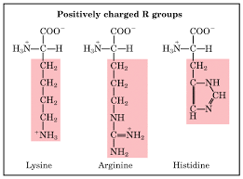

Slide 11
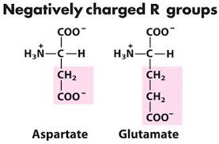

Slide 12
Non polar amino acids: R is alkyl hydrophobic group which can’t enter in hydrogen bond formation.
9 amino acids are non-polar ( glycine, alanine, valine, leucine, isoleucine, phenyl alanine, tryptophan, proline and methionine).

Slide 13
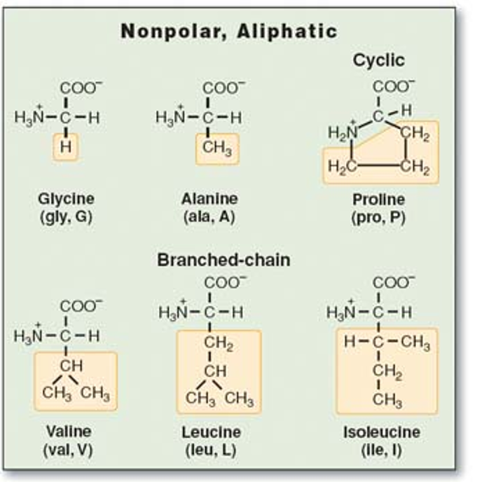

Slide 14
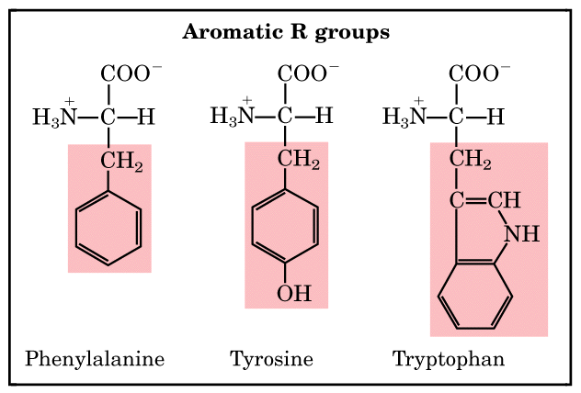

Slide 15
The twenty common amino acids are often referred to using three-letter abbreviations. The structures, names, and abbreviations for the twenty common amino acids are shown below. Note that they are all α-amino acids.

Slide 16
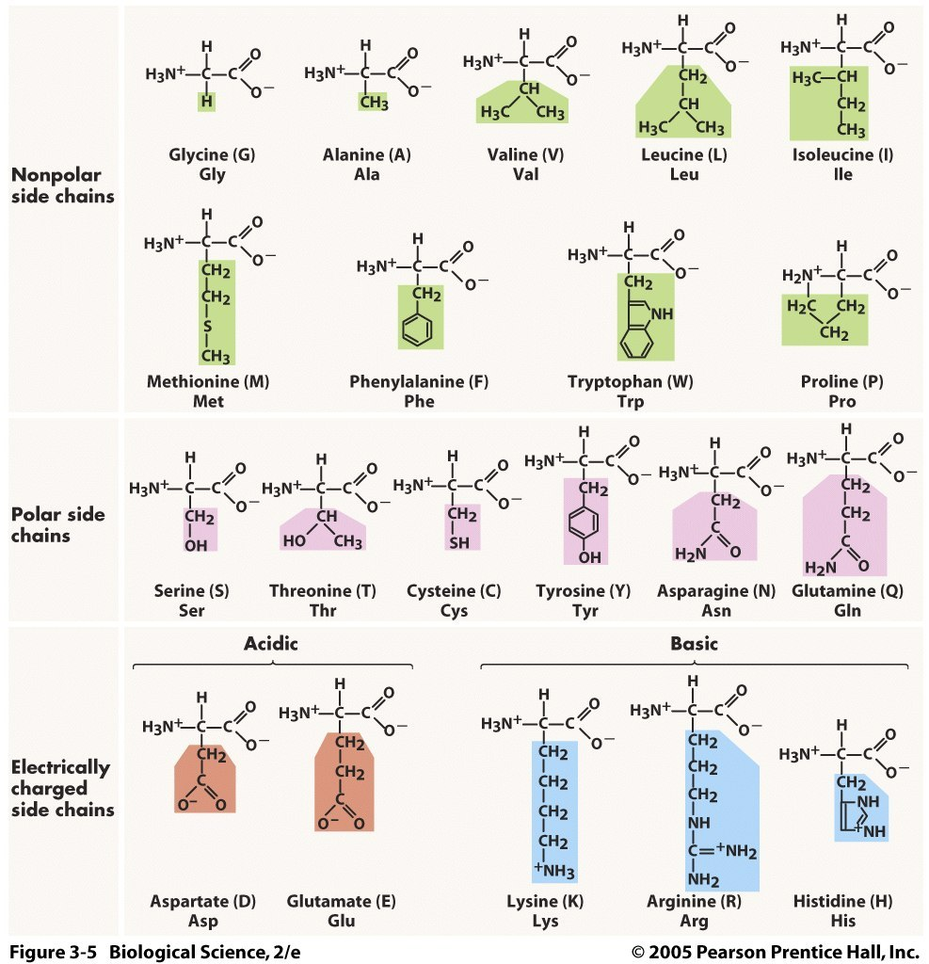

Slide 17
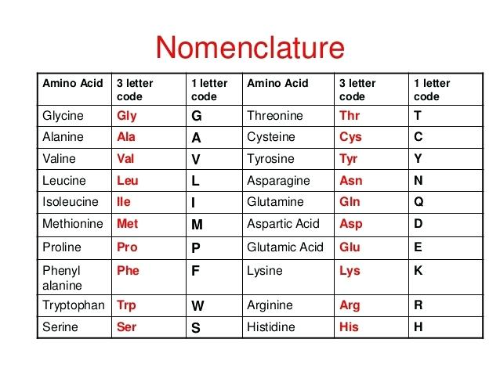
Each amino acid, aside from its name, has a three letter abbreviation and a one letter code.

Slide 18
Nutritional Classification
1- Essential Amino Acids Can’t be synthesized in the body, essential to be taken in diet. Their deficiency affects growth, health and protein synthesis. Thus, Isoleucine, Leucine, Threonine, Lysine, Methionine, Phenylalanine, Tryptophan, and Valine are essential amino acids

Slide 19
Nutritional Classification
2- Semi-essential formed in the body but not in sufficient amount for body requirements especially in children. Arginine and histidine are semi-essential .

Slide 20
Nutritional Classification
3- Non-essential can be synthesized in the body. The non-essential amino acids are Alanine, Asparagine, Aspartic acid, Cysteine, Glutamine, Glutamic Acid, Glycine, Proline, Serine and Tyrosine. All body proteins do contain all the non-essential amino acids.

Slide 21
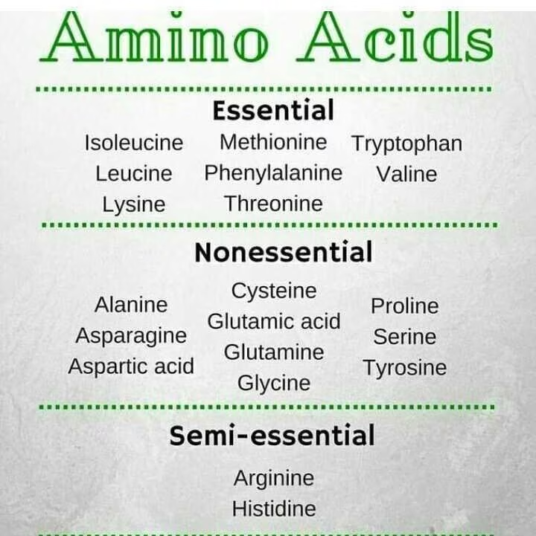

Slide 22
Non-Standard Amino Acids
The standard number of amino acids that are commonly found in proteins is 20.
These are known as the proteinogenic amino acids, which are encoded by the genetic code. However, there are a few additional amino acids that are sometimes included

Slide 23
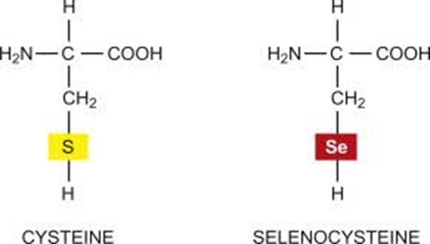
•Selenocysteine (21st amino acid): Often referred to as the 21st amino acid, selenocysteine is incorporated into proteins via a specific mechanism that involves a unique codon (UGA) and requires a special translation factor. It contains selenium instead of sulfur, which is found in cysteine

Slide 24
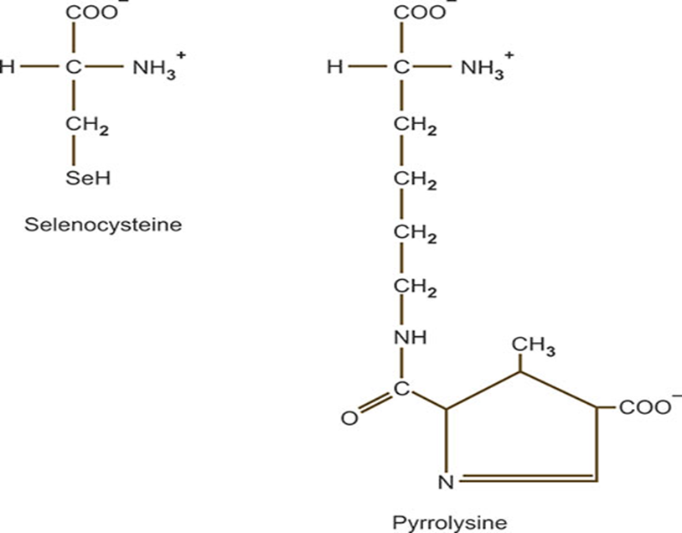
•Pyrrolysine (22nd amino acid): Pyrrolysine is considered the 22nd amino acid and is found in some archaea and bacteria. It is encoded by the UAG codon in specific contexts and is involved in certain enzymatic functions.

Slide 25
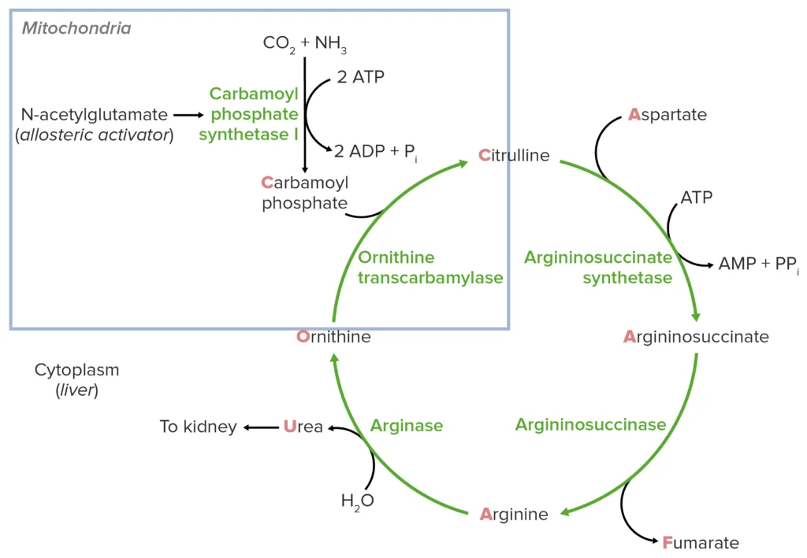
Non-Standard Amino Acids
• Other non-standard amino acids: There are also non-standard amino acids that are not incorporated into proteins but may play important roles in metabolism or signaling, such as ornithine and citrulline

Slide 26
Amino Acid Derivatives
Chemical derivatives of amino acids also have important biological functions, eg. Catecholamines lack the α-carboxylate of amino acids

Slide 27
GABA & Dopamine are neurotransmitters. Histamine mediates parts of the immune response.

Slide 28
Functions of Amino Acids
Apart from being the monomeric constituents of proteins and peptides, amino acids serve variety of functions.
(a) Some amino acids are converted to carbohydrates and are called as glucogenic amino acids.

Slide 29
(b) Specific amino acids give rise to specialized products, e.g.
• Tyrsione forms hormones such as thyroid hormones, (T3, T4), epinephrine and norepinephrine and a pigment called melanin.
• Tryptophan can synthesize a vitamin called niacin.

Slide 30
• Glycine, arginine and methionine synthesize creatine.
• Glycine and cysteine help in synthesis of Bile salts.
•Glutamate, cysteine and glycine synthesis glutathione.
• Histidine changes to histamine on decarboxylation.
• Serotonin is formed from tryptophan.
.

Slide 31
• Glycine is used for the synthesis of haem.
• Pyrimidines and purines use several amino acids for their synthesis such as aspartate and glutamine for pyrimidines and glycine, aspartic acid, Glutamine and serine for purine synthesis
c) Some amino acids such as glycine and cysteine are used as detoxicants of specific substances.

Slide 32
(d) Methionine acts as “active” methionine (S-adenosylmethionine) and transfers methyl group to various substances by transmethylation.
(e) Cystine and methionine are sources of sulphur

