Slide 1
MNT of Atherosclerosis and Hypertension
Assistant prof. Mayasah A. Sadiq FIBMS-FM

Slide 2
REFERENCE
Williams’ Basic Nutrition and Diet Therapy 15 EDETION.
KRAUSE AND MAHAN’S FOOD AND THE NUTRITION CARE PROCESS,
SIXTEENTH EDITION

Slide 3
What is medical nutrition therapy?
Medical nutrition therapy (MNT) is a form of treatment that uses nutrition education and behavioral counseling to prevent or manage a medical condition.

Slide 4
What does medical nutrition therapy involve?
Dietitians generally follow these steps for medical nutrition therapy:
Nutrition assessment: Learning about the patient and his(her) nutritional needs.
Nutrition diagnosis: Identifying a nutrition-related issue to address.
Nutrition intervention: Creating a plan and explaining what the patient will need to do.
Nutrition monitoring and evaluation: Checking on how things are going and changing the plan as needed.

Slide 5
MNT of Cardiovascular Disease

Slide 6
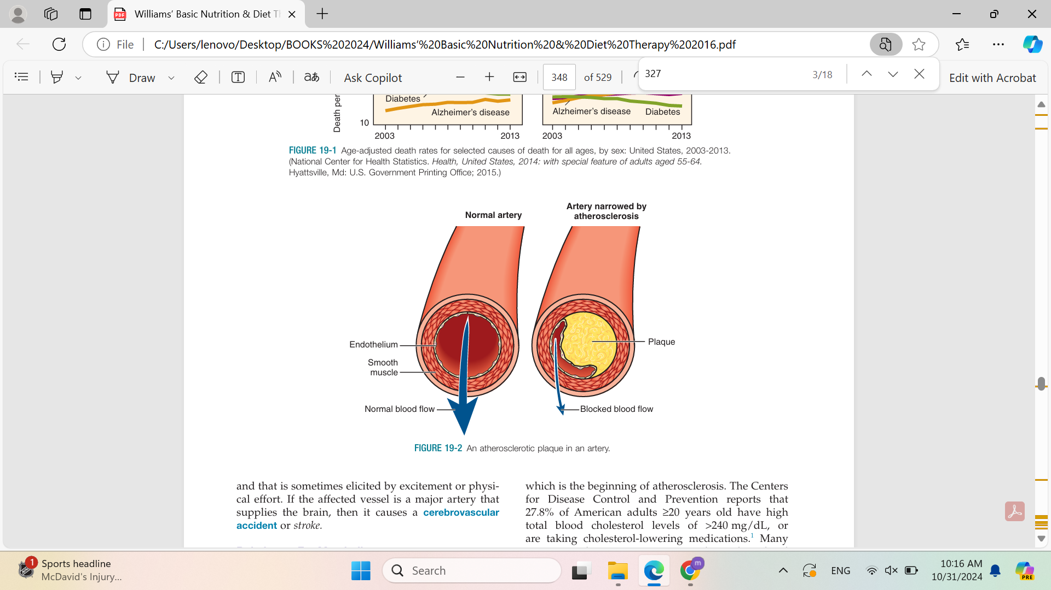
The major cause of CVD and the underlying pathologic process in coronary heart disease is atherosclerosis.
. This process is characterized by fatty plaques, which are largely composed of cholesterol, on the inside lining of major blood vessels.
.

Slide 7
Although the exact mechanisms and all of the contributing factors involved are not known, it is believed that the plaques begin as a result of an initial injury to the endothelial lining of the artery and inflammation ensues.
Atherosclerotic plaque may begin as early as childhood in susceptible individuals.

Slide 8
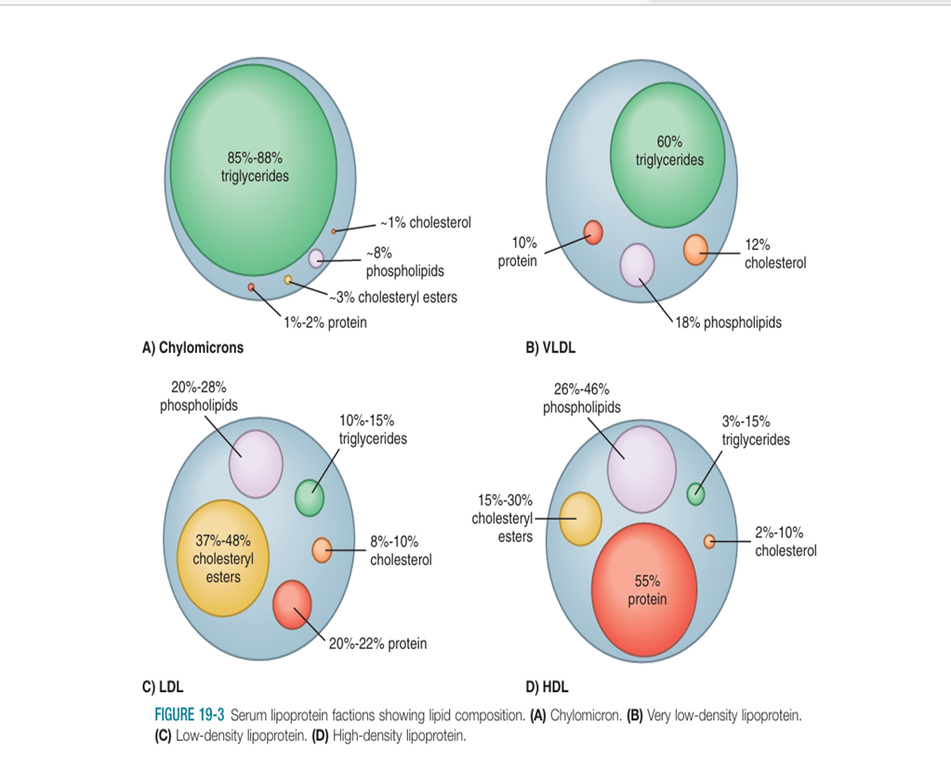
Atherosclerosis Relation to Fat Metabolism
Chylomicrons: dietary TGL.
Very low-density lipoproteins (VLDLs): formed in the liver from endogenous fat.
Intermediate-density lipoproteins (IDLs): Degradation of VLDLs leaves IDLs in circulation.

Slide 9
Blood lipids(cont.)
4. Low-density lipoproteins (LDLs): LDLs are formed endogenously in the liver and in serum from the catabolism of VLDLs and IDLs, Because LDLs deliver cholesterol to the tissue, they are considered the “bad cholesterol.” With regard to cardiovascular health.
5.High-density lipoproteins (HDLs): HDLs carry less total fat and more protein than the other lipoproteins). They transport cholesterol from the tissues and arteries back to the liver for catabolism. HDLs are endogenously produced in the liver. Compared with LDL-cholesterol, HDL is the “good cholesterol,” and higher serum levels are protective against CVD

Slide 10
There are both pharmacologic interventions and lifestyle modifications that influence HDL metabolism.
Exercise increases metabolic kinetics within the liver, skeletal muscle, and adipose tissue, all of which are cardio protective and favor HDL production.
HDLs have a high density of protein.
We do not consume VLDLs, IDLs, LDLs, or HDLs in our food.
Thus, dyslipidemia is not nutritionally addressed by “eating less LDL-cholesterol” or “eating more HDL-cholesterol.” There are other dietary modifications that can improve lipid profiles, but it is not via a direct consumption or avoidance of these lipoprotein fractions.

Slide 11
Triglycerides
Simple fats, whether in the body or in food.
Cardiovascular disease screenings will test for the levels of total triglycerides circulating in the blood.
Hypertriglyceridemia is commonly associated with low HDL cholesterol, both of which are independent risk factors for CVD.

Slide 12

The current guidelines for starting
cholesterol-lowering medications are not based
exclusively on these classifications.
The algorithm for
determining drug therapy needs to take into account
many factors, including age, race, sex, family history,
blood pressure measurements, co-morbidities, and
lifestyle factors.

Slide 13
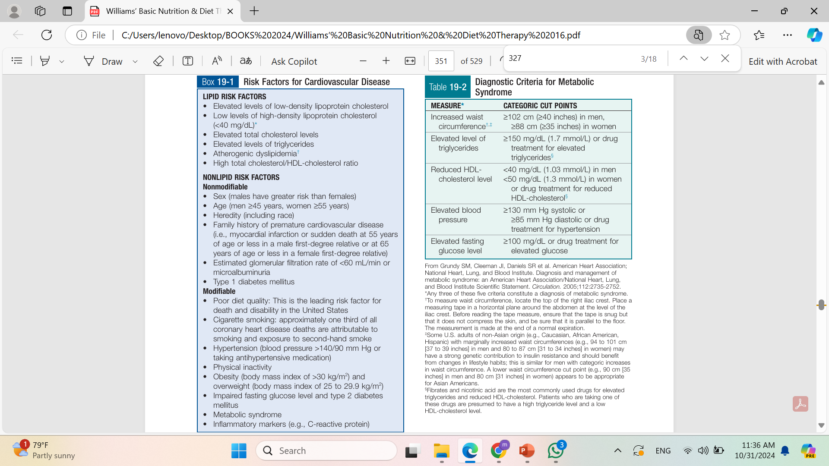
Atherogenic dyslipidemia (AD) refers to elevated levels of triglycerides (TG) and small-dense low-density lipoprotein and low levels of high-density lipoprotein cholesterol (HDL-C)

Slide 14
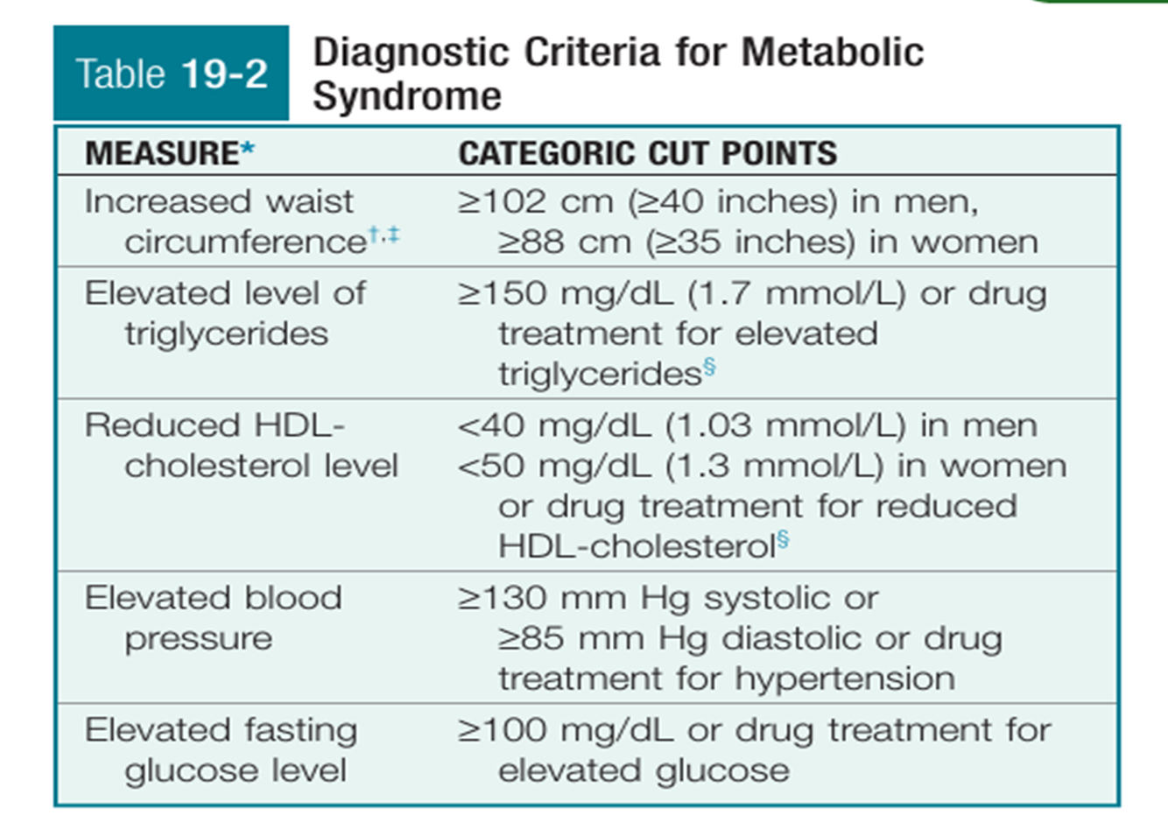
metabolic syndrome a combination of disorders that, when they occur together, increases the risk of cardiovascular disease and diabetes; it is also known as syndrome X and insulin resistance syndrome.

Slide 15
IDEAL CARDIOVASCULAR GOALS ARE AS FOLLOWS FOR ADULTS:
• Never smoked or quit >1 year ago
• At least 150 min of moderate or 75 min of vigorous physical activity each week
• Body mass index between 18.5 and 24.9 kg/m2

Slide 16
What is Light, Moderate, And Vigorous Activity?
Light Intensity
Light intensity activities require the least amount of effort compared to moderate and vigorous activities, but it is acceptable because it encourages people to do more activity to gain additional health benefits, which may encourage a higher level of physical activity.
Talk test: "I can sing" while doing the activity.

Slide 17
Light activity Examples:
Casual walking
Bicycling (less than 5 mph=8 km)
Stretching
Light weight training
Dancing slowly
Leisurely sports (table tennis, playing catch, fishing)
Light yard and house work

Slide 18
Moderate Intensity
Moderate intensity activities mean you’re working hard enough to raise your heart rate and break a sweat.
Talk test: "I can talk, but I can't sing" while doing the activity.

Slide 19
Examples:
Brisk walking (3 to 4.5 mph)
Hiking
Bicycling (5 to 9 mph)
Low impact aerobics
Moderate dancing
Competitive tennis and volleyball
Yoga
Weight training
Housework that involves intense scrubbing and cleaning

Slide 20
Vigorous Intensity
Vigorous intensity activities means you’re breathing hard and fast, and your heart rate has gone up quite a bit.
Talk test: "I can't say more than a few words without pausing for a breath" while doing the activity.

Slide 21

Examples:
Race walking (more than 4.5 mph)
Jogging/Running
Mountain climbing
Bicycling (more than 10 mph)
High impact or step aerobics
Vigorous dancing
Karate, judo, tae kwon do, jujitsu
Competitive basketball, soccer, or football
Swimming laps
While Karate has a focus on punching and hand-based strikes, and Taekwondo focuses on (often spectacular) kicking combinations, Jiu-Jitsu is about subduing an opponent or aggressor.

Slide 22
IDEAL CARDIOVASCULAR GOALS ARE AS FOLLOWS FOR ADULTS: (CONT.)
• Achieve at least 4 of the 5 following key components of a healthy diet:
• Fruits and vegetables: consume >4.5 cups per day
• Fish: consume more than two, 3.5-oz servings per week (preferably oily fish)
• Fiber-rich whole grains ( >1.1 g of fiber per 10 g of carbohydrates): consume three 1-oz-equivalent servings per day
• Sodium: limit to <1500 mg per day
•Sugar-sweetened beverages: limit to <450 kcal (36oz) total per week
Blood pressure: <120/<80 mm Hg
Fasting blood glucose: <100 mg/dL
Cholesterol: <200 mg/dL

Slide 23
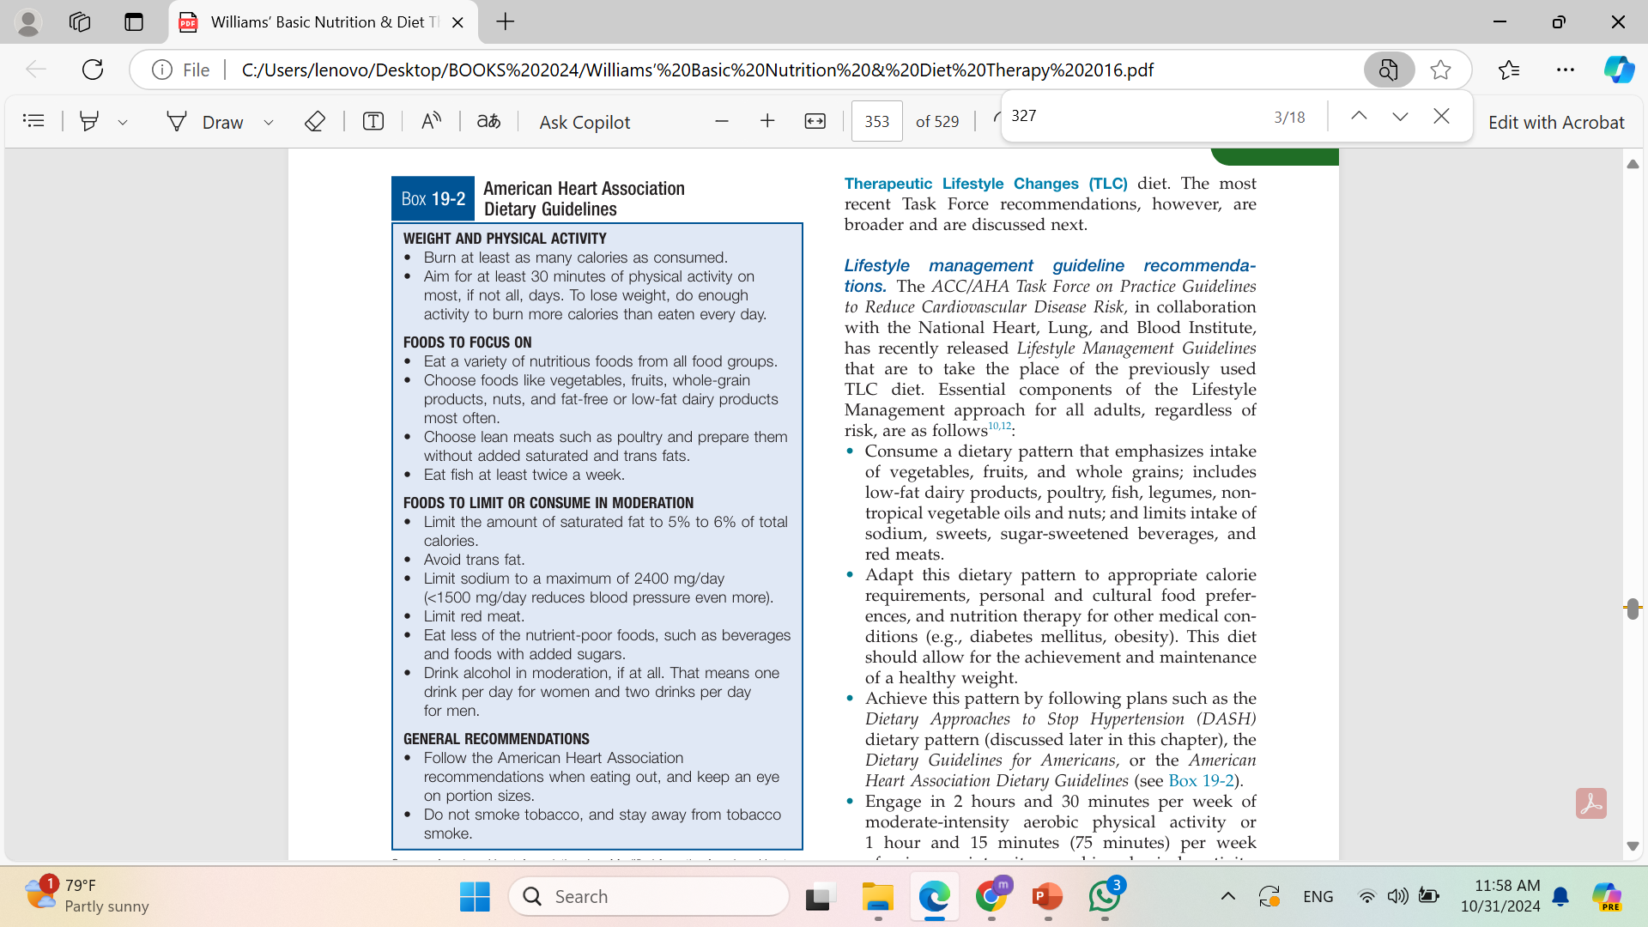

Slide 24
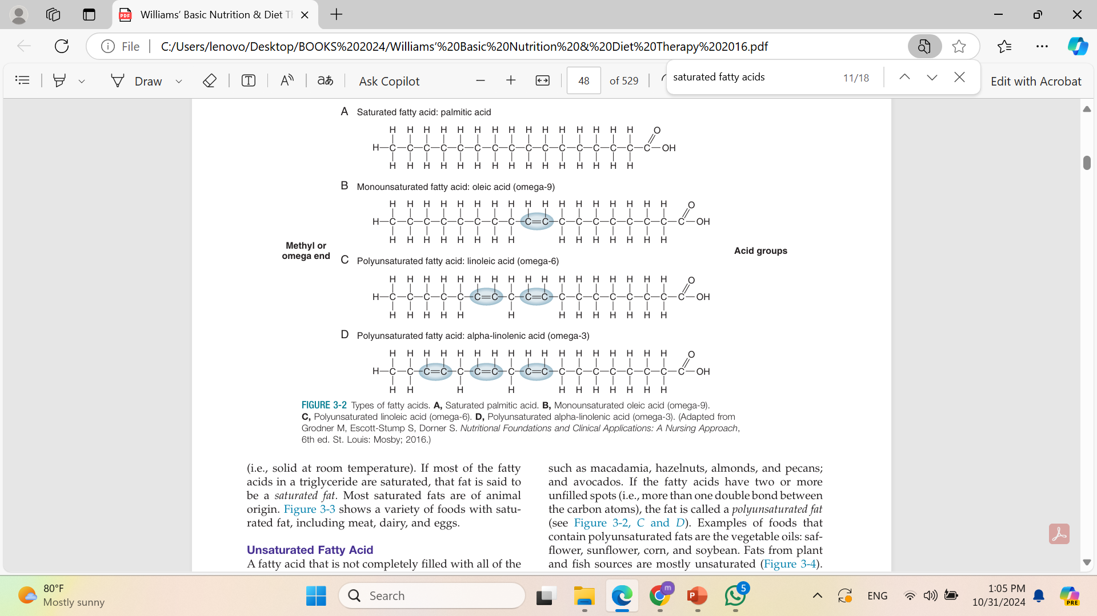

Slide 25
Trans fats
Trans fat, also called trans-unsaturated fatty acids, or trans fatty acids, is a type of unsaturated fat that occurs in foods.
Trace concentrations of trans fats occur naturally, but large amounts are found in some processed foods.
Saturated fat increases serum cholesterol. Trans fat does the same thing, but the increase in LDL (bad cholesterol) is greater, while HDL (good cholesterol) may decrease, making the critical LDL/HDL ratio worse. In addition, trans fat may have a greater impact on inflammation.

Slide 26
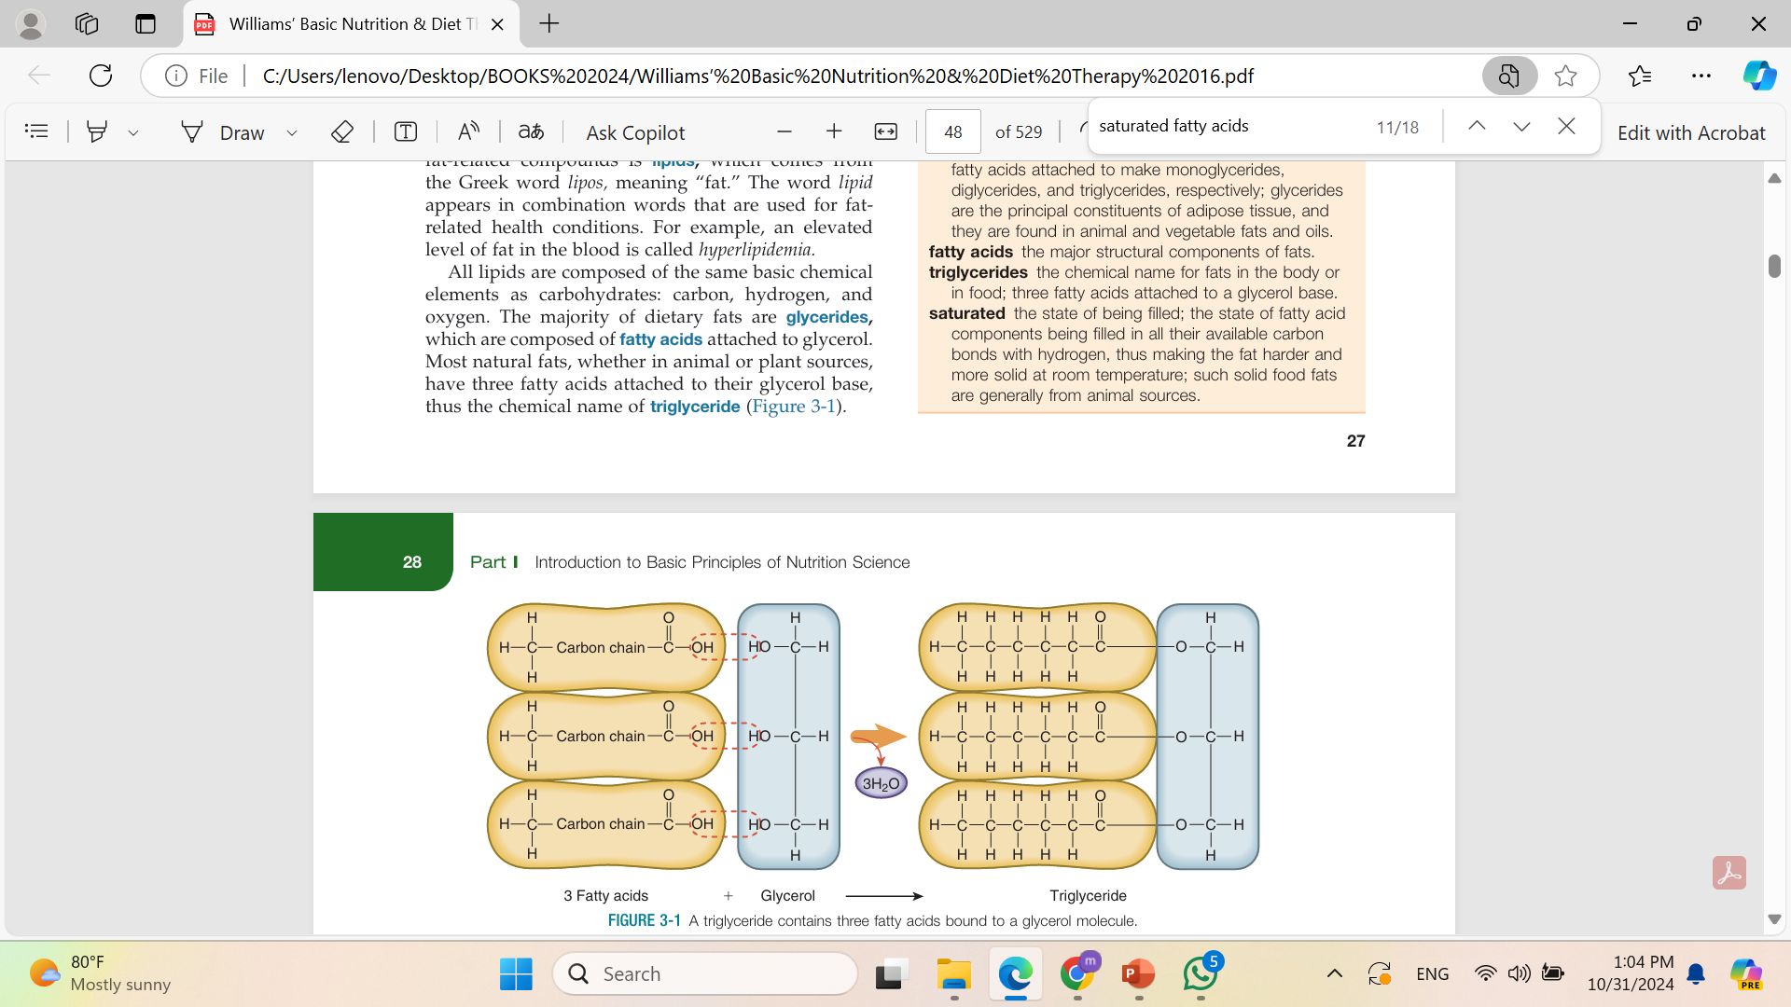

Slide 27
Therapeutic Lifestyle Changes (TLC)
an intensive lifestyle intervention that is focused on appropriate weight, diet, physical activity, and other controllable risk factors to reduce cholesterol levels and to prevent other complications of heart disease.

Slide 28
When the risk factor of obesity is present, weight loss via negative energy balance is encouraged.
Negative energy balance should be achieved through reduced energy intake and increased energy expenditure from regular physical activity.
A treadmill exercise tolerance test is ideal to determine the exercise limit for individuals who are older, who are obese, or who have a history of CVD or hypertension before they start an exercise program

Slide 29
Drug therapy
As the number and severity of risk factors increase, the point at which drug therapy should begin is hastened. For example, a person with few or no risk factors associated with CVD may wait to initiate drug therapy until LDL-cholesterol levels exceed 190 mg/dL .
whereas an individual with significant risk for CVD should consider drug therapy when LDL-cholesterol levels rise to more than 100 mg/dL.

Slide 30
ESSENTIAL HYPERTENSION “The silent killer,”
Essential (or primary) hypertension(90%) an inherent form of high blood pressure with no specific identifiable cause; it is considered to be familial.
When speaking of the chronic condition of elevated blood pressure, the term hypertension is more appropriate than high blood pressure, because blood pressure may occasionally be elevated during situations that involve over exertion or stress.

Slide 31
There are significant indications that many genetic variants play a role in the heritability of hypertension and the individual differences to medication treatment.
A family history of hyper tension quadruples one’s risk of developing hyper tension.
Children of hypertensive parents are twice as likely to develop hypertension; and hypertension during childhood is strongly associated with pervasive hypertension throughout life.
Obesity worsens the condition through a multitude of pathways, including inflammation, renal damage, endothelial damage, oxidative stress, and hyperinsulinemia.
Smoking also increases blood pressure, because nicotine constricts the small blood vessels.
Other risk factors include increasing age, ethnicity, physical inactivity, alcohol consumption, sodium intake, and chronic stress.

Slide 32
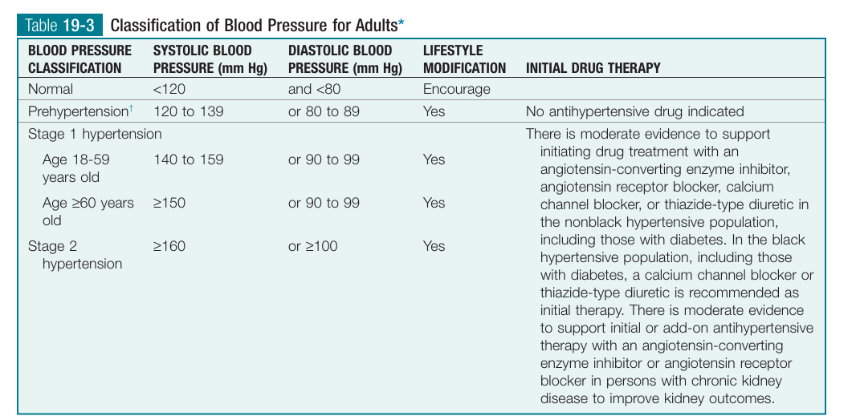

Slide 33
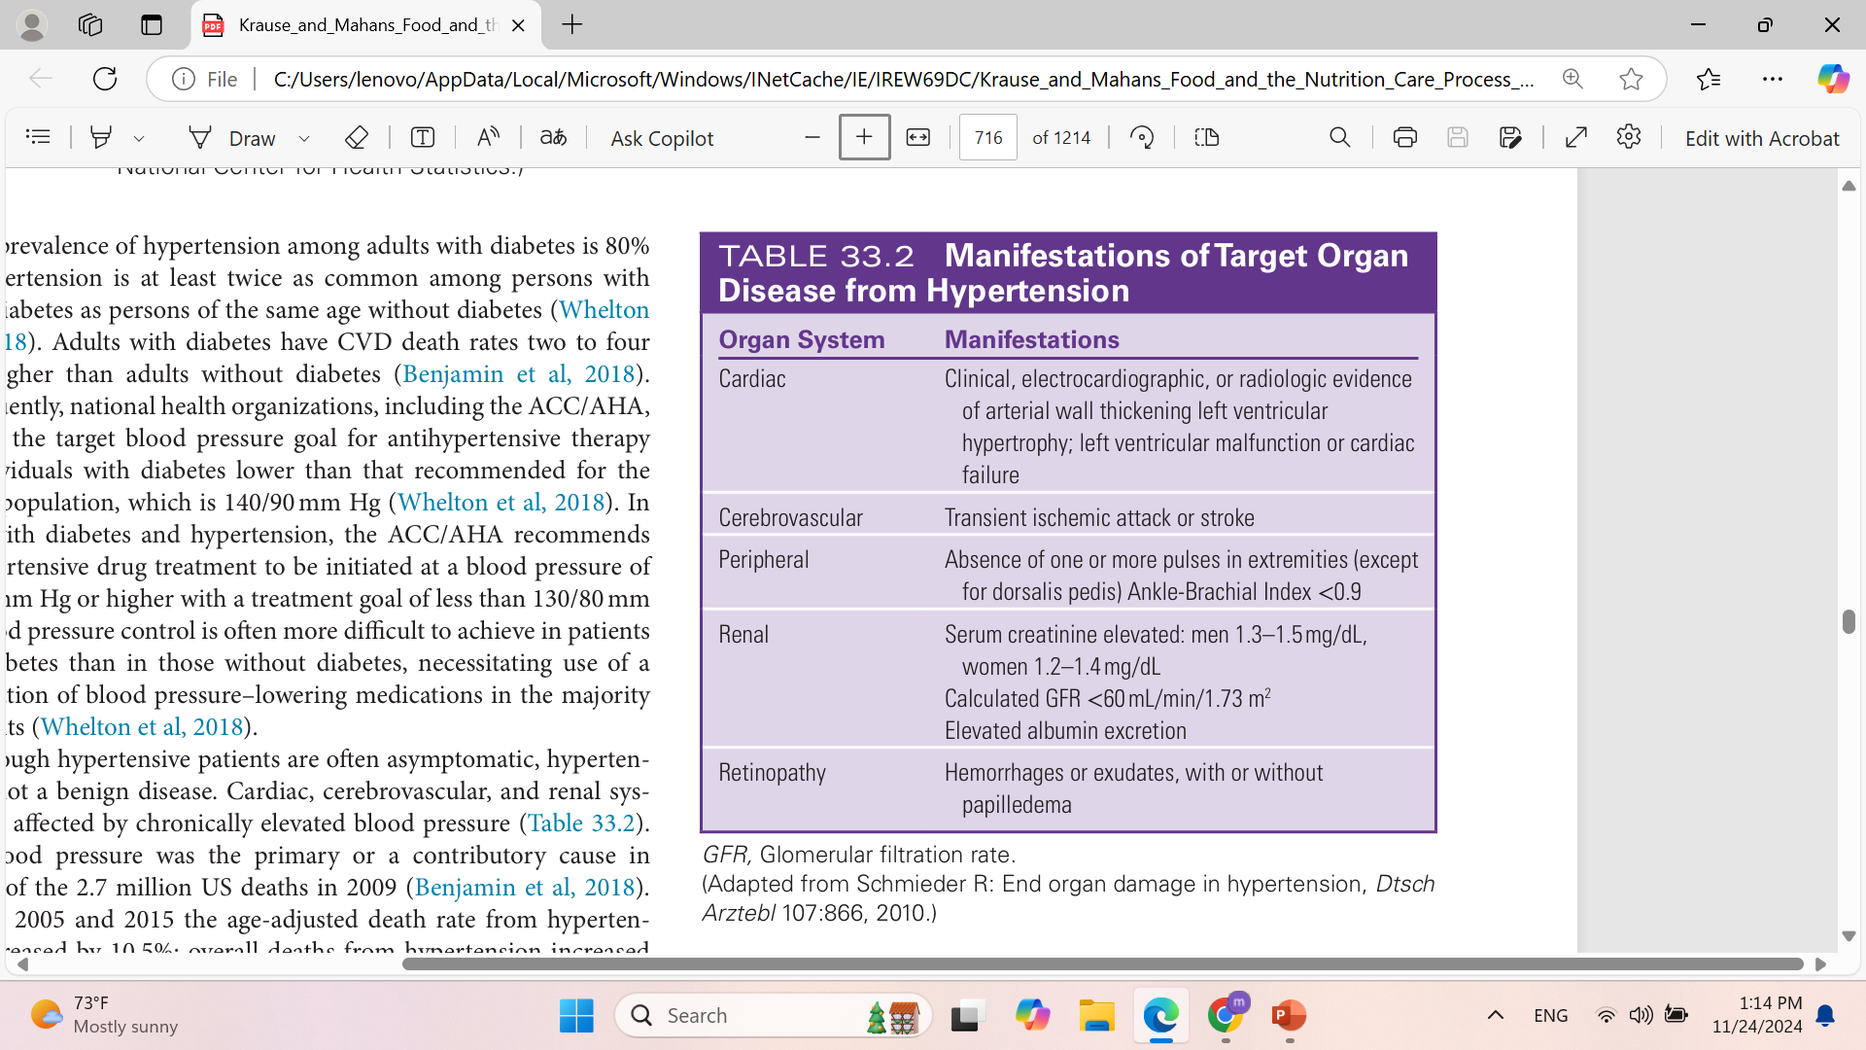

Slide 34
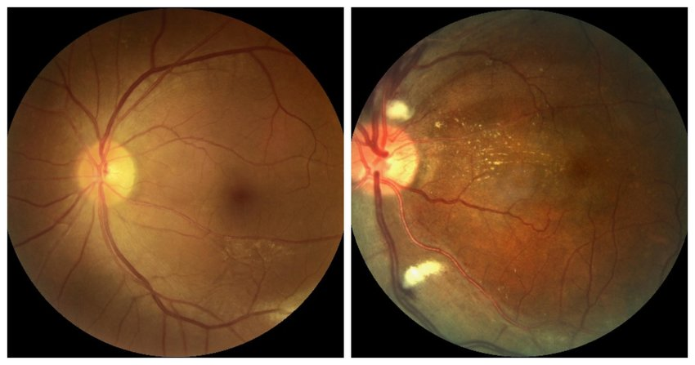
Normal vs hypertensive retinopathy

Slide 35
Prehypertension
is identified by blood pressure measurements that are above normal but are not so high as to meet the diagnostic criteria for hypertension.
It is similar in this regard to prediabetes.
The assumption is that without intervention, the patient will likely
progress to stage 1 hypertension.

Slide 36
Prehypertension(cont.)
The initial focus of hypertension treatment is on lifestyle modifications. Lifestyle choices that are encouraged include the following:
(1) weight loss, if indicated;
(2) increased fruit, vegetable, and low-fat dairy consumption;
(3) reduced sodium, total fat, and saturated fat intake;
(4) moderation of alcohol use;
(5) regular aerobic physical fitness; and
(6) cessation of smoking, if indicated.
Such lifestyle changes are able to reduce the risk of chronic disease and improve blood pressure

Slide 37
Resistant hypertension the presence of high blood pressure despite treatment with three antihypertensive medications

Slide 38
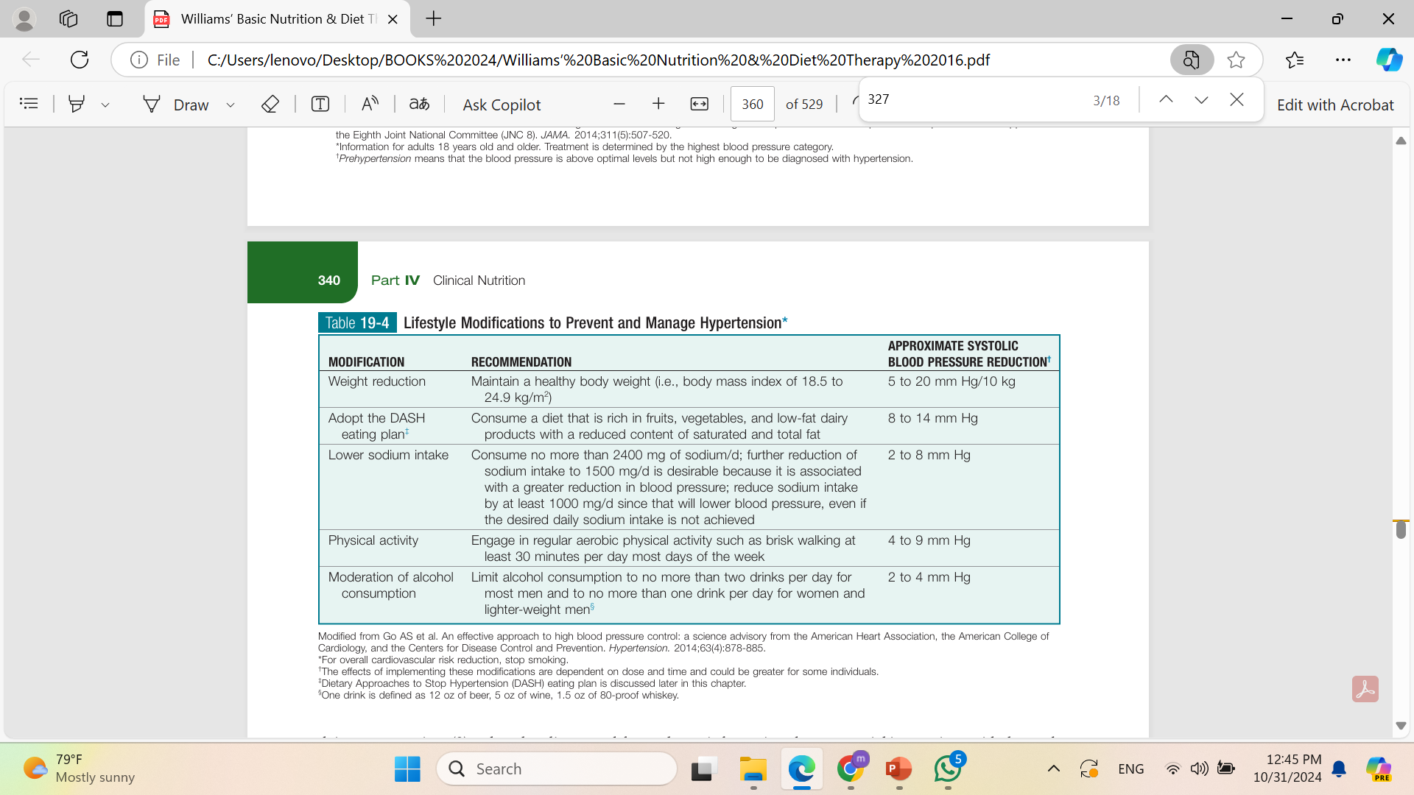

Slide 39
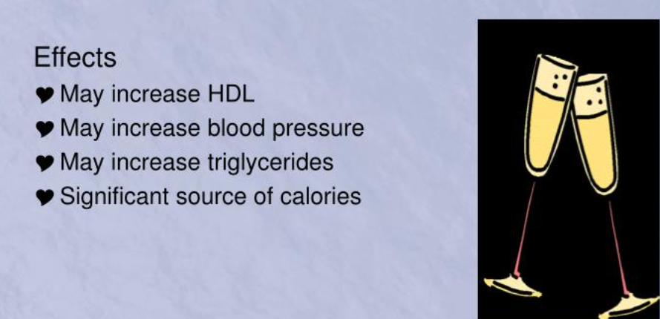
The effects of alcohol

Slide 40
The DASH Diet
Dietary Approaches to Stop Hypertension
able to lower blood pressure significantly by diet alone within a 2-week period.
The diet recommends eating 4 to 6 servings of fruits, 4 to 6 servings of vegetables, and 2 to 3 servings of low-fat dairy foods per day in addition to lean meats, nuts, seeds, dried beans, and high-fiber grains.

Slide 41
The DASH Diet(cont.)
Combining the DASH diet with exercise and weight loss also produces a reduction in total cholesterol and LDL-cholesterol levels, a reduced risk for coronary heart disease and heart failure, and improvements in insulin sensitivity.
The DASH diet is recommended for individuals with high blood pressure, blood pressure in the prehypertension range, and a family history of high blood pressure; it is also recommended for those who are trying to eliminate the use of blood–pressure lowering medications.

Slide 42
Additional life style factors
Smoking cessation and stress management techniques are lifestyle modifications that can help reduce the burden of hypertension.

Slide 43
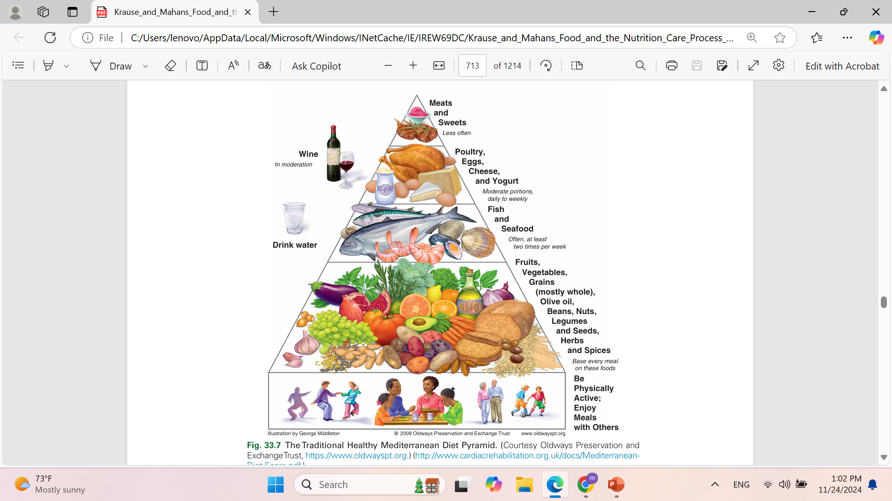

Slide 44
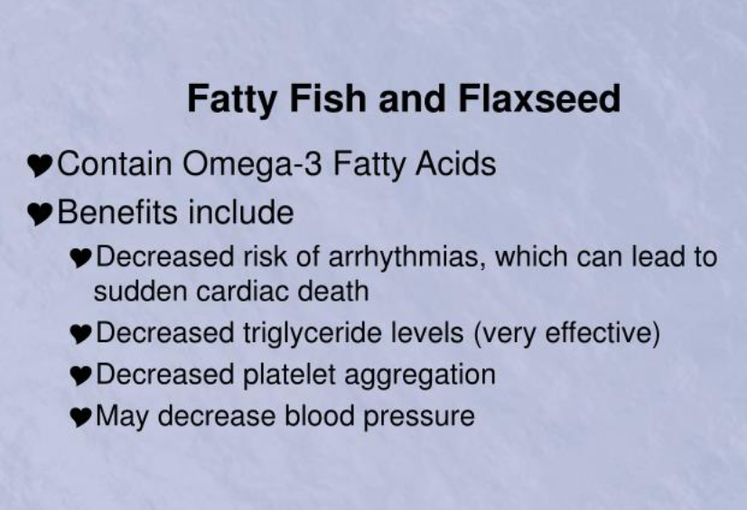

Slide 45
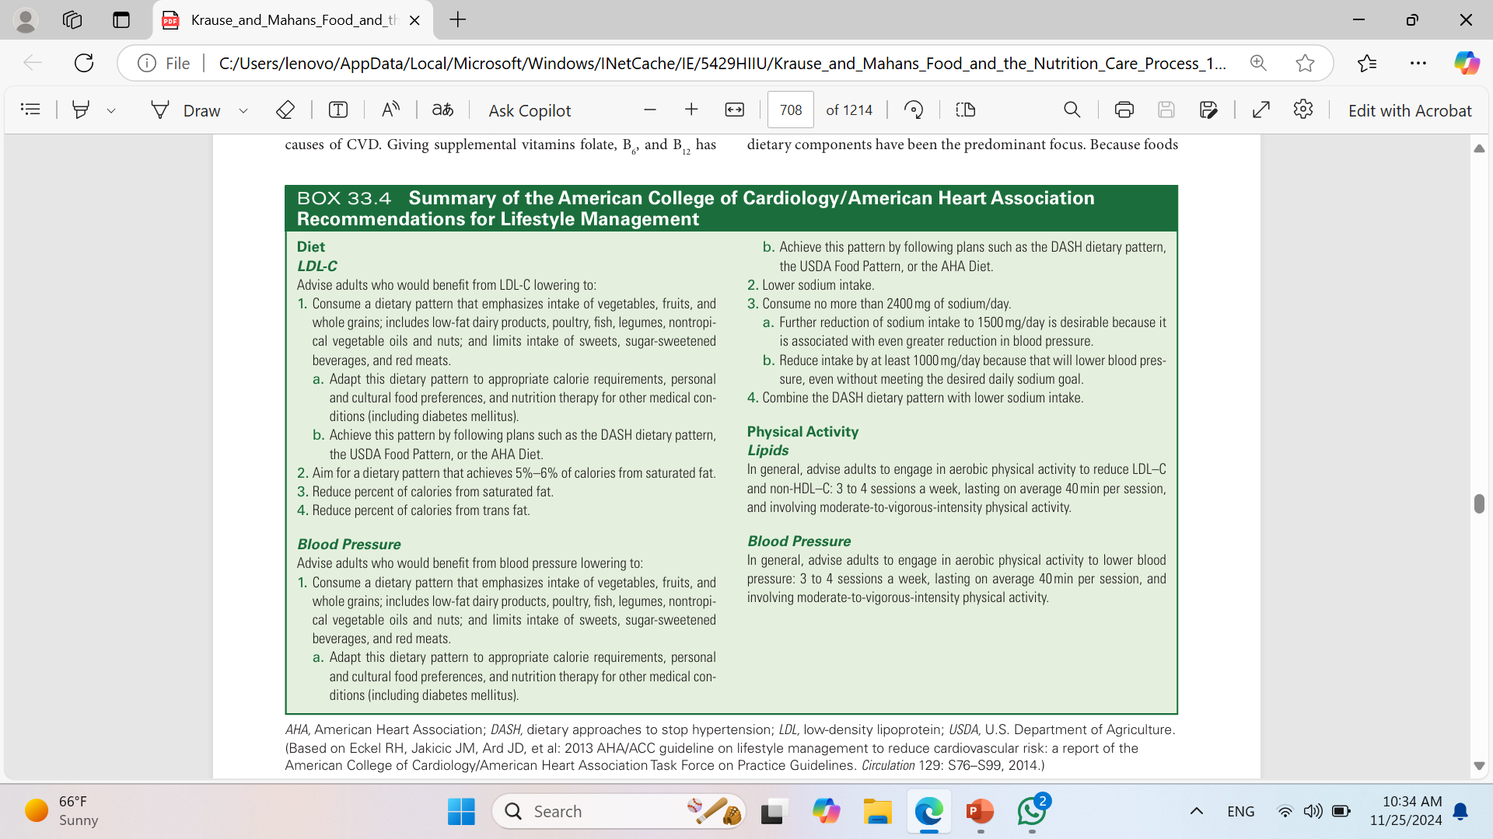

Slide 46
Vegan Diet
A vegan diet is a strict vegetarian diet that includes no dietary sources from animal origins

Slide 47
ACC/AHA lifestyle guidelines recommend the DASH diet as best for prevention of CVD, but also suggest that a MeD pattern is cardioprotective.
There is ongoing research to suggest only vegan diet(very restricted diet) can actually reverse ASCVD

Slide 48
Heart failure
Normally the heart pumps adequate blood to perfuse tissues and meet metabolic needs.
In heart failure (HF), formerly called congestive HF, the heart cannot provide adequate blood flow to the rest of the body, causing symptoms of fatigue, dyspnea (shortness of breath), and fluid retention.
Diseases of the heart (valves, muscle, blood vessels) and vasculature can lead to HF.
HF can be right-sided or left-sided or can affect both sides of the heart. It is further categorized as systolic failure when the heart cannot pump or eject blood efficiently out of the heart or diastolic failure, meaning the heart cannot fill with blood as it should.

Slide 49
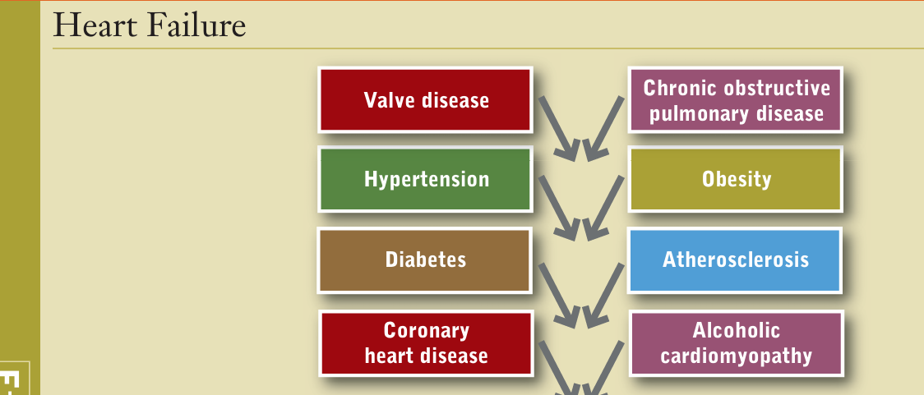
Aetiology

Slide 50
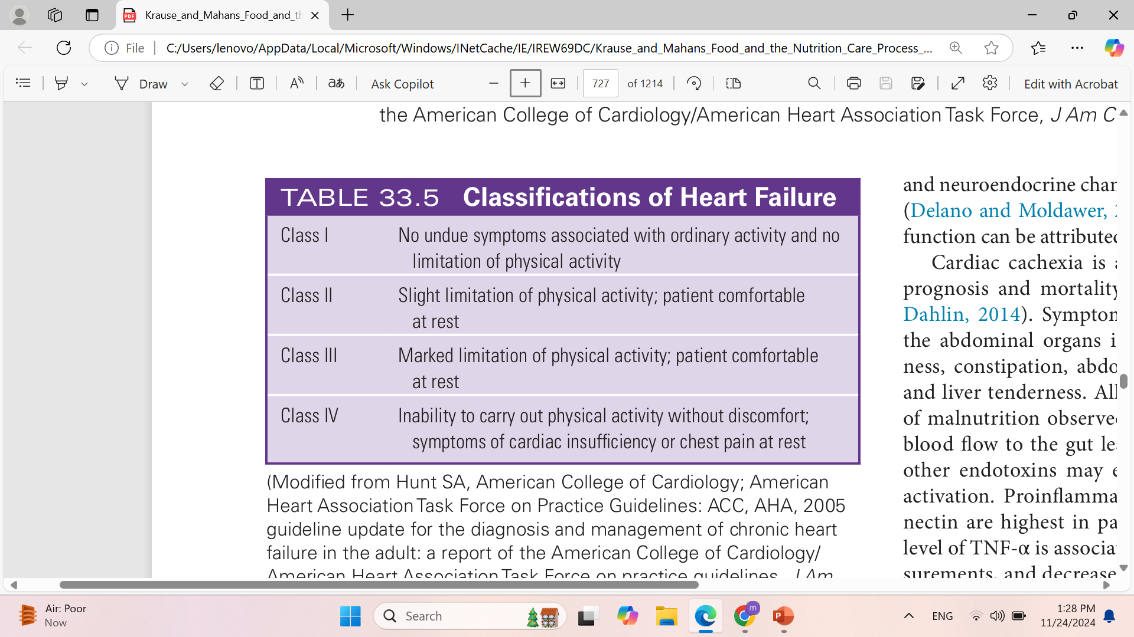

Slide 51
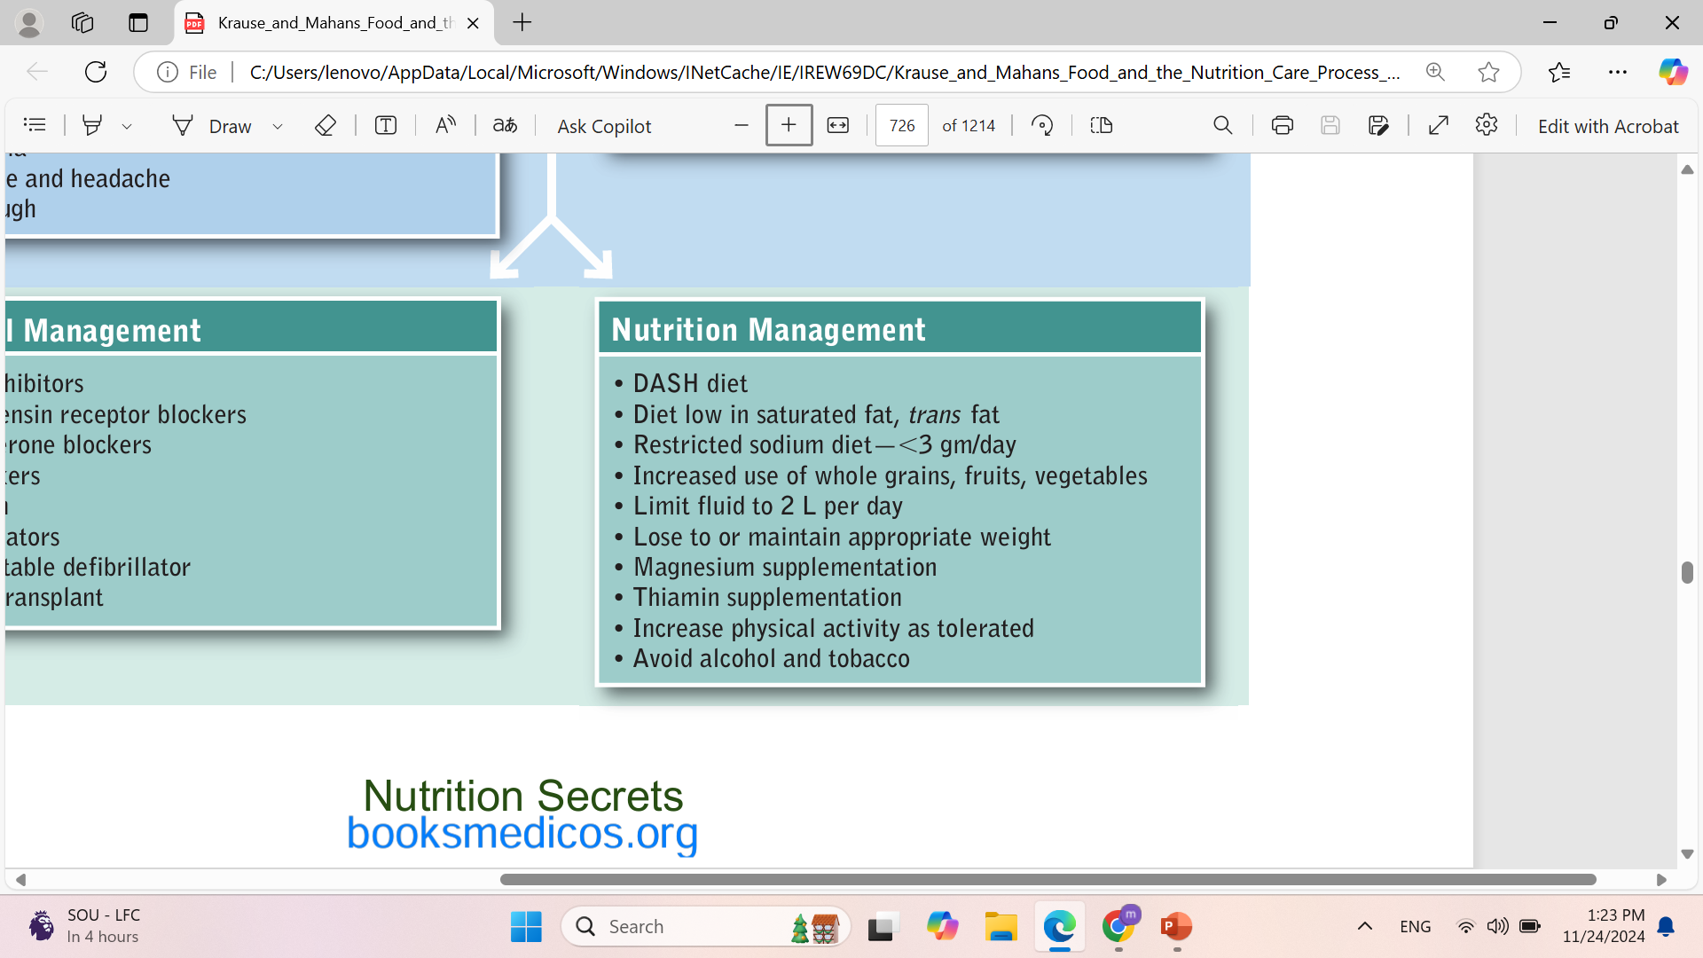
Heart failure

Slide 52
QUESTIONS??
THANK YOU

