Slide 1
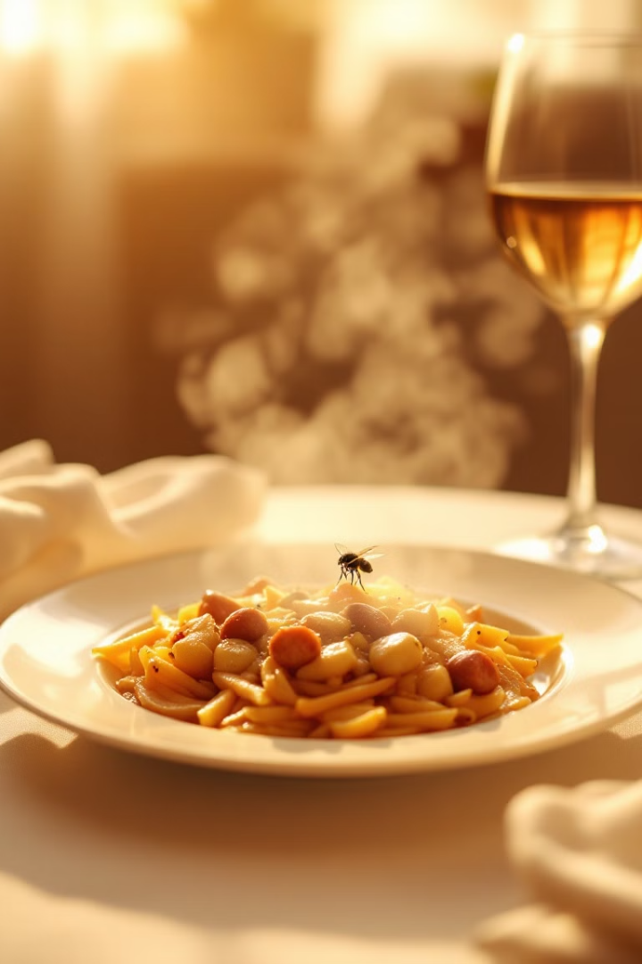
Food Poisoning

Slide 2
Food poisoning, is a common health concern ,
caused by consuming contaminated food or drink.
It is a wide-ranging term, encompassing various
types of illnesses caused
by a vast array of pathogens like bacteria or its toxin,
viruses, and parasites.

Slide 3
Symptoms and Signs
Gastrointestinal Distress
Other Signs
Nausea, vomiting, diarrhea, stomach cramps, and abdominal pain are common symptoms.
Fever, chills, headache, muscle aches, and fatigue can also occur, depending on the type of food poisoning.

Slide 4
Severity
Symptoms can range from mild to severe, and duration can vary depending on
the pathogen and individual factors. For example : Bloody diarrhea, High
fever, Signs of dehydration which including not urinating much , a dry mouth
and throat, feeling dizzy when standing up and Diarrhea that lasts more than 3 days.

Slide 5
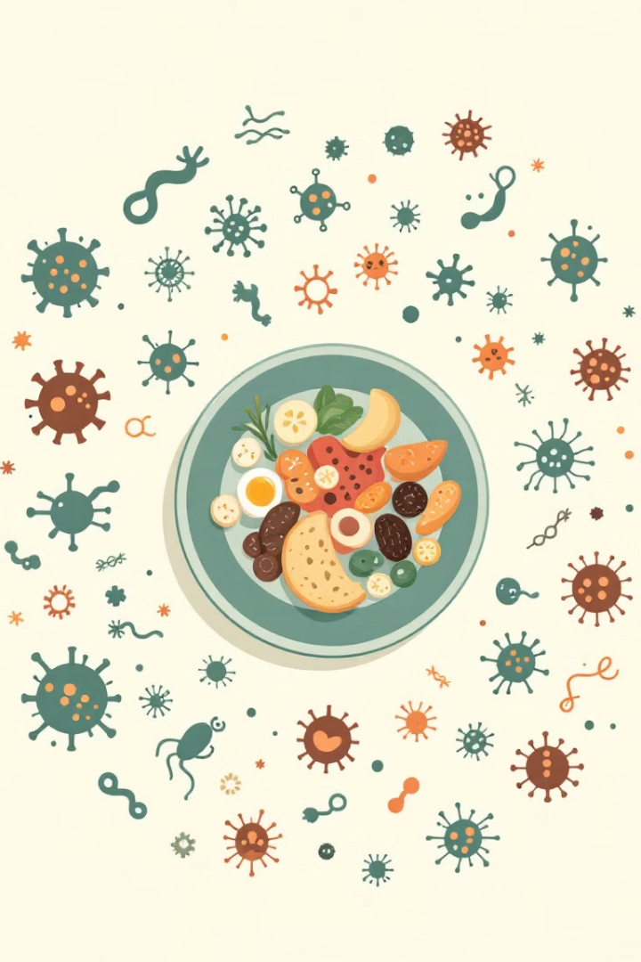



Types of Food Poisoning
Bacterial
Viral
Caused by harmful bacteria like Salmonella, E. coli, and Staphylococcus aureus.
Caused by viruses like norovirus and hepatitis A, often spread through contaminated water or food.
Parasitic
Caused by parasites like Giardia and Cryptosporidium, commonly found in contaminated water and raw or undercooked food.

Slide 6
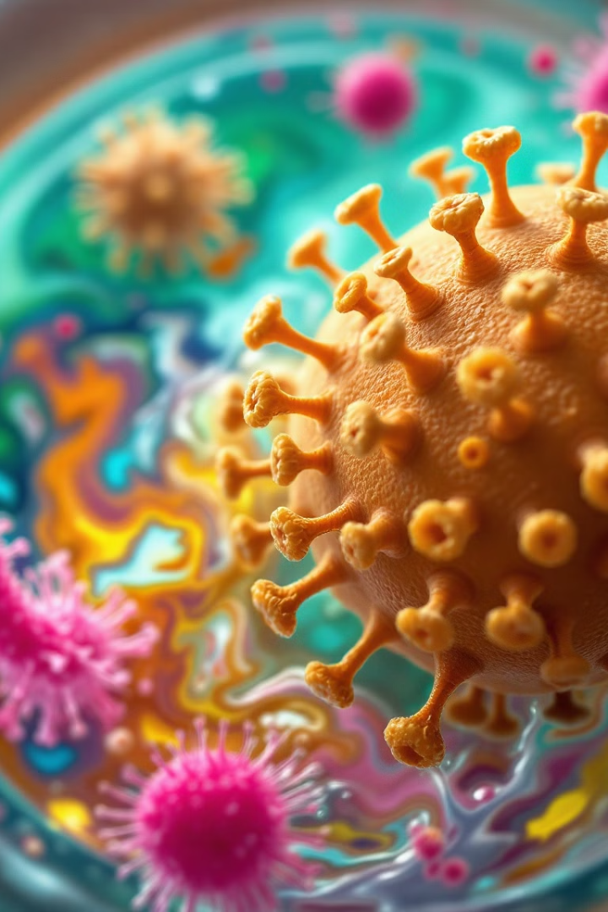
Viral Food Poisoning
1-Norovirus is the most common cause of foodborne illness . It is highly contagious caused by interacting with someone with the virus or by consuming contaminated food or water.
It is most common in places with close living quarters.
Symptoms usually start within 12 to 48 hours and last one to three days. Most common symptoms are diarrhea, vomiting, nausea and stomach pain.

Slide 7
Viral Food Poisoning
2- Rotavirus: highly contagious causes vomiting, fever, diarrhea ,stomach pain, inflammation and other intestinal symptoms.it is most common in infants and young children. Symptoms usually start two days after exposure and last three to eight days.

Slide 8
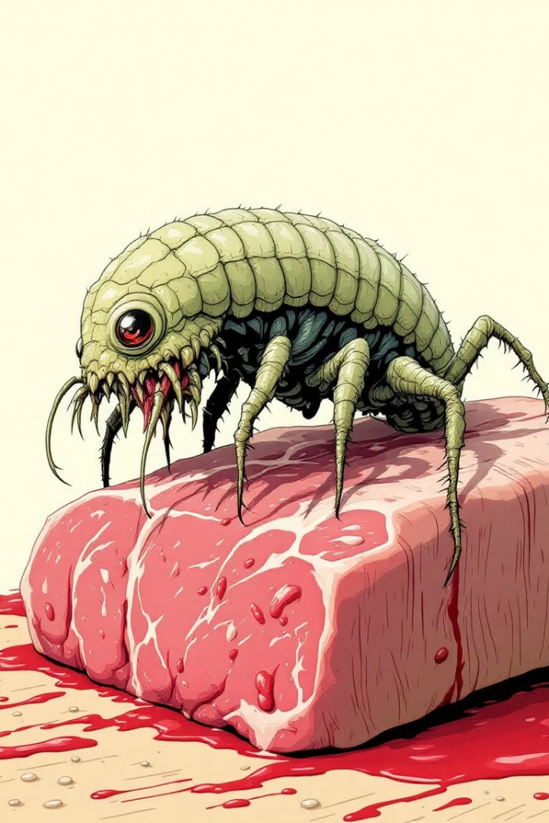
Parasitic Food Poisoning
Giardiasis
Contaminated water, raw or undercooked food washed with contaminated water .
Symptoms: diarrhea, gas and bloating, abdominal cramps, nausea.

Slide 9
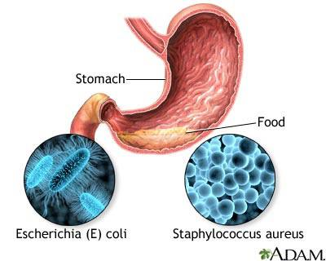
Bacterial Food Poisoning
1-Staphylococcus aureus
Gram positive cocci in cluster, ﻿﻿nonsporing, nonmotile, aerobic organisms.
﻿﻿
2nd most reported food borne disease.
﻿﻿
Heat resistant exotoxin acts as enterotoxin - boiling for 30 minutes not sufficient to denature the organism.

Slide 10
Bacterial Food Poisoning
Staphylococcus aureus
An intoxication (not an infection) of abrupt (within 4 hours)and sometimes violent onset, with severe nausea, cramps, vomiting and prostration, often accompanied by diarrhea and sometimes with subnormal temperature and lowered blood pressure.
Deaths are rare; illness commonly lasts only a day or two, but can take longer in severe cases.
may require hospitalization

Slide 11
Mode of transmission
Ingestion of a food product containing staphylococcal enterotoxin, particularly those foods that come in contact with food handlers' hands, either without subsequent cooking or with inadequate heating or refrigeration.
When food remain at room temperature for several hours before being eaten, toxin-producing staphylococci multiply and elaborate the heat-stable toxin.
About 25% of people are carriers of this pathogen.

Slide 12

Diagnosis and Treatment
Incubation Period : •Interval between eating food and onset of symptoms is 30 minutes to 8 hours, usually 2-4 hours.
Detection of enterotoxin from an epidemiologically implicated food item confirms the diagnosis.
Treatment:
• ﻿﻿No specific treatment.
• ﻿Fluid replacement and hospitalization if needed.

Slide 13
2-Bacillus cereus
• Bacillus cereus, an aerobic spore former.
• ﻿﻿Two enterotoxins have been identified :
﻿﻿﻿Heat stable: causing vomiting, is produced in food when B. cereus levels reach 105 colony-forming units/gram of food . ﻿﻿﻿
Heat labile: causing diarrhea, formed in the small intestine of the human host.

Slide 14
2-Bacillus cereus
Mode Of Transmission:
• ﻿﻿Ingestion of food kept at ambient temperatures after cooking, with multiplication of the organisms. especially rice.
• ﻿﻿Various mishandled foods have been implicated in outbreaks associated with diarrhea.
Incubation Period:
• ﻿From 0.5 to 6 hours in cases where vomiting is the predominant symptom.
• ﻿﻿From 6 to 24 hours where diarrhea predominates.
• ﻿﻿Illness generally persists no longer than 24 hours and is rarely fatal.

Slide 15
Diagnosis and Treatment
Diagnosis is confirmed through quantitative cultures on selective media to estimate the number of organisms present in the suspected food.
﻿Isolation of organisms from the stool of 2 or more ill persons also confirms the diagnosis.
Treatments
﻿Fluid replacement and hospitalization if needed.
Symptomatic treatments

Slide 16

3-Escherichia coli (E.coli)
gram-negative, facultative anaerobic, rod-shaped bacteria normally live in the intestines of healthy people and animals.
Most types of E. coli are harmless or cause relatively brief diarrhea. But a few strains, such as E. coli O157:H7, can cause severe stomach cramps, bloody diarrhea and vomiting.
People usually notice symptoms 3 to 4 days after they have been infected.
The most common way to get an E. coli infection is by eating contaminated food, such as:
• Ground beef. • Unpasteurized milk • contaminated water

Slide 17
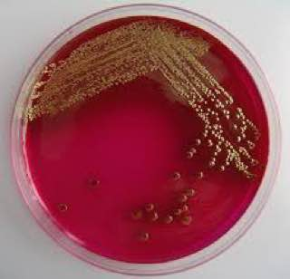
Diagnosis
stool sample to a laboratory to test for the presence of E. coli bacteria. The bacteria may be cultured to confirm the diagnosis and identify specific toxins, such as those produced by E. coli O157:H7.
Treatments
Rest and fluids
Avoid taking an anti-diarrheal and antibiotics medication because they can increase the risk of serious complications

Slide 18
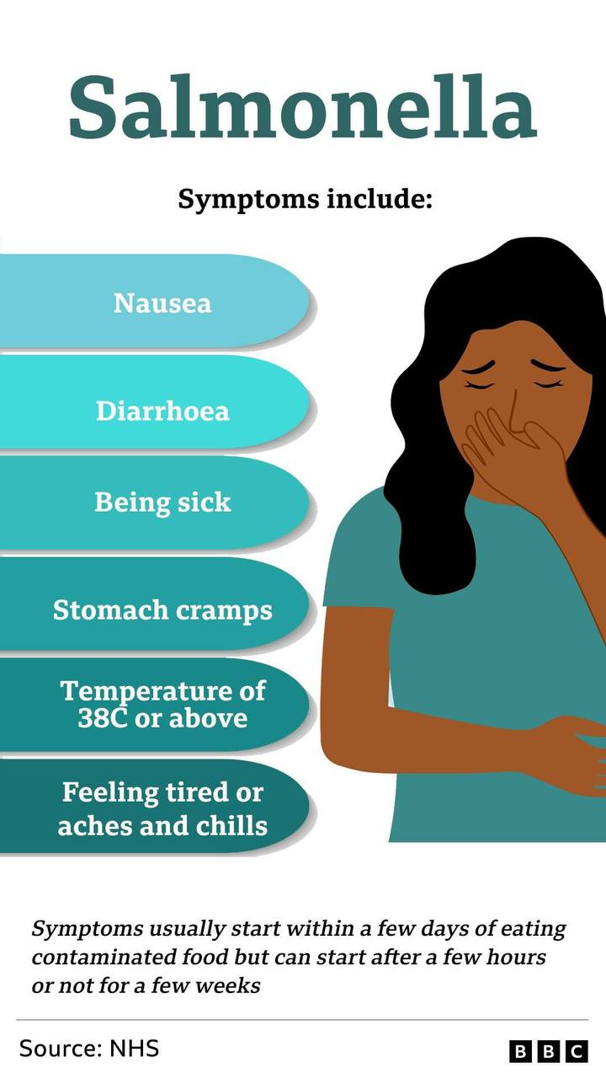
4-Salmonellosis
Salmonella, the name of a group of bacteria,
is one of the most common causes of food
poisoning
and leading cause of bacterial diarrhea worldwide.

Slide 19
4-Salmonellosis
Mode of transmission by fecal-oral: direct or indirect
﻿﻿Commonly contaminated items :﻿﻿Meat, eggs, water
﻿﻿Fecal material from: Livestock, dogs, cats, adult poultry
Two broad classification:
﻿﻿Non-typhoidal salmonella : ﻿﻿Carried by both humans and animals
﻿﻿Ex: salmonella javiana & salmonella enteritidis
﻿﻿Typhoidal salmonella ﻿﻿Carried only by humans﻿﻿ : Ex: salmonella typhi

Slide 20
Incubation period: 6-72 hours but illness usually occurs within 12-36 hours after exposure.
﻿﻿The illness usually lasts 4-7 days, and most people recover without treatment.
Rates of invasive infections and death are generally higher among infants, older adults, and people with immunosuppressive conditions

Slide 21
Diagnosis and Treatment
Diagnosis is based on isolation of Salmonella organisms from stool sample
﻿﻿About 40% of isolates are obtained from routine stool culture, but isolates are also obtained from blood, urine, and material from sites of infection
﻿﻿Isolates of salmonellae are needed for serotyping and antimicrobial susceptibility testing
﻿﻿PCR
Treatment
﻿﻿Uncomplicated salmonella infection with supportive therapy and no antimicrobial agents
﻿﻿Fluoroquinolones: azithromycin and rifaximin are also commonly used in severe illness
﻿﻿Resistance to antimicrobial agents varies by serotype and geographic region.

Slide 22
5-CLOSTRIDIUM BOTULINUM
﻿Clostridium botulinum is an anaerobic Gram +ve, spore forming, rod.
﻿﻿The spores are heat resistant and exist widely in the environment, and in the absence of oxygen they germinate, grow and produce toxins.
Botulinum toxins are one of the most lethal substance known. It blocks the nerve function.
mortality rate is high 5-10% of cases.

Slide 23
5-CLOSTRIDIUM BOTULINUM
﻿
Mode Of Transmission:
﻿Consumption of improperly processed food including canned tuna, meat products such as sausage.
Feco-oral ex soil
IP Commonly 12-36 hours (minimum 4hours to 8 days maximum)

Slide 24
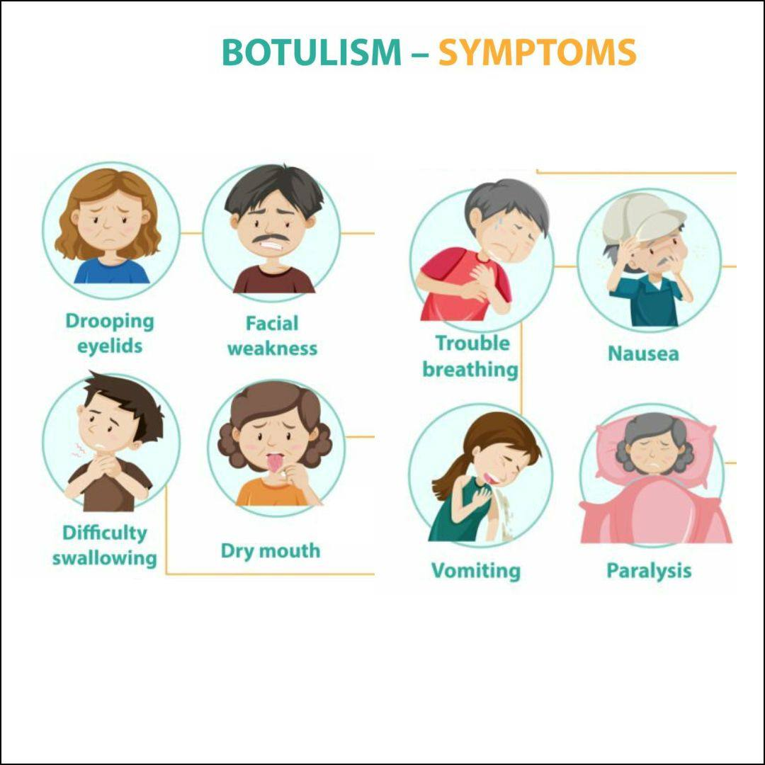

Slide 25

Diagnosis and Treatment
• ﻿﻿History &Examination.
• ﻿﻿Laboratory confirmation including :
1. ﻿﻿﻿Demonstrating the presence of botulinum toxins in serum, stool or food.
2. ﻿﻿﻿Culture of C. botulinum from stool or food.
Treatment:
• ﻿﻿Antitoxin ( neutralising antibodies).
• ﻿﻿Antibiotics ( penicillin G or metronidazole).
• ﻿﻿Mechanical ventilation.

Slide 26
6-Shigella
Shigella is a group of bacteria that causes shigellosis, a type of food poisoning. The infection can cause watery or bloody diarrhea.
Children under age 5 are most likely to get shigella infection. But the illness can happen at any age.
shigella spread easily through an infected person's stool, fingers, on surfaces, or into food or water. and also while visiting developing countries where poor hygiene could cause traveler’s diarrhea.
IP start 1–2 days after infection and last 7 days.

Slide 27
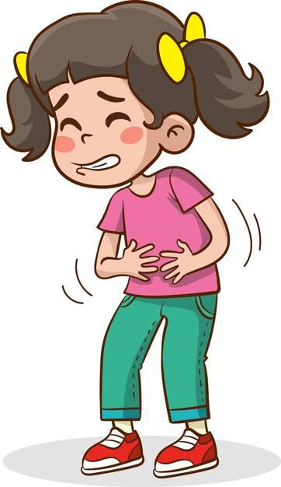
The four species of Shigella are:
Shigella sonnei (the most common species)
Shigella flexneri ,Shigella boydii and Shigella dysenteriae
Diagnosas stool culture
Treatment rest , fluid and ciprofloxacin as first line treatment, and ceftriaxone, or azithromycin as second line treatment

Slide 28
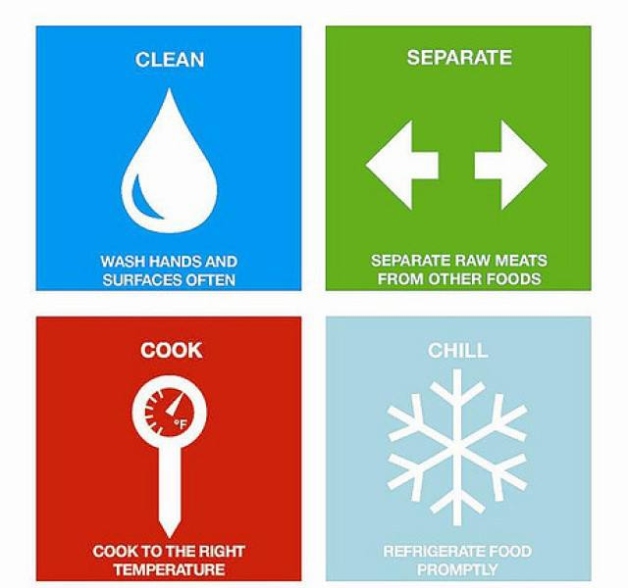
Prevention
﻿
Individual
• ﻿﻿Wash hands thoroughly before handling food
• ﻿﻿ wash food and always cook by your self.
• ﻿﻿Keep food preparation surfaces clean and disinfected (e.g. anti-bacterial).

Slide 29
• ﻿﻿Ensure that refrigerator and freezer are operating properly. The refrigerator should operate at 5 degrees C or lower and the freezer at -18 degrees C or lower
• ﻿﻿Check the 'Use by' dates on food and ensure that you use the food before the date expires
• ﻿﻿Always store eggs in the refrigerator and do not eat food containing uncooked eggs
• ﻿﻿Keep pets away from food and food preparation surfaces
﻿﻿

Slide 30
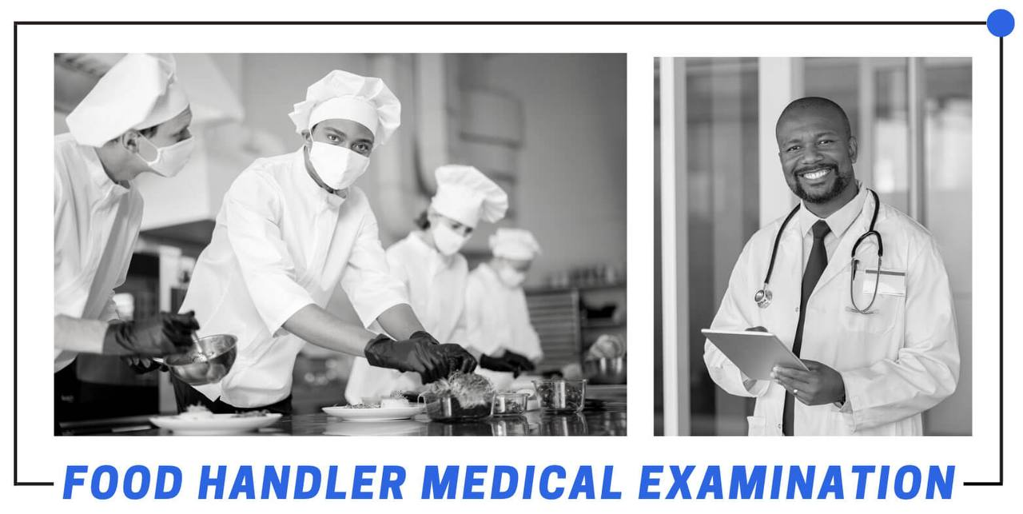
Government
• ﻿﻿Appropriate training for preventative control
• ﻿﻿Food handlers have a major role in the prevention of food poisoning during food preparation since they may cross contaminate raw and cooked foodstuffs as well as inadequately cook and store foods.

