Slide 1
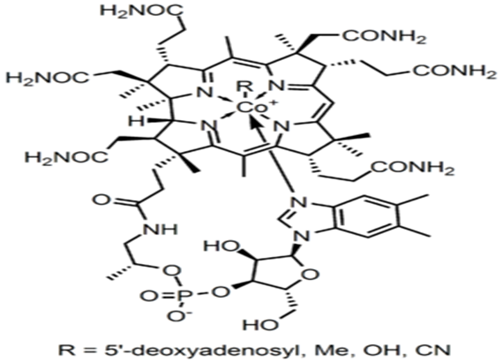
Vitamin B₁₂, vitamin B12 or vitamin B-12, also called cobalamin, is a water soluble vitamin with a key role in the normal functioning of the brain and nervous system, and for the formation of blood. It is one of the eight B vitamins.
A common synthetic form of the vitamin, cyanocobalamin, does not occur in nature, but is used in many pharmaceuticals and supplements, and as a food additive, because of its stability and lower cost.
A central cobalt nucleus surrounded by porphyrins like a ring to which are attached nucleotide and aminopropanol
Medical uses
Vitamin B₁₂, is used to treat vitamin B₁₂ deficiency, cyanide poisoning, and hereditary deficiency of transcobalamin II.
It is also given as part of the schilling test for detecting pernicious anemia.
For cyanide poisoning, large amount may be given intravenously, and sometimes in combination with sodium thiosulfate. The mechanism of action is straightforward: the hydroxycobalamin hydroxide ligand is displaced by the toxic cyanide ion, and the resulting harmless B₁₂ complex is excreted in urine.
High vitamin B₁₂ level in elderly individuals may protect against brain atrophy or shrinkage, associated with Alzheimer's disease and impaired cognitive function.

Slide 2
Cyanocobalamin is one such "vitamer" in this B complex, the cyanocobalamin form of B₁₂ is easy to crystallize and is not sensitive to air-oxidation, it is typically used as a form of B₁₂ for food additives and in many common multivitamins.
All cyanocobalamin is vitamin B₁₂, but not all vitamin B₁₂ is cyanocobalamin.
Pure cyanocobalamin possesses the deep pink color associated with most octahedral cobalt(II) complexes and the crystals are well formed and easily grown up to millimeter size.
Hydroxocobalamin is another form of B₁₂ commonly encountered in pharmacology, but which is not normally present in the human body. Hydroxocobalamin is sometimes denonoted B_{12a}. This form of B₁₂ is the form produced by bacteria.
It is supplied typically in water solution for injection. Hydroxocobalamin is thought to be converted to the active enzymic forms of B₁₂ more easily than cyanocobalamin.
Hydroxocobalamin (B12a) is superior as :
1-It is more active in enzyme systems.
2-It is retained longer in the body when given orally.
Hence,B12a is more useful for theraptic administration of B 12a by mouth.
Absorption
Vitamin B12 is absorbed from ileum , for its proper absorption it requires:
Presence of HCL, and Intrinsic factor(IF) of Castle, a constituent of normal gastric juice.
Mechanism of absorption, it has been shown that two binding proteins are required:
Cobalophilin: a binding protein secreted in the saliva.
Intrinsic factor(IF) : a glycoprotein secreted by parietal cells of gastric mucosa.
1-Gastric acid(HCL) and pepsin release the Vit B12 from protein binding in food and make it available to bind to salivary protein, cobalophilin.
2-In the duodenum, cobalophilin is hydrolyzed, releasing the vitamin for binding to Intrinsic factor (IF).

Slide 3
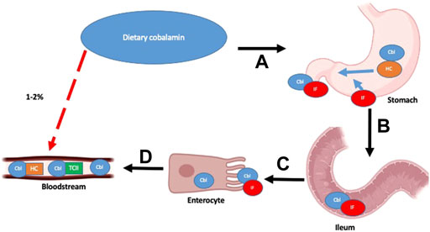
There are two distinct mechanisms by which B12 is absorbed:
1- Passive diffusion across the mucous membranes of the gastrointestinal tract .
2- A receptor-mediated absorption process.
Only an estimated 1%–2% of oral B12 can be passively absorbed and therefore, high dosages of oral B12 are required to provide therapeutic benefit in cases where the receptor-mediated process malfunctions.
In the receptor-mediated absorptive process, ingested B12 is initially bound to Haptocorrin (HC)/R-factor secreted by salivary glands.
Free B12 is once again released following degradation of HC by pancreatic proteases in the duodenum.
It subsequently binds to the intrinsic factor (IF), which is secreted by gastric parietal cells.
This B12-IF complex reaches the terminal ileum, where it binds to heterodimeric receptors cubam composed of an outer protein cubulin and transmembrane protein amnionless, located on the surface of polarized epithelial enterocytes in the apical brush border.
The complex is then endocytosed, and free B12 is released into the bloodstream.
Vitamin B12 absorption pathways and main factors and organs involved
Receptor-mediated absorption processes shown as sequential steps (A–D) with black arrows and Passive diffusion process outlined with red, dashed arrow.

Slide 4
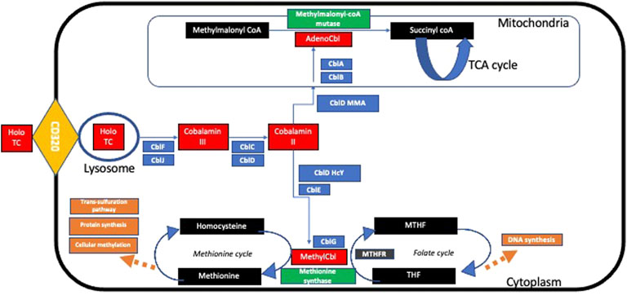
In the bloodstream, free B12 may be bound by Haptocorrin HC or transcobalamin (TC).
B12 bound to HC is not taken up by cells and thus, is biologically inactive.
WHILE B12 bound to TC forms a complex known as holoTC, which is the biologically active form of B12, that is taken up into cells via endocytosis using a specific CD320 receptor.
Following endocytosis, the HoloTC complex is degraded in lysosomes and free B12 is released into the cytoplasm.
This free cytoplasmic B12 undergoes a series of intracellular transport and modifications to enable two core enzymatic reactions:
1) adenosyl-B12 acts as a co-factor for the enzyme methylmalonyl-coA mutase that catalyzes the conversion of methylmalonyl-coA to succinyl-coA, thereby enabling restoration of tricarboxylic acid (TCA) cycle intermediates. 2) methyl-B12 enables methionine synthase in the re-methylation of homocysteine to methionine using methyl-tetrahydrofolate (MTHF) as a methyl donor, thereby enabling the vital biochemical pathways of the folate cycle and methionine cycle, facilitating the downstream synthesis of important compounds like DNA and RNA.
Summary of intracellular metabolism of transcobalamin.

Slide 5
In the receptor-mediated absorptive process, ingested B12 is initially bound to Haptocorrin (HC)/R-factor secreted by salivary glands. Free B12 is once again released following degradation of HC by pancreatic proteases in the duodenum.
It binds to the intrinsic factor (IF), which is secreted by gastric parietal cells. This B12-IF complex reaches the terminal ileum, where it binds to heterodimeric receptors cubam composed of an outer protein cubulin and transmembrane protein amnionless, located on the surface of polarized epithelial enterocytes in the apical brush border .The complex is then endocytosed, and free B12 is released into the bloodstream.
In the bloodstream, free B12 may be bound by HC or transcobalamin (TC). B12 bound to HC is not taken up by cells and thus, is biologically inactive .
B12 bound to TC forms a complex known as holoTC, which is the biologically active form of B12, that is taken up into cells via endocytosis,Following endocytosis, the HoloTC complex is degraded in lysosomes and free B12 is released into the cytoplasm, viaCblF.
Intracellular vitamin B₁₂ is maintained in two active coenzymes, methylcobalamin and 5-deoxyadenosylcobalamin.

Slide 6
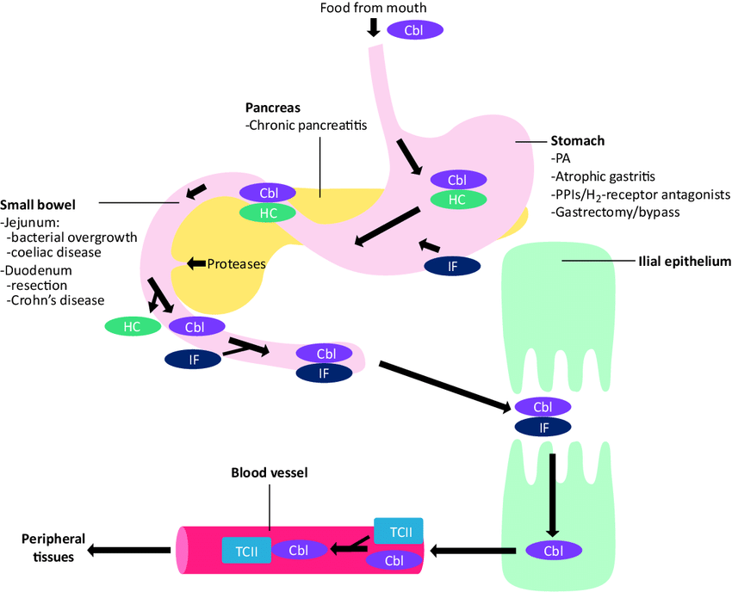
Dietary vitamin B 12 is found in association with food proteins, and must be released on exposure to the low pH within the gastric lumen to facilitate absorption in the small bowel.
Once liberated, vitamin B 12 is immediately bound by haptocorrin (transcobalamin I) and remains attached until proteolytic cleavage of the complex in the duodenum. So, it is available to bind intrinsic factor (IF), a second carrier protein, synthesized by the parietal cells of the gastric mucosa.
IF is necessary for uptake of vitamin B 12 in the terminal ileum. On traversing the brush border, vitamin B 12 dissociates from IF, and enters the circulation where it binds transcobalamin II or haptocorrin. Transcobalamin II and haptocorrin are responsible for delivery of cobalamin to peripheral tissues and the liver.
In supplements, B12 is not bound to protein, and therefore does not need digestive enzymes or stomach acid to be detached from a protein. Stomach acid is needed to dissolve some B12 tablets, especially if not chewed.
There is some preliminary evidence that unbound B12, especially when combined with an absorption enhancer, can be directly absorbed through the membranes under the tongue at higher rates than through passive diffusion in the digestive tract.
Cbl = cobalamin; HC = haptocorrin; IF = intrinsic factor; PA = pernicious anaemia; PPI = proton pump inhibitor; TCII = trancobalamin II.

Slide 7
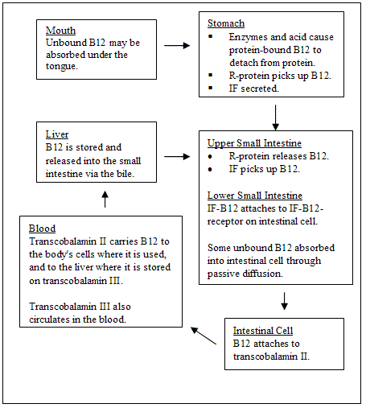
Transport in blood
Vitamin B12 is transported in blood in association with specific proteins named Transcobalamine I and Transcobalamine II and III.
Physiologically Transcobalamine II is more important.
This free cytoplasmic B12 undergoes a series of intracellular transport and modifications to enable two core enzymatic reactions:
1) Adenosyl-B12 acts as a co-factor for the enzyme methylmalonyl-coA mutase that catalyzes the conversion of methylmalonyl-coA to succinyl-coA, thereby enabling restoration of tricarboxylic acid (TCA) cycle intermediates.
2) Methyl-B12 enables methionine synthase in the re-methylation of homocysteine to methionine using methyl-tetrahydrofolate (MTHF) as a methyl donor, thereby enabling the vital biochemical pathways of the folate cycle and methionine cycle, facilitating the downstream synthesis of important compounds like DNA and RNA

Slide 8
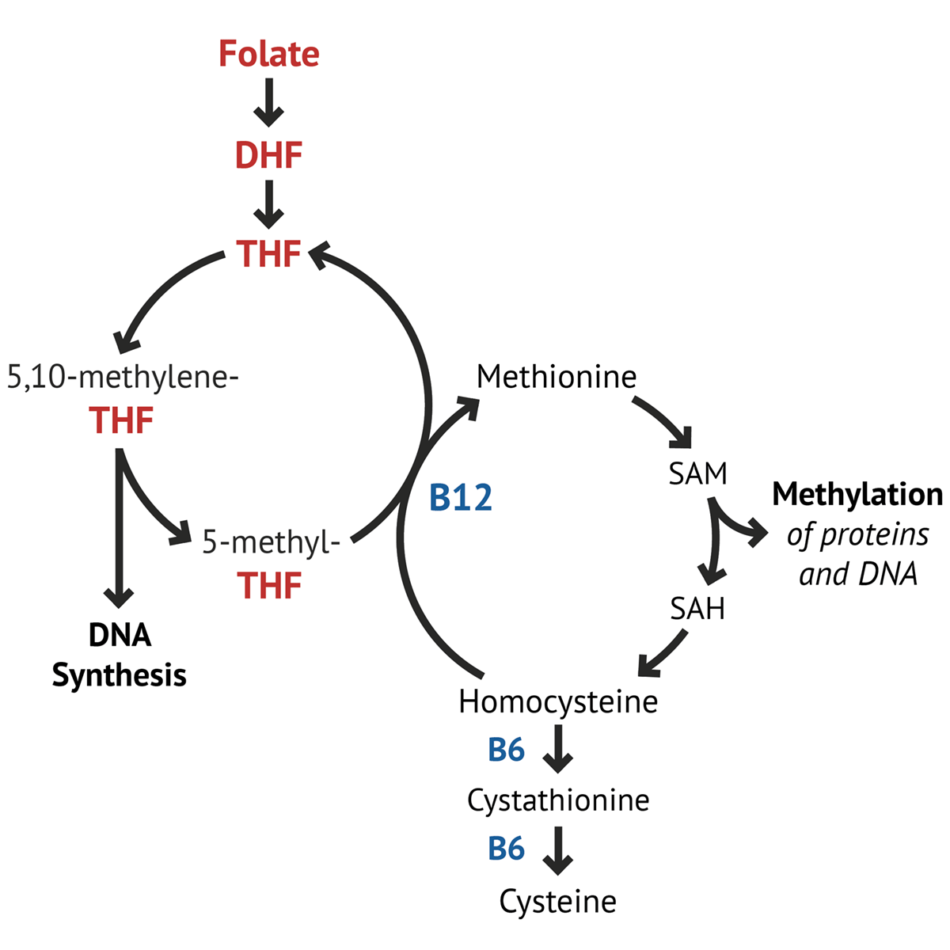
In vitamin B₁₂ deficiency, conversion of methylmalonyl-CoA to succinyl –CoA cannot take place, which results in accumulation of methylmalonyl-CoA and aberrant fatty acid synthesis.
In the other enzymatic reaction, methylcobalamin supports the methionine synthase reaction, which is essential for normal metabolism of folate.
The folate-cobalamin interaction is pivotal for normal synthesis of purines and pyrimidines and the transfer of the methyl group to cobalamin is essential for the adequate supply of tetrahydrofolate, the substrate for metabolic steps that require folate. In a state of vitamin B₁₂ deficiency, the cell responds by redirecting folate metabolic pathways to supply increasing amounts of methyltetrahydrofolate. The resulting elevated concentrations of homocysteine and MMA are often found in patients with low serum vitamin B₁₂ and can usually be lowered with successful vitamin B₁₂ replacement therapy.

Slide 9
Deficiency
May be due to dietary factors, gastric factors as in post gastrostomy and in strict vegetarians .
If absorption is prevented by lack of intrinsic factor it will cause pernicious anemia.
Megaloblastic anemia appears due to B₁₂ deficiency
Malabsorption of vitamin B₁₂ resulting from damage to the stomach, where intrinsic factor is secreted, or damage to the ileum , where intrinsic factor facilitates vitamin B₁₂ absorption. These conditions include tropical sprue and non-tropical sprue (celiac disease).
Clinical Symptoms of vitamin B ₁₂ deficiency:
1-Cardiovascular- increased risk of stroke or heart attack.
2-Psychiatric-
a- Irratability and overall personality change.
b-Mild memory impairment ,occasional dementia.
c-Depression.
3-Hematologic- a-Megaloblastic anemia.
b-Pancytopenia.

