Slide 1
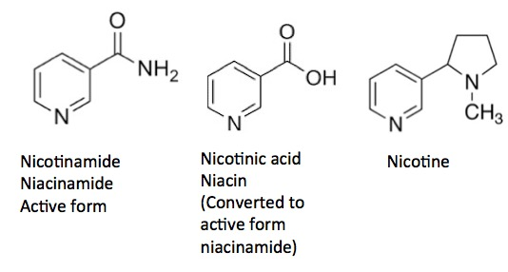
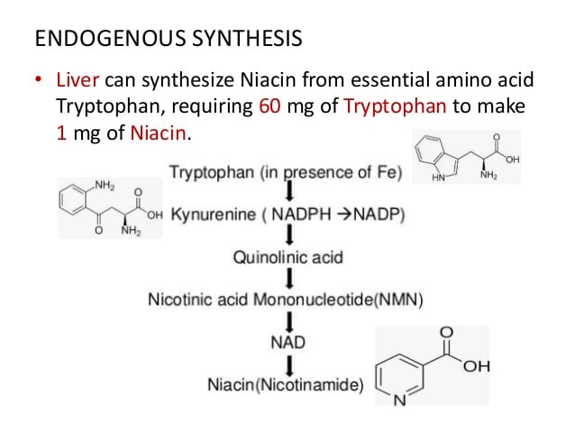
Vitamin B3
Dr. Shatha AL- Khateeb
Lec.5
Niacin and niacinamide are forms of Vitamin B3,(water soluble vitamin) an organic compound with the formula C6H5NO2.It extremely stable to heat, light, acid, alkali, and oxidation.
Essential to all forms of life, the nicotinamide coenzyme NAD+ is synthesized in the body from four precursors that are provided in the diet: nicotinic acid, nicotinamide, nicotinamide riboside, and tryptophan
Niacin is a precursor to NAD+/NADH and NADP+/NADPH, which play essential metabolic roles in living cells. Niacin is involved in both DNA repair, and the production of steroid hormones in the adrenal gland.
Niacin is a unique vitamin since it can be synthesized from tryptophan, one of the essential amino-acids. It takes 60 g of tryptophan to make 1 g of niacin provided that the intestinal flora is healthy and the diet contains sufficient amounts of vitamins B2, B6 and proteins.
For these reasons, niacin's recommended intake is expressed as niacin equivalents (NE). 1 niacin equivalents (NE) = 1 mg of niacin or 60 mg of tryptophan.

Slide 2
Food sources
Niacin is found in variety of foods, including liver, chicken, beef, fish, cereal, peanuts and legumes.
Biological Active Forms
Two such nucleotide active forms are known:
1-Nicotinamide adenine dinucleotide (NAD+)
The compound contains:
* One molecule of nicotinamide.
*Two molecules of D-ribose.
*Two molecules of phosphoric acid, and
*One molecule of adenine.
2-Nicotinamide adenine dinucleotide phosphate (NADP)
This compound differs from NAD+ in that it contains an additional molecule of phosphoric acid attached to 2-position of D-ribose attached to N-9 of Adenine. The reduced form of either coenzymes is designated by the prefix dihydro-nicotinamide adenine dinucleotide (NADH).

Slide 5
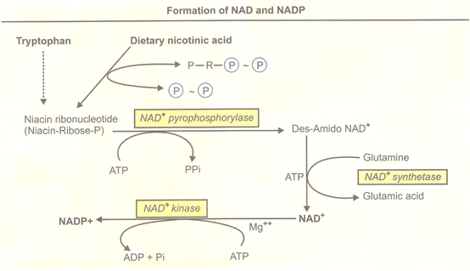

Slide 6
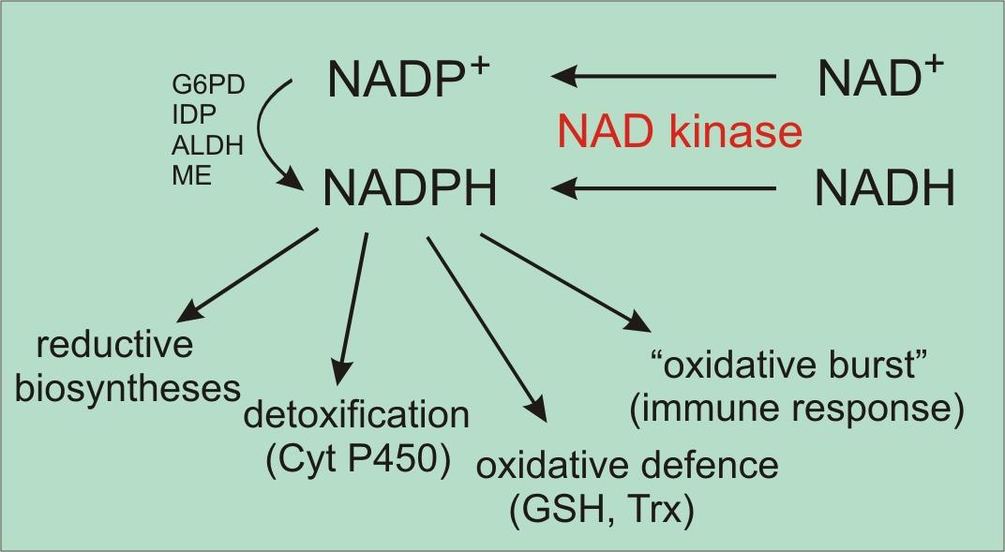
Function
NAD as a coenzyme in electron-transfer reactions
Living organisms derive most of their energy from redox reactions, which are processes involving the transfer of electrons.
Enzymes require the niacin coenzymes, NAD and NADP, mainly to accept or donate electrons for redox reactions .
NAD functions most often in energy-producing reactions involving the degradation (catabolism) of carbohydrates, fats, proteins, and alcohol.
NADP generally serves in biosynthetic (anabolic) reactions, such as in the synthesis of fatty acids, steroids (e.g., cholesterol, bile acids, and steroid hormones), and building blocks of other macromolecules . NADP is also essential for the regeneration of components of detoxification and antioxidant systems . To support these functions, the cell maintains NAD in a largely oxidized state (NAD+) to serve as oxidizing agent for catabolic reactions, while NADP is kept largely in a reduced state (NADPH) to readily donate electrons for reductive cellular processes.
The enzyme NAD kinase is responsible for the final step in the conversion of vitamin B3 to NADP (used collectively for NADPH and NADP+). NADPH is an important molecule, which connects metabolism and various defence mechanisms. These include the immune response, detoxification reactions and the "fueling" of natural antioxidant systems.

Slide 7
Lipid-modifying effects
Niacin blocks the breakdown of fats in adipose tissue.
These fats are used to build very-low-density lipoproteins (VLDL) in the liver, which are precursors of low-density lipoprotein (LDL) or "bad" cholesterol.
Because niacin blocks the breakdown of fats, it causes a decrease in free fatty acids in the blood and, as a consequence, decreases the secretion of VLDL and cholesterol by the liver.
By lowering VLDL levels, niacin also increases the level of high-density lipoprotein (HDL) ,therefore it is sometimes prescribed for people with low HDL, who are also at high risk of a heart attack.

Slide 8
Niacin reduces synthesis of low-density lipoprotein cholesterol (LDL-C), very low-density lipoprotein cholesterol (VLDL-C), lipoprotein(a) and triglycerides, and increases high-density lipoprotein cholesterol (HDL-C).
The lipid-therapeutic effects of niacin are partly mediated through the activation of G protein-coupled receptors, including hydroxycarboxylic acid receptor 2 (HCA2)and hydroxycarboxylic acid receptor 3 (HCA3), which are highly expressed in body fat.
HCA2 and HCA3 inhibit cyclic adenosine monophosphate (cAMP) production and thus suppress the release of free fatty acids (FFAs) from body fat, reducing their availability to the liver to synthesize the blood-circulating lipids in question.
A decrease in free fatty acids also suppresses liver expression of apolipoprotein C3 and PPARg coactivator-1b, thus increasing VLDL-C turnover and reducing its production.
Niacin also directly inhibits the action of diacylglycerol O-acyltransferase 2 (DGAT2) a key enzyme for triglyceride synthesis.
Niacin increases apolipoprotein A1 levels by inhibiting the breakdown of this protein, which is a component of HDL-C. It also inhibits HDL-C hepatic uptake by suppressing production of the cholesterol ester transfer protein (CETP) gene.
It stimulates the ABCA1 transporter in monocytes and macrophages and upregulates peroxisome proliferator-activated receptor gamma, resulting in reverse cholesterol transporter.
Having a low HDL level by itself is a risk factor for developing heart disease.
Deficiency
Niacin deficiency is sometimes seen in developed countries, and it is usually apparent in conditions of poverty, malnutrition, and chronic alcoholism.
Mild niacin deficiency has been shown to slow metabolism, causing decreased tolerance to cold.
Pellagra
Pellagra is a vitamin deficiency disease most commonly caused by a chronic lack of niacin (vitamin B₃) in the diet. It can be caused by decreased intake of niacin or tryptophan, and possibly by excessive intake of leucine. It may also result from alterations in protein metabolism in disorders such as carcinoid syndrome. A deficiency of the amino acid lysine can lead to a deficiency of niacin, as well.

Slide 9
Toxicity
Pharmacological doses of niacin (1.5 - 6 g per day) occasionally lead to side effects that can include dermatological conditions such as skin flushing and itching, dry skin, and skin rashes including eczema exacerbation. These symptoms are generally related to niacin's role as the rate limiting cofactor in the histidine decarboxylase enzyme which converts l-histidine into histamine.
Although high doses of niacin may elevate blood sugar, thereby worsening diabetes mellitus.

