Slide 1
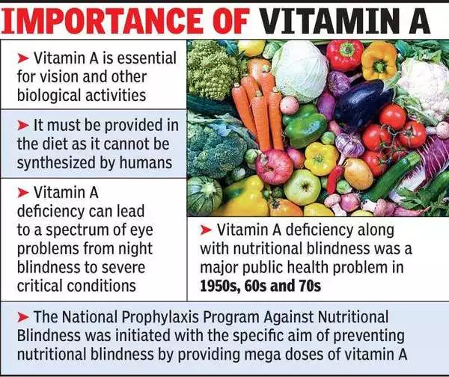
Dr.Shatha AL-Khateeb Lec.3

Slide 2
Vitamin A is a fat soluble vitamin; the active form is present only in animal tissue.
The pro-vitamin, beta carotene is present in plant tissue.
Retinol, retinal, retinoic acid, and related compounds are known as retinoid.
Beta-carotene and other carotenoids that can be converted by the body into retinol are referred to as provitamin A (carotenoids).
All forms of vitamin A have a beta-ionone ring to which an isoprenoid chain is attached, called a retinyl group.
The orange pigment of carrots – beta-carotene – can be represented as two connected retinyl groups, which are used in the body to contribute to vitamin A levels.
Alpha-carotene and gamma-carotene also have a single retinyl group, which give them some vitamin activity.

Slide 3
Vitamin A is present in three forms:
1-RETINOL: which involve in reproduction,bone formation and store in liver.
2- RETINAL: involved in night and color vision
3- RETINOIC ACID:involve in cell growth and cell differentiation

Slide 8
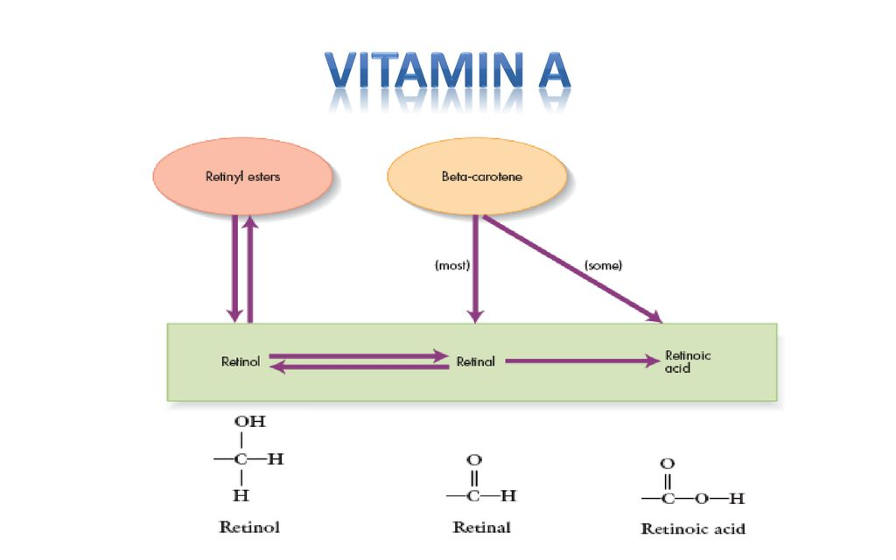

Slide 9
Vitamin A can be found in two principal forms in foods:
*Retinol, the form of vitamin A absorbed when eating animal food sources, is a yellow, fat-soluble substance. Since the pure alcohol form is unstable, the vitamin is found in tissues in a form of retinyl ester. It is also commercially produced and administered as esters such as retinyl acetate or palmitate.
*The carotenes alpha-carotene, beta-carotene, gamma-carotene; and the xanthophyll beta-cryptoxanthin (all of which contain beta-ionone rings), but no other carotenoids, function as vitamin A , which possess the enzyme required to convert these compounds to retinal.

Slide 11
Cis-trans isomers exhibit a type of stereoisomerism where the atoms have different spatial arrangements in three-dimensional space. In the field of organic chemistry, cis isomers contain functional groups on the same side of the carbon chain whereas the functional groups are on opposite sides in trans isomers.

Slide 13
Metabolism
Absorption
Seventy to ninety percent of vitamin A from the diet is absorbed in the intestine.
Absorption of vitamin A is very rapid, with maximum absorption occurring two to six hours after digestion.
Beta carotene is cleaved by a di-oxygenase enzyme , to form retinal .
The retinal is reduced to retinol by an NADH or NADPH dependent retinal reductase present in the intestinal mucosa.
Intestine is the major site of absorption

Slide 14
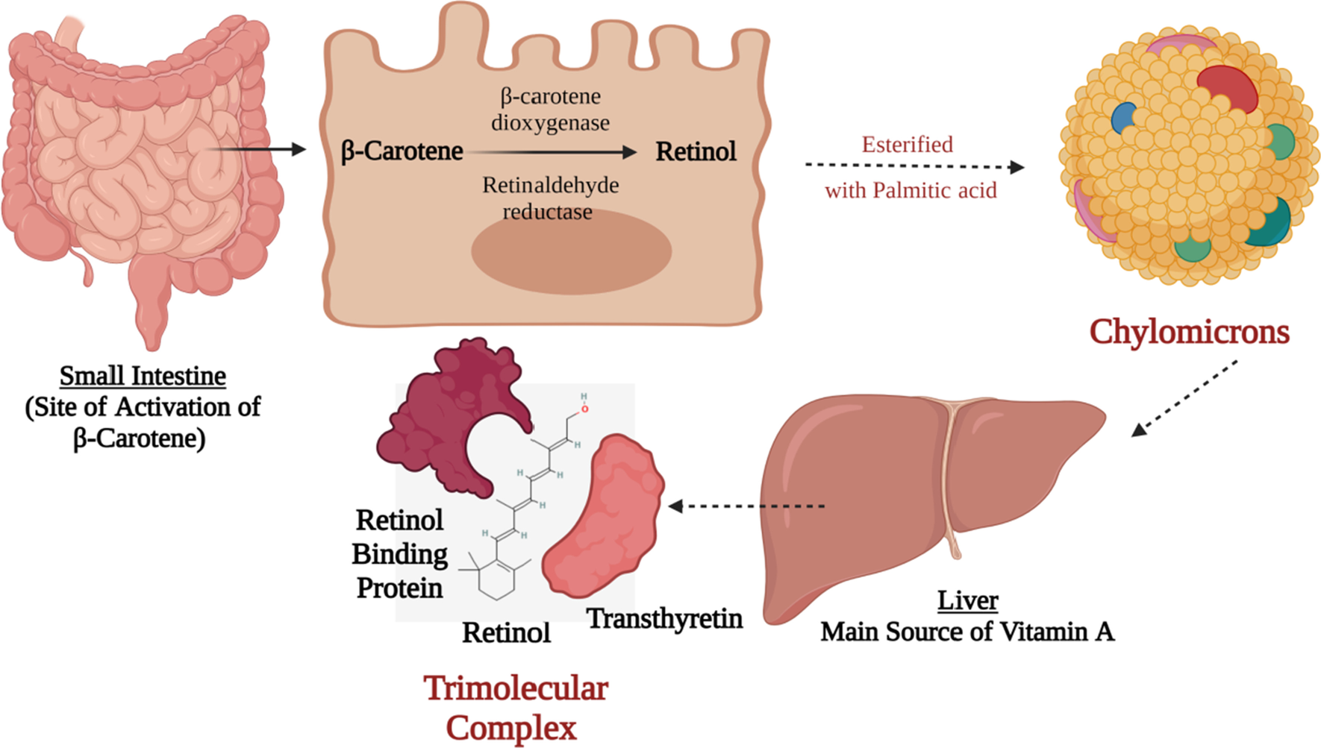
The activation process of β-carotene to retinol in the small intestine following the absorption of the β-carotene from t;9he apical membrane and then the transportation of the activated retinol via the basolateral membrane directed towards the liver via chylomicrons. In the liver, it is processed in a trimolecular complex that is made up of active retinol, retinol-binding protein, and transthyretin protein. Such trimolecular complex prevents its glomerulus filtration via the kidneys

Slide 15
1-Ingested food is digested in the stomach where retinyl palmitates (esters) are released from proteins. Retinol and beta-carotene are absorbed directly into the small intestine where retinyl esters and beta-carotene are transformed into retinol . Retinol is the most easily absorbed form of vitamin A.
2.-That retinol absorbed by the enterocytes in the ileum (small intestine) along with bile is then transported to the liver with the help of chylomicrons a protein that transports fat.
3.-Fifty to 80% of the vitamin A is stored in the liver and the remaining is deposited into adipose tissue, lungs and kidneys.
4.-When stored retinol is released from the liver into the circulation to target organs, it is bound to plasma retinol-binding protein (RBP4) a transporting protein produced by the liver that requires ZINC, which is synthesized by the liver; This complex is stabilized by transthyretin (TTR), which reduces renal excretion.
Retinol is a crucial component for reproduction, embryological development, cellular differentiation, growth, protein synthesis, and immunity in the form of retinoic acid and vision in the form of retinal.

Slide 19
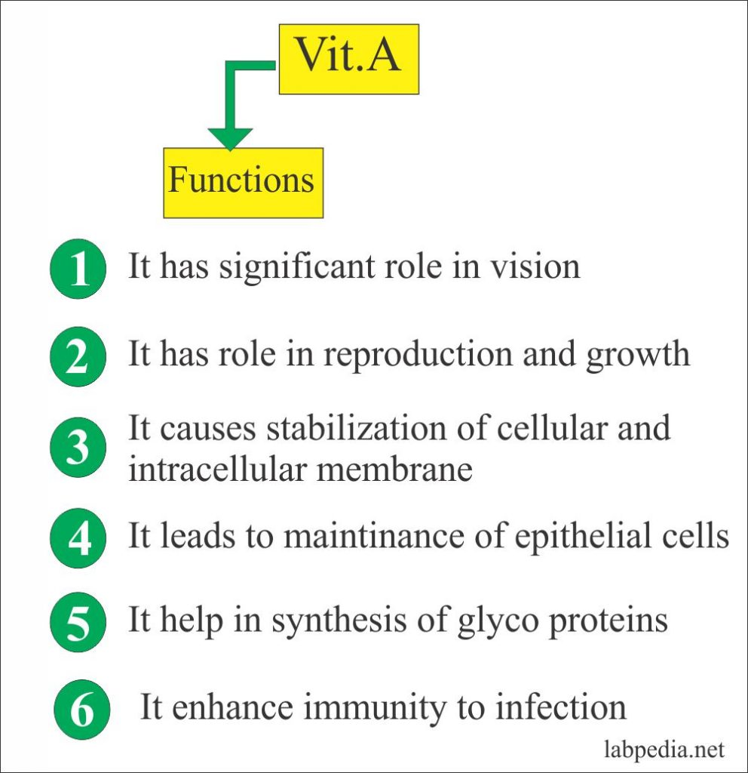

Slide 20
Transport
1-After leaving the enterocytes chylomicron, which carry retinyl esters, carotenoids, and unesterfired retinol along with triglycerides, are circulated first through the lymphatic system and then through the general circulation.
2- Upon arriving at extra-hepatic cells chylomicron release triglycerides, however vitamin A remains within the chylomicron.
3-The vitamin A is then incorporated into a chylomicron remnant.
4-The chylomicron remnant then travels back to the liver where it is taken up and further metabolized or stored.
When needed retinol is mobilized from the liver and requires the use of a carrier for transport through the blood. Retinol-binding protein (RBP) is the specific carrier used to transport all-trans retinol in the plasma.

Slide 21
Each mole of retinol released binds equivocally with RBP to form holo-RBP. This compound then binds with a molecule of transthyretin (TTR), formerly known as prealbumin.
Transthyretin (TTR) is also known as vitamin A binding protein, pre-albumin (PA), and thyroid-binding pre-albumin.
It is a plasma transporter, mainly synthesized by the liver, that binds and transports thyroxine and retinol in the form of a tetramer.

Slide 22
Storage
Approximately 50 to 85% of the total body retinol are stored in the liver when vitamin A status is adequate.
Retinol returning to the liver is re-esterified before storage. Because of this, over 90% of the retinol is stored in the form of retinyl esters.
Once hepatic stellate cells are saturated with all the retinol they can hold, Hypervitaminosis can result.
The precursor to vitamin A,( beta-carotene) can be stored in adipose cells of fat depots throughout the body . Serum levels of beta-carotene are an indicator of recent intake and not body stores.

Slide 23
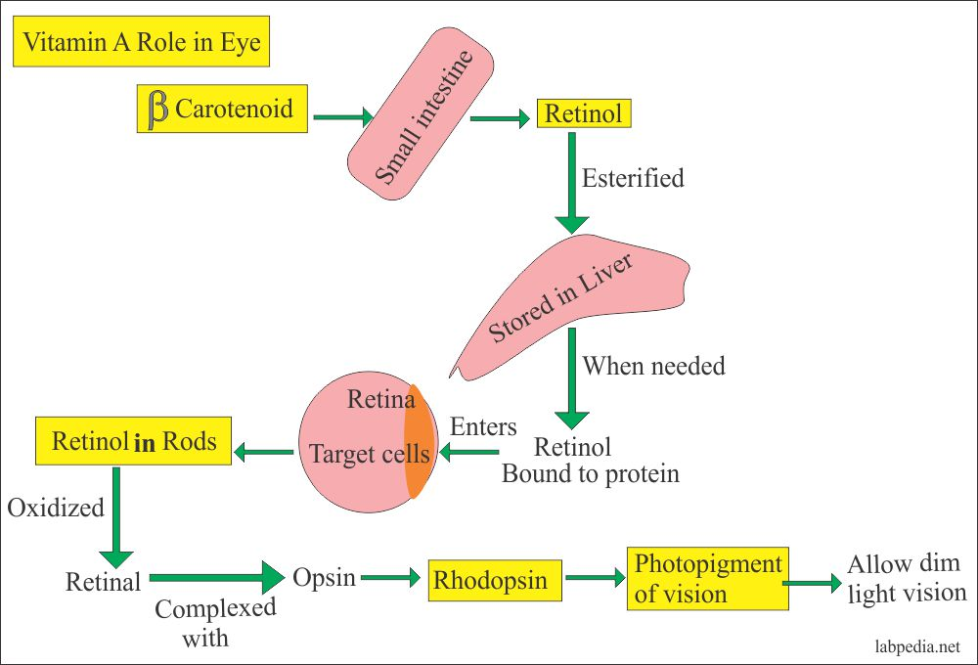
Role of Vitamin A in the eye

Slide 24
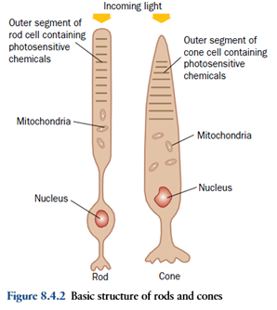
The retina comprises cones and rods, which mediate color and low light vision, respectively. The vitamin A derivative 11-cis-retinal is found in the rods, forming rhodopsin.

Slide 25
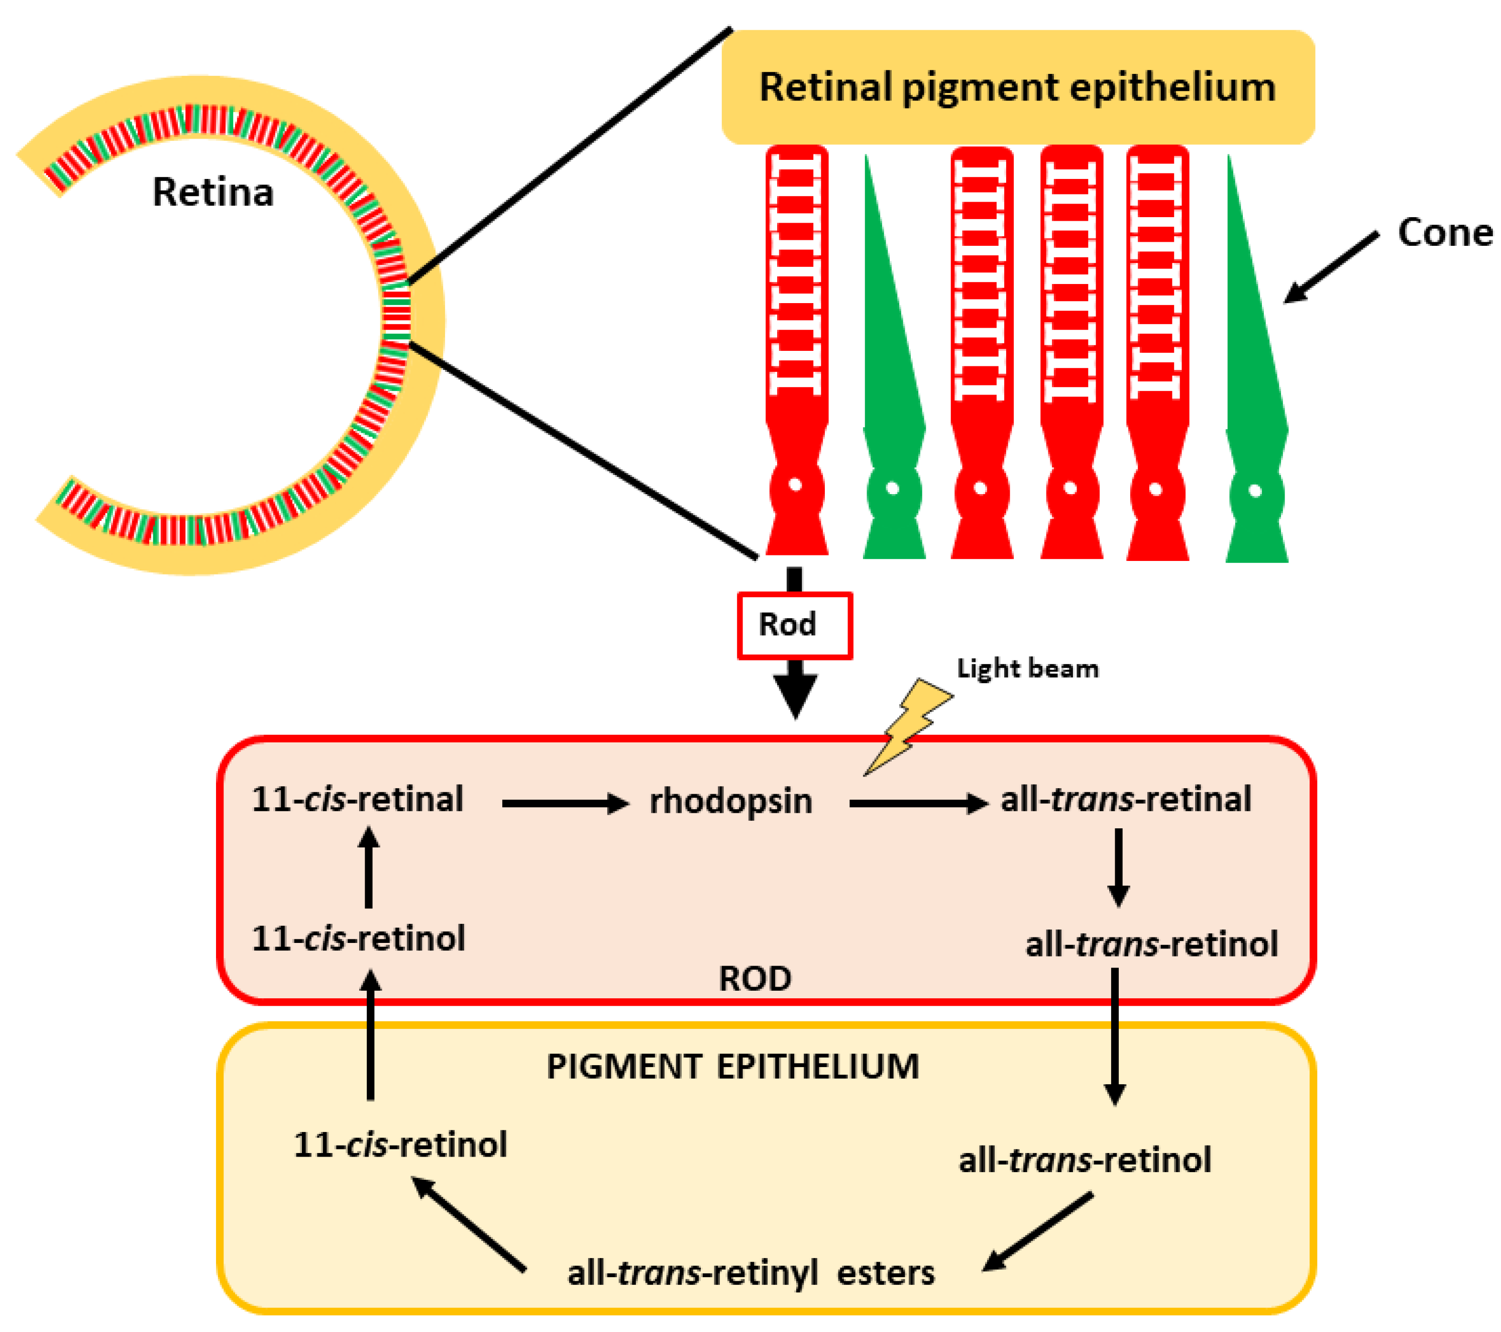
Vision and the role of 11-cis-retinal in the process

Slide 27
Phototransduction
It is a process by which light is converted to electrical signals.
The first step in the process is absorption of photons by the visual pigment, which causes isomerization of 11-cis-retinal to all-trans-retinal.
This change triggers further biochemical reactions downstream that results in the change of the electrical potential across the photoreceptor membrane. Electrical signals from the retina then travel through the optic nerve to the brain, where they are converted into an image

Slide 28
The all-trans-retinal is continuously recycled back to the 11-cis-retinal in the process called the visual cycle.
Rhodopsin, the rod visual pigment, bleaches in the light to opsin and all-trans-retinal. All-trans-retinal is converted to all-trans vitamin A which is then transported to the pigment epithelium and isomerized via an enzyme (isomerase) to 11-cis vitamin A. The 11-cis vitamin A is transported back to the rods and converted to 11-cis retinal, which spontaneously combines with opsin to reform rhodopsin

Slide 30
Enzymatic processing within the visual cycle begins with delivery of vitamin A (all- trans -retinol) from the blood circulation.
Upon entry into the RPE, all- trans -retinol is converted to a retinyl ester through the activity of lecithin retinol acyl transferase (1).
The resulting all- trans retinyl ester pool represents a storage form of vitamin A upon which RPE65 acts to generate 11- cis -retinol (2); 11- cis -retinol is then oxidized by an 11- cis -specific retinol dehydrogenase to form the visual chromophore, 11- cis -retinal (3). The visual chromophore is delivered to rod and cone outer segments (4) where it combines with opsins to form visual pigments (e.g., rhodopsin). Light activation of rhodopsin initiates visual transduction processes and liberates all- trans -retinal as a photoproduct. Reduction of all- trans -retinal, via all- trans -retinal dehydrogenase, produces all- trans -retinol (5), which is transferred back to the RPE for recycling. The continued activity of RPE65 in the light state ensures sustained levels of rhodopsin, closure of ion channels through transducin activation, and reduced oxygen demand.

Slide 31
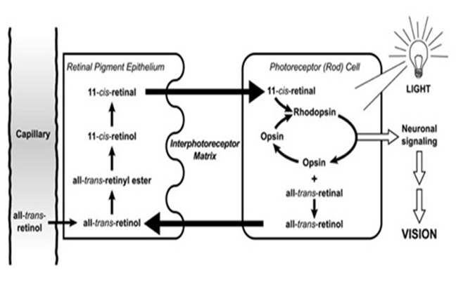
The Visual Cycle

Slide 32
When needed, retinyl esters are broken apart (hydrolyzed) and isomerizes to form 11-cis-retinol, which can be oxidized to form 11-cis-retinal.
11-cis-retinal can be shuttled to the rod cell, where it binds to a protein called opsin to form the visual pigment, rhodopsin. Absorption of a photon of light catalyzes the isomerization of 11-cis-retinal to all-trans-retinal and results in its release.
This isomerization triggers a cascade of events, leading to the generation of an electrical signal to the optic nerve. The nerve impulse generated by the optic nerve is conveyed to the brain where it can be interpreted as vision. Once released, all-trans-retinal is converted to all-trans-retinol, which can be transported across the interphotoreceptor matrix to the retinal epithelial cell to complete the visual cycle.

Slide 33
The role of vitamin A in the visual cycle is specifically related to the retinal form.
Within the eye, 11-cis-retinal is bound to rhodopsin (rods) and iodopsin (cones) at conserved lysine residues.
As light enters the eye, the 11-cis-retinal is isomerizes to the all-"trans" form.

Slide 34
The all-"trans" retinal dissociates from the opsin in a series of steps called photo-bleaching.
This isomerization induces a nervous signal along the optic nerve to the visual center of the brain.
After separating from opsin, the all-"trans"-retinal is recycled and converted back to the 11-"cis"-retinal form by a series of enzymatic reactions.
In addition, some of the all-"trans" retinal may be converted to all-"trans" retinol form and then transported with an interphotoreceptor retinol-binding protein (IRBP) to the pigment epithelial cells.

Slide 35
Further esterification into all-"trans" retinyl esters allow for storage of all-trans-retinol within the pigment epithelial cells to be reused when needed.
The final stage is conversion of 11-cis-retinal will rebind to opsin to reform rhodopsin in the retina.
Rhodopsin is needed to see in low light (contrast) as well as for night vision.
It is for this reason that a deficiency in vitamin A will inhibit the reformation of rhodopsin and lead to one of the first symptoms, night blindness

Slide 36
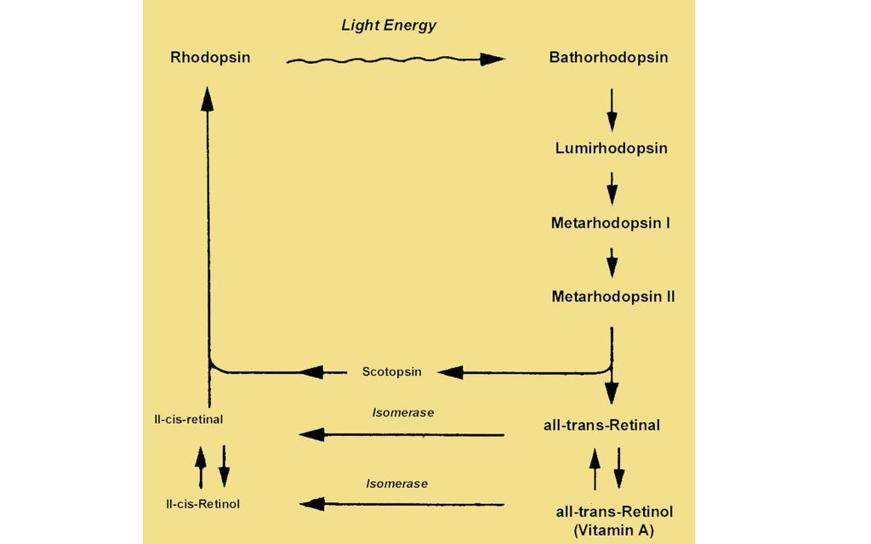

Slide 37
Transducin is a guanine-nucleotide binding protein (G protein), the structure and function of which is similar to those of G-protein that take part in hormonal signals across biological membranes.
Transducin binds to GDP when it is inactive, while it binds to GTP when it is in the active state.
It is trimeric and composed of three subunits.
GDP̸ GTP binding site associated with the α-subunit.

Slide 39
Mechanism of action of transducin:
1-Photoactivated rhodopsin, metarhodopsin III, initiates guanine nucleotide amplification.
It interacts with the α-subunit of transducine catalyzing the exchange of bound GDP for GTP.
2-When transducine binds to GTP; the α-subunit gets dissociated from β and γ –subunits, activating the transducine (Tα-GTP complex).
3-The activated transducine in turn activate phosphodiesterase (PDE) by binding to inhibitory γ –subunit and removing this. Thus activating the α, β subunit of PDE (PDE α β).

Slide 40
4-The activated PDE α β then catalyzes the hydrolysis of second messenger (cGMP) to 5-AMP, lowering the c-GMP level to the plasma membrane of the outer segment, causing the Na+ channels to close.
Thus in the dark, there are high level of c-GMP, which binds to the Na+ channels, causing them to open.
While the opposite in the light, photo-activated rhodopsin, through transducine and phosphodiesterase, lowers the levels of c-GMP, thus closing the most of Na+ channels.

Slide 43
Retinoids and Aging
Retinoids also increase cell turnover in the skin, making way for new cell growth ,it can boost the production of hyaluronic acid and collagen in the skin and reduce the breakdown of collagen that already exists in the skin.
Collagen is essential to strong, youthful-looking skin. In aging , the body begins to produce less collagen and elastin. The body also begins to break down the collagen, elastin, and fat stores. This can contribute to thin and sagging skin, fine lines, and wrinkles.
In addition to preserving the collagen stores, retinoids can also promote new collagen production.
This may help “fill in” or reduce the appearance of existing wrinkles and help prevent new ones from forming.

Slide 44
Retinoids work by neutralizing free radicals in the skin that may be causing collagen damage. They can also enhance skin shedding and reduce inflammation.
Retinoids reduce fine lines and wrinkles by increasing the production of collagen. They also stimulate the production of new blood vessels in the skin, which improves skin color. Additional benefits include fading age spots and softening rough patches of skin. However, it takes three to six months of regular use before improvements in wrinkles are apparent—and the best results take six to 12 months.
Tretinoin also known as retinoic acid is a prescription strength form of synthetic vitamin A that is used by doctors to treat acne and sun damaged skin.

Slide 45
Deficiency:
Vitamin A deficiency can occur as either a primary or a secondary deficiency.
Primary vitamin A deficiency occurs among children and adults who do not consume an adequate intake of provitamin A.
Secondary vitamin A deficiency is associated with chronic malabsorption of lipids, impaired bile production and release, and chronic exposure to oxidants, such as cigarette smoke, and chronic alcoholism.
Vitamin A is a fat soluble vitamin and depends on micellar solubilization for dispersion into the small intestine, which results in poor use of vitamin A from low-fat diets.
Zinc deficiency can also impair absorption, transport, and metabolism of vitamin A because it is essential for the synthesis of the vitamin A transport proteins and as the cofactor in conversion of retinol to retinal.

Slide 46
Causes for vitamin A deficiency
1-Decreased intake.
2-Obstructive jaundice causing defective absorption.
3-Cirrhosis of liver leading to reduced synthesis of RBP.
4-Severe malnutrition, where amino acids are not available for RBP synthesis.
5-Chronic nephrosis, where RBP is excreted through urine.

Slide 48
Assessment of deficiency
1-Dark adaptation test- it is the time required to adapt the eye to see objects in dim light, it is increased in vitamin A deficiency.
2-RBP (retinol-binding protein) level in serum is decreased.
3-Vitamin A in serum is decreased, it may be directly measured by spectrophotometry(has maximum absorption at 325 nm).
Normal blood level of vitamin A is 25 to 50 microgram / dl.

