Slide 1

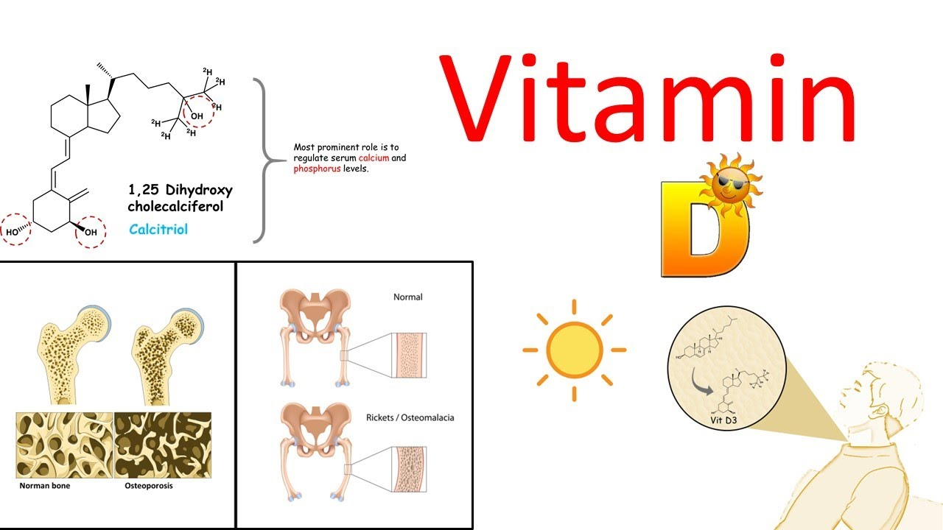
Dr.Shatha Alkhateeb
Lec.2

Slide 2
Vitamin D is a group of fat-soluble responsible for intestinal absorption of calcium and phosphate.
So, vitamin D is called the sun-shine
It is not actually an essential dietary vitamin , as it can be synthesized in adequate amounts by most mammals exposed to sunlight.
A substance is only classified as an essential vitamin when it cannot be synthesized in sufficient quantities by an organism, and must be obtained from its diet.

Slide 3
Vitamin D is a fat-soluble vitamin essential for the proper metabolism of calcium (Ca) and phosphorus (P), and the maintenance of normal skeletal integrity.
Vitamin D also plays a role in Ca and P absorption, regulation of parathyroid hormone, bone mineralization and mobilization, and it controls the incidence of bone disorders .

Slide 4
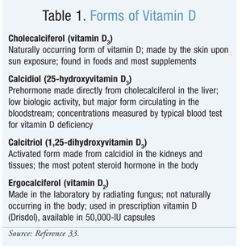

Slide 5
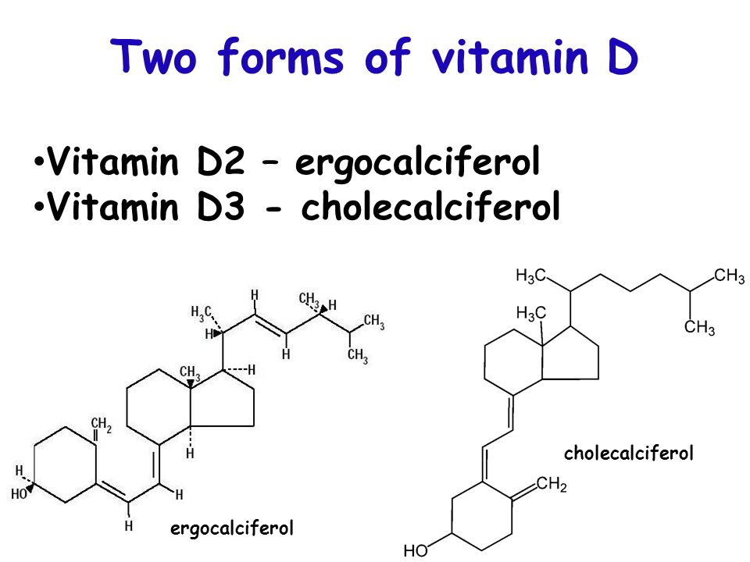

Slide 6
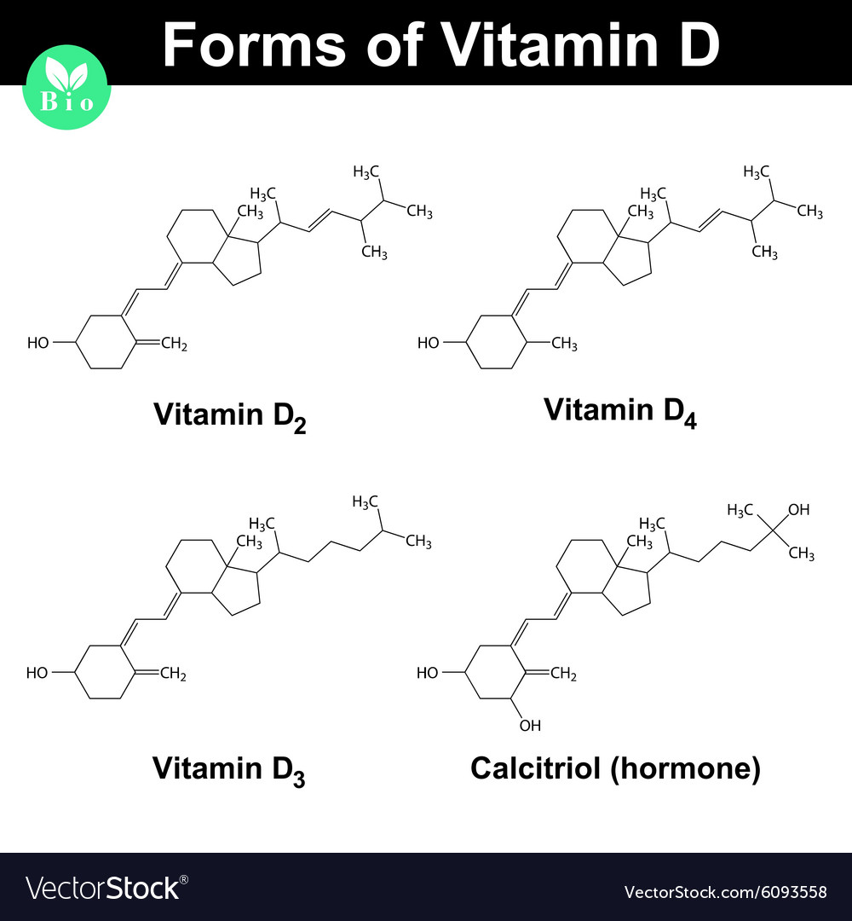

Slide 7
Chemically, the various forms of vitamin D are secosteroids, that is, steroids in which one of the bonds in the steroid rings is broken.
The structural difference between vitamin D₂ and vitamin D₃ is in the side chain, which contains a double bond, between carbons 22 and 23, and a methyl group on carbon 24 in vitamin D₂.

Slide 8
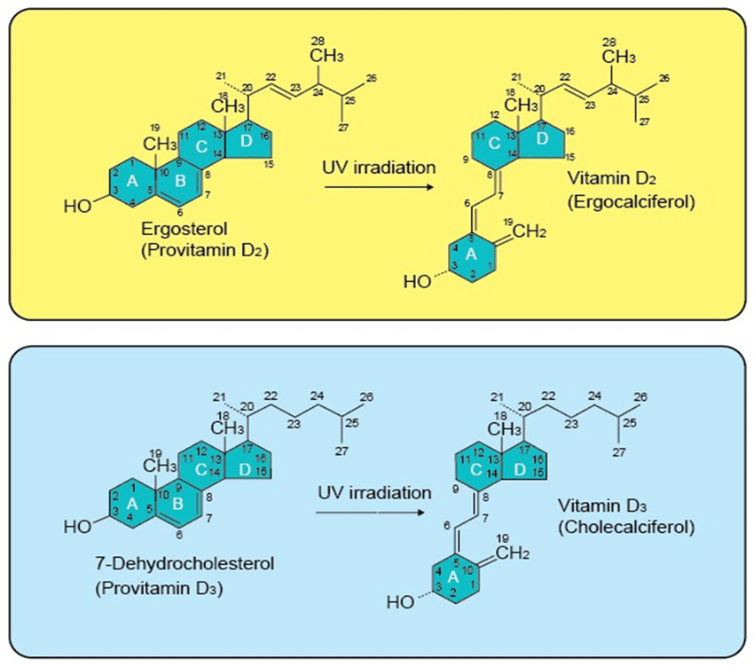

Slide 9
Vitamin D is also known as calciferol, comprises a group of fat-soluble seco-sterols. The two major forms are vitamin D₂ and vitamin D₃.
Vitamin D₂ (ergocalciferol) is largely human-made and added to foods, whereas vitamin D₃(cholecalciferol) is synthesized in the skin of humans from 7-dehydrocholesterol and is also consumed in the diet via the intake of animal-based foods.
The D₂ and D₃ forms differ only in their side chain structure. The differences do not affect metabolism (i.e., activation), and both forms function as prohormones. When activated, the D₂ and D₃ forms have been reported to exhibit identical responses in the body, and the potency related to the ability to cure vitamin D–deficiency rickets is the same

Slide 10
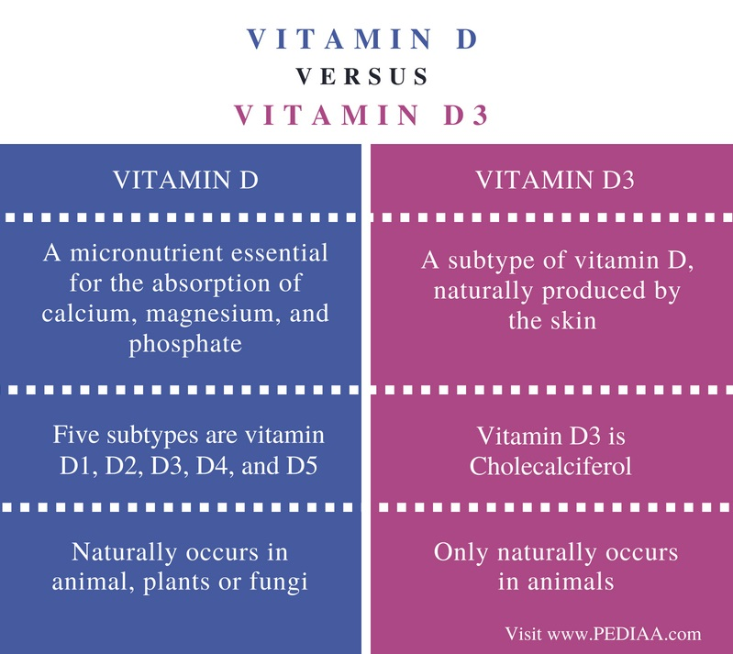

Slide 11
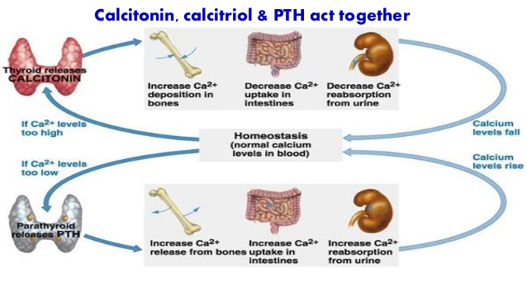
Calcitriol: is the physiological active form of vitamin D, it increases the blood calcium level.
Calcitonin: is the peptide hormone released from thyroid gland, it decreases the blood calcium.

Slide 12
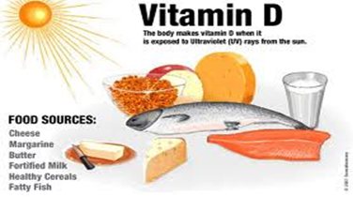
Sources of Vitamin D
1- Food
2- Sun exposure
3-Dietary supplements

Slide 13
METABOLISM
Vitamin D3 produced in the epidermis must be further metabolized to be active.
The first step, 25-hydroxylation, takes place primarily in the liver, although other tissues have this enzymatic activity as well. There are several 25-hydroxylases.
25OHD is the major circulating form of vitamin D. However, in order for vitamin D metabolites to achieve maximum biologic activity they must be further hydroxylated in the 1α position by the enzyme CYP27B1;
1,25(OH)2D is the most potent metabolite of vitamin D and accounts for most of its biologic actions.

Slide 14
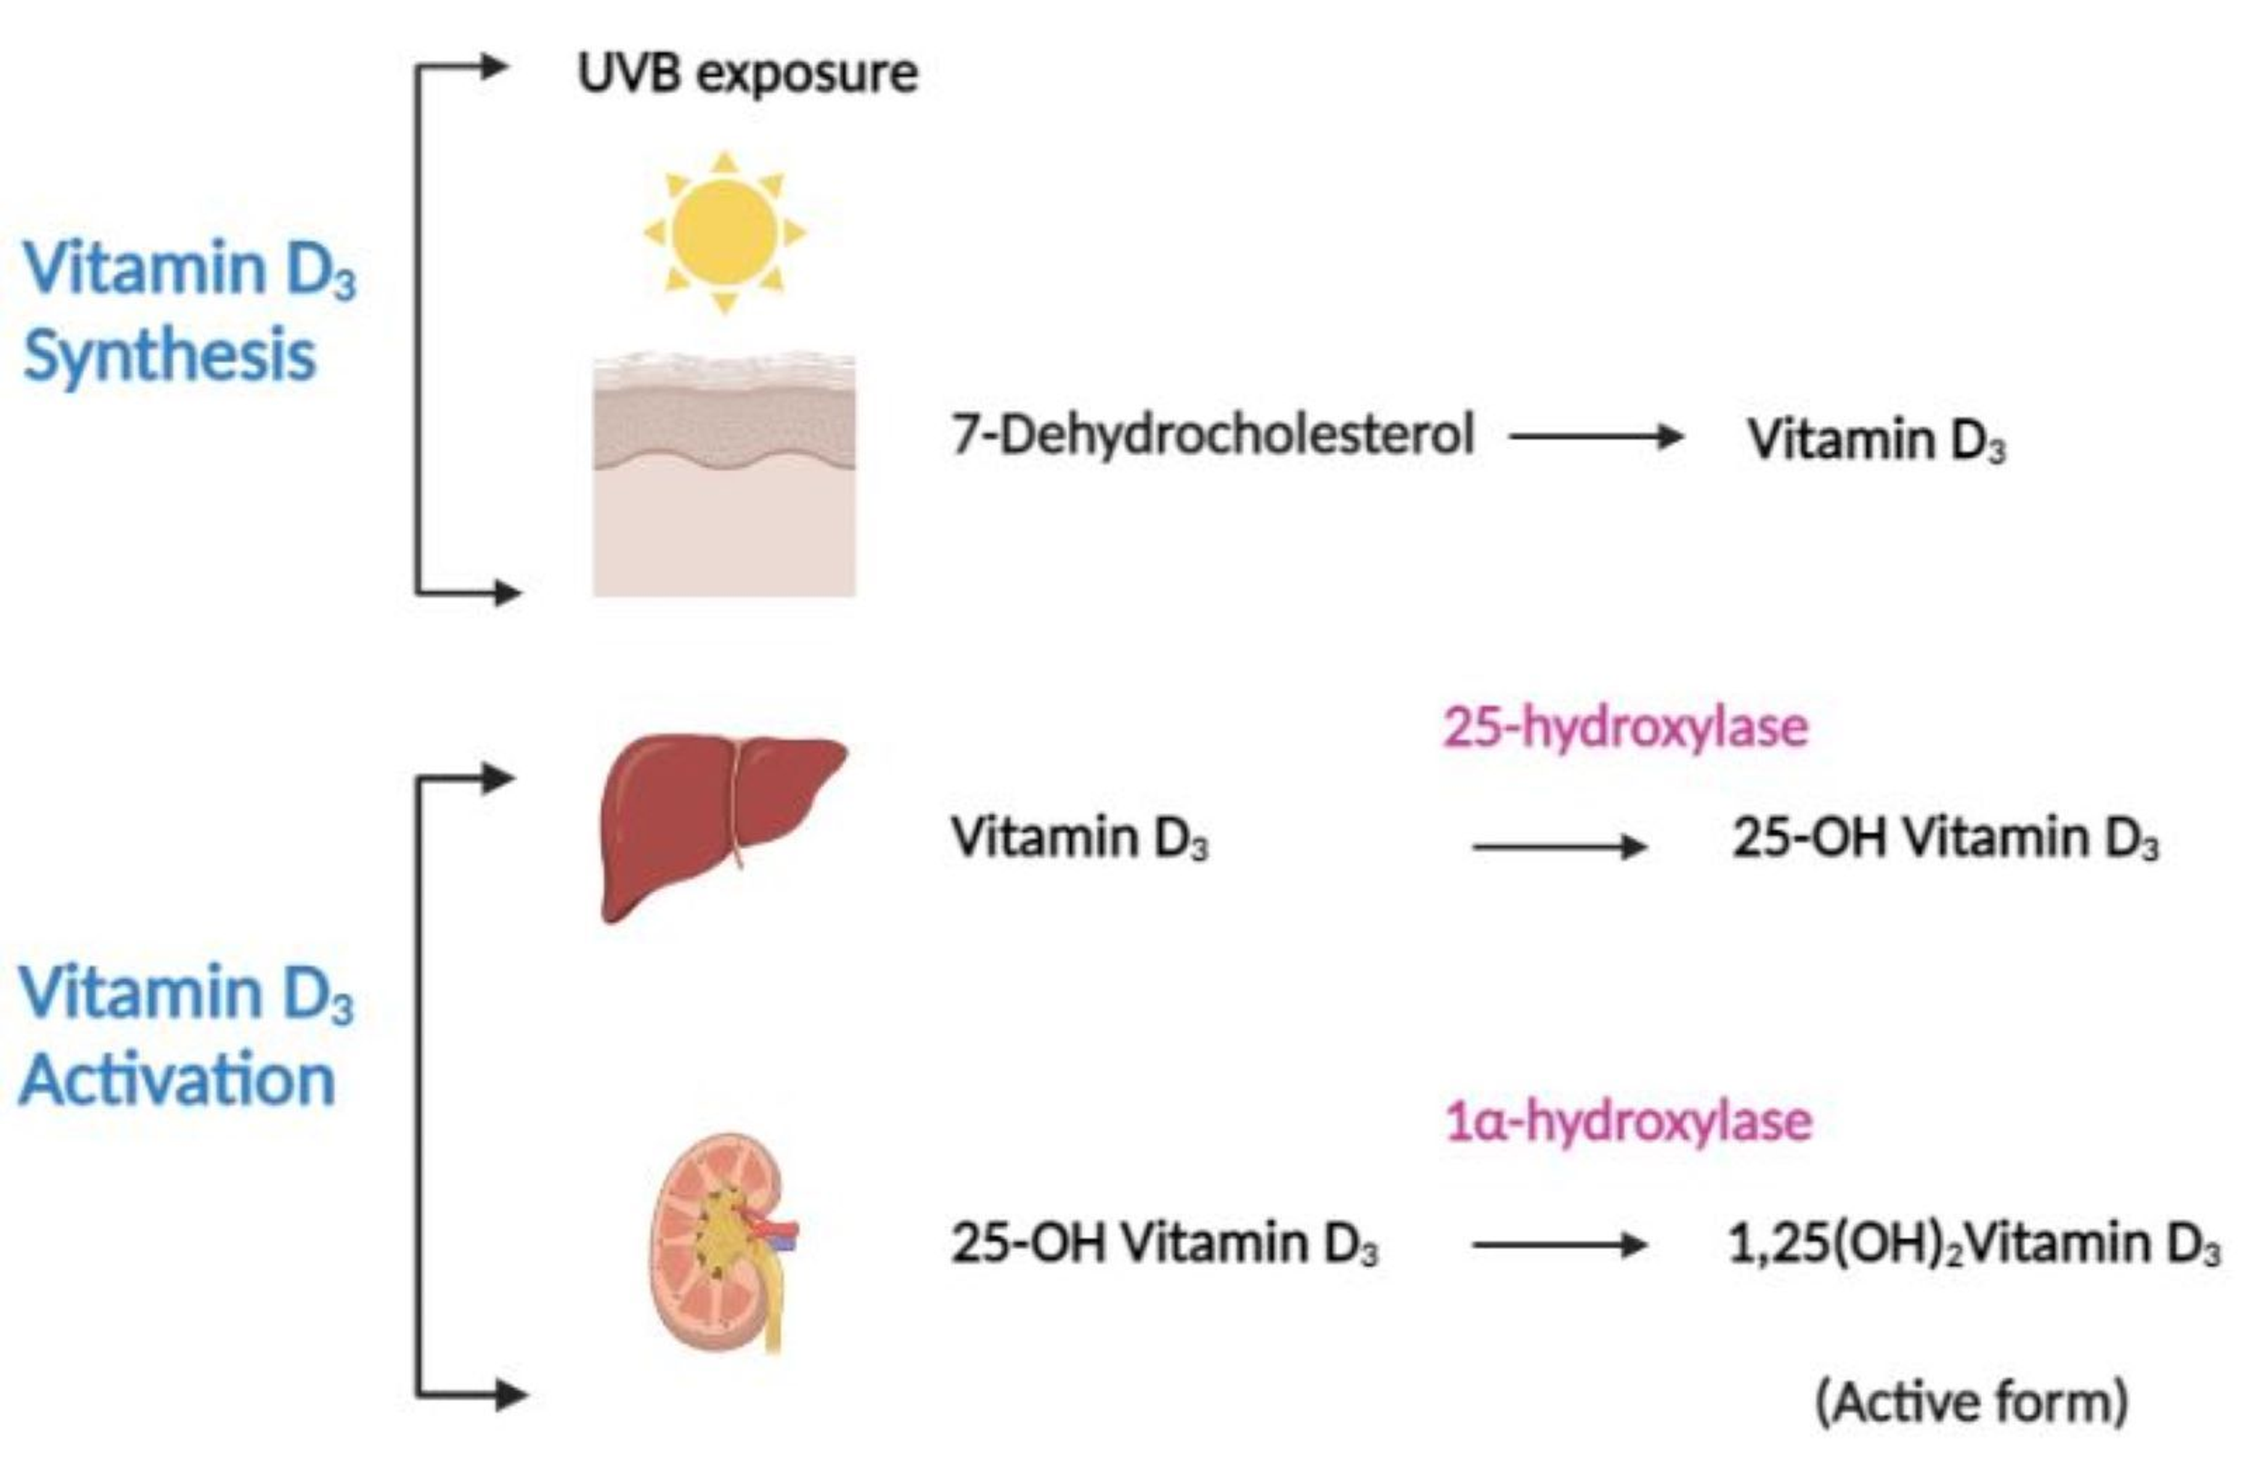

Slide 15
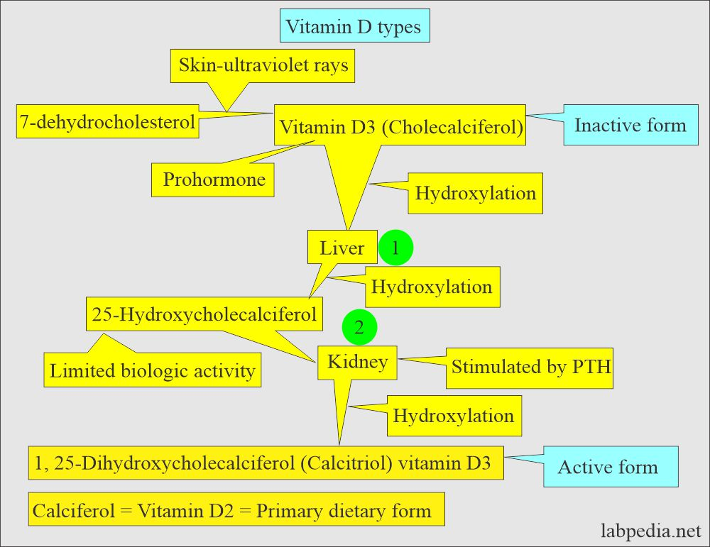

Slide 16
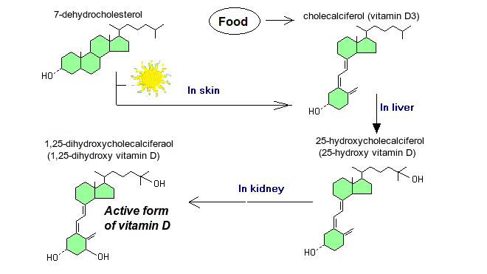

Slide 17
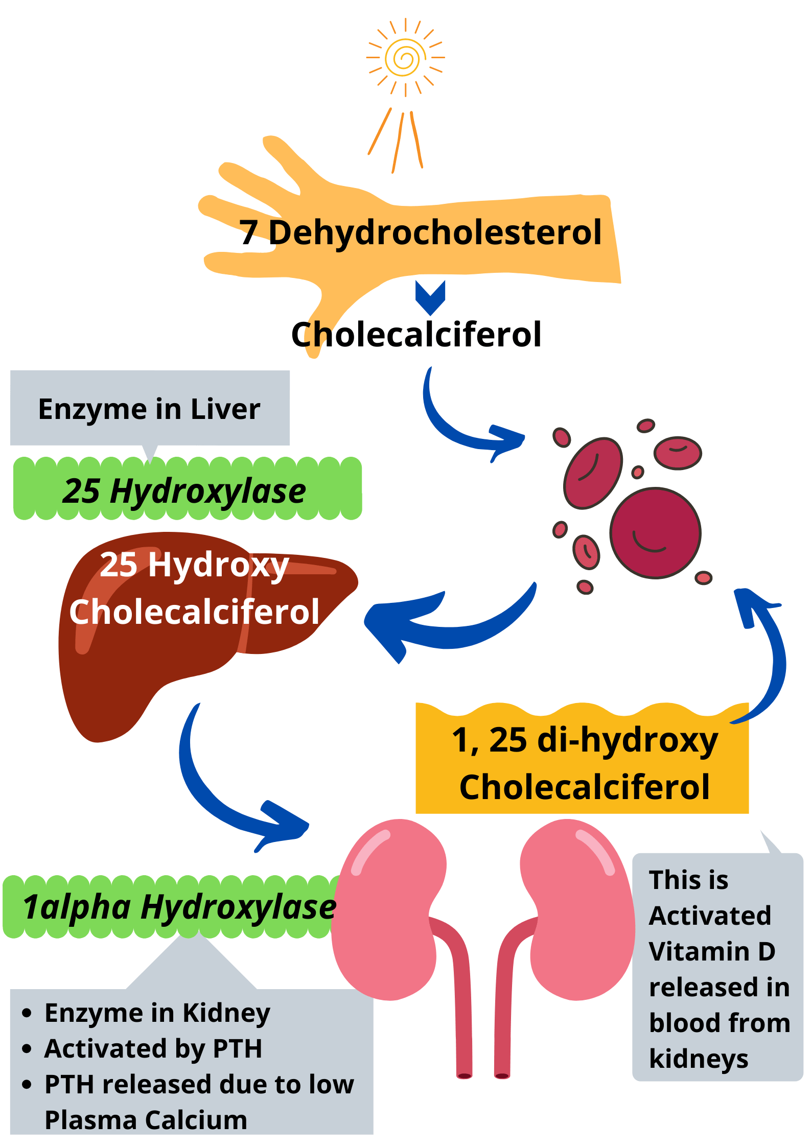

Slide 18
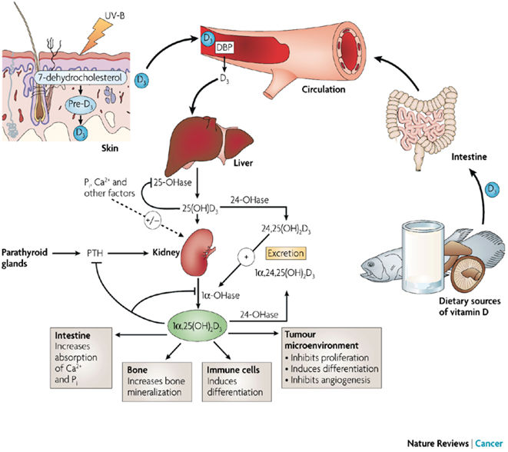

Slide 19
The activity of the 1, α- hydroxylase depends on:
a-Parathyroid hormone and plasma calcium: a low level of plasma calcium stimulates 1,α- hydroxylase through the secretion of parathyroid hormone.
b-Plasma Phosphate: reduced plasma phosphate activates the 1,α- hydroxylase but independent of parathyroid hormone.
c-Insulin,growth hormone prolactin and estrogen are affect (increase) the production of active form of vitamin D.
The most potent inhibitor of the 1,α- hydroxylase is the product of the reaction 1:25 dihydroxycholecalciferol.

Slide 20
Hepatic production of 25OHD.
The next step in the bioactivation of D2 and D3,is the hydroxylation to 25OHD. 25OHD is the major circulating form of vitamin D and provides a clinically useful marker for vitamin D status.
Renal production of 1, 25(OH) 2D.
1,25(OH)2D is the most potent metabolite of vitamin D, and mediates most of its hormonal actions especially those involving the vitamin D receptor (VDR), 1,25(OH)2D is produced from 25OHD by the enzyme 25OHD-1αhydroxylase (CYP27B1).
Renal production of 24, 25(OH) 2D. The kidney is also the major producer of a second important metabolite of 25OHD, namely 24, 25(OH) 2D, and the enzyme responsible is 25OHD-24 hydroxylase.

Slide 21
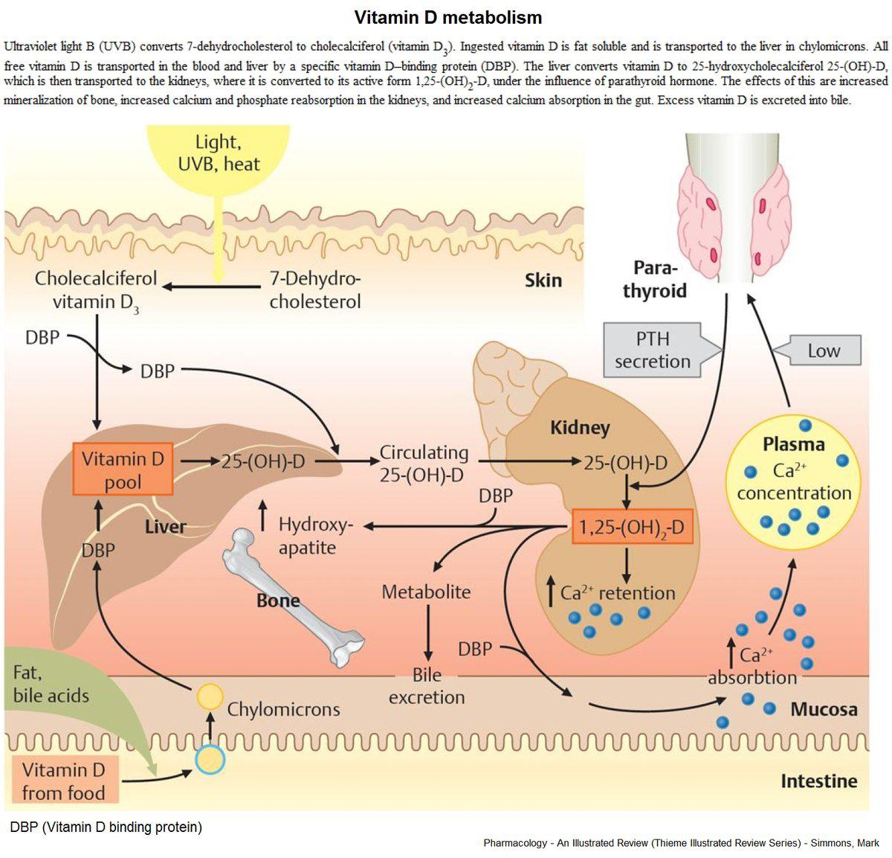

Slide 22
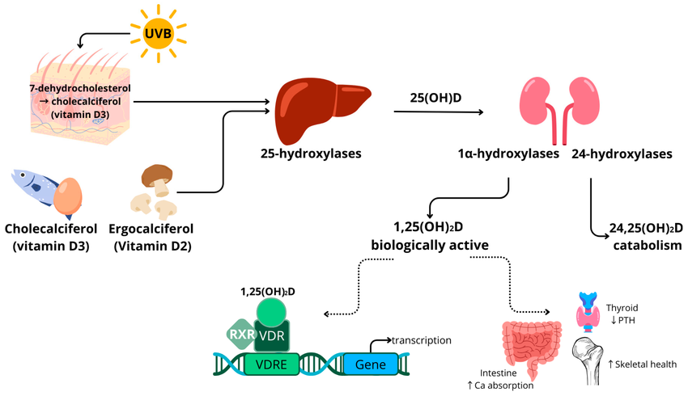

Slide 23
Calcium balance
Maintenance of serum calcium concentrations within a narrow range is vital for normal functioning of the nervous system, as well as for bone growth and maintenance of bone density. Vitamin D is essential for the efficient utilization of calcium by the body
The parathyroid glands sense serum calcium concentrations and secrete parathyroid hormone (PTH) if calcium concentrations decrease below normal .
Elevations in PTH stimulate the activity of the 25-hydroxyvitamin D₃-1α-hydroxylase enzyme in the kidney, resulting in the increased production of 1α,25-dihydroxyvitamin D,after releasing the active form into the circulation and transported to target tissues.
Within target cells, 1α,25-dihydroxyvitamin D binds to and induces the activation of VDR, which leads to changes in gene expression that normalize serum calcium by :
(1) increasing the intestinal absorption of dietary calcium, (2) increasing the reabsorption of calcium filtered by the kidneys, and (3) mobilizing calcium from bone when there is insufficient dietary calcium to maintain normal serum calcium concentrations .

Slide 24
THUS
Classical pathway of vitamin D and calcium homeostasis. A drop in the serum calcium stimulates an increase in the secretion of PTH and mobilizes further calcium from the bone. PTH increases the synthesis of 1,25(OH)2D in the kidney, which, in turn, stimulates the mobilization of calcium from bone and intestine and regulates the synthesis of PTH by negative feedback.

Slide 25
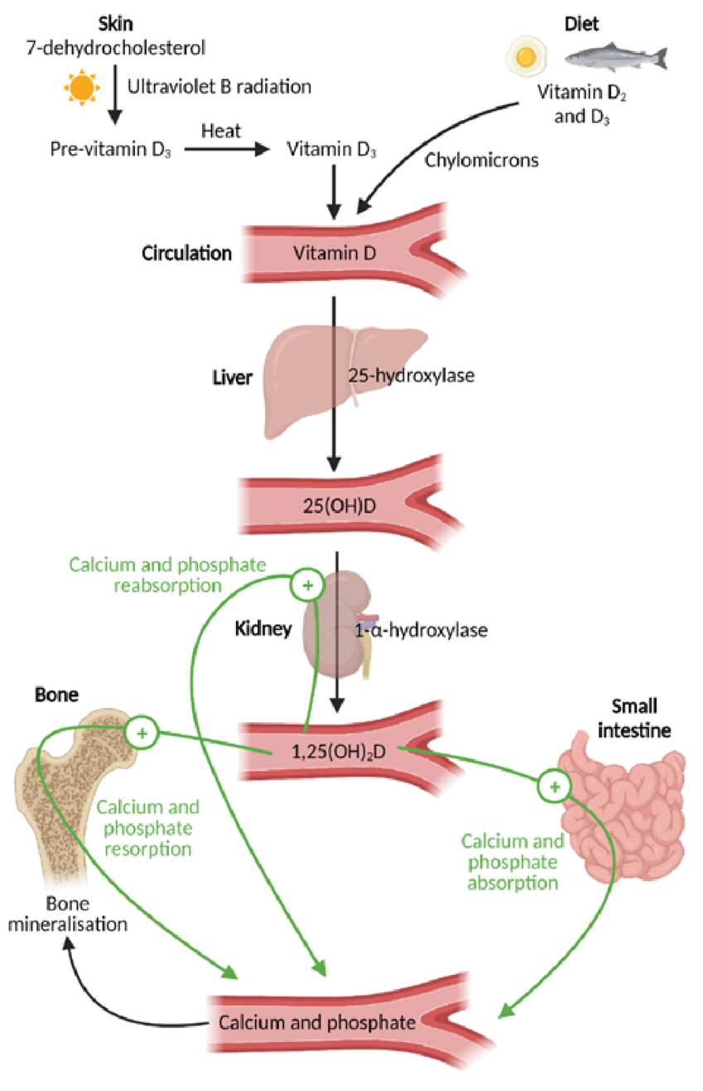

Slide 26
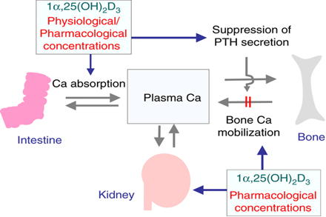

Slide 27
Vitamin D and all its metabolites are bound to a specific vitamin D binding protein, (DBP)
DBP is genetically the oldest member of the albuminoid family (including albumin, α-fetoprotein and afamin, all involved in transport of fatty acids or hormones).
DBP has a single binding site for all vitamin D metabolites and has a high affinity for 25OHD and 1,25(OH)2D, thereby creating a large pool of circulating 25OHD, which prevents rapid vitamin D deficiency.

Slide 28
Serum concentration of 25(OH)D is currently the main indicator of vitamin D status. It reflects vitamin D produced endogenously and that obtained from foods and supplements .
In serum, 25(OH)D has a fairly long circulating half-life of 15 days .
Assessing vitamin D status by measuring serum 25(OH)D concentrations is complicated by the considerable variability of the available assays .As a result, a finding can be falsely low or falsely high, depending on the assay used and the laboratory.
In contrast to 25(OH)D, circulating 1,25(OH)2D is generally not a good indicator of vitamin D status because it has a short half-life measured in hours, and serum levels are tightly regulated by parathyroid hormone, calcium, and phosphate . Levels of 1,25(OH)2D do not typically decrease until vitamin D deficiency is severe

Slide 29
Functions of vitamin D:
Vitamin D’s major role is to regulate serum calcium and phosphorus in the blood by:
1-Promoting their absorption of food in the intestine.
2-By promoting the reabsorption of calcium in the kidneys.
3-This will prevent Rickets from growing children.
4-Prevents osteomalacia in adults.
5-Prevents hypocalcemic tetany.
6-Corrects and maintains the concentration of ionized calcium.
7-Inhibits parathyroid hormone secretion from the parathyroid gland.

Slide 30
Vitamin D promotes:
1-The immune system by increasing phagocytosis.
2-Anti-tumor activity.
3-Immunomodulatory function.
Role in calcium absorption:
1-It stimulates intestinal absorption of calcium and phosphorus.
2-It stimulates the PTH-dependent reabsorption of calcium in the distal renal tubule.
3-It helps PTH to mobilize the calcium from the bone.
4-PTH, vitamin D, and calcitonin maintain a normal amount of Ca⁺⁺ in bone and plasma.

Slide 31
Vitamin D Deficiency
Vitamin D deficiency is known to cause several bone diseases including:
1-Rickets, a childhood disease characterized by impeded growth, and deformity, of the long bones.
2-Osteomalacia, a bone-thinning disorder that occurs exclusively in adults and is characterized by proximal muscle weakness and bone fragility.
3-Osteoporosis, a condition characterized by reduced bone mineral density and increased bone fragility.
4-Muscle aches and weakness.
5-Muscle twitching .

Slide 32
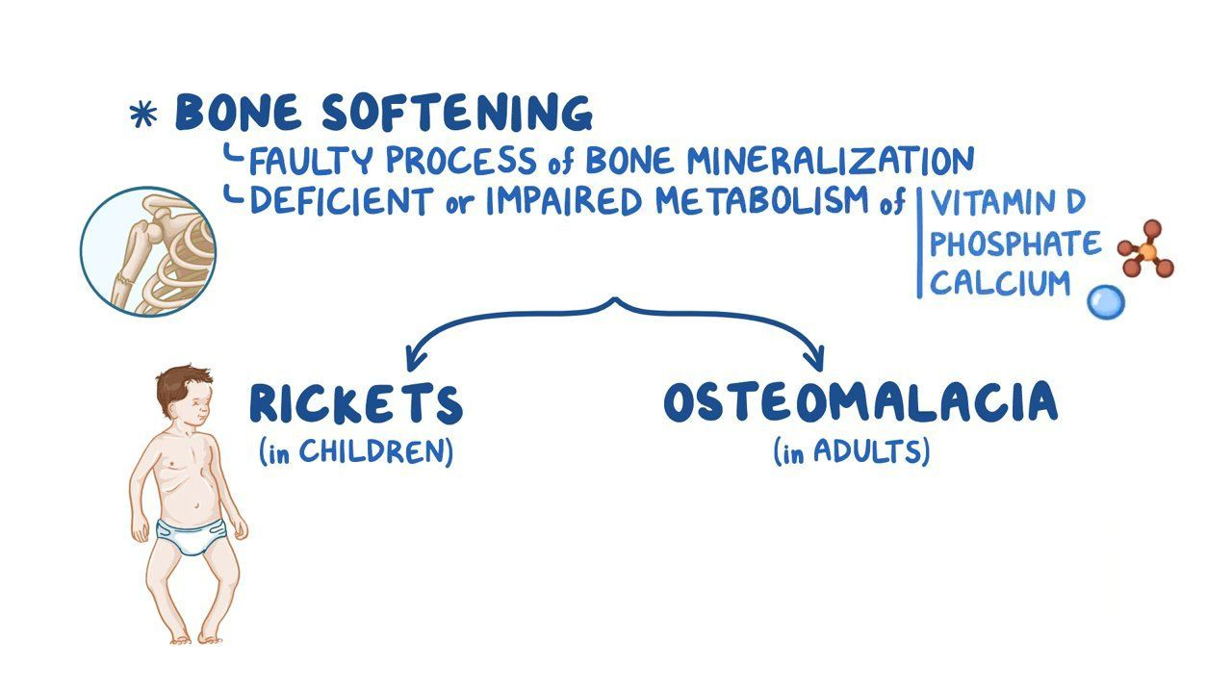
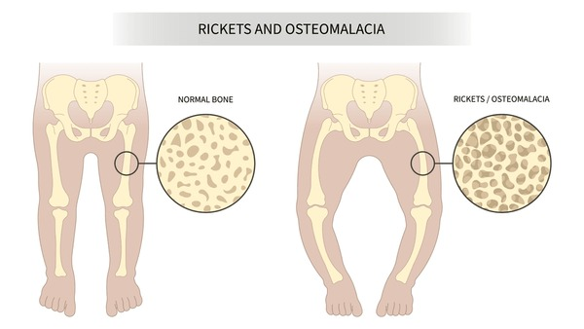

Slide 33
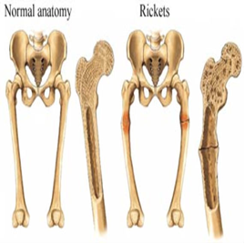
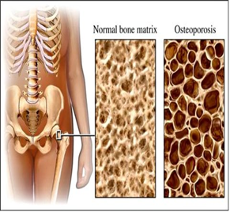
In general, the two main causes of vitamin D deficiency are:
1- Not getting enough vitamin D in your diet and/or through sunlight.
2-The body isn’t properly absorbing or using vitamin D.

Slide 34
Vitamin D deficiency can occur for a number of reasons:
1-Don't consume the recommended levels of the vitamin over time.
2-Breastfed infants
3-Older adults
4-Exposure to sunlight is limited.
5-Have dark skin.
6- People with fat malabsorption (Digestive tract cannot adequately absorb vitamin D).
7- Kidneys cannot convert vitamin D to its active form.

Slide 35
Causes of Vitamin D deficiency are:
1- Inadequate dietary intake
2- Inadequate sunlight exposure
3- Malabsorption syndrome
4- Liver or kidney disorders
5- Metabolic hereditary disorders

Slide 36
Toxicity of vitamin D:
1-Overdosage of vitamin D leads to metastatic calcification of soft tissues.
2- Hypervitaminosis of vitamin D (calcitriol) leads to hypercalcemia.
3- Increased level of vitamin D increases intestinal absorption and excessive bone resorption.
4- Increased vitamin D leads to increased calcium and suppresses the PTH

Slide 37
WHAT HAPPENS WITH OVERDOSING OF VITAMIN D?
This never happens with overexposure to sunlight. It only happens with supplementation.
It causes Stone, Bones, Abdominal moans and Psychic groans

Slide 38
