Slide 1
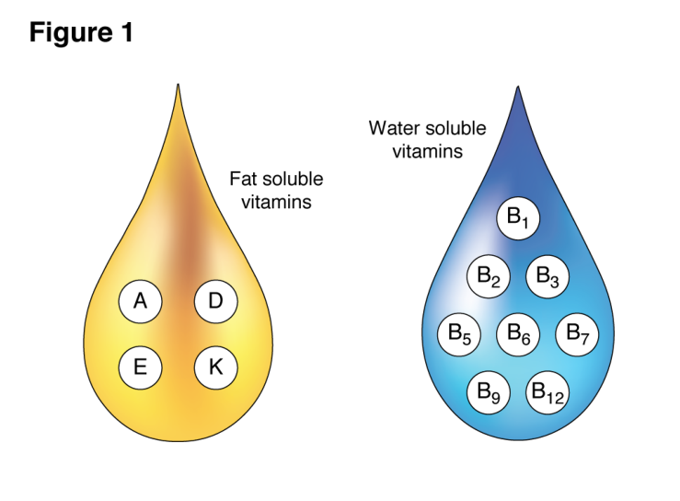
Dr.Shatha AL-Khateeb Lec.1

Slide 3
Vitamins are organic molecules that are essential to an organism in small quantities for proper metabolic function.
Essential nutrients cannot be synthesized in the organism in sufficient quantities for survival, and therefore must be obtained through the diet .
Some can be synthesized by intestinal microorganisms, but in quantities that are not sufficient to meet our needs.
Most vitamins are not single molecules, but groups of related molecules called vitamers. For example, there are eight vitamers of vitamin E.
Discovery of vitamins started from observation of deficiency manifestations. Scurvy ,Rickets ,Beriberi ,etc.

Slide 4
Vitamins have diverse biochemical functions.
(1) Some have hormone-like functions as regulators of mineral metabolism (e.g., vitamin D)
(2) Regulators of cell and tissue growth and differentiation (3)Others function as antioxidant .
(4)The largest number of vitamins functions as precursors for enzyme (cofactors), which help enzymes in their work as catalysts in metabolism.
In this role, vitamins may be tightly bound to enzymes as part of prosthetic group.
Vitamins may also be less tightly bound to enzyme catalysts as coenzymes , detachable molecules that function to carry chemical groups or electrons between molecules.

Slide 6
Vitamins are classified by their biological and chemical activity, not their structure.
Thus, each "vitamin" refers to a number of Vitamer compounds that all show the biological activity associated with a particular vitamin.
Vitamer is a term used to describe any of a number of compounds that possess a given vitamin activity.

Slide 7
Vitamins differ from other organic food stuffs
1-They do not enter into tissue structures, unlike protein.
2- Do not undergo degradation for providing energy unlike carbohydrates and lipid.
3- Several B-complex vitamins play an important role as coenzymes in several energy transformation reactions in the body.
The same with hormones
vitamins differ from hormones in not being produced within the organism, and most of them have to be provided in the diet.

Slide 8
What is the difference between vitamins and minerals in food?
Chemical Nature: Vitamins are organic compounds, which means they contain carbon. While minerals are inorganic substances that come from the earth's soil and water.
They are categorized as either macrominerals (required in larger amounts, such as calcium, potassium, and magnesium) or trace minerals (needed in smaller quantities, such as iron, zinc, and copper).

Slide 9
2.Structure and Function: Vitamins are complex molecules with specific structures and functions. They often act as coenzymes or cofactors,
Minerals, are simple elements or ions that play crucial roles in various bodily functions. They are involved in processes like bone formation, nerve transmission, muscle contraction, and fluid balance.
3.Requirement and Dosage: Vitamins are needed in relatively small amounts by the body, and a deficiency or excess of certain vitamins can lead to specific health problems. The recommended daily intake for vitamins varies depending on the specific vitamin and factors like age, sex, and physiological conditions.
Minerals, are required in varying quantities. Macrominerals are needed in larger amounts, typically measured in grams, while trace minerals are required in smaller quantities, usually measured in milligrams or micrograms.

Slide 10
4.Storage and Absorption: The body has limited capacity to store most vitamins, especially water-soluble vitamins.
Minerals are also stored in the body, with some being stored in bones and tissues. Absorption of vitamins and minerals occurs in different parts of the digestive system. Vitamins are generally absorbed in the small intestine, while minerals can be absorbed in various parts of the gastrointestinal tract.

Slide 11
5.Food Sources: Both vitamins and minerals are found in a wide variety of foods. Vitamins are present in fruits, vegetables, whole grains, dairy products, meats, and other sources.
Minerals can be obtained from plant-based sources, such as nuts, seeds, legumes, and leafy greens, as well as animal-based foods like meat, fish, and dairy products.
While both vitamins and minerals are essential for overall health, they have distinct characteristics and play different roles in the body. A balanced diet that includes a variety of nutrient-rich foods is key to obtaining adequate amounts of both vitamins and minerals.

Slide 12
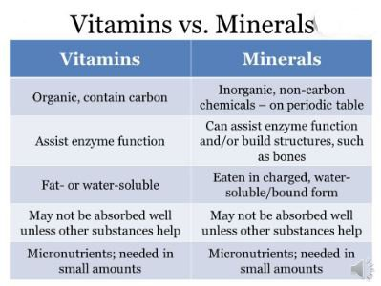

Slide 13
Characteristics of the vitamins are:
Micronutrients.
Do not supply energy.
Do not contribute to body mass.
Essential for metabolism.
Lack results in deficiency disease.

Slide 14
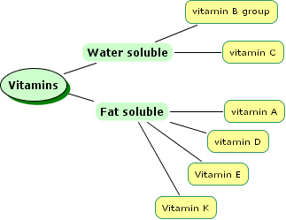
Vitamins are classified into two categories based
on their solubility:
Water-soluble or fat-soluble. In humans there are 13 vitamins: 4 fat-soluble (A, D, E, and K) and 9 water-soluble (8 B vitamins and vitamin C)

Slide 15
Characteristics of Fat-Soluble Vitamins | Characteristics of Water-Soluble Vitamins
Protect cell membranes from free radical damage; act within the cell’s nucleus to influence gene expression | Act in the cytosol of cells or in extracellular fluids such as blood
Absorbed into lymph with fats from foods | Absorbed directly into blood
Large storage capacity in fatty tissues | Little to no storage capacity
Do not need to be consumed daily to prevent deficiency (may take months to develop) | Need to be consumed regularly to prevent deficiency
Toxicity is more likely | Toxicity is rare

Slide 16
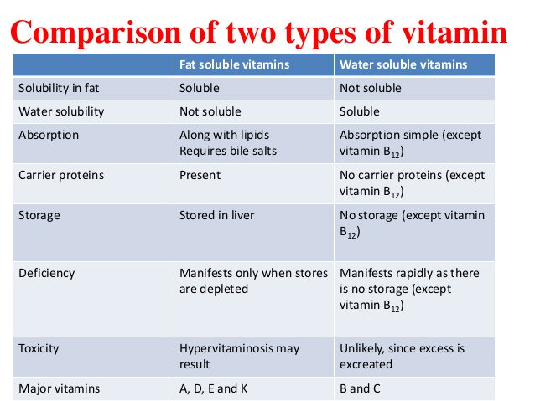

Slide 17
Water soluble vitamins
Water soluble vitamins are are the ones which dissolve in water. These vitamins are sent out of the body through urine. The ups and downs in the fat absorption do not affect the absorption of water soluble vitamins. The following are the main characteristics of water soluble vitamins:
1-Dissolve in water
2-Readily excreted by kidney
3-Function as a coenzyme & in energy metabolism
4-Vitamin C, thiamin and riboflavin are especially susceptible to heat and alkalinity
5-Hydrophilic compounds and water leach them from vegetables
6-Deficiency more common

Slide 18
Fat soluble vitamins
These vitamins are not soluble in water but are readily soluble in fat dissolving organic solvents. They need presence of fats for their transport and metabolism.
They are absorbed along with dietary fats. Adequate bile flow and good micelle formation favor absorption of fat-soluble vitamins.
The following are the characteristics of fat soluble vitamins:
1-Adsorbed with dietary fat in micelles
2-Excreted much more slowly
3-Stored in adipose tissue & liver and hence they pose a greater risk of toxicity when consumed in excess
4-Chylomicrons containing fat-soluble vitamins are transported via the lymph to the bloodstream and eventually to the liver.

Slide 19
Deficiencies
Vitamin deficiency can cause a range of symptoms such as fatigue, irritability, and changes to the skin and hair.
The specific symptoms depend on which vitamin(s) are at low levels, as each one plays a different role in your body.
Humans must consume vitamins periodically but with differing schedules, to avoid deficiency. The human body's stores for different vitamins vary widely; vitamins A, D, and B₁₂ are stored in significant amounts in the human body, mainly in the liver, and an adult human's diet may be deficient in vitamins A and D for many months and B₁₂ in some cases for years, before developing a deficiency condition.

Slide 20
In general, deficiency of vitamins may occur due to:
1-Reduced intake. 2-Impaired absorption.
3-Impaired metabolism. 4-Addetional requirements. 5-Increased losses.
Deficiencies of vitamins are classified as either primary or secondary:
A primary deficiency occurs when an organism does not get enough of the vitamin in its food.
A secondary deficiency may be due to an underlying disorder that prevents or limits the absorption or use of the vitamin, due to a "lifestyle factor", such as smoking, excessive alcohol consumption, or the use of medications that interfere with the absorption or use of the vitamin.

Slide 21
Side-effects and overdose
Some vitamins have documented side-effects that tend to be more severe with a larger dosage.
Overdosing (vitamin poisoning) from vitamin supplementation does occur. At high enough dosages, some vitamins cause side-effects such as nausea, diarrhea , and vomiting . When side-effects emerge, recovery is often accomplished by reducing the dosage.
Anti-vitamins
Anti-vitamins are chemical compounds that inhibit the absorption or actions of vitamins. For example, Avidin is a protein in egg whites that inhibits the absorption of Biotin .

Slide 22
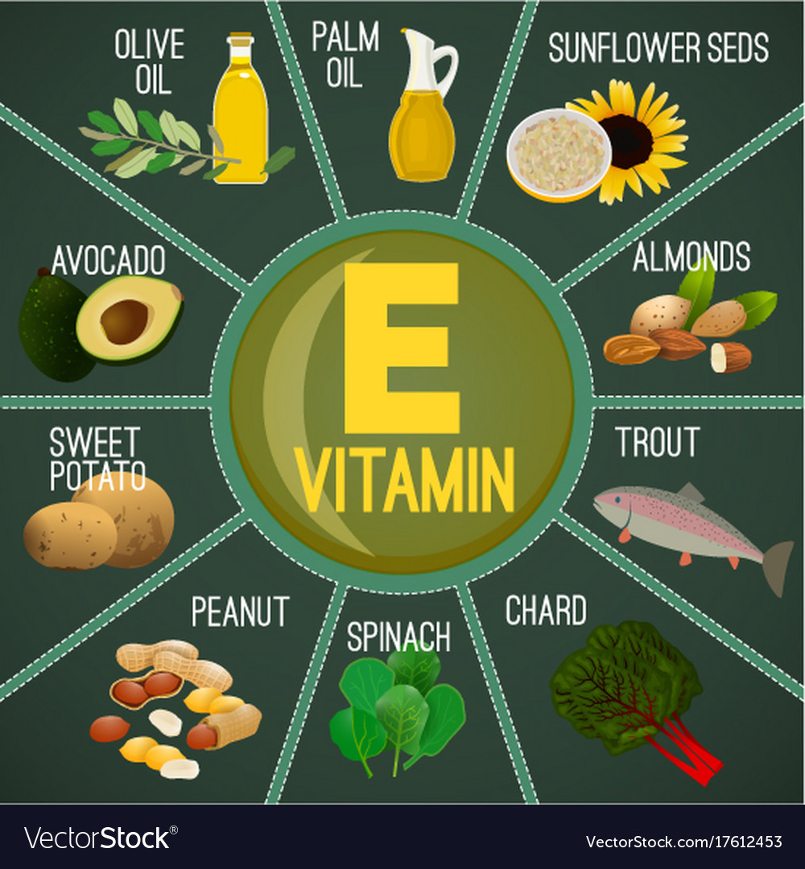
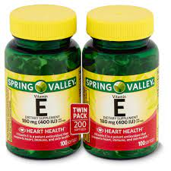
Vitamin E

Slide 23
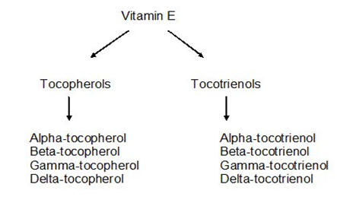
Vitamin E
Vitamin E refers to a group of eight fat-soluble compounds that include both tocopherol and tocotrienol. The vitamin is synthesized by plants, and has eight different isoforms (Vitamers) divided into two classes of four Vitamers each.

Slide 24
Vitamin E is the principle membrane-associated antioxidant molecule in mammals. It plays a major role in preventing oxidative damage to membrane lipids by scavenging free radicals.
Each of the different tocopherols exists in eight stereoisomers.
One mechanism of vitamin E's antioxidant effect is in the termination of lipid peroxidation.
Vitamin E reacts with unstable lipid radicals, producing stable lipids and a relatively stable vitamin E radical. The vitamin E radical is then reduced back to stable vitamin E by reaction with ascorbate or glutathione.
The structure of alpha-tocopherol is the long hydrocarbon chain similar to the tail of a fatty acid.

Slide 25
Vitamin E has been proposed to be the major lipid-soluble chain-breaking antioxidant and protects biologic membranes from lipid peroxidation .
Mechanisms that have been pro- posed to explain the glutathione effect include the removal of species that initiate lipid peroxidation, scavenging of radicals by a glutathione-dependent protein , scavenging of peroxy radicals by glutathione , maintenance of membrane protein thiols by glutathione , the protection by glutathione and -tocopherol of a glu- tathione S-transferase isozyme responsible for the reduction of lipid hydroperoxides , and a glutathione-dependent protein that recycles -tocopherol from the -tocopheroxy radical.

Slide 26
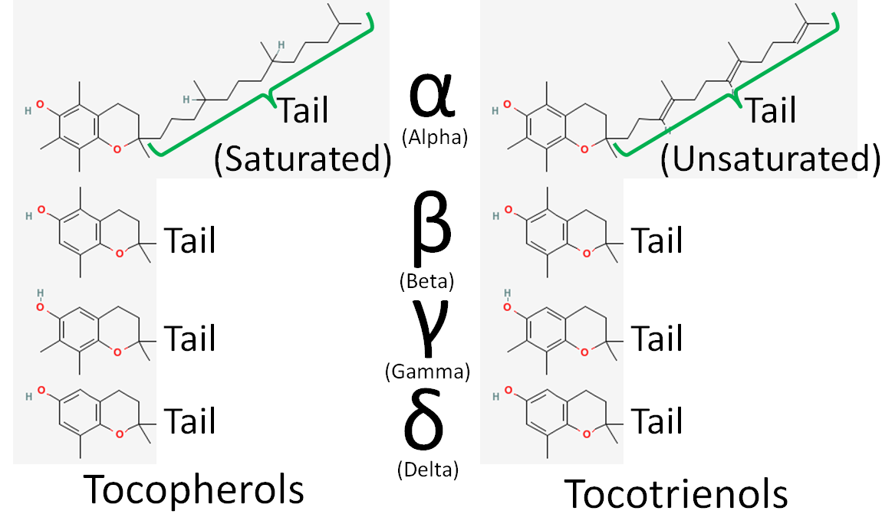

Slide 29
Physicochemical Properties
The tocopherols are viscous oils at room temperature, insoluble in water but soluble in ethanol and aprotic solvents.
Vitamin E is a slightly yellow to amber, nearly odorless, clear, viscous oil, which darkens on exposure to air or light by oxidation.
The physicochemical properties of α-tocopherol, the most abundant and active form of vitamin E in humans

Slide 30
α-Tocopherol
α-Tocopherol is an important lipid-soluble antioxidant.
It performs its functions as antioxidant by the glutathione peroxidase pathway and it protects cell membranes from oxidation by reacting with lipid radicals produced in the lipid peroxidation chain reaction .
This would remove the free radical intermediates and prevent the oxidation reaction from continuing.

Slide 31
Tocotrienol
Tocotrienol are members of the vitamin E family.
The slight difference between tocotrienol and tocopherol lie in the unsaturated side chain having three double bonds in its farnesyl isoprenoid tail.

Slide 32
Comparison of Tocotrienol and Tocopherol
Tocotrienol are forms of natural vitamin E that can protect against brain cell damage, prevent cancer and reduce cholesterol.
These biological characteristics, however, are not present in tocopherol due to their chemical structure.
The unsaturated side-chain in tocotrienol causes them to penetrate tissues with saturated fatty layers more efficiently making them ideal for anti-aging oral supplements and the skin care range.
Tocotrienol are better able than tocopherol at combating oxidative stress of skin that had been exposed to UV rays of the sunlight.

Slide 33
Why is the natural form of vitamin E better than the synthetic form?
The difference is: availability.
Natural vitamin E has roughly twice the availability of synthetic vitamin E.
There is a difference in the molecule, in its potency and in the way it behaves in the body. The natural form, is a single entity, in other words all the molecules are identical.
The synthetic dl-alpha-tocopherol is a mixture of 8 different molecular entities, known as "stereoisomers".
Of these 8, only 1 is identical to the natural form, the other 7 do not exist in nature..

Slide 35
The plant chloroplast is the site of biosynthesis, and the aromatic amino acid tyrosine can be considered the basic precursor.

Slide 36
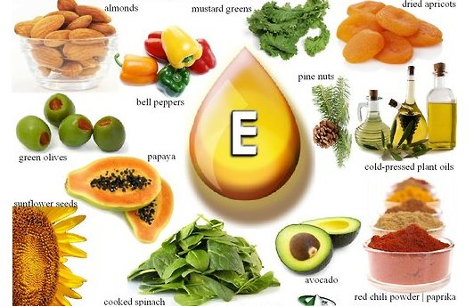
Sources
The natural form of the vitamin is synthesized only by plants and is found predominantly in plant oils.

Slide 37
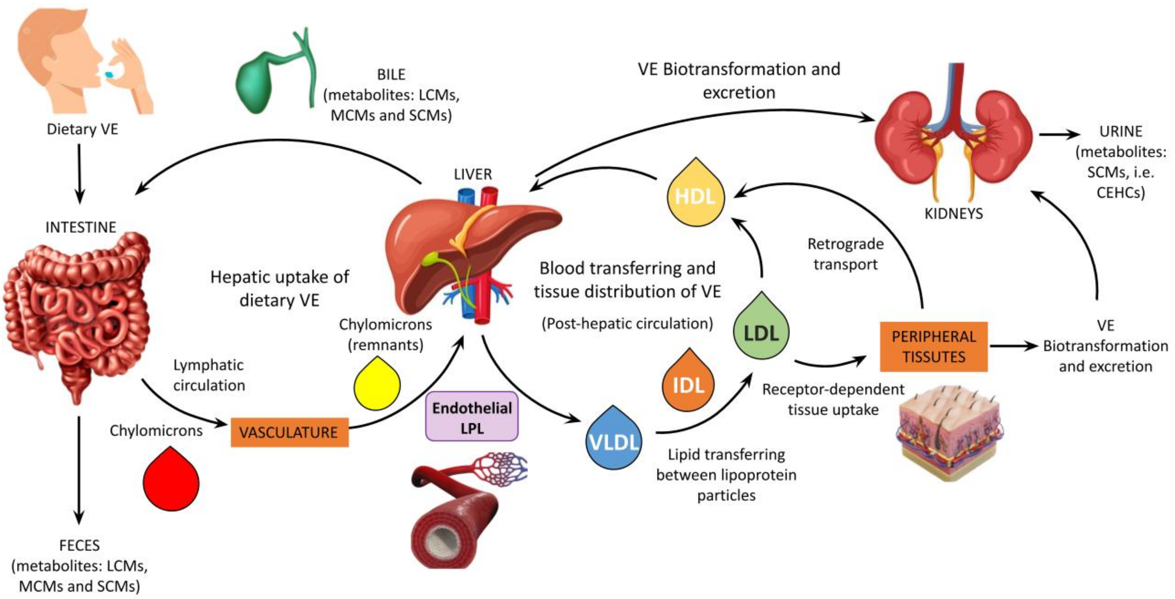
Schematic representation of vitamin E metabolism

Slide 38
α-tocopherol metabolism.
α-Tocopherol (α-T) is absorbed in the intestine and incorporated in chylomicrons, which are converted into remnant particles by lipoprotein lipase–mediated remodeling in muscle and adipose tissues.
Remnant chylomicron-associated α-tocopherol ultimately is transported to the liver, where it is selectively incorporated into very–low density lipoproteins (VLDL) by the α-tocopherol transfer protein (α-TTP) and is re-secreted into the circulation.
Endogenous apoB–containing lipoproteins (VLDL and LDL) can exchange α-tocopherol with high-density lipoproteins (HDL).
LDL and HDL are the major carriers of plasma α-tocopherol as well as the main sources of α-tocopherol for cellular uptake in peripheral tissues. HDL can also remove excess α-tocopherol from cells.

Slide 39
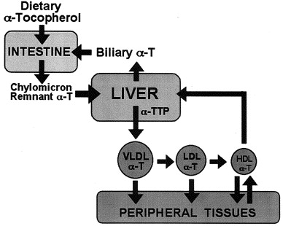

Slide 40
Absorption and Transport
Absorption of vitamin E is highly dependent upon the same processes that are utilized during fatty acid digestion and metabolism. Bile acids are considered essential for vitamin E absorption and micelle formation.
Once formed, the micelle is then able to cross the unstirred water layer and release its contents into the enterocytes. After passing through the enterocytes the vitamin E is packaged into a chylomicron and readied for circulation.

Slide 41
Once in the circulation, vitamin E is liberated from chylomicrons and much is taken up by the liver, where it is repackaged into very low density lipoproteins and secreted again into blood.
Vitamin E is transported in blood bound to a variety of lipoproteins, from which it is taken up by tissues throughout the body. Vitamin E is stored within the fat droplets of adipose tissue cells.

Slide 45
Storage
Vitamin E is a lipid soluble vitamin and therefore over 90% of total body vitamin E is found in the adipose tissue.
Excretion
Vitamin E is excreted mainly via bile, urine, feces, and the skin.
The vitamin is oxidized and forms hydroquinone and then is conjugated to form glucuronate.
Once formed the glucuronate can be excreted into bile or further degraded in the kidneys and excreted in the urine. Because of the poor intestinal absorption of vitamin E, fecal excretion is the main route of vitamin E elimination.

Slide 46
Functions of vitamin E
Vitamin E is integral part of cellular membranes whose main role is to defend the cell against oxidation.
1-Antioxidant. 2-Regulates oxidation reactions. 3-Cell-membrane stability.
4-Protect polyunsaturated fatty acids .
The primary role of vitamin E within the body is to function as an antioxidant. Vitamin E is considered to be the major chain breaking antioxidant in membranes.

Slide 47
Vitamin E requirements are dependent upon the degree of oxidative stress, the dietary polyunsaturated fatty acid (PUFA) intake and the intake of other antioxidants. Vitamin E activity is dependent upon an “antioxidant network” involving a wide variety of antioxidants and antioxidant enzymes, which functions to maintain vitamin E in its unoxidized state, ready to intercept and scavenge radicals

Slide 48
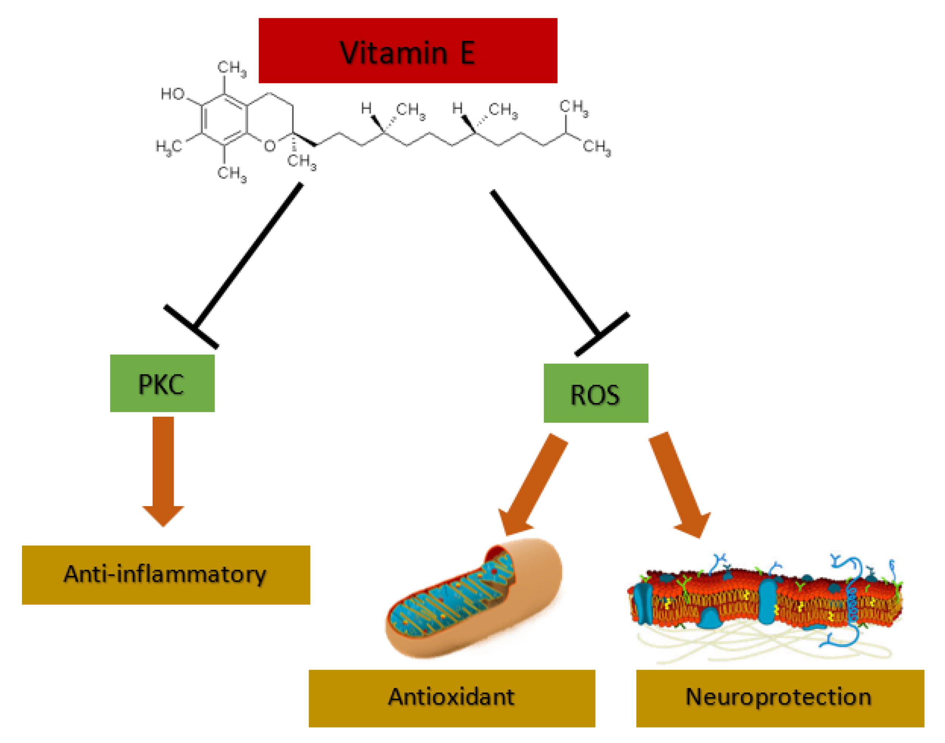
Vitamin E can act as anti-inflammatory through protein kinase C (PKC) inhibition and has antioxidant and neuroprotection properties through the attack to reactive oxygen species (ROS).

Slide 49
Mechanism of action of antioxidants, vitamin E
Free radicals, such as superoxide, hydroxyl ions and nitric oxide all contain an unpaired electron.
These radicals can have a negative effect on cells causing oxidative damage that leads to cell death. Antioxidants, such as vitamin E due to its lipid solubility is particularly important in protecting cell membranes, prevent cell damage by binding to the free radical and neutralizing its unpaired electron.
The resulting tocopherol radical is then reduced back to tocopherol by glutathione, vitamin C or other molecules. Thus the free hydroxyl group on the aromatic ring is responsible for the antioxidant properties.

Slide 50
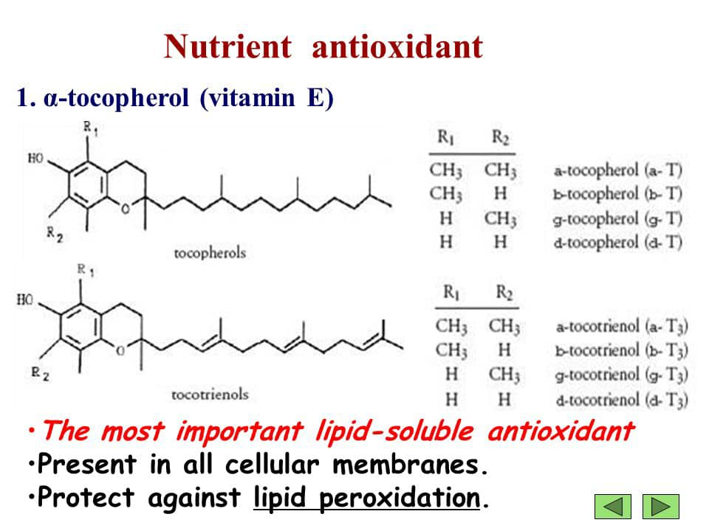
Reactive oxygen species and various electrophiles are involved in the etiology of diseases varying from cancer to cardiovascular and pulmonary disorders. The human body is protected
against damaging
effects of these
compounds
by a wide variety of
systems. An important
line of defense is
formed by antioxidants.

Slide 51
The glutathione-dependent enzymes form another line of defense Two important enzymes in this class are the free radical reductase and glutathione S-transferases (GSTs).
The GSTs are a family of phase II detoxification enzymes. They can catalyze glutathione conjugation with various electrophiles. In most cases the electrophiles are detoxified by this conjugation, but in some cases the electrophiles are activated.
Antioxidants do not act in isolation but form an intricate network. It is, for instance, known that vitamin E, together with glutathione (GSH) and a membrane-bound heat labile GSH-dependent factor, presumably an enzyme, can prevent damaging effects of reactive oxygen species on polyunsaturated fatty acids in biomembranes (lipid peroxidation).

Slide 52
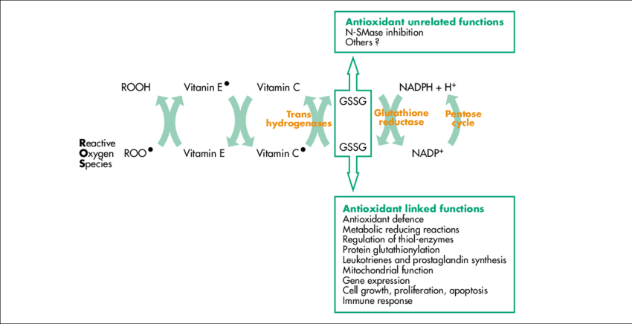
Reduced (GSH) and oxidized (GSSG) glutathione

Slide 53
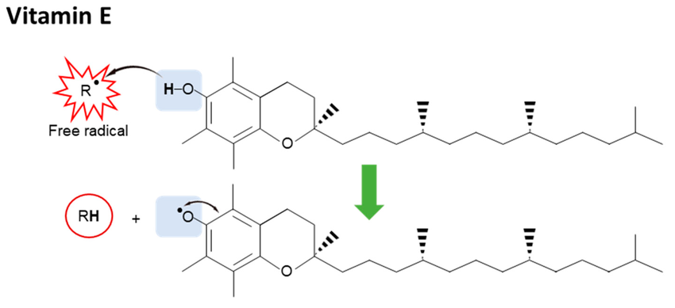
The hydroxyl group on chromanol ring can donate its hydrogen atom to a free radical resulting in a delocalized and stabilized unpaired electron, vitamin E radical.

Slide 55
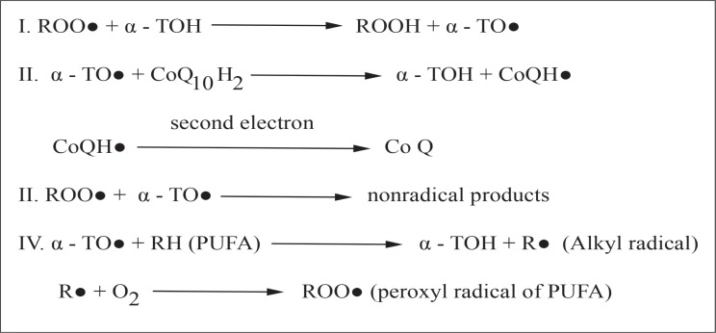

Slide 56
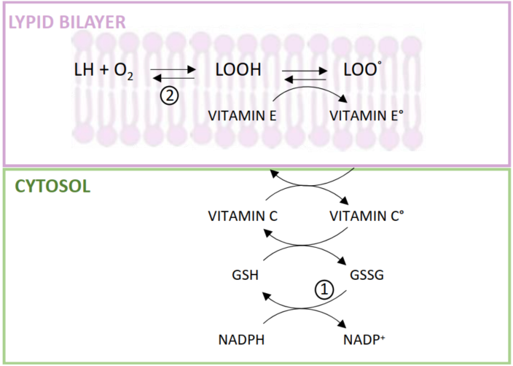
Interaction between hydrophilic antioxidants and vitamin E in the scavenging of lipoperoxyl radicals formed in the cellular membrane.
(1) Hexose monophosphate shunt
and GSH-reductase activity
(2) Membrane GSH-peroxidase activity.

Slide 57
Deficiency
It happens almost exclusively in people with an inherited or acquired condition that impairs their ability to absorb the vitamin (for instance, cystic fibrosis, short bowel syndrome or bile duct obstruction) and in those who cannot absorb dietary fat or have rare disorders of fat metabolism.
Vitamin E deficiency causes neurological problems due to poor nerve conduction.
Deficiency can also cause anemia due to oxidative damage to red blood cells, retinopathy and impairment of the immune response
.

Slide 58
The existence of a lack of vitamin E is rare.
If this occurs, it is manifested in specific cases, that is, in the following three situations:
1-Persons with a difficulty of absorbing or secreting bile or who suffer from fat metabolism-related disease (celiac disease or cystic fibrosis)
2-Premature infants (with Very low birth weight, VLB) who weigh <1,500 grams at birth
3-Persons with genetic abnormalities in alpha-tocopherol transporter proteins.

