Slide 1
NUTRITION
FOR
ELDERLY
Dr.Yossra K.Al-Robaiaay
Assistant professor
FICMS (FM)

Slide 2
Geriatrics: the branch of the medicine dealing with health problems of the elderly i.e. delaying the onset of severely degenerating aspects of aging and treating the disease of the elderly .
Gerontology: Broad area of science concerned with all the psychological, social, economic, physiological and medical problem of elderly.

Slide 3
OLD AGE
Old age is best defined as age of retirement that is 60 years and above.
Nutrition for old age is known as Geriatric Nutrition.
Aging brings physiological, psychological and immunological changes which inf
influence the nutritional
status.
luence the

Slide 4
changes associated with ageing
Physiological Changes
Socio Psychological Changes

Slide 5
Physiological Changes
Loss of Teeth
Decreased Neuromuscular coordination
Impaired hearing and poor vision

Slide 6
Physiological Changes
Diminished sense of taste and smell
Anorexia
Physical Discomfort

Slide 7
Physiological Changes
Change in Body Composition
Change in gastro-intestinal tract
Change in cardiovascular system

Slide 8
Physiological Changes
Change in respiratory function
Change in renal function
Change in skeletal tissue

Slide 9
Socio Psychological Changes
Food habit
Economic aspects
Loneliness

Slide 10
Socio Psychological Changes
Lack of nutritional knowledge
Depression
Anxiety

Slide 11
Socio Psychological Changes
Loss of self-esteem
Loss of independence

Slide 12
N U T R I T I O N R E L A T E D P R OB L E M S AMONG E L D E R LY
Obesity
Under nutrition and malnutrition
Osteoporosis
Cardiovascular diseases
Diabetes
Cancer

Slide 14
Malnutrition is one of the main health problems of the elderly.
Predisposing Factors:
Impaired physiological functioning with aging, including digestion, absorption and metabolism.
Loss of teeth.
Chronic disease may be associated with anorexia.
Psychological disturbance may be associated with anorexia, and neglecting or refusing food.

Slide 15
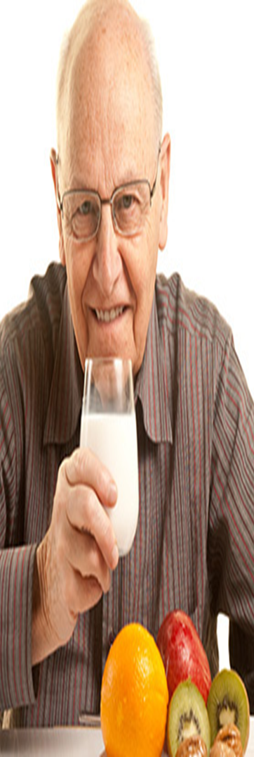
What are the nutrients requirement for elderly?
Energy
Protein
Carbohydrate
Vitamins
Minerals
Or we can say needs can be explained as:
Energy giving food
Body building food
Protective food

Slide 16
Energy
Energy requirement reduces
Basal metabolic rate decreases (15-20%) due to reduced muscle mass.
Reduced physical activity
Increase in fatty tissue.
Sedentary |  | Moderate
Male | 1900 kcal | 2200 kcal
Female | 1700kcal | 2000 kcal

Slide 17
Carbohydrates
Requirement reduces.
Impaired glucose tolerance can lead to hypoglycemia, hyperglycemia, and type II diabetes mellitus.
Insulin sensitivity can be enhanced by balance energy intake, weight management and regular physical activity.
50% energy should derive from carbohydrates.

Slide 18
Protein
Decresed skeletal tissue mass.
Decrease in store of protein is inadequate to meet the need of protein synthesis.
Intake of 1.0 gm/kg is safe during old age.
Protein rich food like milk and curd should be included.

Slide 19
Due to decrease appetite and poor digestion, old people consume less protein which may lead to:
Edema
Anemia
low resistance to infections.

Slide 20
Lipids
Dementia and CVD may share risk factors like high intake of dietary total fat.
Emphasis should be placed on reducing the intake of saturated fat and choosing monounsaturated or polyunsaturated fat sources.
Sufficient intake of omega -3 fatty acids helps in visual acuity, hair loss, tissue inflammation, improper digestion, poor kidney function and mental depression.

Slide 21
Minerals
Calcium: 800 mg/day
To compensate age related bone loss, to improve calcium balance and to decrease prevalence of fracture.
Ca absorption efficiency decreases, vitamin D level decreases so need more Ca. Total food consumption decrease so Ca supplements needed.

Slide 22
Iron : 30 mg/day
Deficiency is seen in elderly due to inadequate iron intake, blood loss due to chronic disease or reduced non-heam iron absorption.
Vitamin C deficiency also reduce iron absorption.
Mild anemia affect health due to less efficient circulation of blood.
.

Slide 23
Minerals
Zinc
Some features like delayed wound healing, decreased taste sensitivity and anorexia are associated with zinc deficiency.
But healthy elderly don’t show zinc deficiency.

Slide 24
Vitamins
Vitamin D : elderly are at risk of Vitamin D deficiency due to decreased exposure to sunlight or decrease in renal mass.
Dietary supplements with calcium and vitamin D improves bone density and prevent
fractures.
People with Parkinson disease have low vitamin D levels.
vent

Slide 25
Vitamins
Stress, smoking, and medication can increase vitamin c requirement.
The antioxidant vitamins such as vitamin E, carotinoids and vitamin c enhances health of elderly.
Vitamin C may be protective against cataract at an intake level of 150-250 mg/day.
Vitamin E is potent nutrient for reducing decline in cellular immunity that occur in elderly.
•
•
•
•

Slide 26
Vitamin E
Changes in immune system can be overcome by taking 200 mg of vitamin E.
Vitamin B6
Requirement of vitamin B6 increased due to atrophic gastritis, interferes with absorption.
Alcoholic and liver dysfunction are additional risk factor for deficiency of vitamin B6.
Vitamin B6 have significant role in immune system.

Slide 27
Folate
Alcoholism is a risk factor for folate deficiency.
Severe deficiency of folic acid may result anemia and elevated serum homo-cystiene level which is a risk factor for cardiac diseases.
consumption of folate rich food is needed.
Vitamin B12
Causes for vitamin B12 deficiency are atrophic gastritis and bacterial overgrowth, which decreases absorption and leads to pernicious anemia.

Slide 29
During old age, digestion and absorption power decreases
Problem: Heaviness, fullness in the stomach, even gas formation and acidity
Solution:
- Avoid fried, fatty, spicy and very sweet foods.
- Very large meals may not be tolerated, so 3-4 small meals may be preferred
- Small nutritious snacks in between meals may help to alleviate acidity and heart burn, diet should therefore be carefully selected
Contd….
Notes:
Changes in digestive system occur necessitating certain modifications in the kind and amount of food we can eat and number of meals to be taken

Slide 30
Problem : The pleasure of eating diminishes
Solution:
- The ability to perceive tastes like sweet and salty diminishes. The taste of food appears bland
- Meals should be made more attractive and appealing by including a variety of foods
- Use a variety of seasonings but not very spicy
Problem : Loss of teeth with advancing age leads to several dental problems. Chewing becomes extremely difficult
Solution:
- Soft, well-cooked foods like soup can be eaten.
- Hard foods like raw vegetables and fruits can be included in the grated, boiled or stewed form.

Slide 31
Problem: Capacity to eat is less
Solution:
-Select nutrient-dense foods such as fish, lean meat, liver, eggs, soy products and low-fat dairy products, fruits and vegetables, whole-grain cereals, nuts and seeds
Problem: constipation.
Solution:
-Eat fiber rich foods like whole cereals and pulses, vegetables and fruits
-Consume Soluble fibers in fruits, that are better tolerated
Drink at least 6-8 glasses of fluids like water, milk, juice, tea, soup etc. daily.
Try to Include whole fruits instead of juices.

Slide 32
Neurocognitive disorders in elderly and role of nutrition

Slide 33
Dementia
It is a broad category of brain disease that includes any disease that causes loss of cognitive ability (the ability to think and reason clearly)
It is bad enough to affect a person's daily functioning
Alzheimer’s
The most common form of dementia is Alzheimer's
Its most common symptoms are short-term memory loss and word-finding difficulties
Notes:
Dementia must also represent a worsening of functioning compared to how the person was previously.

Slide 34
Nutrition related Challenges associated with dementia?
Dementias often lead to changes in eating
behavior such as:
Increased or decreased food intake,
Altered food choices
Poor appetite
Disturbances in eating processes.
As the disease progresses, sensory and perceptive loss may affect vision and smell which can hamper recognition of food items
Notes:
Increased or decreased food intake- people with dementia may overeat. Reasons for this include forgetting they have recently eaten or being concerned about where the next meal is coming fro or they completely forget to take a meal.
Altered food choices -As a person gets older it is common for the senses of taste and smell to decline, which can lead to food being less palatable. People may have a preference for additional sugar and salt. It is not uncommon for people with dementia to develop a fondness for sweet foods.
Poor Appetite- this could be due to depression, tiredness, medication, constipation etc.

Slide 35
Some people with dementia will lose the ability to judge
the temperature of food. Make sure food is not too hot,
as it could burn the person’s mouth and result in eating
becoming uncomfortable
Environment should be made more stimulating and
social so that person feel at ease while eating
It is important to keep people involved in preparing food and drink. This is because it can help to maintain certain skills, and keep the person interested in food and drink
Regular snacks or small meals are better than set mealtimes

Slide 36
Role of Specific Nutrients in neurocognitive disorders

Slide 37
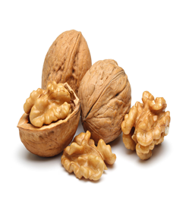
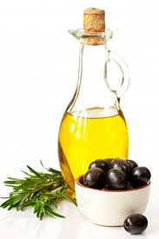
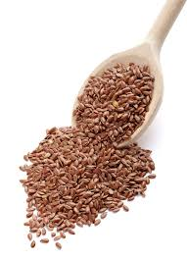
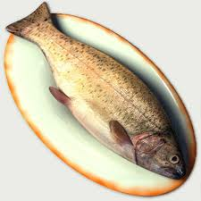
Some foods and nutrients are beneficial and help improve neurocognitive performance
A special type of fat : omega-3 fatty acid protect against cognitive decline and dementia.
Rich sources of omega-3 fatty acid are:
Olive oil
Flax seeds
Fish
walnut

Slide 38
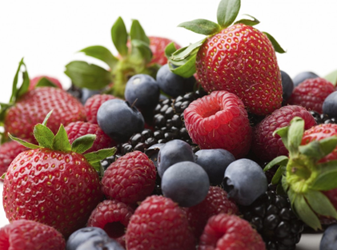
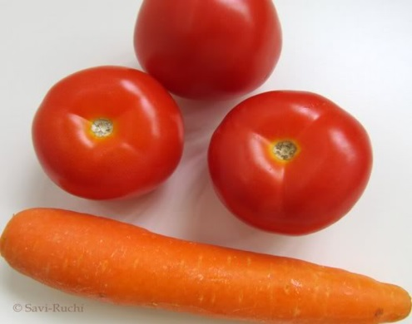
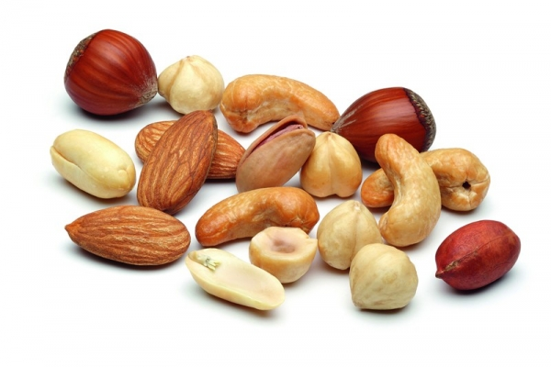
ANTIOXIDANTS
these are protective substances such as vitamin A, C, E which protect the body from free radical damage
Why are they important?
Dietary antioxidant intake is associated with lower prevalence of degenerative diseases and maintenance of physiologic functions in older adults
Greater antioxidant intake may prevent age-related neurologic dysfunction.
Therefore consumption of foods rich in antioxidants should be encouraged
Berries such as raspberry;
strawberry
Nuts such as walnut,
almond, peanut,
sunflower seeds
Beverages such as green tea
and coffee
Vegetable such as carrot and tomato

Slide 39
Some B vitamins like B6, B12 and folate
Higher dietary intake of vitamins B6, B12 and folate are related to greater likelihood of neurocognitive protection reducing risk for untoward neurocognitive functioning, including Alzheimer's disease
Deficiency of these nutrients has been linked to neurocognitive disorders such as:
Depression
Dementia
Seizures

Slide 40
Therefore food rich in these nutrients should be made part of daily diet.
Rich Sources of Vitamin B6:
Fish, Meat, Vegetables such as bell peppers, spinach, green peas, yam, broccoli; nuts like peanuts, cashewnuts, hazelnuts; whole grains, bran; legumes such as chickpeas, lentils, soya bean.
Rich Sources of Vitamin B12:
Cheese, yoghurt, egg, liver, fish
Rich Sources of Folate:
Dark green leafy vegetables, fruits, nuts, peas, dairy products, poultry and meat, eggs, seafood, grains

