Slide 1
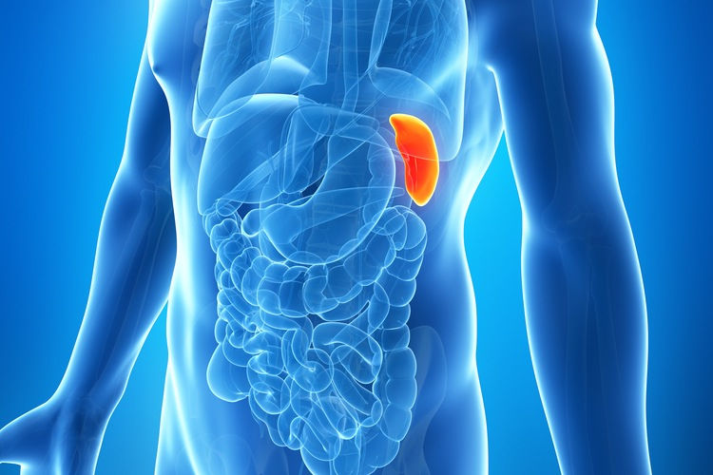
spleen

Slide 2
Learning objectives
Indications for Splenectomy
Complications
Antibiotic prophylaxis and immunizations.

Slide 3
Sickle cell disease
Autosomal recessive trait
Occurring mainly among those of African origin
The Hb A is replaced by Hb S.
Hb S crystallise when O2 tension is reduced.
So it may cause splenic infarcts ?
Clinical features depend on the vessel affected, so it may cause:
Bone or joint pain
Priapism
Neurological signs
Skin ulcers
Abdominal pain

Slide 4
Diagnosis by:1. blood film
2. Hb electrophoresis
Treatment:
Avoid hypoxia to prevent crisis
Adequate hydration
Partial exchange transfusion
Splenectomy if:
a. hypersplenism develop
b. after 1 crisis

Slide 5
Porphyria
Hereditary error of Hb catabolism
Abdominal crisis characterized by sever colick and constipation and can be precipitated by administration of barbiturates.
Anaemia
Photosensitivity
Neurological and mental symptoms
Porphyrinuria occurs
So urine color may be orange.
Splenectomy has a little role

Slide 6
Felty syndrome
A triad of rheumatoid arthritis, leukopenia and splenomegally.
Splenectomy produce a transient improvement in blood picture but RA may respond well to corticosteroids in resistant patients.

Slide 7
Neoplasm
Caused by vinyl chloride and thorium dioxide
Haemangioma is the most common benign tumor of the spleen, it may convert into malignant angiosarcoma.
Lymphoma is the commonest neoplasm of the spleen.
Splenectomy play a role in lymphoma management
Especially if there is no obvious liver or nodal enlargement.

Slide 8
Myelofibrosis:
abnormal proliferation of mesenchymal element of the RES.
Occur in elderly patients more than 50 years
Pain caused by gross enlargement or by splenic infarcts.
Splenectomy is done to treat anaemia and to relieve the pain and discomfort.

Slide 9
Injury to the Spleen
Blunt injury : Acceleration – Deceleration energy.
R.T.A., F.F.H.
Penetrated Injury : Bullet, Stab , Fracture Lt lower ribs.
Isolated or Combined.
Injury Grading (Splenic CT Injury Grading Scale) .
Splenic CT Injury Grading Scale.
A way to remember this system is:
Grade 1 is less than 1 cm.
Grade 2 is about 2 cm (1-3 cm).
Grade 3 is more than 3 cm.
Grade 4 is more than 10 cm.
Grade 5 is total devascularization or maceration.

Slide 10
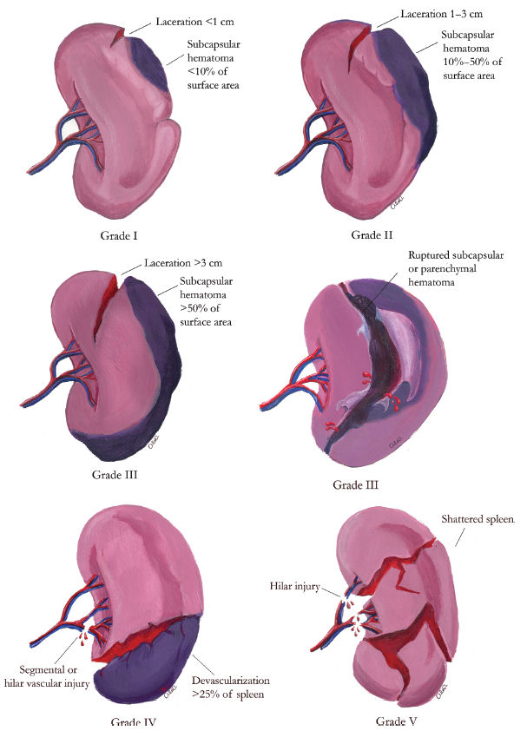

Slide 11
Indications for Splenectomy
1. Trauma (Accidental / Intraoperative).
2. Oncological: Part of en-block resection of stomach or pancreas
Diagnostic.
Therapeutic.
3. Hematological diseases: to reduce anaemia, thrombocytopenia in Spherocytosis, ITP & Hypersplenism.
4. Portal Hypertension ( Variceal surgery ).

Slide 12
Preoperative Preparations
Blood bank.
According to the disease.( bl. tendencies).
Coagulation profile.
Prophylactic antibiotics.
Preoperative Immunization.
Surgical Modalities
Open Splenectomy
Emergency
Elective
Lap. Splenectomy

Slide 13
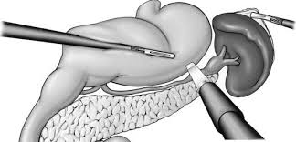
Postoperative Complications
1. Bleeding ( slipped ligature)
2. Gastric:
Hematemesis
Gastric dilatation
Gastric fistula
3. pancreatic:
Damage to tail of pancreas
Pancreatic abcess
Pancreatic fistula

Slide 14
4. pulmonary:
Atelectasis
Pleural effusion
5. Postoperative thrombocytosis:
The platelet may reach 1,000,000 per ml, prophylactic aspirin may be given to prevent venous thrombosis
6. Post splenectomy Septicemia, caused by:
a. strept. Pneumonia
b. N. meningitides
c. H. influenzae & E. coli.

Slide 15
Patient at more risk to develop septicemia are:
Young age
Who treated with chemotherapy
Who have Thalassemia
6. Opportunistic post-splenectomy infection (OPSI)
This major complication can be prevented by:
Appropriate and timely immunization
Antibiotic prophylaxis
Prompt treatment of infection.

Slide 16
Antibiotic prophylaxis:
if child had splenectomy before age of 5 years
Should be treated with daily penicillin until the age of 10.
if child had splenectomy after age of 5 years
Should be treated until age of 16
in adult patient its non useful
The greatest risk of OPSI is during the first 2-3 years, so its reasonable to give antibiotic prophylaxis during this period.

Slide 17
Immunization:
Pneumococcus and meningococcus C both repeated every 5 years.
H influenza type B repeated every 10 years
yearly influenza vaccination is highly recommended
Timing of immunization:
2 weeks before surgery if was ellective
As soon as possible after surgery if was emergency.

Slide 18
Thank you

