Slide 1
Fractures
Dr Muna AZ

Slide 2
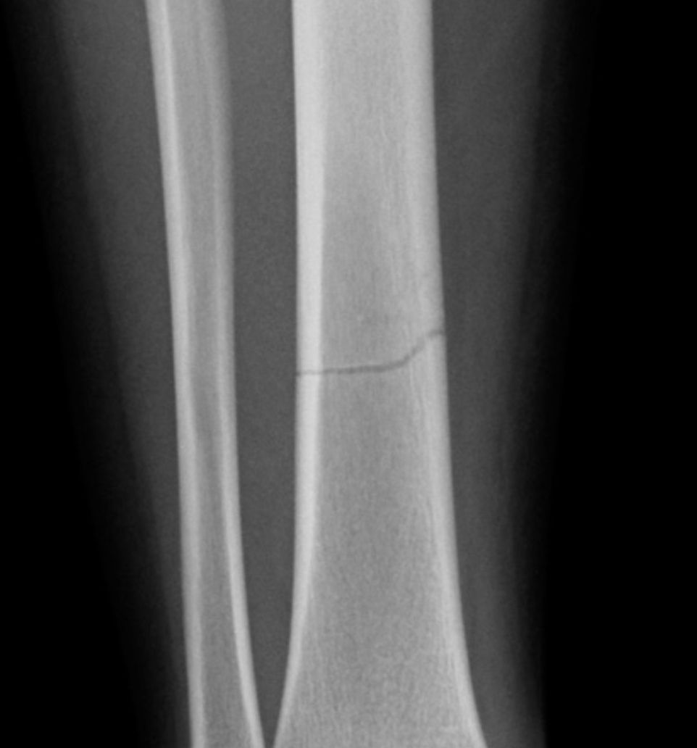
Anatomical classes of fracture
1. transverse fracture … fracture line across the shaft at a right angle

Slide 3
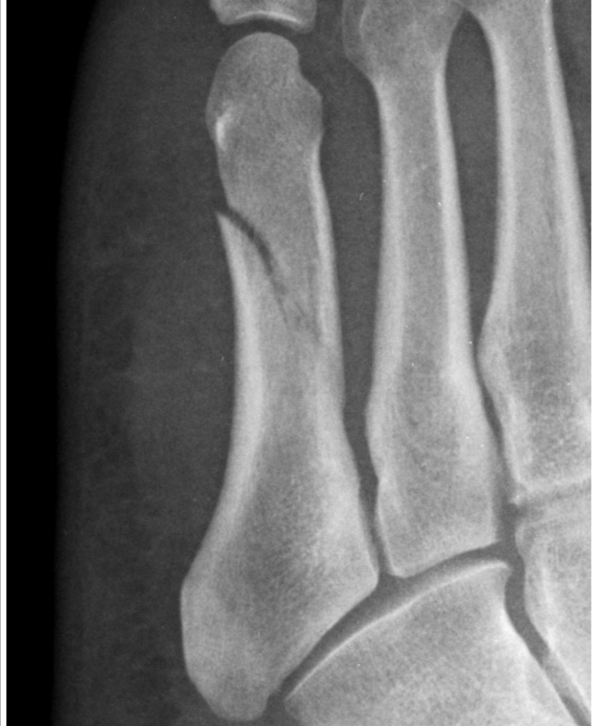
2-Oblique fracture :a fracture passes at an angle oblique to the shaft of the long bone

Slide 4
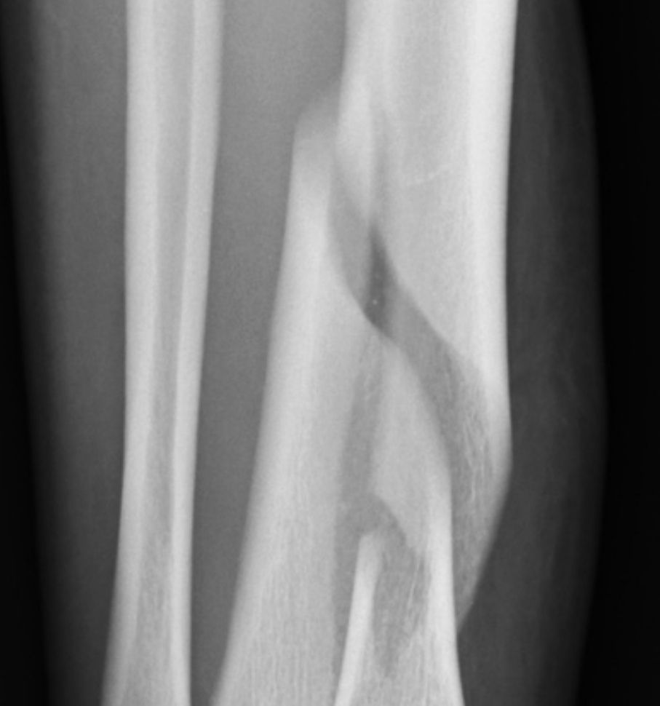
3-Spiral fracture
Result from twisting injury, the fracture line spirals along the shaft of the long bone

Slide 5
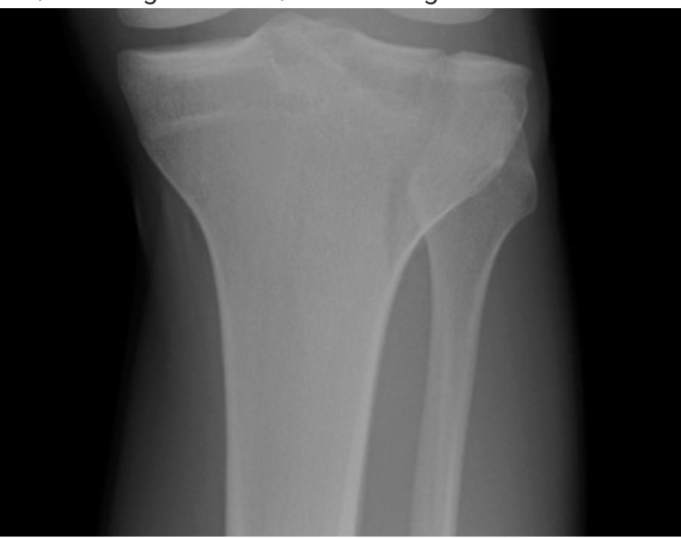
4- sagittal plain fracture
Fracture line pass longitudinal along the long bone shaft

Slide 6
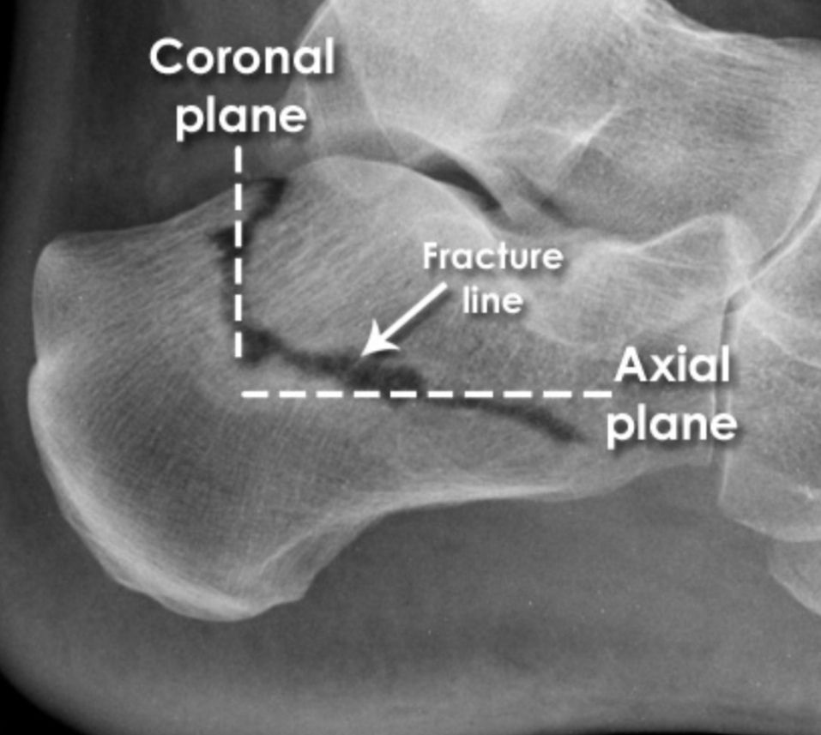
5- irregular fracture
A multidirectional fracture , when the fracture pass in more than one direction , ex combined coronal and axial plain

Slide 7
MRI indication in bone fracture
1.Few bone injuries and most soft tissue injuries can not be detected on plain radiography
2. MRI can detect occult recent bone injuries , missed by radiography due to signal changes on bone marrow
3. identify tendon, ligaments, cartilage and other soft tissue , thus , localizing the cause of morbidity

Slide 8
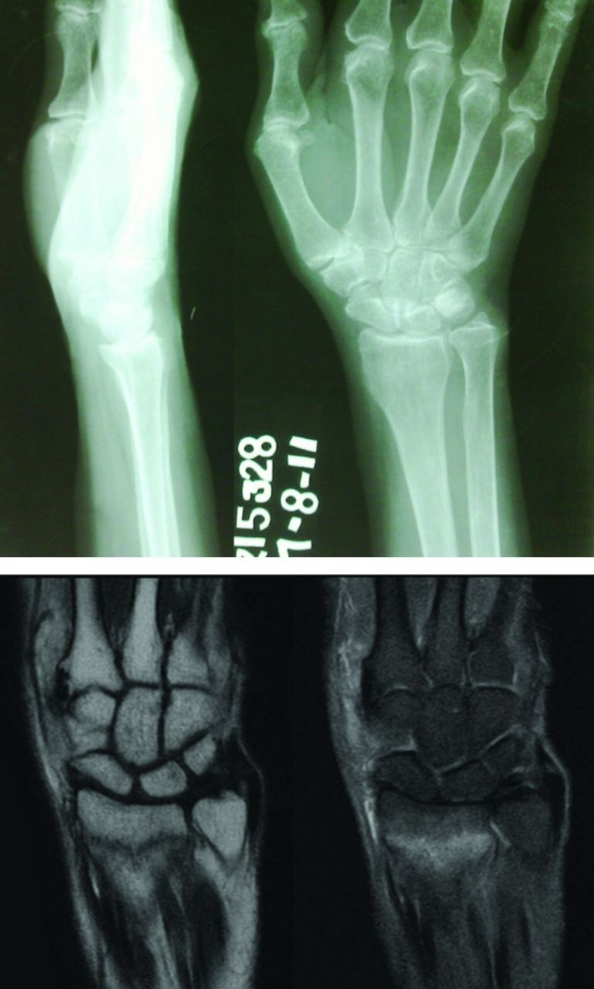
Coronal plain MRI demonstrating hypo- intense linear fracture line with surrounding edema suggesting a fracture
T1 and fat suppression sequence

Slide 9
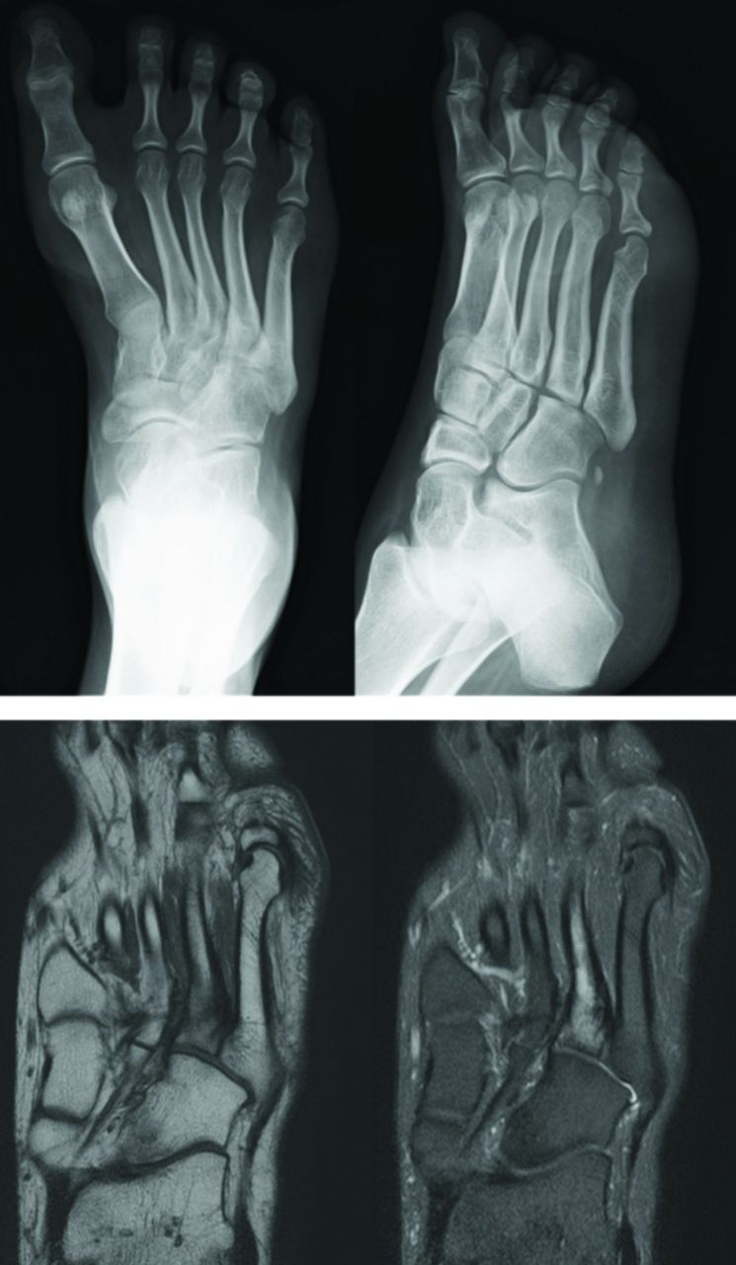
Coronal plain MRI fat suppression sequence and TI demonstrate linear hyperintens linear signal at the base of the fourth metatarsal with surrounding odema seen on fat supress.

Slide 10
Is CT or MRI better for fracture ?
MRI more often correctly identify the location of hidden pelvic and hip fractures when compared to CT scan , however CT may be preferable in the elderly patients in the emergency department (ED) based on decrease time spent and large percentage of elderly patients with MRI contra indications

Slide 11
Stress fracture
A fatigue – induced fracture caused by repeated stress over time , other names , march fracture , fissure fracture and hairline fracture

Slide 12
clinical and Radiological features
Insidious onset of pain and swelling over the affected region.
Pain is initially expressed during activity
Later on pain is experienced at rest.
MRI is the best way to diagnose stress fracture before an x ray show changes , it is also able to distinguish between fracture and soft tissue injury by showing periosteal or adjacent soft tissue edema

Slide 13
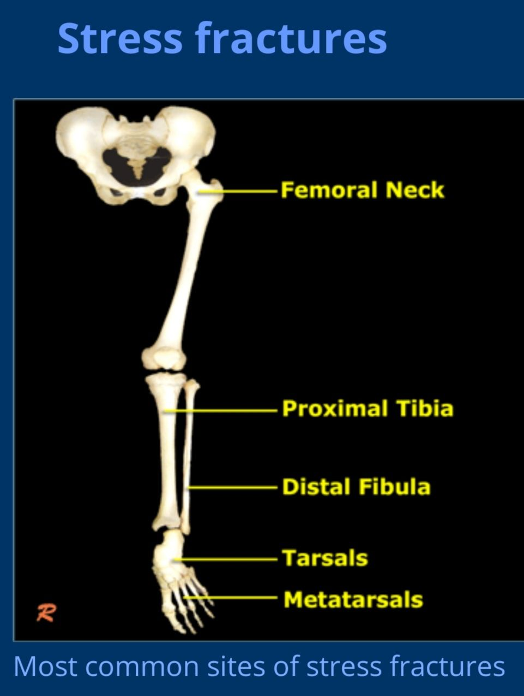

Slide 14
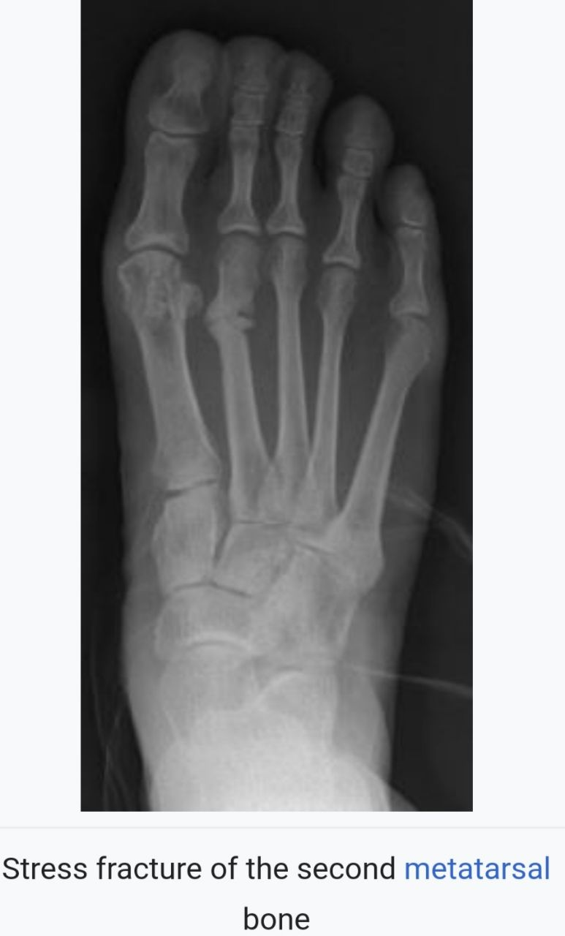

Slide 15
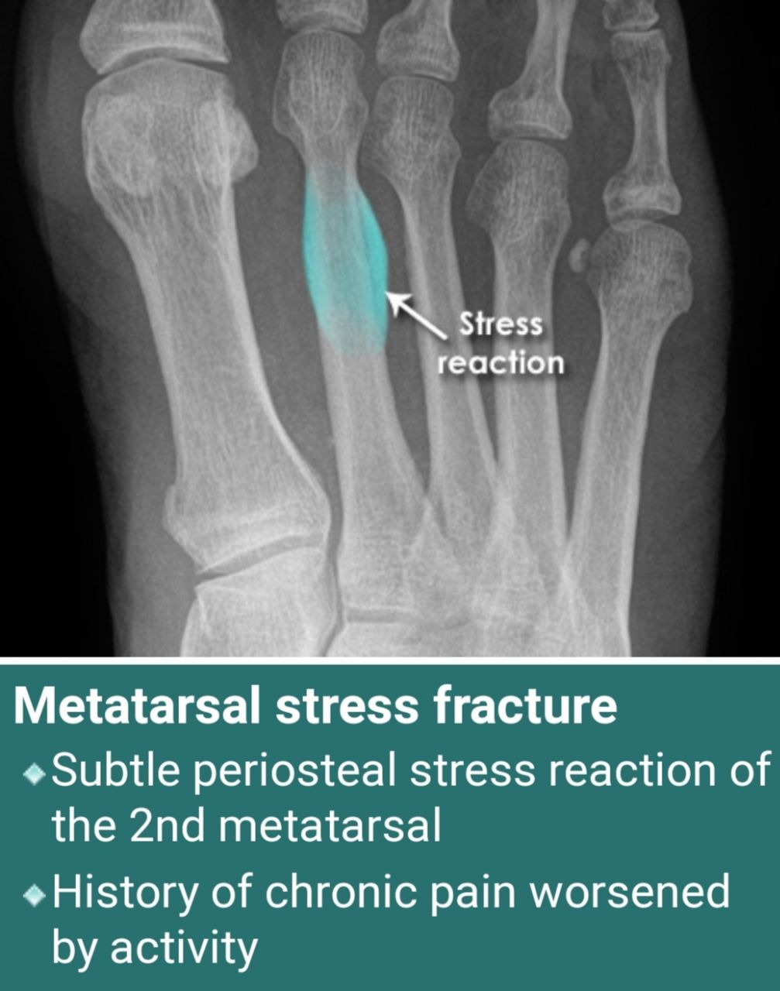
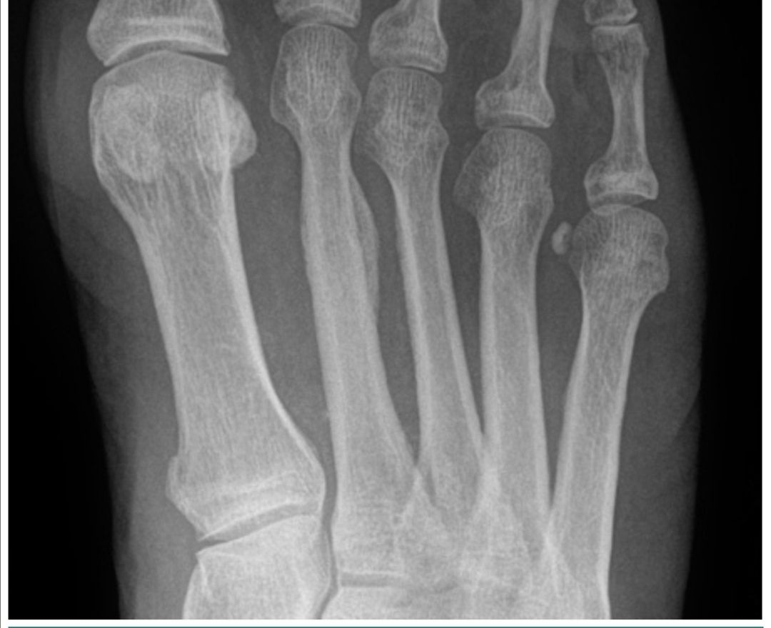

Slide 16
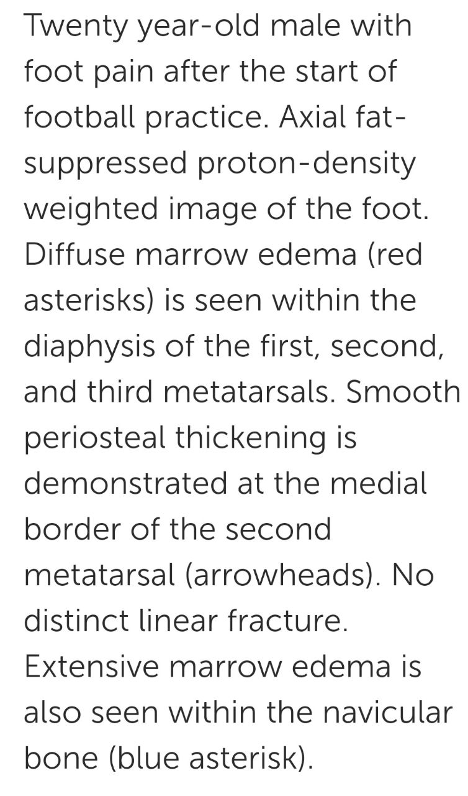
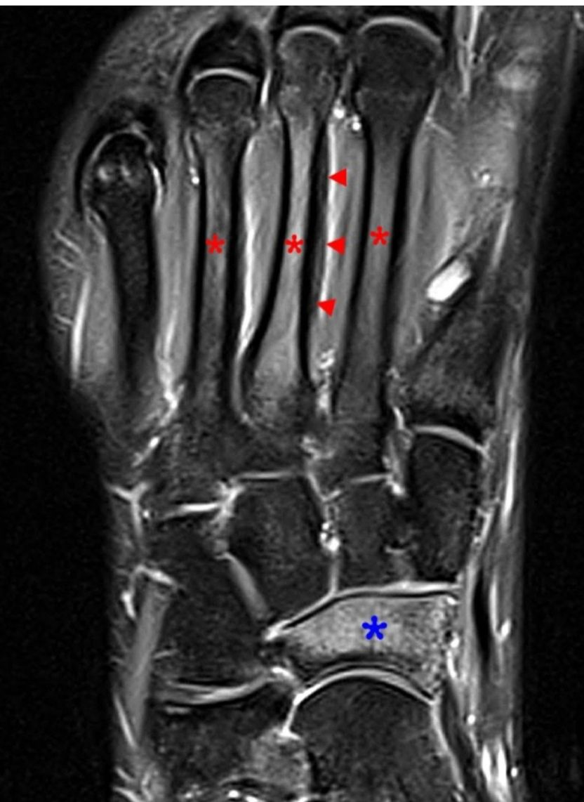

Slide 17
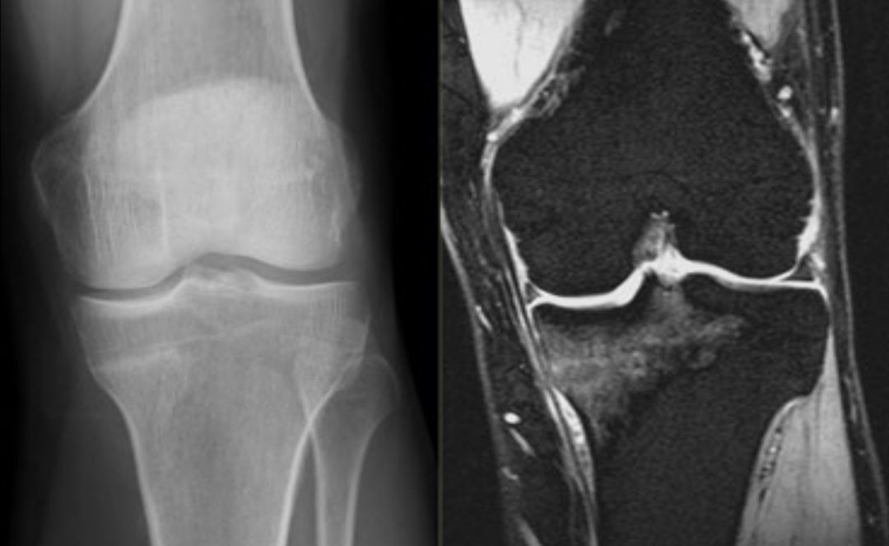
Fracture upper medial end of the Tibia

Slide 18
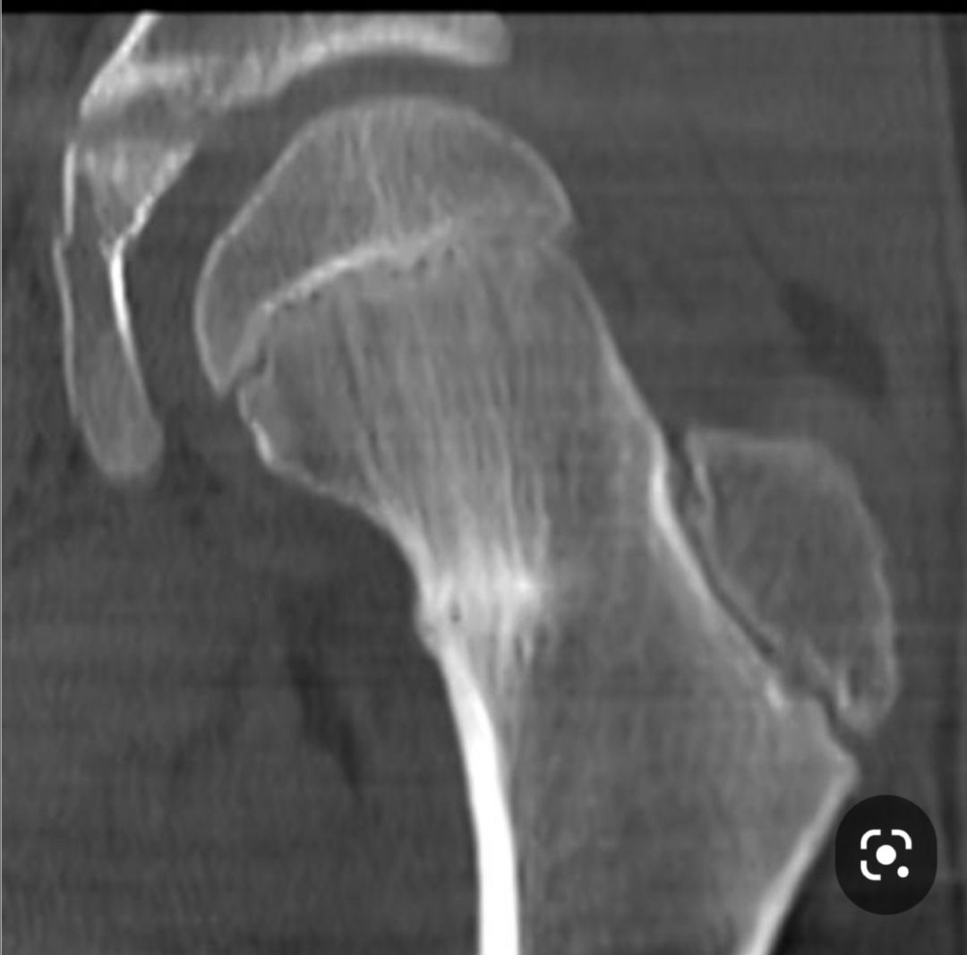
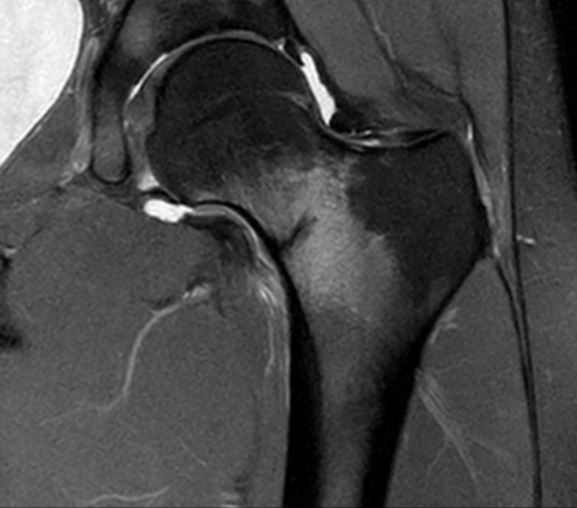
Stress fracture neck femur , CT scan showing cortical fissure at the medial aspect of the femoral neck surrounding by sclerotic band and edema

