Slide 1
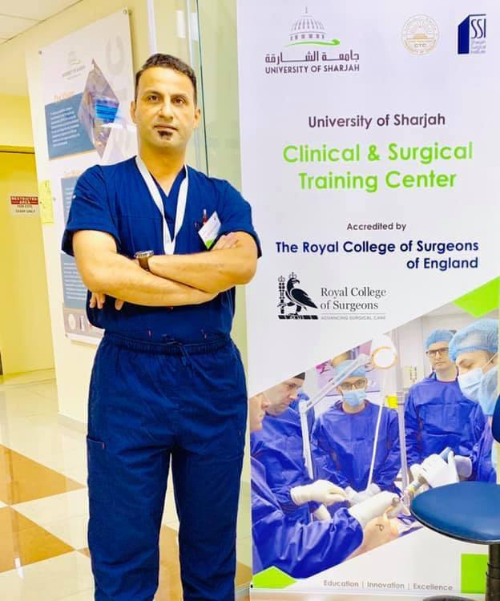
Crystal deposition disorders (gout and pseudogout)
By Ass. Prof.
Dr. AHMED L. AL-SHAMARI
Fellow of American college of surgeons. Consultant Orthopaedic Surgeon.
M.B.Ch.B, F.I.B.M.S, FACS, AO fellow .

Slide 2
Gout
Hyper uricemia &Depostion of monosodium urate crystals in joints with recurrent attacks of acute synovitis
This is a disorder of purine metabolism characterized by hyperuricaemia, deposition of monosodium urate monohydrate crystals in joints and periarticular tissues and recurrent attacks of acute synovitis.
Late changes include cartilage degeneration, renal dysfunction and uric acid kidney stones.

Slide 3
Pathology & pathogenesis

Slide 4
Pathology & pathogenesis

Slide 5
Clinical gout
Urate crystals are deposited in minute clumps in connective tissue, including articular cartilage; the
commonest sites are the small joints of the hands and feet.
For months, perhaps years, they remain inert. Then, possibly as a result of local trauma, the needle-like crystals are dispersed into the joint and the surrounding tissues where they excite an acute inflammatory reaction

Slide 6
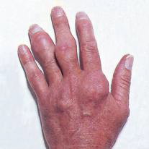
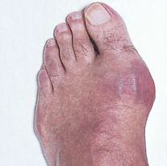
common sites are around the metatarsophalangeal joints of the big toes, the Achilles tendons, the olecranon bursae and the pinnae of the ears.

Slide 7
Classification
Primary gout (95% of cases)
occurs in the absence of any obvious cause and may be due to constitutional under-excretion (the vast majority) or over-production of urate.
Secondary gout (5%)
results from prolonged hyperuricaemia due to acquired disorders such as myeloproliferative diseases, administration of diuretics or renal failure.

Slide 8
Clinical features
Patients are usually men over the age of 30 years.
Often there is a family history of gout.
It is much commoner in Caucasian than in Black African peoples;
Its more wide spread in men than in women (the ratio may be as high as 20:1) and it is seldom seen before the menopause in females.

Slide 9
The acute attack
The sudden onset of severe joint pain which lasts for 1–2 weeks is typical of acute gout which is usually spontaneous or precipitated by minor trauma, operation, unaccustomed exercise or alcohol.
The commonest sites are the metatarsophalangeal joint of the big toe, the ankle and finger joints and the olecranon bursa.
The skin looks red and shiny and swelling. The joint feels hot and extremely tender, suggesting a cellulitis or septic arthritis. Sometimes
the only feature is acute pain and tenderness in the
heel or the sole of the foot.

Slide 10
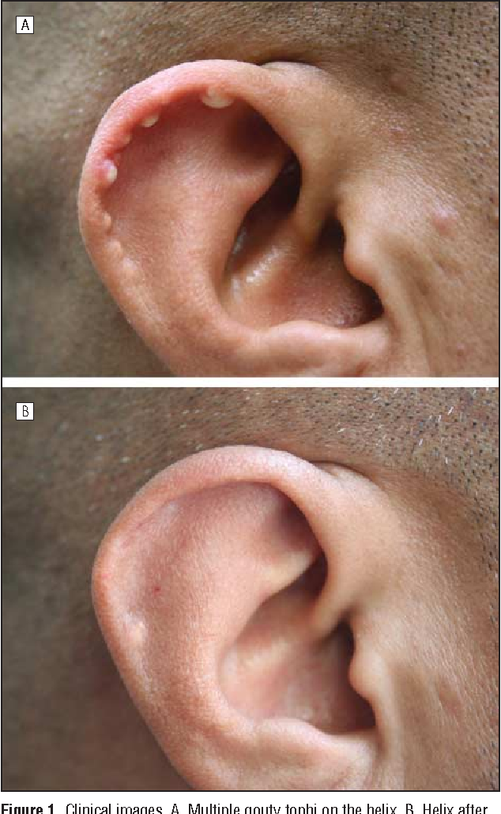
Chronic gout
Recurrent acute attacks may eventually merge into polyarticular gout. Tophi may appear around joints, over the olecranon and in the pinna of the ear.
A large tophus can ulcerate and discharge its chalky material. Joint erosion causes chronic pain, stiffness and deformity. Renal lesions include calculi and parenchymal disease.

Slide 11
X-rays
During the acute attack x-rays show only soft-tissue swelling. Chronic gout may show asymmetrical, punched-out ‘cysts’ in the periarticular bone, joint space narrowing and secondary osteoarthritis.
X-rays show the
typical periarticular excavations (tophi consisting of uric
acid deposits) in the big toe metatarsophalangeal joints

Slide 12
Differential diagnosis
Pseudogout
Pyrophosphate crystal deposition may cause an acute arthritis indistinguishable from gout – except that it tends to affect large rather than small joints and is somewhat more common in women than in men. Articular calcification may show on x-ray. Demonstrating the crystals in synovial fluidestablishes the diagnosis.
Infection
Cellulitis, septic bursitis, an infected bunion or septic arthritis must all be excluded, if necessary by immediate joint aspiration and examination of synovial fluid.
Rheumatoid arthritis
Polyarticular gout affecting the fingers may be mistaken for rheumatoid arthritis, and elbow tophi for rheumatoid nodules. In difficult cases, biopsy will establish the diagnosis.

Slide 13
Treatment of The acute attack
The sooner treatment is started the more effective it is likely to be
1-resting the joint, applying ice packs
2-giving full doses of a non-steroidal anti-inflammatory drug (NSAID). Colchicine, one of the oldest of medications, is also effective but may cause diarrhoea, nausea andvomiting.
3- A tense effusion may require aspiration and intra-articular injection of corticosteroids.
4-Oral corticosteroids are useful for patients in whom NSAIDs are contraindicated.

Slide 14
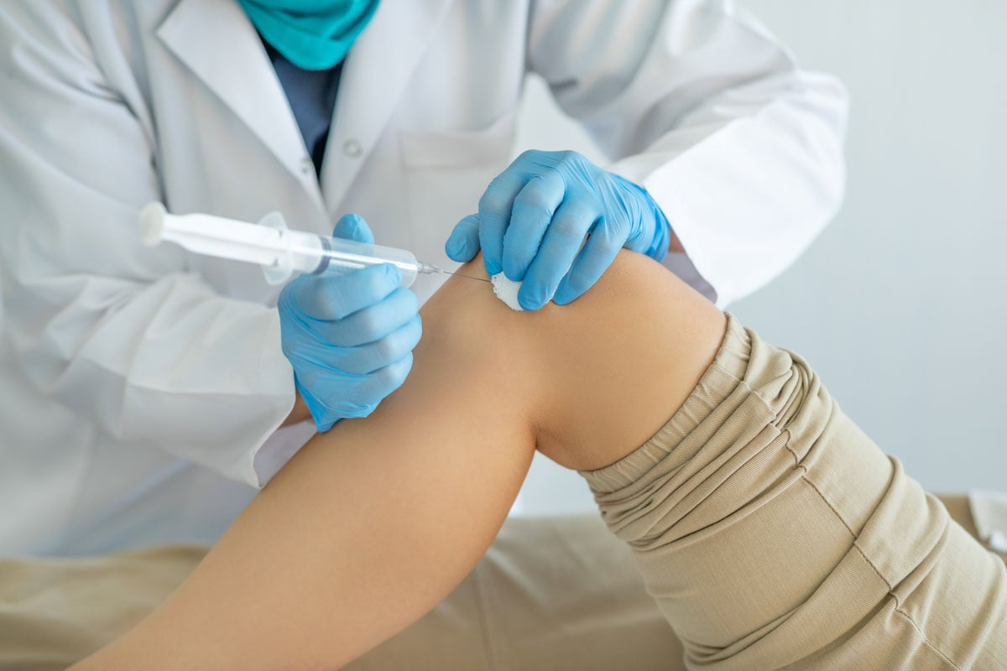
Local steroid injection

Slide 15
Interval therapy
Between attacks, attention should be given to simple measures such as losing weight, cutting out alcohol and eliminating diuretics.
Urate-lowering drugs are indicated if acute attacks recur at frequent intervals, if there are tophi or if renal functionis impaired.
allopurinol, a xanthine oxidase inhibitor, is usually preferred, and for patients with renal complications or chronic tophaceous gout allopurinol is definitely the drug of choice.
Urate-lowering drugs should never be started before the acute attack has completely subsided, and they should always be covered by an anti-inflammatory preparation or colchicine, otherwise they may actuallyprolong or precipitate an acute attack

Slide 16
Surgery
With prolonged urate-lowering therapy, adjusted to maintain a normal serum uric acid level (less than 0.36 mmol/L), tophi may gradually dissolve.
However, ulcerating tophi that fail to heal with conservative treatment can be evacuated by curettage; the wound is left open and dressings are applied until it heals.

Slide 17
Calcium pyrophosphate dihydrate arthropathy (CPPD)
It consist of 3 overlapping conditions:
1- chondrocalcinosis :the appearance of calssification in articular cartilage & menisci.
2- psudogout : crystal induced synovitis.
3- chronic pyrophosphate arthropathy : a type of degenerative joint disease.

Slide 18
Pathology
Pyrophosphate is probably generated in abnormal cartilage by enzyme activity at chondrocyte surfaces; it combines with calcium ions in the matrix where crystal nucleation occurs on collagen fibres.
The crystals grow into microscopic ‘tophi’ which appear in the cartilage matrix and in fibrocartilaginous structures such as the menisci of the knee and the intervertebral discs.
From time to time CPPD crystals are extruded into the joint where they excite an inflammatory reaction similar to gout.

Slide 19
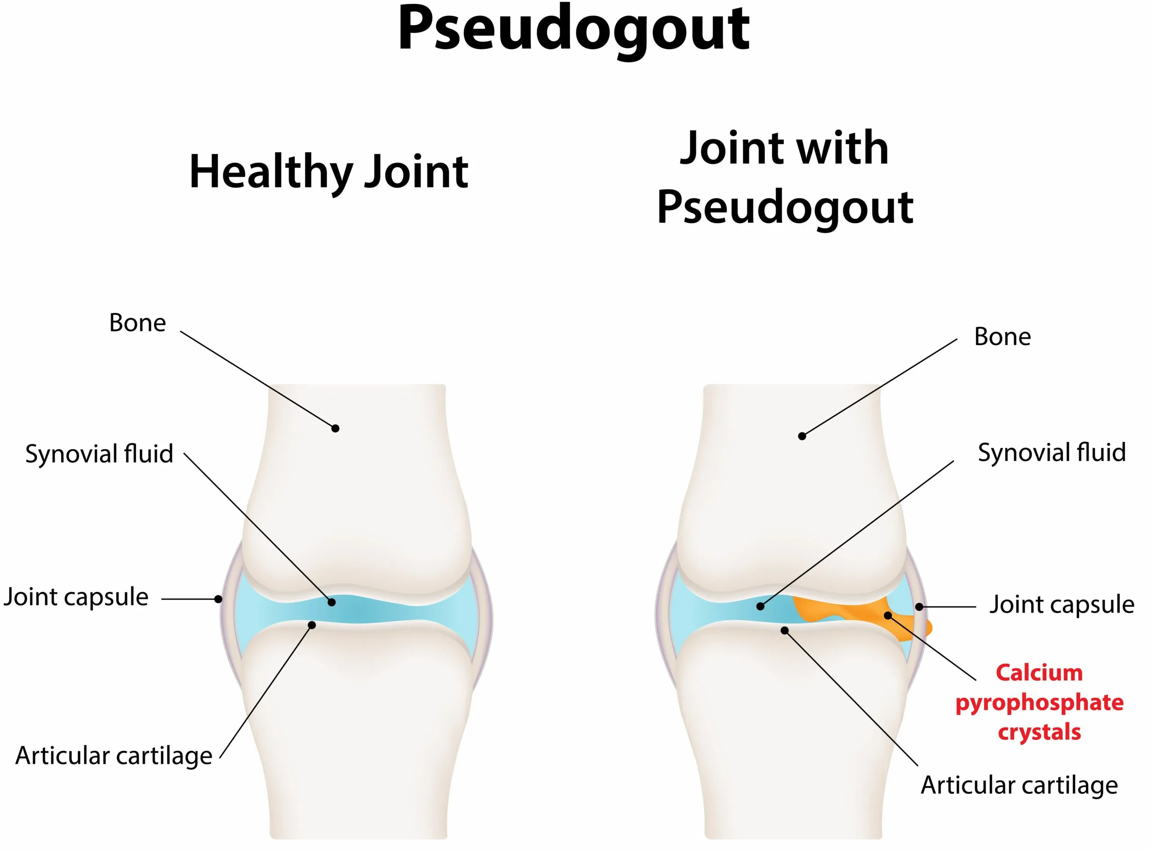
Clinical features
The clinical disorder takes several forms, all of them appearing with increasing frequency in relation to age.
Most of the patients are women over the age of 60 years.

Slide 20
Asymptomatic chondrocalcinosis
Calcification of the menisci is common in elderly people and is usually asymptomatic. When it is seen in association with osteoarthritis this does not necessarily imply cause and effect; both are common in elderly people and they are bound to be seen together in some patients.
X-rays may reveal chondrocalcinosis in other asymptomatic joints.

Slide 21
Acute synovitis (pseudogout)
The patient, typically a middle-aged woman, complains of acute pain and swelling in one of the larger joints – usually the knee.
Sometimes the attack is precipitated by a minor illness or operation.
The joint is tense and inflamed, though usually not as acutely as in gout. Untreated the condition lasts for a few weeks and then subsides spontaneously.
X-rays may show signs of chondrocalcinosis, and the diagnosis can be confirmed by finding positive birefringent crystals in the synovial fluid

Slide 22
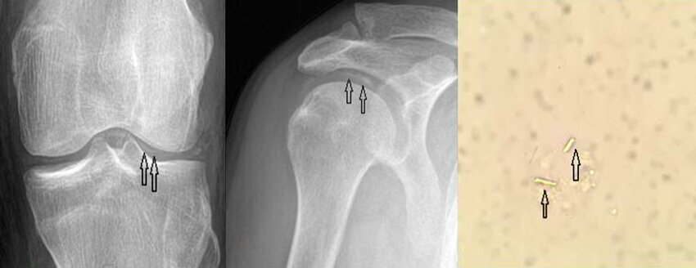
Chronic pyrophosphate arthropathy
The patient, usually an elderly woman, presents with polyarticular ‘osteoarthritis’ affecting the larger joints, including joints such as the ankles, shoulders or elbows where ‘primary’ osteoarthritis is seldom seen.
This is often diagnosed as ‘generalized osteoarthritis’ but the x-ray features are distinctive:
(a) unusual calcification in articular cartilage and menisci as well as the periarticular soft tissues; together with (b) progressive degeneration of the
articular surfaces.

Slide 23
Diagnosis
1. Pseudogout must be distinguished from other acute inflammatory disorders such as gout and infection.
2. Diagnosis rests on identifying the characteristic crystals in synovial fluid.
3. Chronic pyrophosphate arthropathy can resemble other types of polyarticular arthritis and will come into the differential diagnosis of rheumatoid arthritis and polyarticular osteoarthritis

Slide 24
Gout
Small joints
Intense pain
Inflamed joint
Hyperuricemia
Uric acid crystals
Psudogout
Large joints
Moderate pain
Swollen joint
Chondrocalcinosis
Ca pyrophosphate crystals

Slide 25
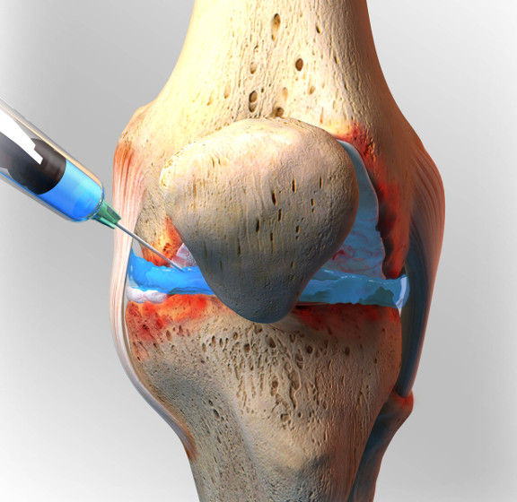
Treatment
The treatment of pseudogout is similar to that of classic gout:
1-Acute symptoms treated by rest, NSAIDs, joint aspiration and intra-articular injection of corticosteroid.
2-Chronic pyrophosphate arthropathy is treated like osteoarthritis.

Slide 26
Thank you

