Slide 1
Poliomyelitis

Slide 2
Identification:
Viral infection, acute onset of flaccid paralysis can occur in 3 clinical presentations:
Asymptomatic: 90-95%
Abortive illness: 4-8% flu- like illness due to viremia,
Paralytic polio: <1% Classified as:
- minor illness: fever, malaise headache, nausea and vomiting, this may progress to :
- major illness: severe muscle pain and stiffness of the neck and the back followed by the flaccid paralysis which is asymmetrical, permanent and with no sensory involvement.

Slide 3
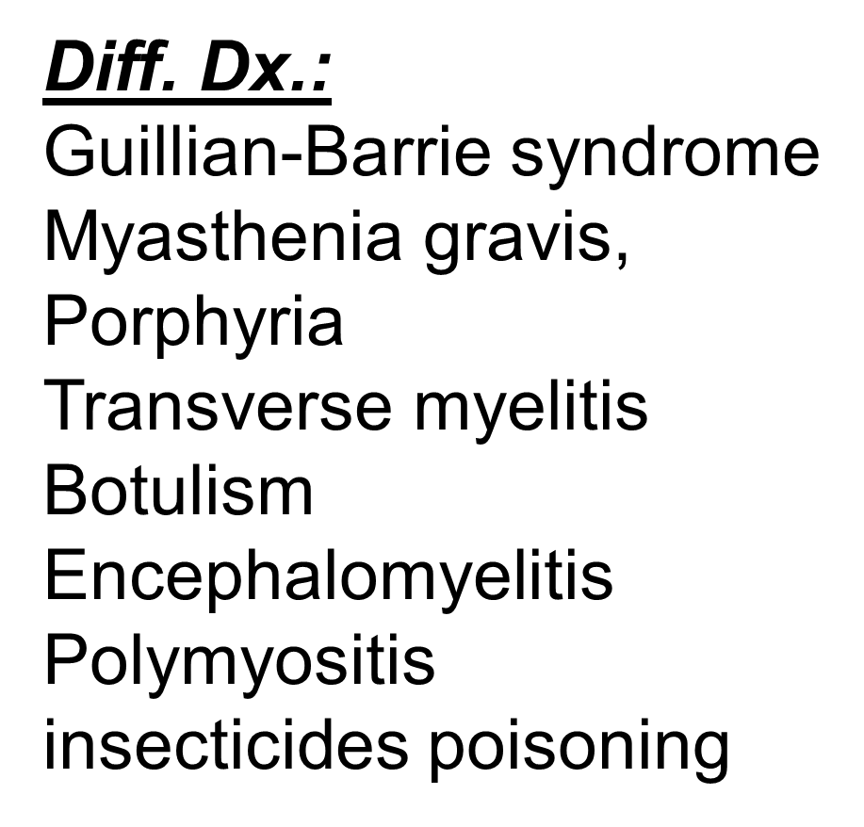

Slide 4
Infectious agent:
Polio virus (genus Enterovirus). Picorna Viraede 1, 2 and 3,
all cause paralysis but mostly 1, less commonly 3, and rarely 2.
2 and 3 are associated with vaccine polio.
Pathogenesis:
GIT
Primary viremia:
Reticulo-endothelial system
Secondary viremia:
Brain stem
Anterior horn cells
Basal ganglion
Cranial nerves

Slide 5
Occurrence:
Prior to the EPI it was common but now decreasing because of immunization & eradication program, occur sporadically or as epidemics usually in areas of low sanitation and low vaccine coverage. Few cases of vaccine polio occur every year.
M.O.T.:
Feco-oral from person to person or by common source especially in low hygienic level.

Slide 6
Incubation period: 7-14 days (3-35).
P.O.C.: Not precisely defined but transmission is possible as long as the virus is excreted in the feces.
Susceptibility:
Universal with some triggering factors:
I.M injection during the incubation period
Tonsillectomy:-- bulbar paralysis
Pregnancy
Vaccine polio
Shifting of age Susceptibility

Slide 7
Prevention:
Educate the people about M.O.T.
Vaccine OPV & IPV
Schedule of immunization
Control:
Report to WHO (1A)
Isolation and enteric precautions
Concurrent dis-infectants
Quarantin: none
Investigations & protection of contacts
Specific treatment

Slide 8
WHO polio eradication program:
Routine vaccination:
Zero dose
2nd month
4th month
6th month
18th month
60th month

Slide 9
WHO polio eradication program:
NIDs (National Immunization days)
Two rounds
Two shots each (4-6 weeks apart):
- Spring (March and April)
- Autumn (September and October)
Irrespective to the immunization history

Slide 10
WHO polio eradication program:
Mopping up:
For all remote or hard to reach areas or areas with low vaccine coverage.

Slide 11
WHO polio eradication program:
AFP (acute flaccid paralysis surveillance system)
1/100000/year for those <15 years (40%)
Diagnosis as early as possible
Admission to hospital within the first two weeks
Two stool samples (24048 hours apart)
Special kit, deep freeze, sent to central lab

Slide 12
WHO polio eradication program:
AFP
The result will be negative when both stool exams are good and negative.
This should be continue for 3 successive years to announce the country as eradicated from polio.

Slide 13
WHO polio eradication program: AFP
The results will be positive if:
Failed to achieve 1/100000 cases of AFP/ year
one of the stool sample is positive
only one sample arrived
one is negative and the other is bad
Then there should be a 60th day exam:
- If the exam is positive
- If the patient is lost
- If the patient died
Then the results will be positive.

