Slide 1
Development of Vascular system
Cardiovascular Part 3
Dr. Ahmed Al-Musawi

Slide 2
Objectives
Define the Vasculogenesis and angiogenesis
Study the development of arterial system
A. Pharyngeal arches arteries and their derivatives
B. Development of main arteries of Head, Neck and Thorax
C. Development of other arteries of body
Study the development of Venous system
A. Vitelline veins B. Umbilical Veins C. Cardinal veins
D. Portal vein E. others
Explain in Detailed Fetal Circulation and Changes that Happened after Birth
Short note about Development of Lymphatic system

Slide 3
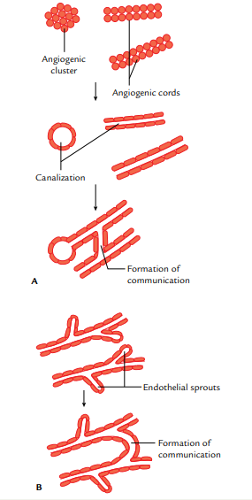
Vasculogenesis and Angiogenesis

Slide 4
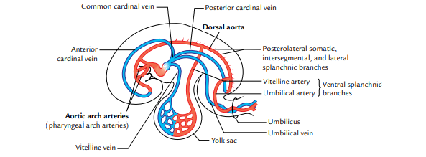
Development of arterial system

Slide 5
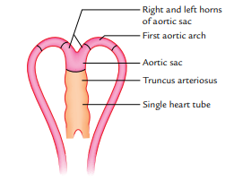
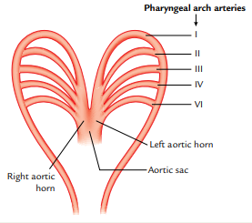
Pharyngeal arches arteries and their derivatives

Slide 6
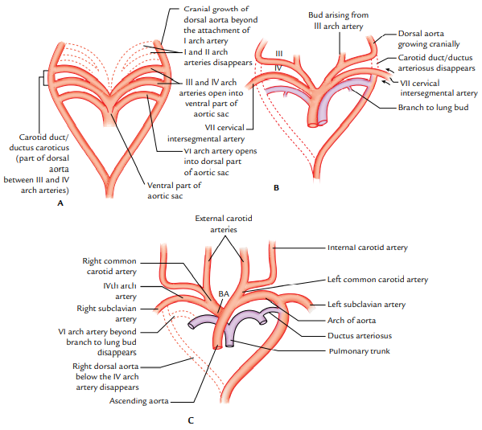
Fate of Pharyngeal arches arteries

Slide 7
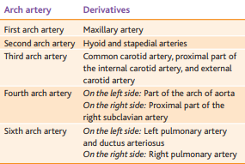
Fate of Pharyngeal arches arteries

Slide 8
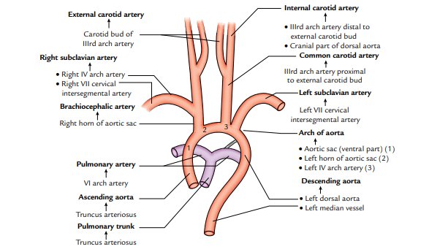
Source of Arteries of Neck, Head and Thorax

Slide 9
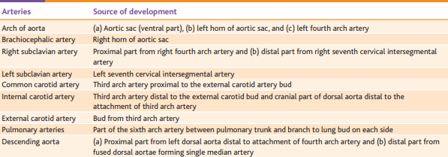
Source of Arteries of Neck, Head and Thorax

Slide 10
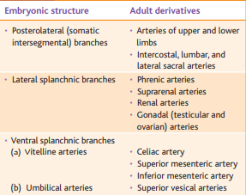
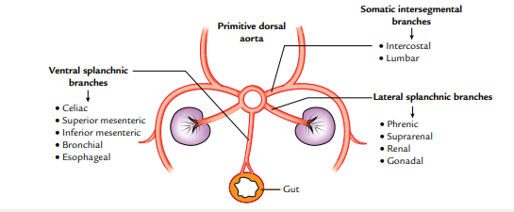
Development of other Arteries

Slide 11
Development of Umbilical Arteries

Slide 12
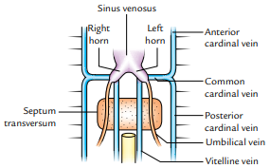
Development of Venous system

Slide 13
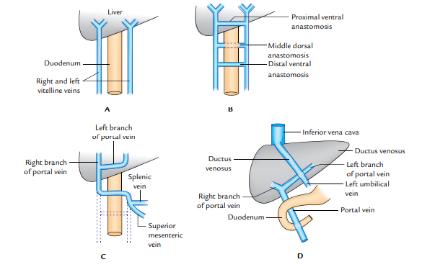
Development of portal Vein

Slide 14
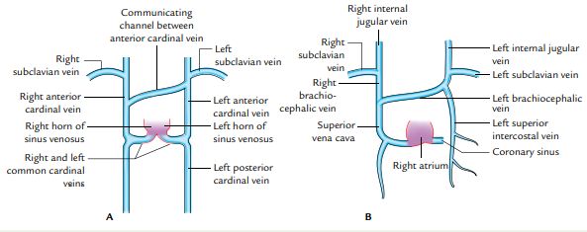
Others

Slide 15
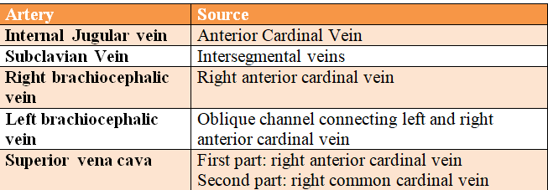
Others

Slide 16
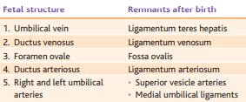
Fetal Circulation

