Slide 1
Cardiovascular system Part 2
Dr. Ahmed Al-Musawi

Slide 2
Objectives
Explain the Formation of Aorticopulmonary Septum
Study of Development of Valves of the Heart
A. tricuspid and mitral valves
B. Define the Pulmonary and Aortic Valves formation
Explain the Development of the Conducting System of the Heart
study the Formation of Pericardium
Study the Congenital anomaly of the heart
A. Dextrocardia
B. Ectopia cordis
C. Atrial septal defects (ASD)
D. Ventricular septal defect (VSD)

Slide 3
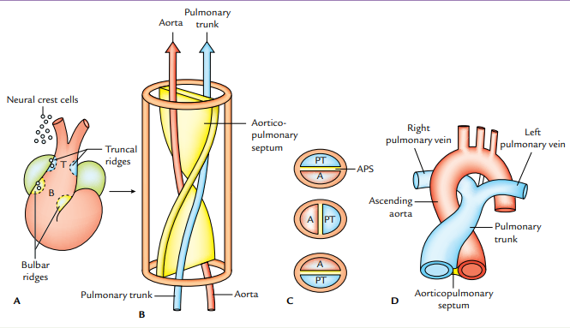
Formation of Aorticopulmonary Septum

Slide 4
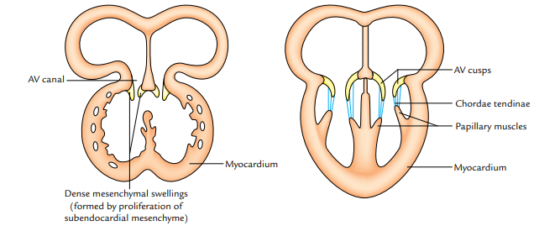
Development of Valves of the Heart

Slide 5
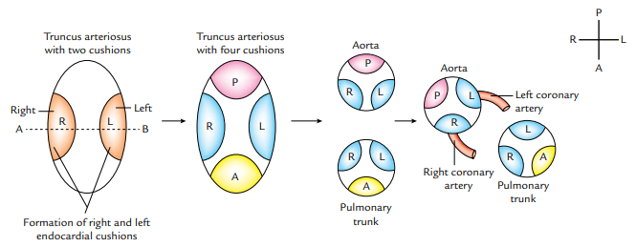
Pulmonary and Aortic Valves

Slide 6
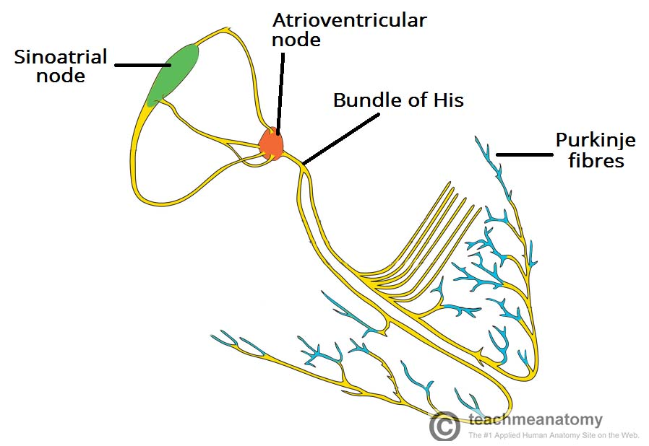
Development of the Conducting System of the Heart

Slide 7
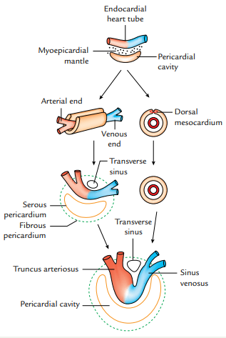
Formation of Pericardium

Slide 8
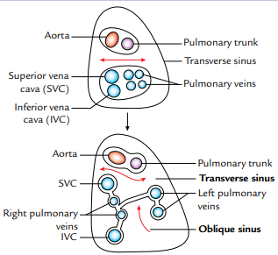
Formation of Pericardium

Slide 9
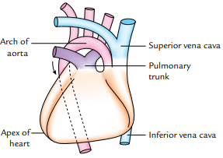
Dextrocardia:

Slide 10
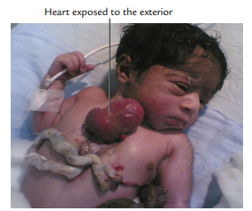
Ectopia cordis

Slide 11
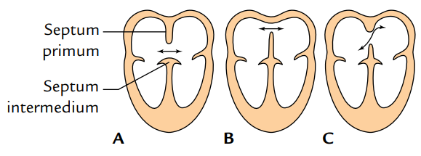
Atrial septal defects (ASD)

Slide 12
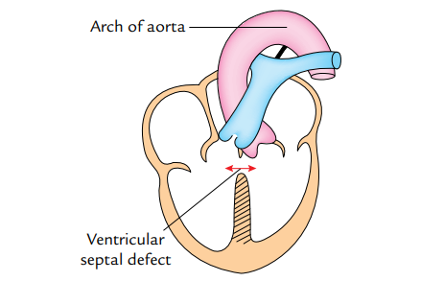
Ventricular septal defect (VSD)

Slide 13
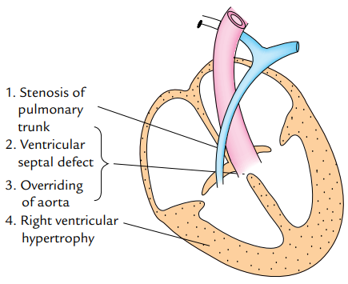
Fallot’s tetralogy [tetralogy of Fallot]

Slide 14
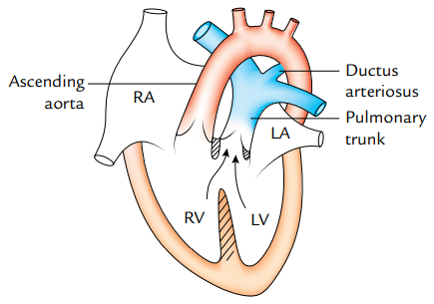
Anomalies of truncus arteriosus

