Slide 1
Cardiovascular system
Dr. Ahmed Al-Musawi
Department of Human anatomy

Slide 2
Objectives
Describe the formation of cardiogenic cord and heart tube
Define and enumerate the dilatations of heart tube with its final fate
Define the arterial end and venous end and their fate
Describe the relation of heart tube to primitive pericardial cavity and body wall
Short note about formation of cardiac wall
Explain how heart tube take the adult shape
Finally explain the formation the cardiac septa

Slide 3
Formation of heart tube

Slide 4
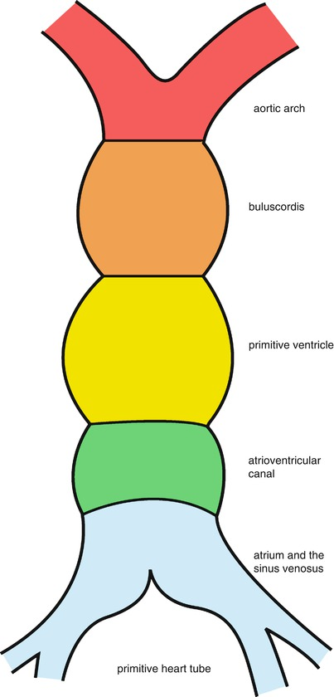
Formation of heart tube

Slide 5
Arterial and venous end

Slide 6
Fate of various dilatations

Slide 7
Positions of heart tube in relation to pericardial cavity

Slide 8
Relation and formation of cardiac wall

Slide 9
Acquisition of external adult form of the heart

Slide 10
Formation of Aterioventricular septum

Slide 11
Formation of inter-atrial septum

Slide 12
Fate of Sinus Venosus

Slide 13
Absorption of Sinus Venousus into Rt Atrium

Slide 14
Fate of left and right venous valve

Slide 15
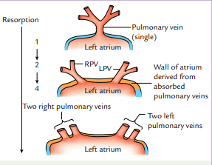
Absorption of Pulmonary veins into left Atrium

Slide 16
Formation of inter-ventricular septum

