Slide 1
Thorax
DR. Ahmed Almusawi
Human Anatomy

Slide 2
Objectives
Define the thoracic region and its functions
Define the parts of this region
Enumerate and explain the apertures of this region along with orientation
Study the relation of thorax with other regions
Study the key features of thorax
study the regional anatomy starting with pectoral region
Define and study the breast along with its blood supply, venous drainage, nerve supply and lymphatic drainage

Slide 3
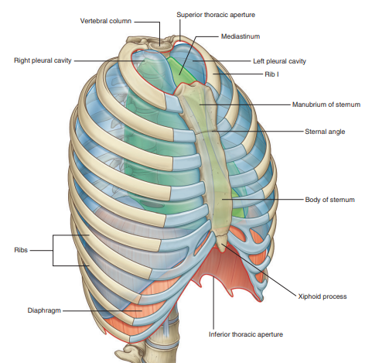
GENERAL DESCRIPTION
Function
Breathing
Protection
Conduit

Slide 4
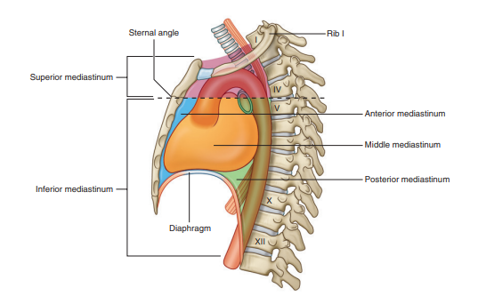
Conduit
From the neck:
Trachea
Esophagus
Superior vena cava
Vagus nerve
Phrenic nerve
From the abdomen:
Thoracic duct
Inferior vena cava
From thorax to abdomen
Aorta

Slide 5
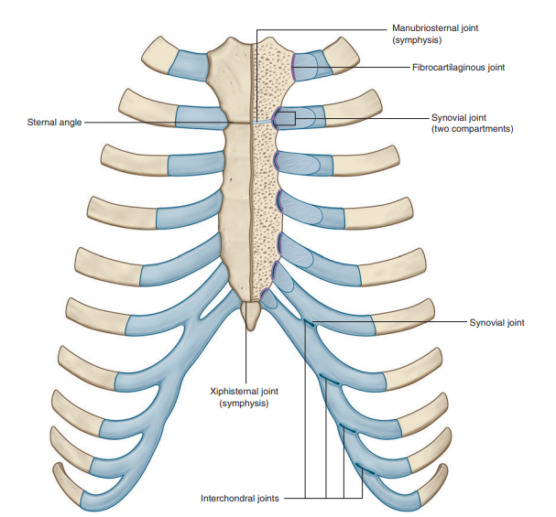
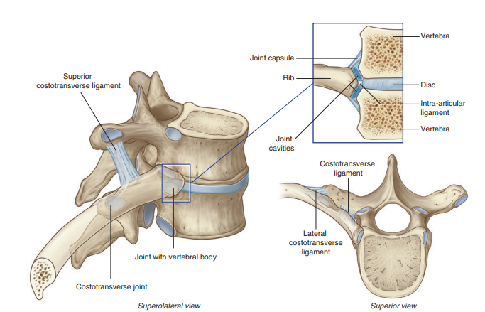
Thoracic wall

Slide 6
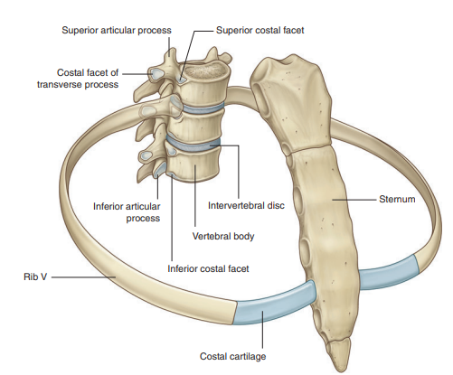
COMPONENT PARTS\Thoracic wall

Slide 7
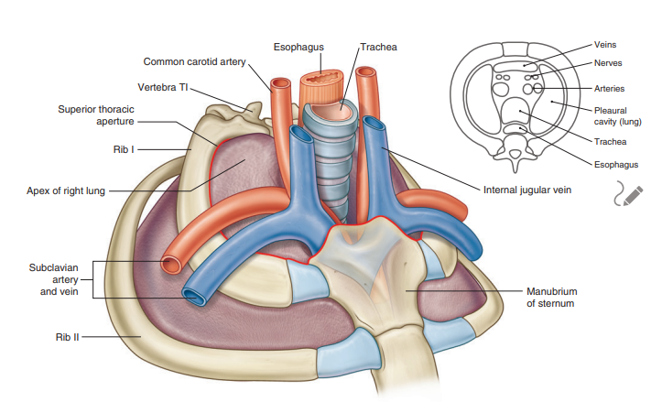
Superior thoracic aperture

Slide 8
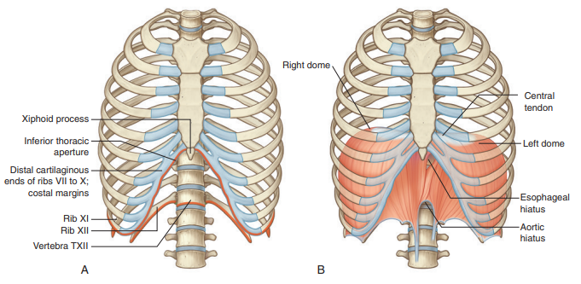
Inferior thoracic aperture

Slide 9
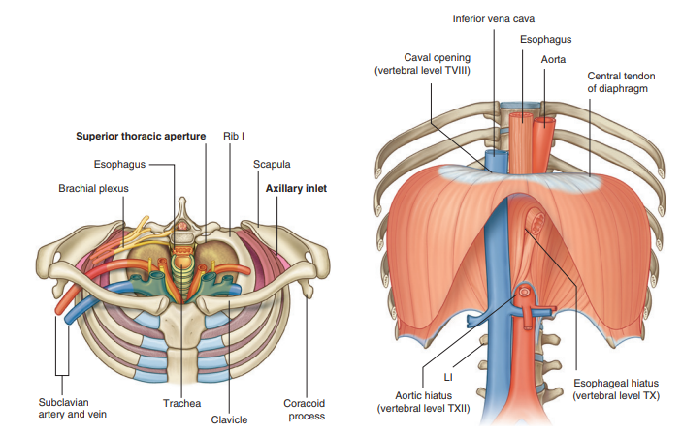
RELATIONSHIP TO OTHER REGIONS

Slide 10
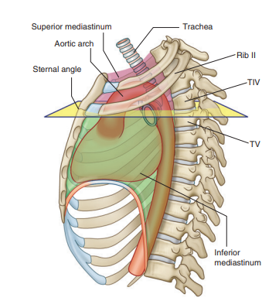
KEY FEATURES
Sternal angle
2nd rib
Vertebral level of T4-T5
Separate superior med. From inferior med.
Beginning and end of arch of aorta
Superior limit of pericardium
Superior limit of pulmonary trunk
Entrance of sup. vena cava
Bifurcation of trachea

Slide 11
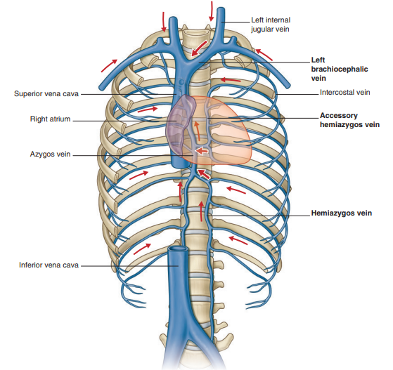
Venous shunts from left to right

Slide 12
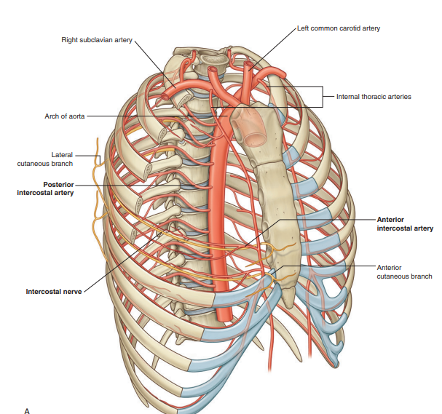
Segmental neurovascular supply of thoracic wall

Slide 13
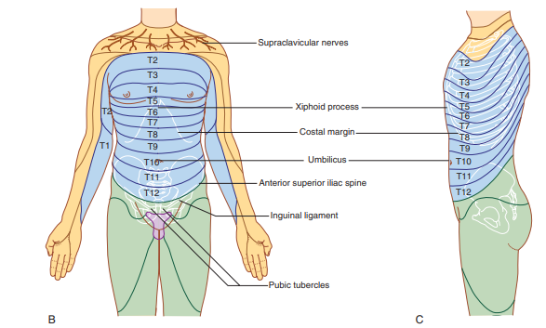
Segmental neurovascular supply of thoracic wall

Slide 14
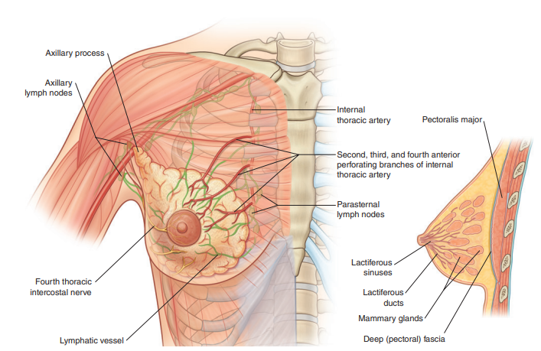
Pectoral region\ the breast

Slide 15
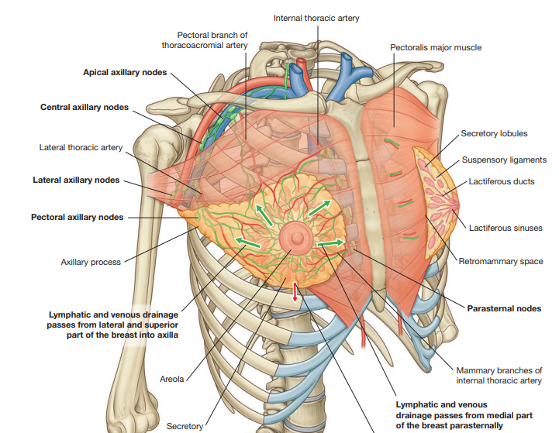
Arterial supply\venous drainage and lymphatic

Slide 16
Thank you

