Slide 1
Venous drainage of lower limb
The last lecture in lower limb anatomy
Dermatome, Myotome and Nerve injury
Dr. Ahmed Al-Musawi
PhD Human anatomy

Slide 2
Objectives
Define the venous drainage of lower limb
Explain the factors that help venous drainage of lower limb
Define the types of veins in lower limb and its clinical problems
Define the Dermatomes of lower limb
Define the Myotome of lower limb
Explain the injuries that happen to lower limb nerves and their finding on human

Slide 3
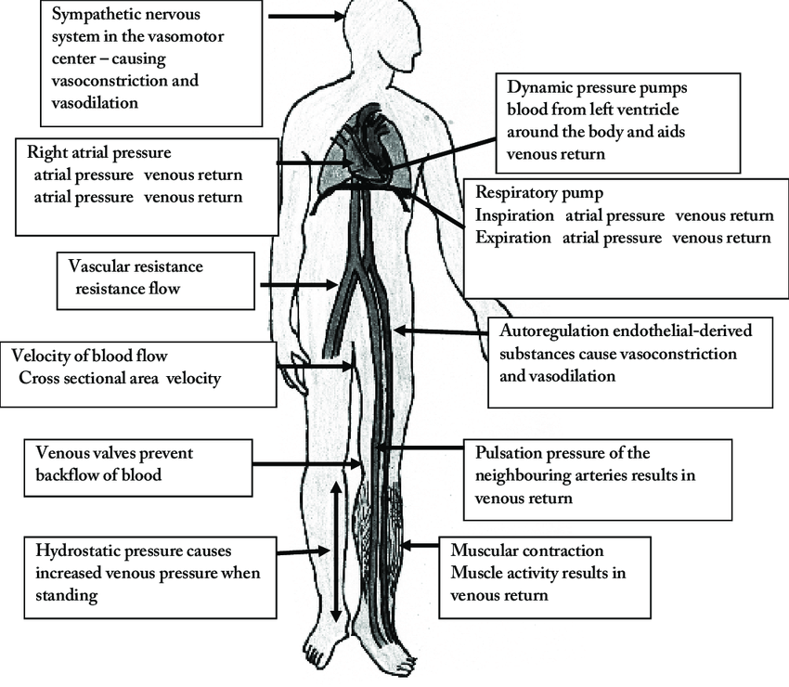
Factors

Slide 4
Types of veins

Slide 5
Great saphenous vein

Slide 6
Small saphenous vein

Slide 7
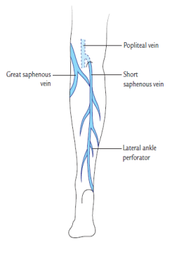
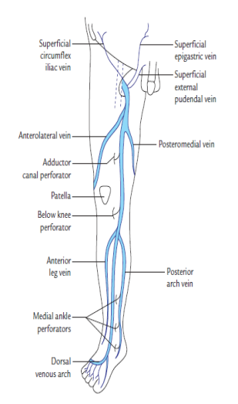
Perforators and peripheral heart

Slide 8
Dermatomes

Slide 9
Myotome

Slide 10
Nerve injury\ Femoral nerve

Slide 11
Signs of femoral nerve injury
Etiology
Stab injury
Gun shot

Slide 12
Obturator nerve injury

Slide 13
Signs of Obturator nerve injury
Etiology
rarely injured by wounds or hip dislocations
commonly compressed by the fetal head during parturition or by
growing pelvic tumors.

Slide 14
Sciatic nerve injury
Etiology
badly placed intramuscular injections in the gluteal region.
It is sometimes injured by penetrating wounds,
pelvic fractures or
hip dislocations

Slide 15
Sciatica
Etiology
Disc herniation
Spinal stenosis
Spondylolisthesis and nerve compression
Degeneration

Slide 16
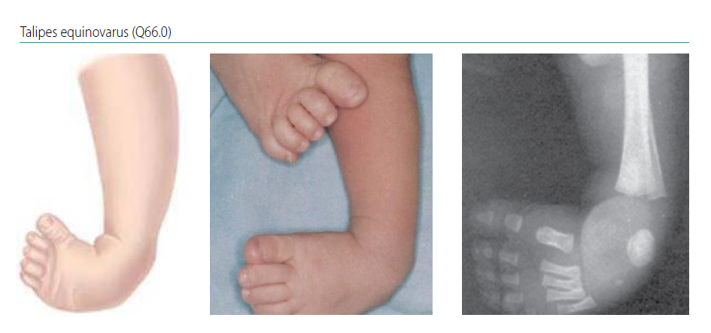
Common fibular nerve injury

Slide 17
Tibilal Nerve injury

Slide 18
Arterial pulse

Slide 19
Thank you

